Slide 1
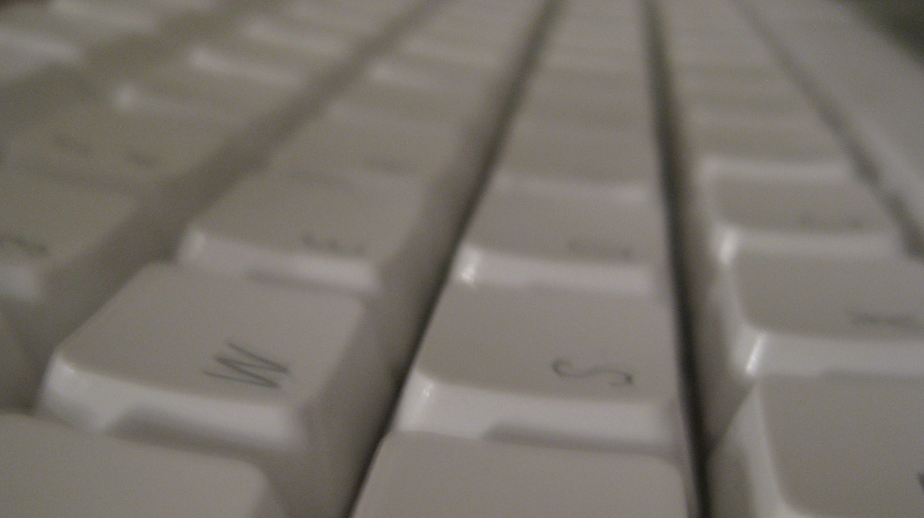
Securing the USB Interface
Jan Sebastian GOETTE
Waseda NSL
securehid@jaseg.net

Slide 2
Why do we need this?
Organically grown mess ecosystem of protocols
Created in another century
Bad Ideas™ abound, then and now

Slide 3
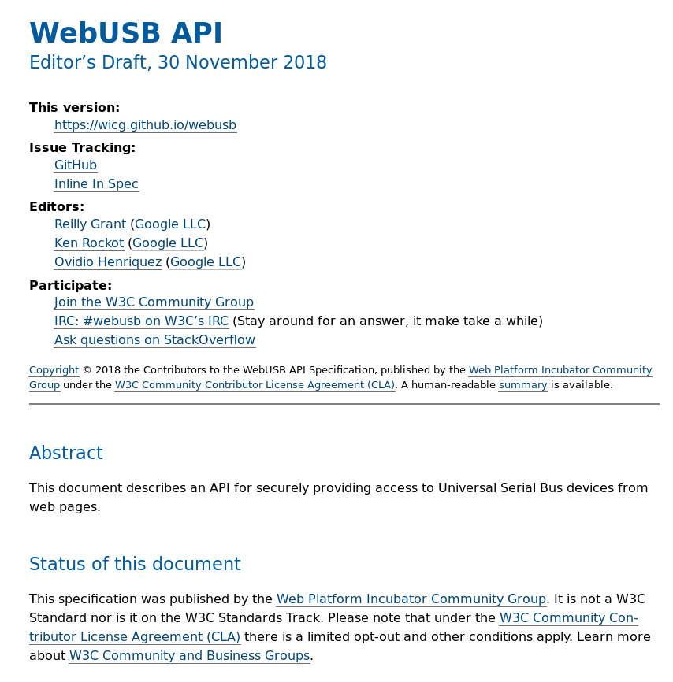
Why do we need this?

Slide 4
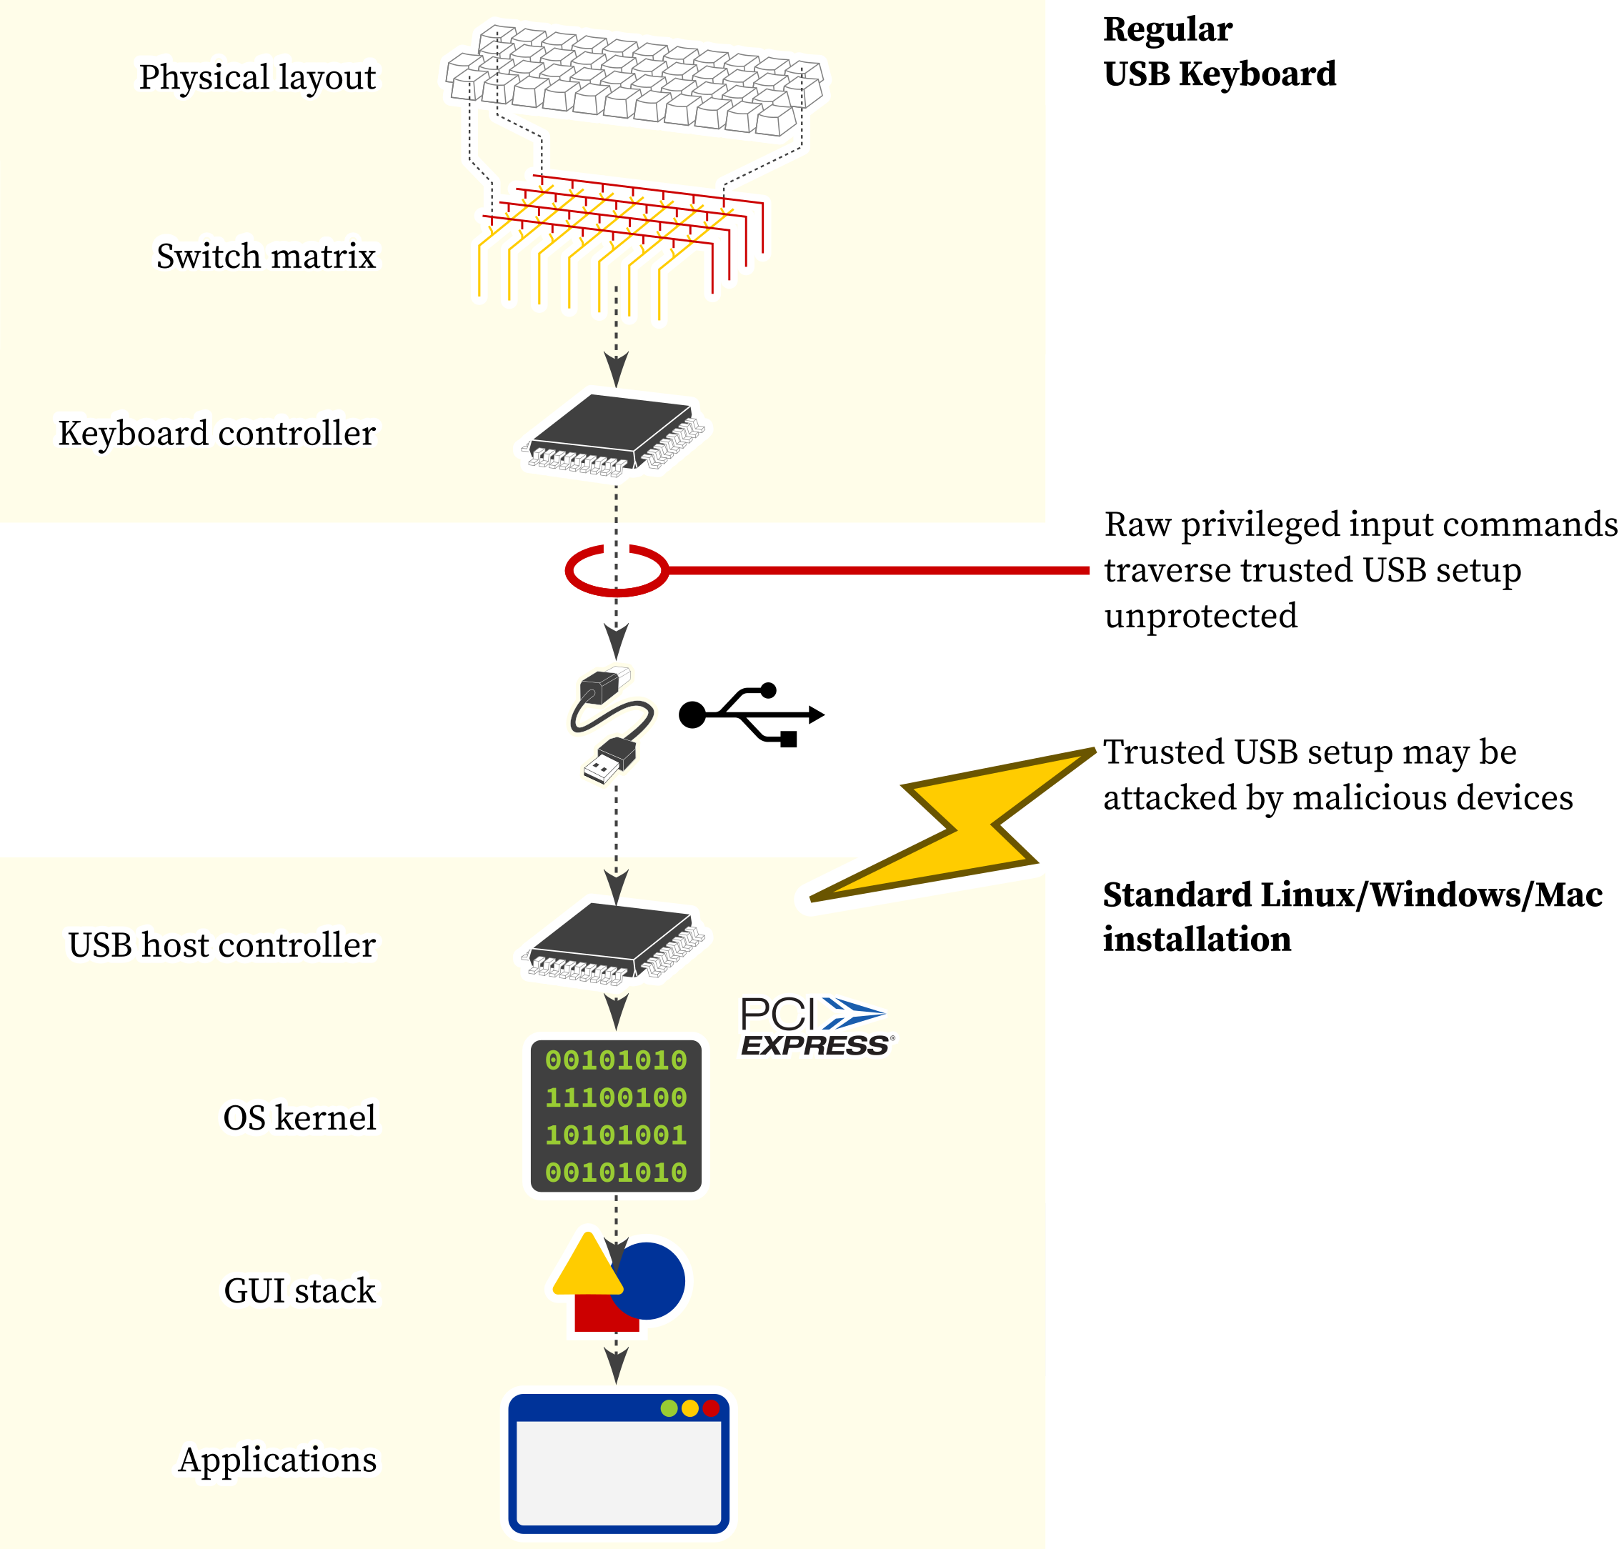
Conventional system using a USB keyboard

Slide 5
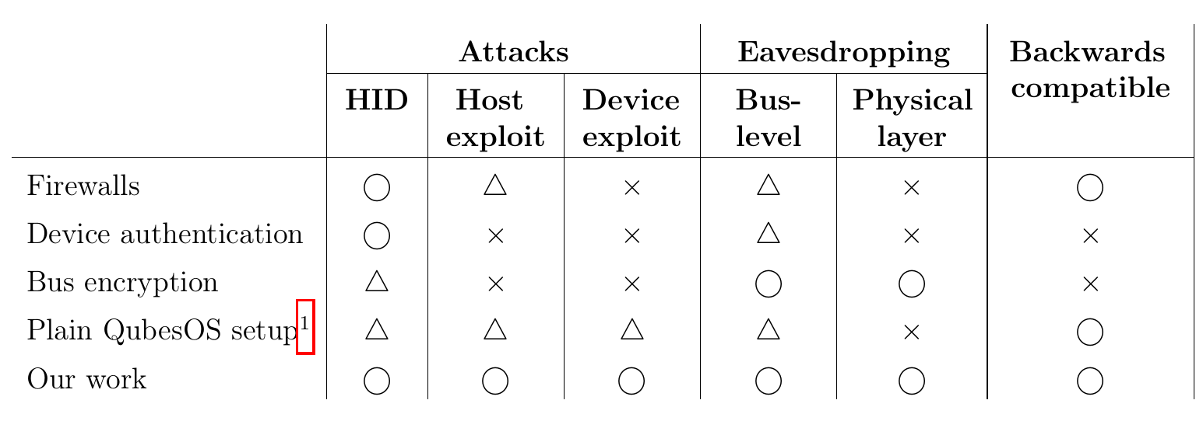
The state of the art

Slide 6
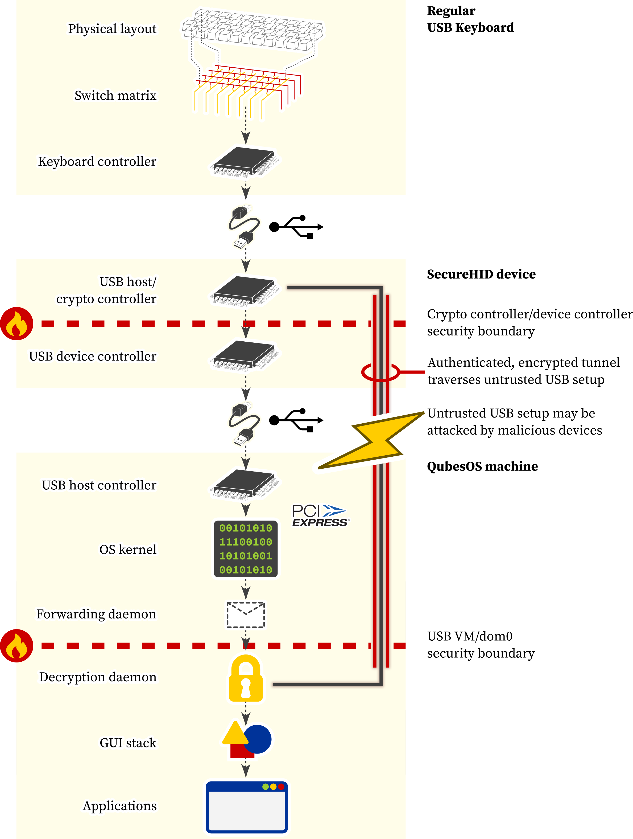
SecureHID/QubesOS-based system

Slide 7
SecureHID/QubesOS-based system:
Keyboard side

Slide 8
SecureHID/QubesOS-based system:
Host side

Slide 9
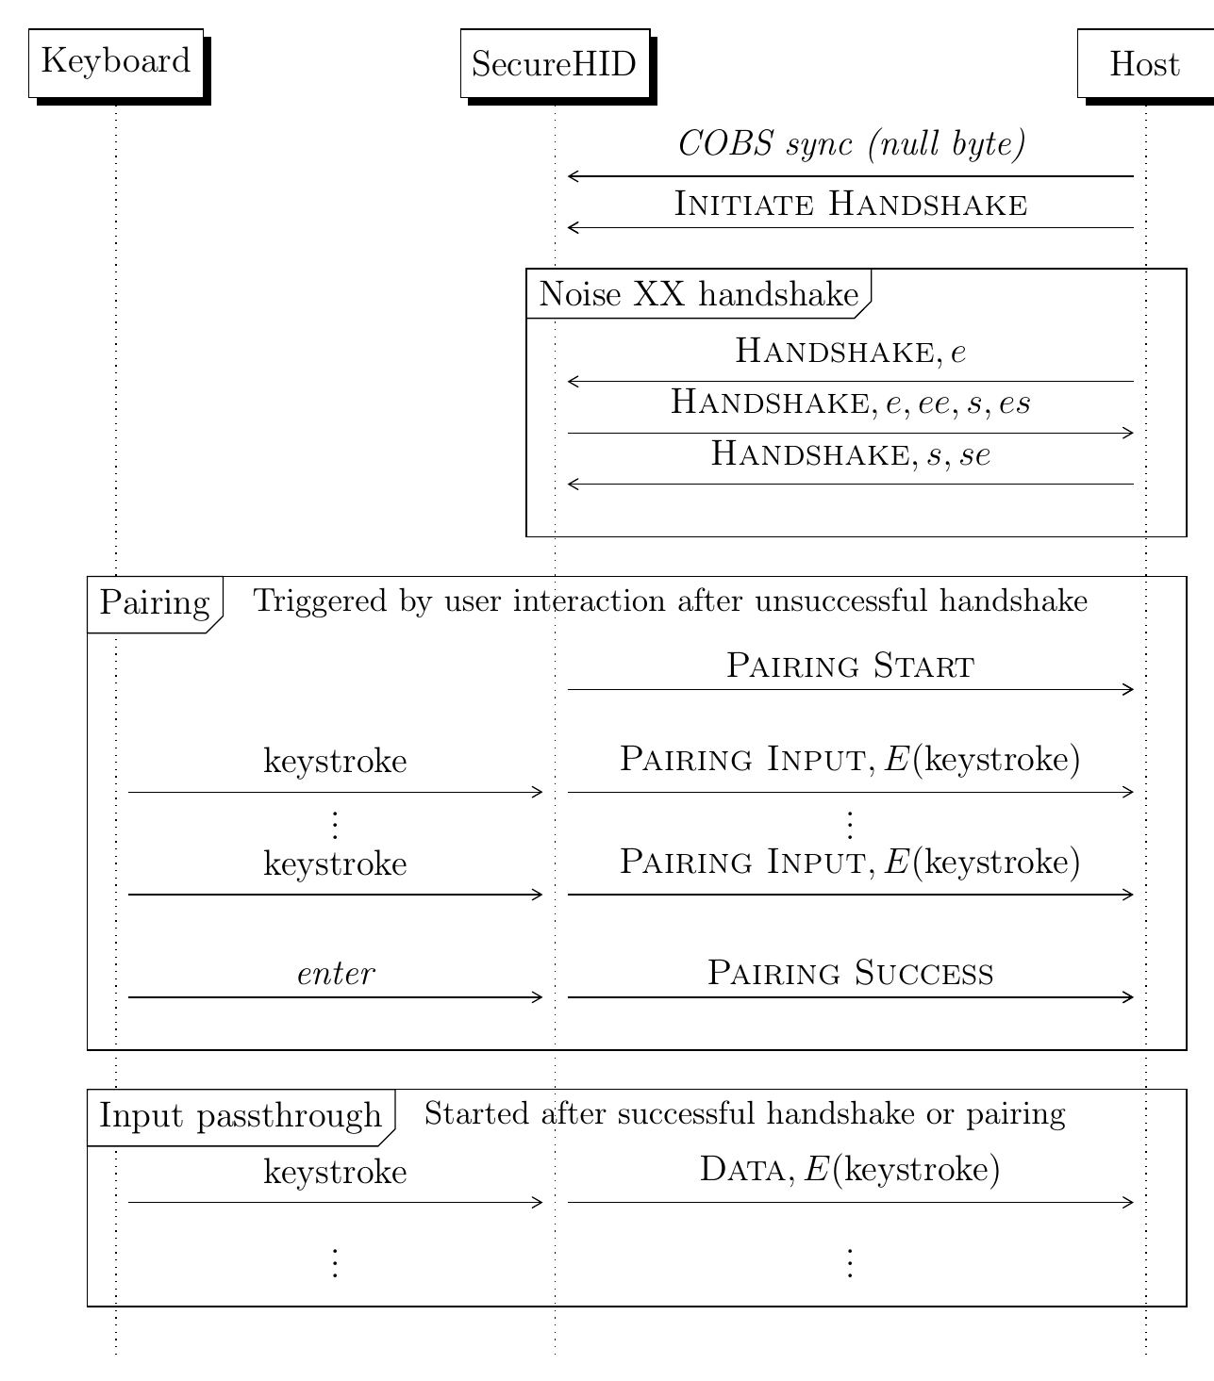
Handshake
and pairing protocol

Slide 10
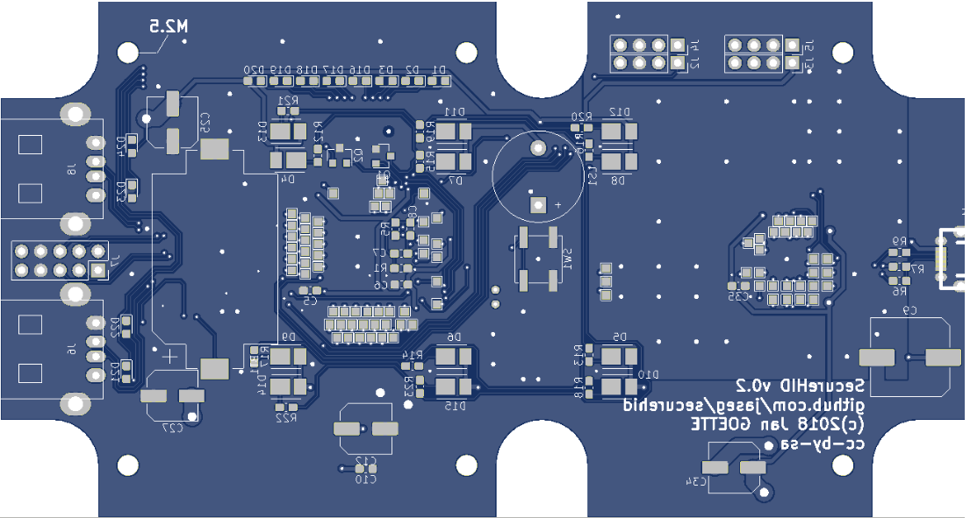
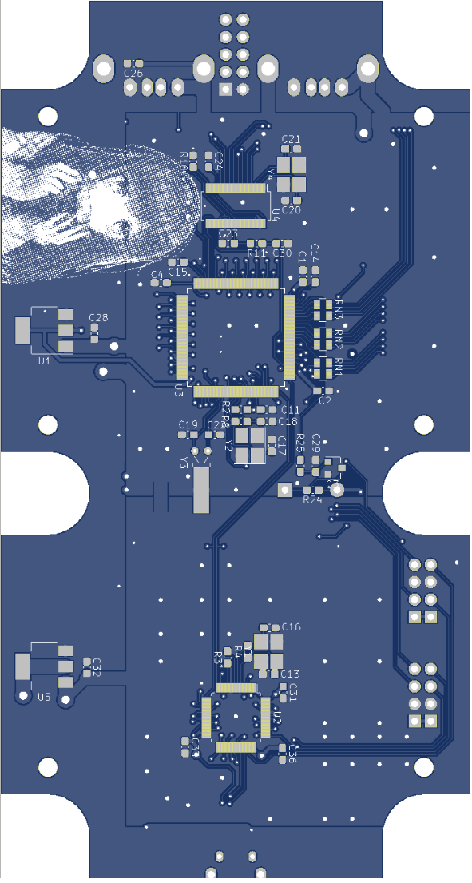
Physical realization

Slide 11
Questions?
Comments? securehid@jaseg.net
Title slide picture by Gürkan Sengün on Wikimedia Commons

