Slide 1
Regaining Trust in Everyday Computers the Hacky Way™
<33c3@jaseg.net>

Slide 2
What is the problem?

Slide 3
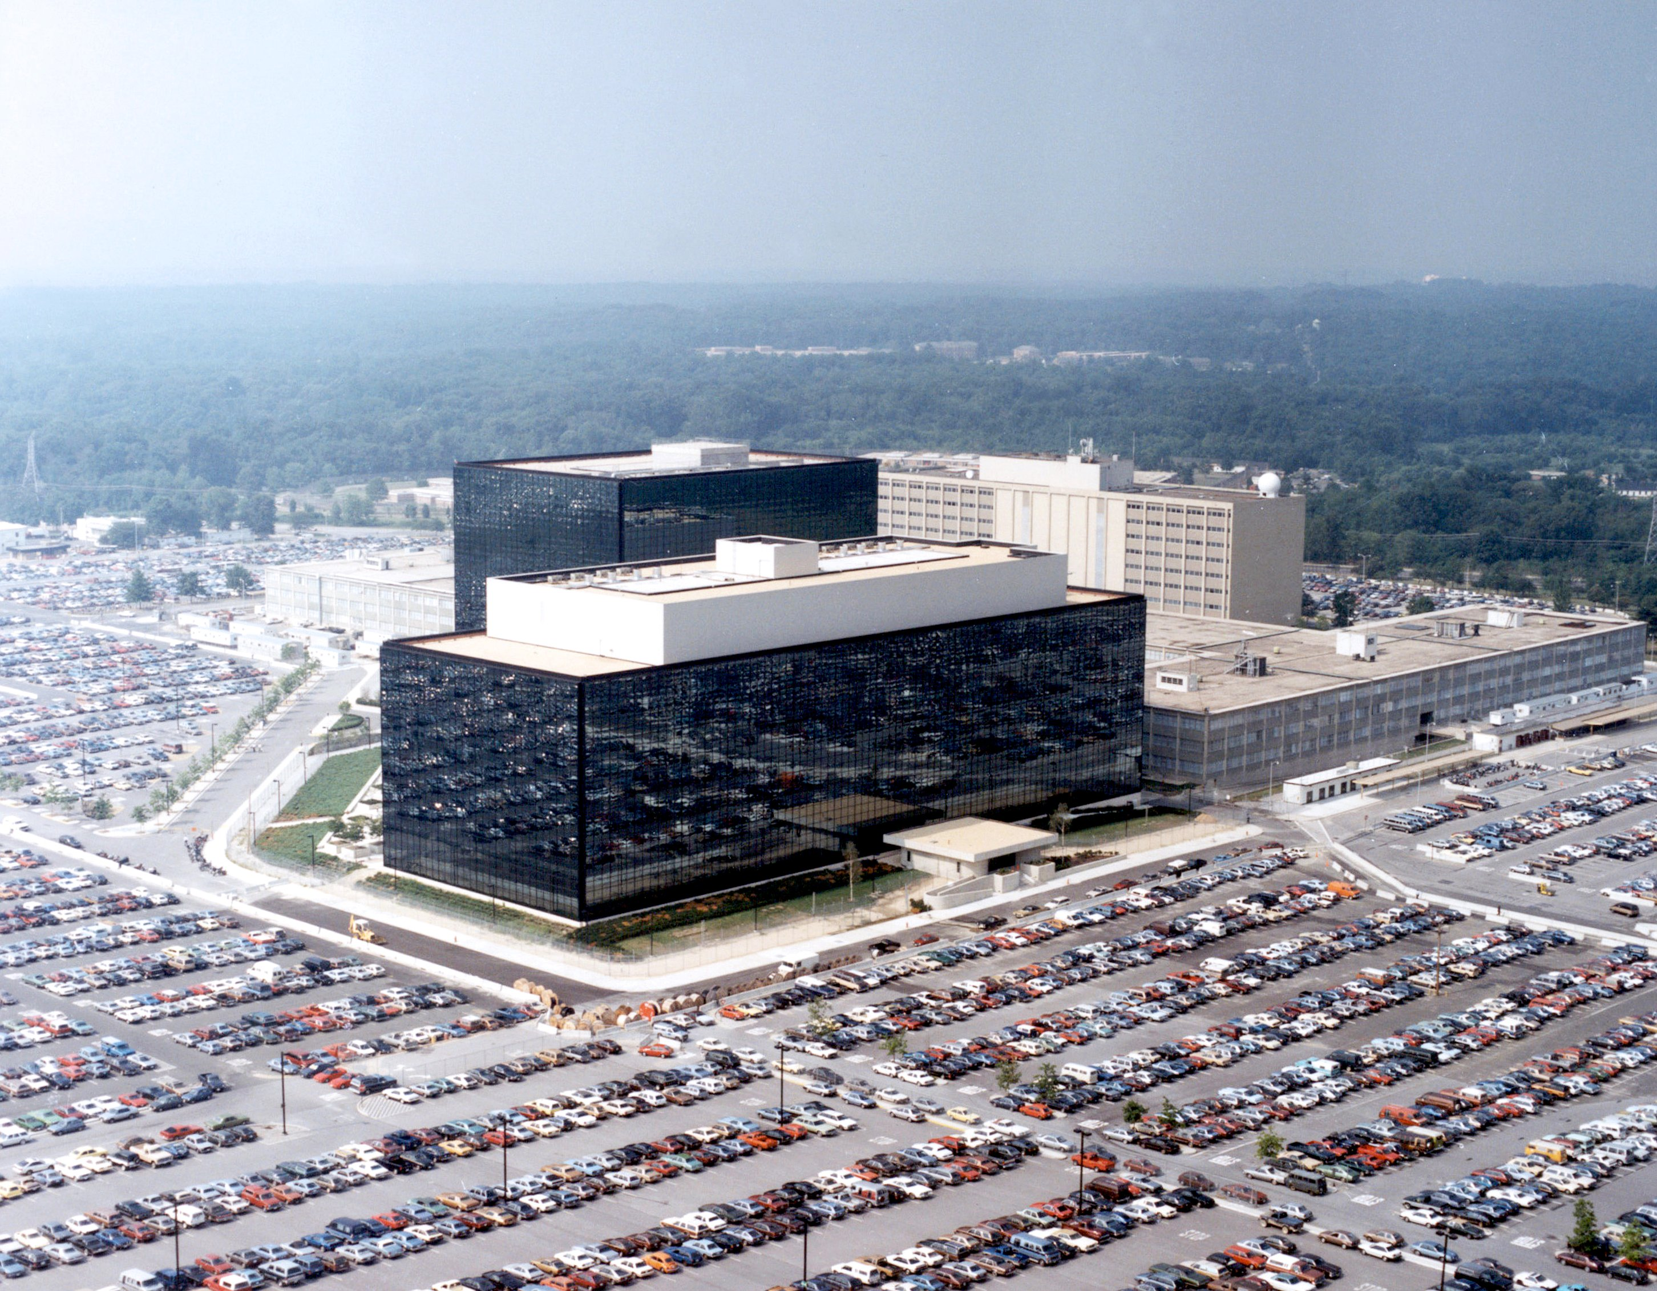

Slide 4
Specifically...

