Slide 1
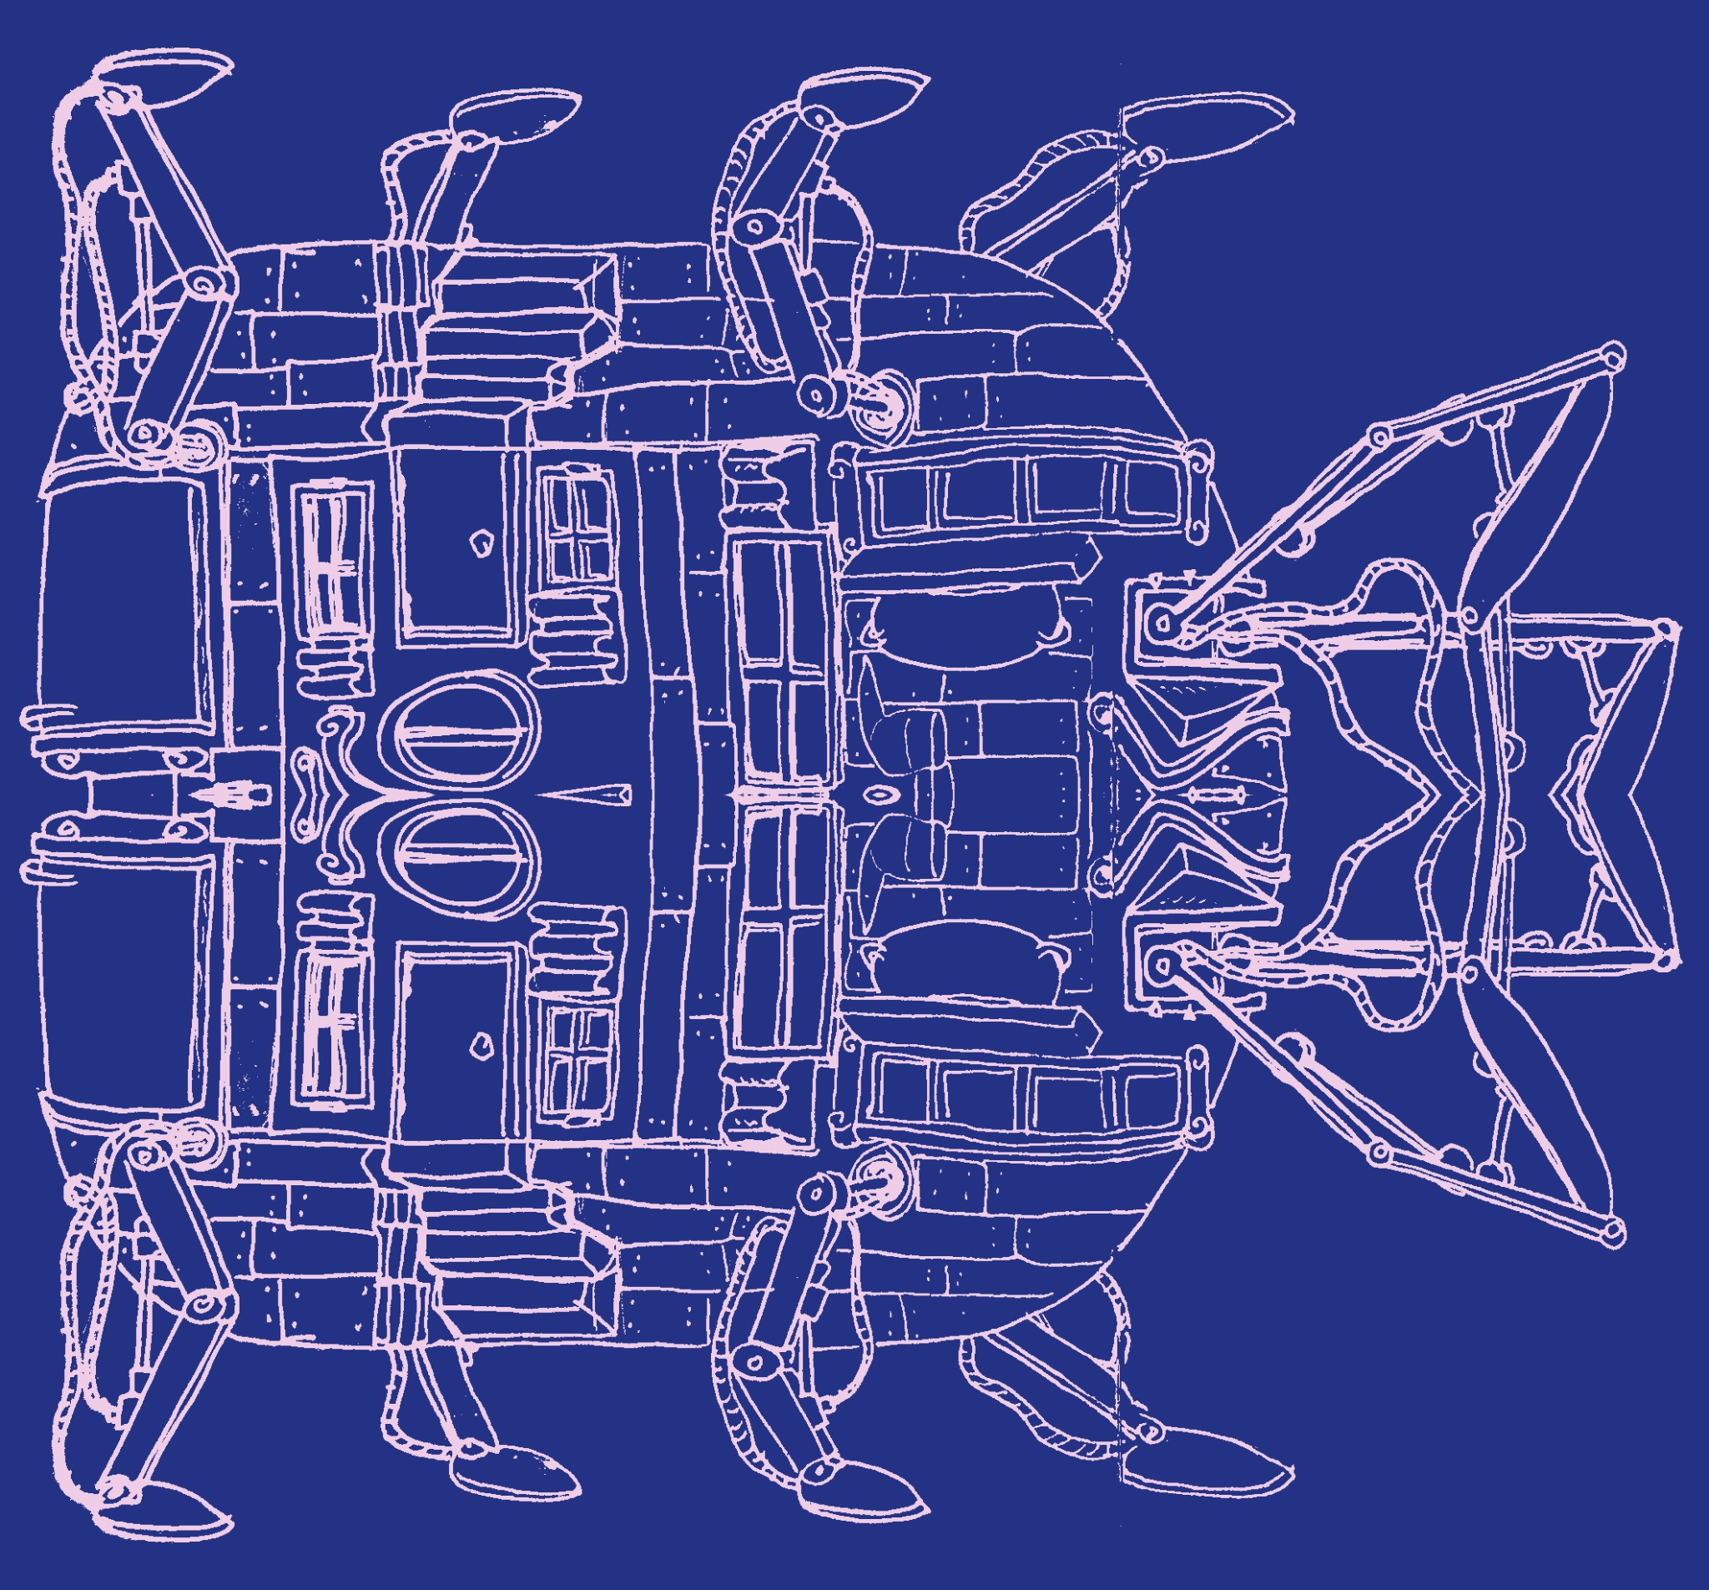
workshop 2
ample samples
SuperCollider
+
norns
Sunday, July 25th, 2021
Zack Scholl
aka
infinite digits

Slide 2
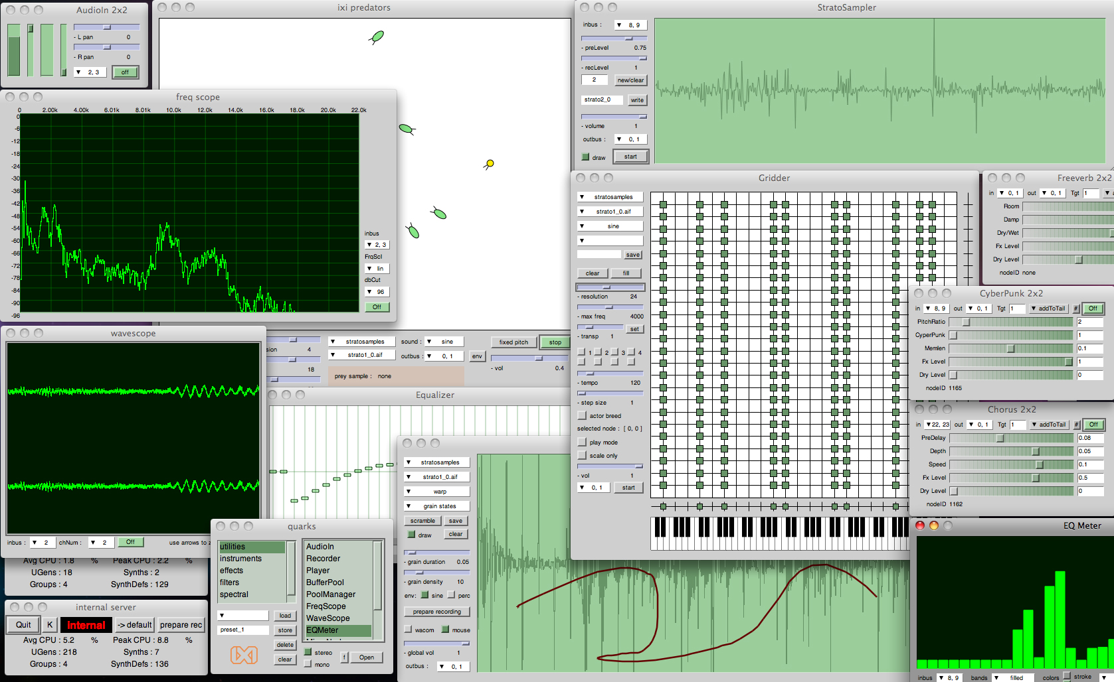
SuperCollider
program in C-like syntax
speaks midi/osc
sample
playback/recording
modulate w/ mouse
gui
sound generation
effects
CC BY-SA 3.0, https://commons.wikimedia.org/w/index.php?curid=62694675

Slide 3
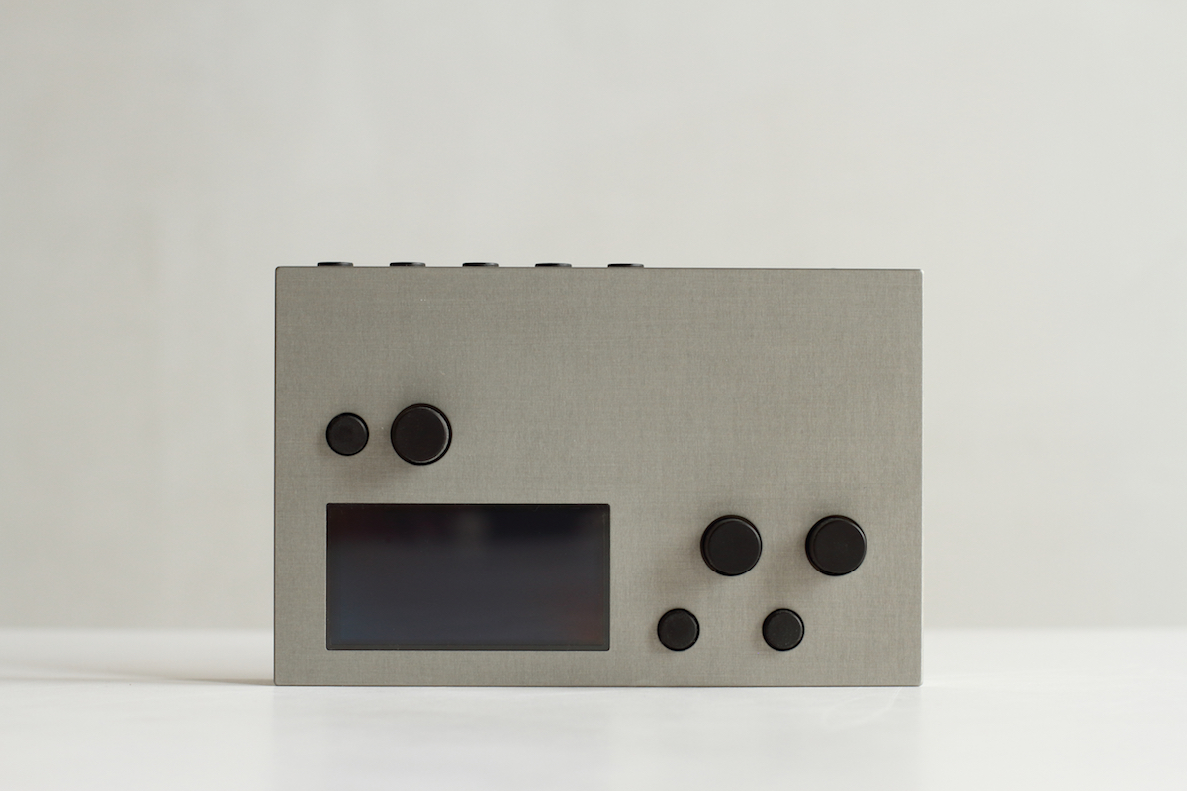
/
norns
SuperCollider
program in C-like syntax
program in lua
speaks midi/osc
sample
playback/recording
modulate w/ mouse
modulate w/ button/knobs
gui
sound generation
speaks monome protocols
effects
CC BY-SA 3.0, https://commons.wikimedia.org/w/index.php?curid=62694675
https://monome.org/docs/norns/

Slide 4
+
norns
SuperCollider
program in C-like syntax
program in lua
speaks midi/osc
sample
playback/recording
modulate w/ mouse
modulate w/ button/knobs
gui
sound generation
speaks monome protocols
effects
CC BY-SA 3.0, https://commons.wikimedia.org/w/index.php?curid=62694675
https://monome.org/docs/norns/

Slide 5

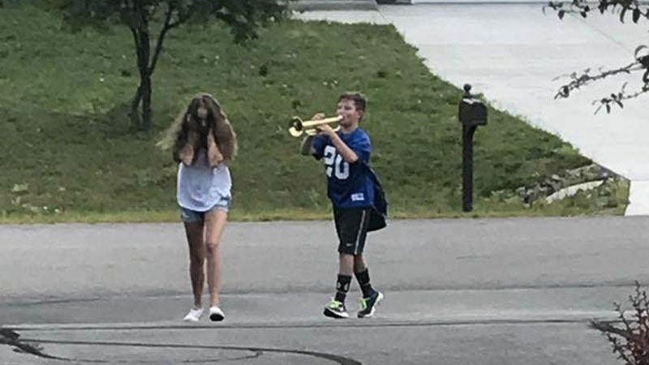
SuperCollider safety
stop
- install the SafetyNet quark if you can.
otherwise, please use instead of headphones.
otherwise, if you do use headphones w/o SafetyNet, take off your headphones before running a sound.
why is this necessary?
norns and your operating system may not limit the volume on SuperCollider, so a mistake in code could could harm your ears. SafetyNet prevents this, as would keeping the speaker volume down and distanced from your ear.
RLPF.ar(in,0)
SinOsc.ar(mul:440)

Slide 6
workshop 2
ample samples
lets begin
resources:
github.com/schollz/ambulation

