Slide 1

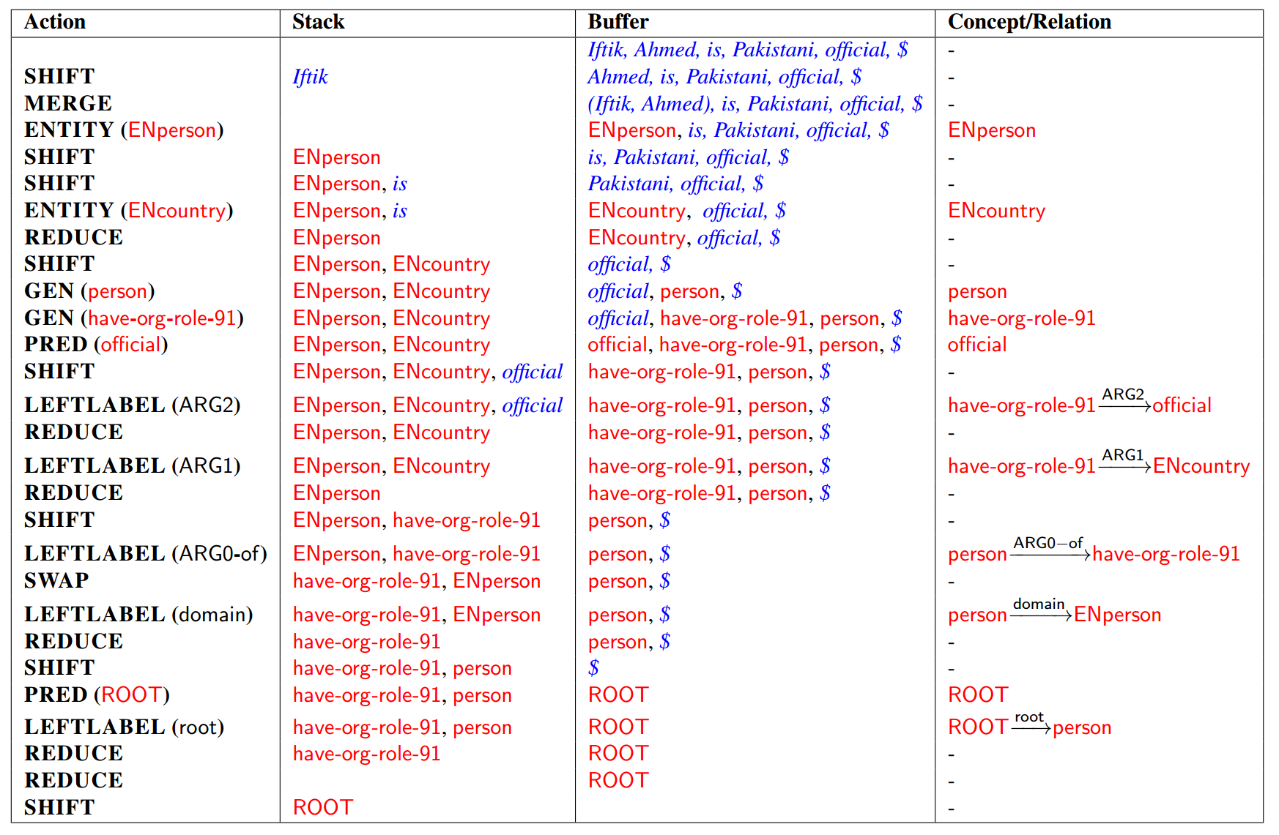
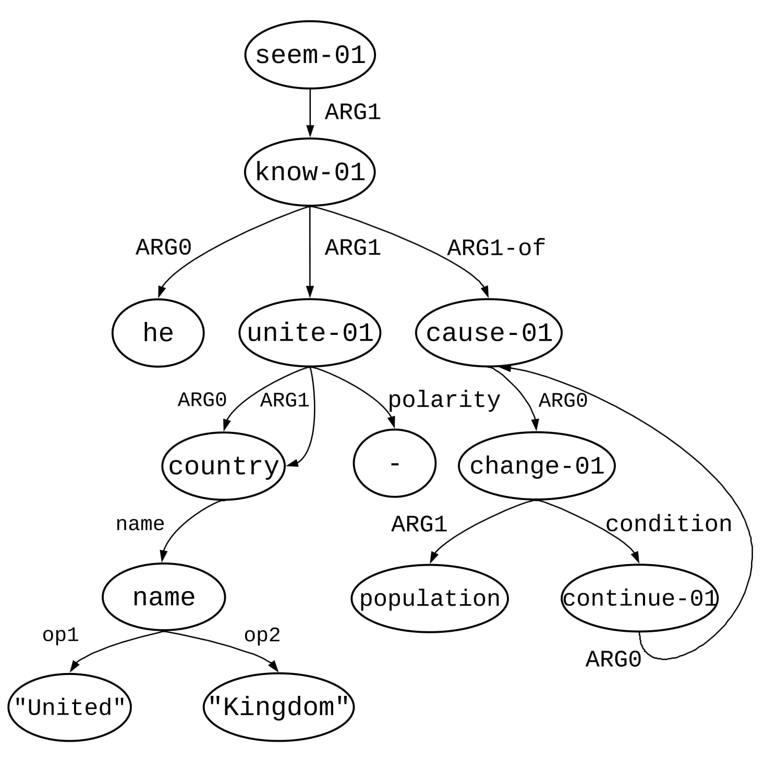
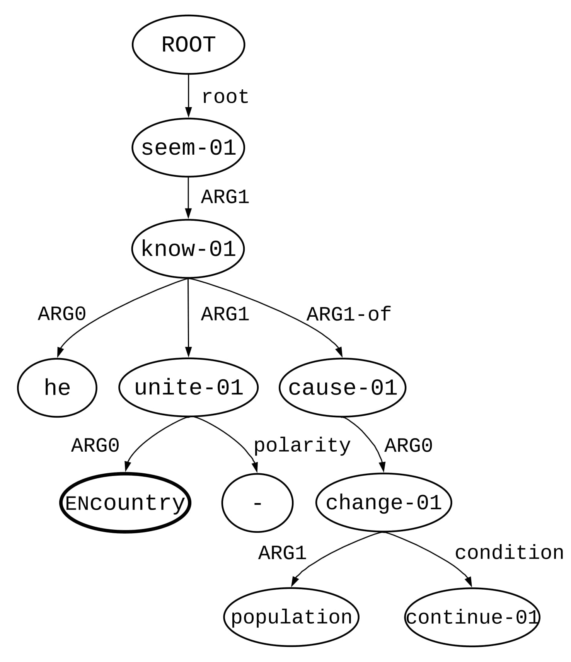
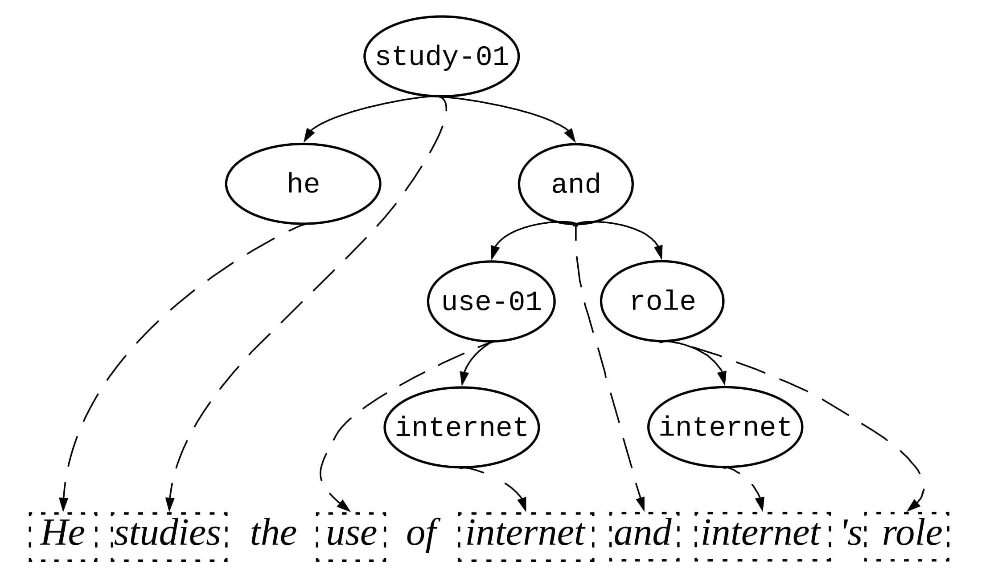
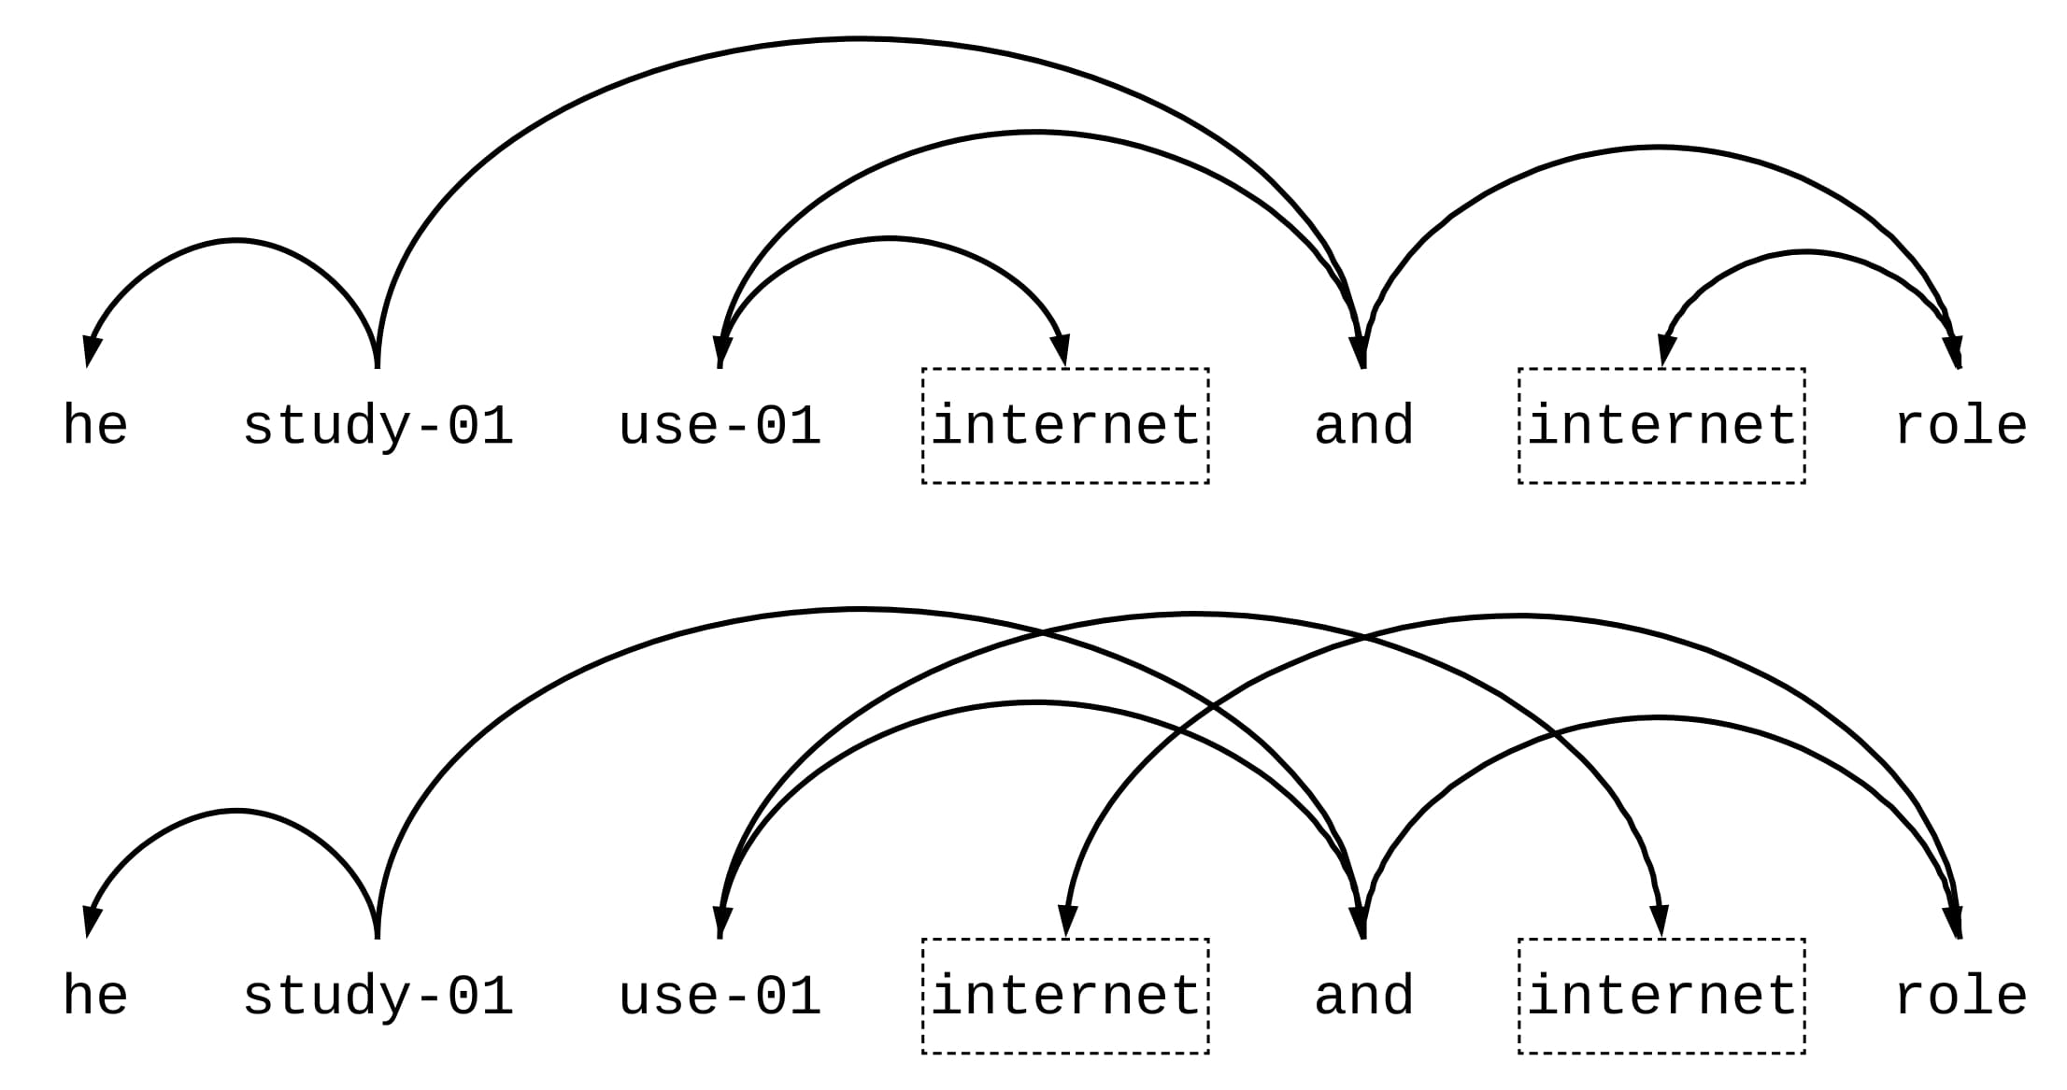
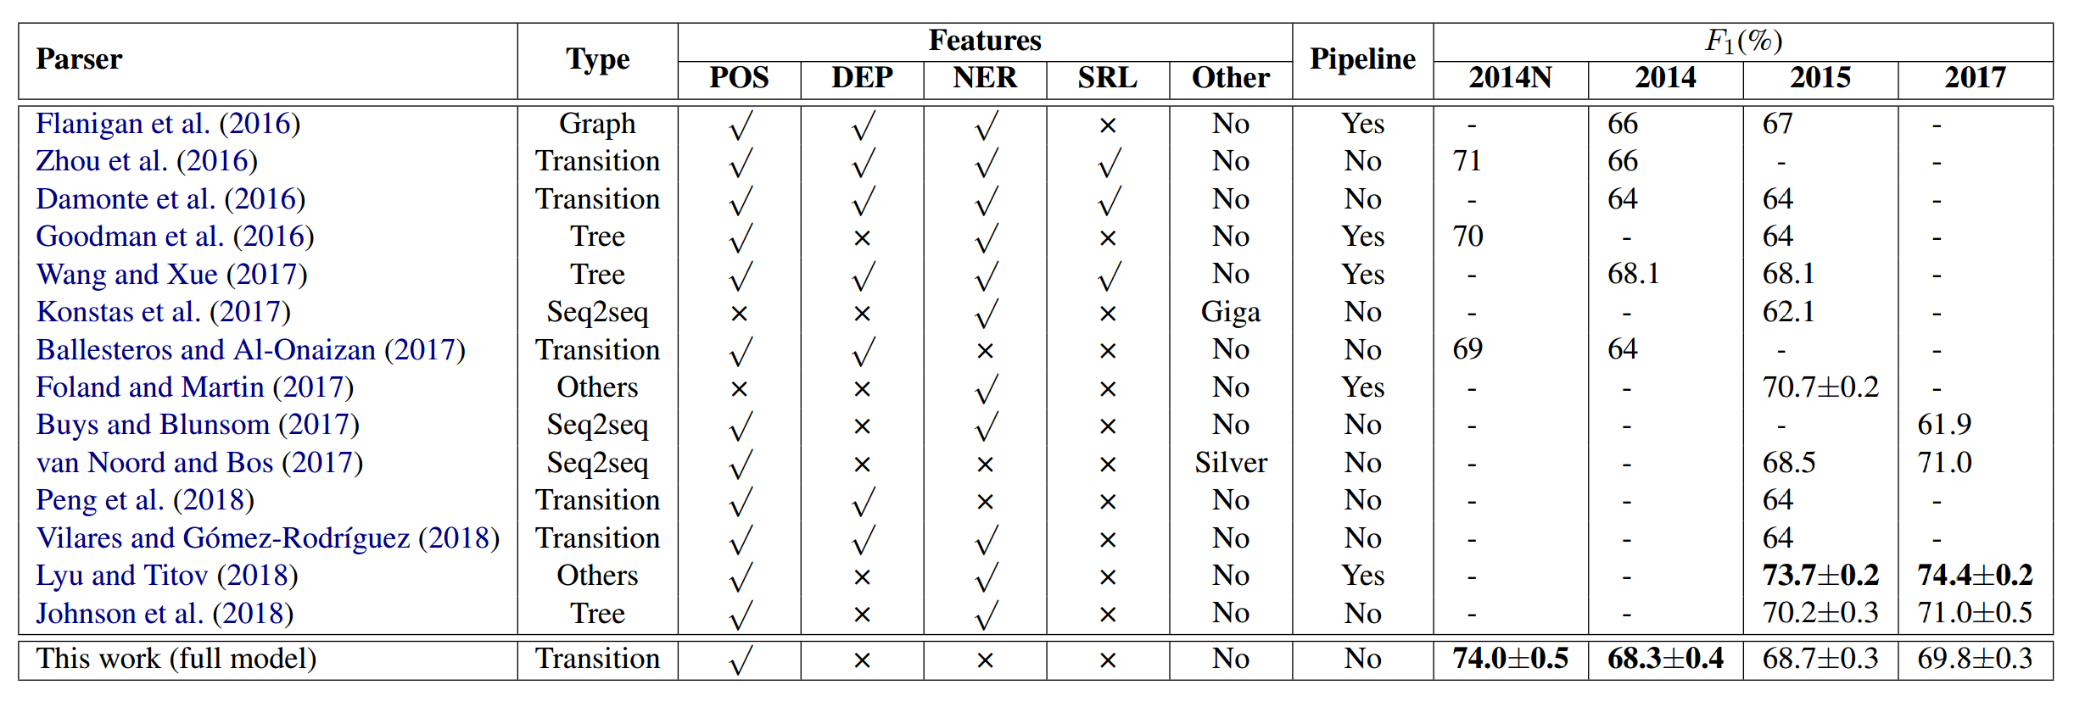
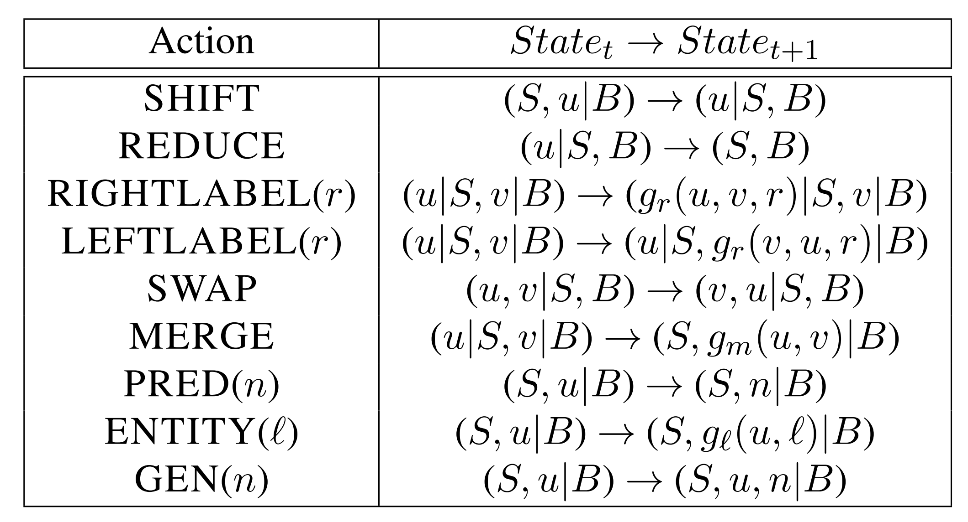
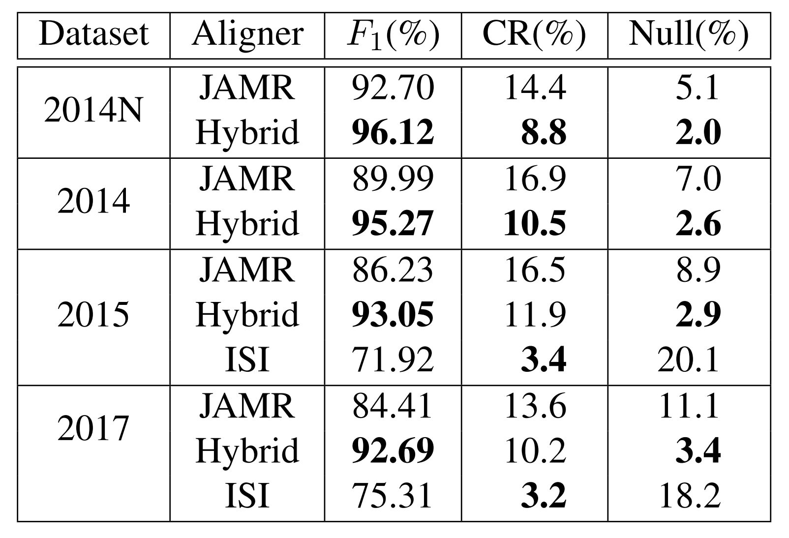
Better Transition-Based AMR Parsing with
a Refined Search Space Zhijiang Guo and Wei Lu Singapore University of Technology and Design zhijiang_guo@mymail.sutd.edu.sg wei_lu@sutd.edu.sg
Introduction
We introduce a simple yet effective transtion-based system for Abstract Meaning Representation (AMR) parsing.
The search is conducted on a new compact AMR graph and an improved oracle. We also propose an aligner that finds better alignment for training.
Our parser achieves the state-of-the-art results on various datasets with minimal additional information.
Example
Example action sequence for parsing the sentence: Iftik Ahmed is Pakistani official. Here $ is the end-of-sentence symbol.
Hybrid Aligner
We identify two limitations associated with the current rule-based aligner. The first one is non-projectivity caused by the alignment error as shown in figures. The second one is that the aligner yields more empty alignments as the corpus gets larger, since matching rules are static.
To address these issues, we propose the hybrid aligner, which combines unsupervised learning and rule-based strategy.
Experiments
The table shows comparison with other existent parsers on LDC2014T12, LDC2015E86 and LDC2017T10 datasets. Our parser gets competitive results, especially on LDC2014T12 and its newswire section.
Approach
Compact AMR Graph
A representation called compact AMR graph is designed to simplify concepts and relations of an AMR graph.
Then we define several properties that the compact graph should respect to further refine the search space:
Acyclicity: cycles are forbidden. The relation ARG0 between concepts cause-01 and continue-01 is removed.
Simple: for each parent-child concept pair, only one relation is attached. There exist two relations ARG0 and ARG1 between concepts unite and country. One of them is removed.
Non-terminal restricted: only a subset of concepts are allowed to have children. For example, concept – can only be a terminal node, which means that it can be removed from the stack once it's been attached.
Reentrancy restricted: reentrancy is forbidden for certain concepts, which means these concepts only have one parent concept. An example is that concept – cannot be reentrant.
Transition System
We design 9 types of actions based on the compact graph. Stack LSTMs are used to decide which action to take at each time step, given the current state.
We also report results of our hybrid aligner, JAMR aligner and ISI aligner. Improvements on two limitations mentioned above allow the aligner to yield better action sequences for training the parser.

