Slide 1
Neurogenomics
An exercise in writing out an entire field of research on Wikipedia
By Shamsuddin A. Bhuiyan & Jasleen Grewal

Slide 2
Motivation
Neurogenomics
Is part of neuroscience
Is one of the main areas of focus of neuroinformatics
Is not neurogenetics
Is ????

Slide 3
What is Neurogenomics?
Neuro genomics
Imaging studies (data)
Next Generation Sequencing data
Model organisms
Development patterns
Study of psychiatric disorders
Microarray data

Slide 4
Houston, we are live
https://en.wikipedia.org/wiki/Neurogenomics

Slide 5
How much did we write?
Classification | Word Count
Novel | > 40,000 words
Novella | 17,500 – 40,000 words
Novelette | 7,500 – 17,500 words
Short story | < 7,500 words
https://en.wikipedia.org/wiki/Word_count

Slide 6
How much did we write?
Classification | Word Count
Novel | > 40,000 words
Novella | 17,500 – 40,000 words
Novelette | 7,500 – 17,500 words
Short story | < 7,500 words
9195 words
https://en.wikipedia.org/wiki/Word_count

Slide 7
Sub-topics left to be discussed
Controversies in neurogenomics research
Causes of autism
Genomics based diagnosis of psychiatric disorders
Relationship between genotypes and spectrum disorders
Patterns of inheritance
already covered under neurogenetics
Additional focus on non-psychiatric disorders and diseases
Ex. GBM
More Wikipedia pages
Notes:
1001 genomes project; 10,000 genomes project

Slide 8
Learning outcomes
Neurogenomics is a vast field
Translation of personal genomics into psychiatric disorders is ….tricky
Wikipedia has lots of grammar Nazis – bots and humans
Wikipedia articles are well policed
Ergo, Wikipedia is an authentic source of information
Writing scientific reviews is not easy

Slide 9

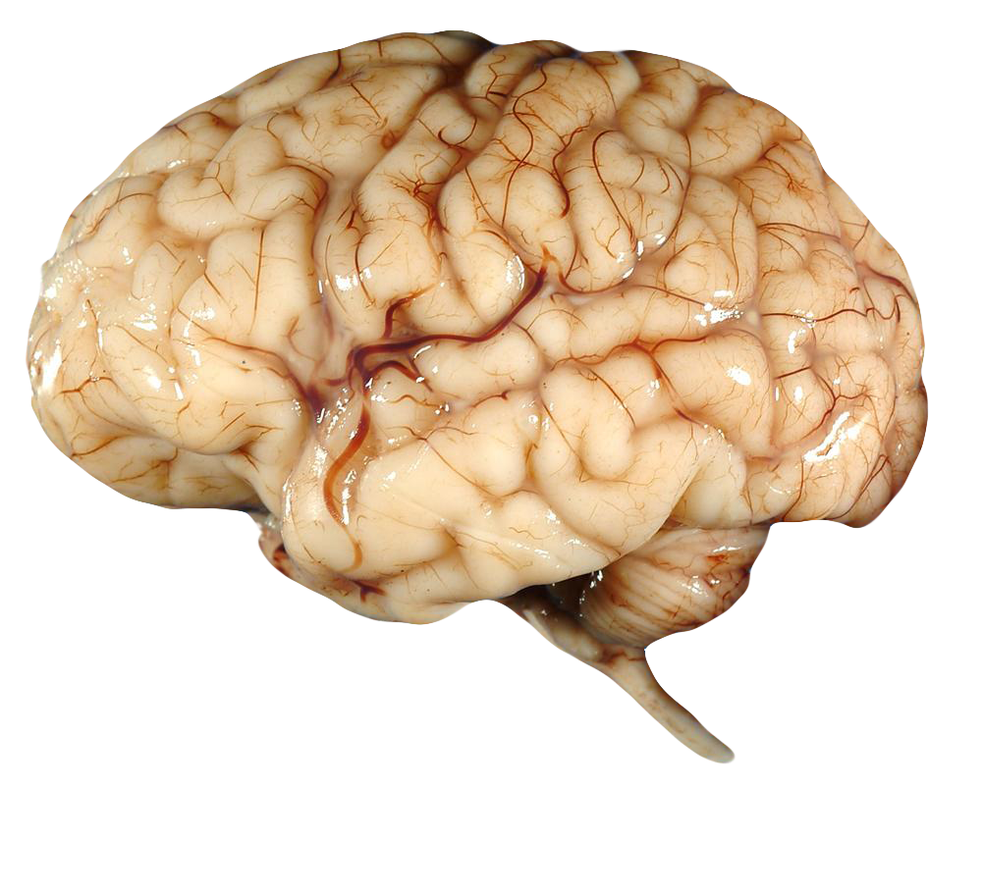
Q/A?

