Slide 1
Introduction to ggplot2
By
Jasleen Grewal | jgrewal@bcgsc.ca
PhD Student, Jones Lab
Genome Sciences Centre

Slide 2
Is this a nice way to waste lunchtime?
Yes, if
You are new to ggplot2
You want to learn about some quick hacks to make pretty plots in R
You are familiar with Rstudio
No, if
You are already an intermediate/advanced R user
A purveyor of all things ggplot.

Slide 3
What is ggplot2?
R package for data visualization
Created by Hadley Wickham

Slide 4
Objectives
Learn about the grammar of ggplot2
Learn about the ways you can tweak the different components of a plot
Be able to make scatterplots, histograms, boxplots, and density distributions with 1-line commands!
Start thinking about how to make your plots more readable and appealing

Slide 5
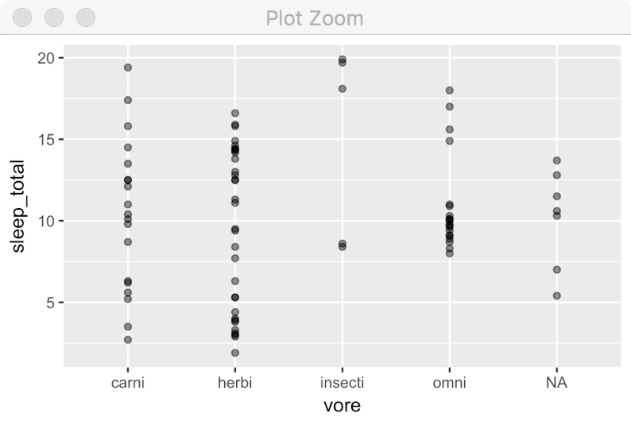
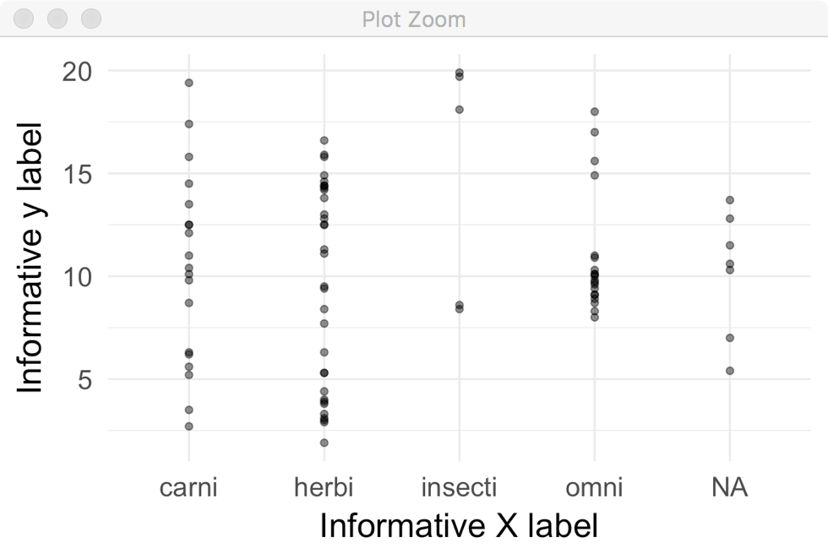
When would I not want to use ggplot?
You want two y-axes on the same plot
Certain types of plots (like clustered heatmaps, dendrograms)
But there are extensions!
You have to do cleanup on your base output
And we will learn how, today!

Slide 6
When would I want to use ggplot?
Getting started with visualizations in R
Very flexible
Uses a ‘grammar of graphics’ approach
Even the basic plots are very easy to read
Good for exploratory analysis
Less painful to look at => go blind at a slower rate
Very simple to modify specific aspects of the plot
add panels
modify legends
group by different parameters

Slide 7
Time to run some code! Open Rstudio, follow along either - using the pdf file sent around earlier - with me as I run the commands

Slide 8
Things we didn’t cover
Modifying the color palettes
Thinking about when colour is needed?

Slide 9
Things we didn’t cover
Modifying the color palettes
Thinking about when colour is needed?
Ggplot2 cheat sheet
Super handy, Google it!

Slide 10
Things we didn’t cover
Modifying the color palettes
Thinking about when colour is needed?
Ggplot2 cheat sheet
Super handy, Google it!
Reading in your data (whoops…)
Factors, modifying your dataframe
dplyr, reshape2

Slide 11
Things we didn’t cover
Modifying the color palettes
Thinking about when colour is needed?
Ggplot2 cheat sheet
Super handy, Google it!
Reading in your data (whoops…)
Factors, modifying your dataframe
dplyr, reshape2
Animated graphs in ggplot2! (gganimate)

