Slide 1
The complete genome sequence of a Neanderthal from the Altai Mountains
Prüfer et al., Nature, 2 January 2014. 10.1038/nature12886
Critical paper review by Jasleen Grewal (PhD Student, UBC)

Slide 2
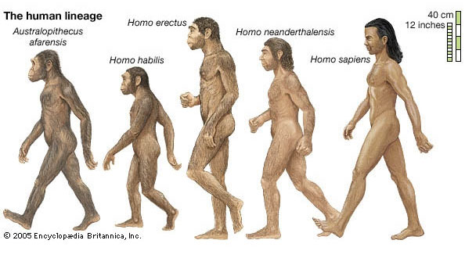
Neanderthals…huh?
Homo neanderthalensis
Our early ancestors in Europe and Western Asia
Closest evolutionary relatives of modern humans
Went extinct 25-30,000 years ago

Slide 3
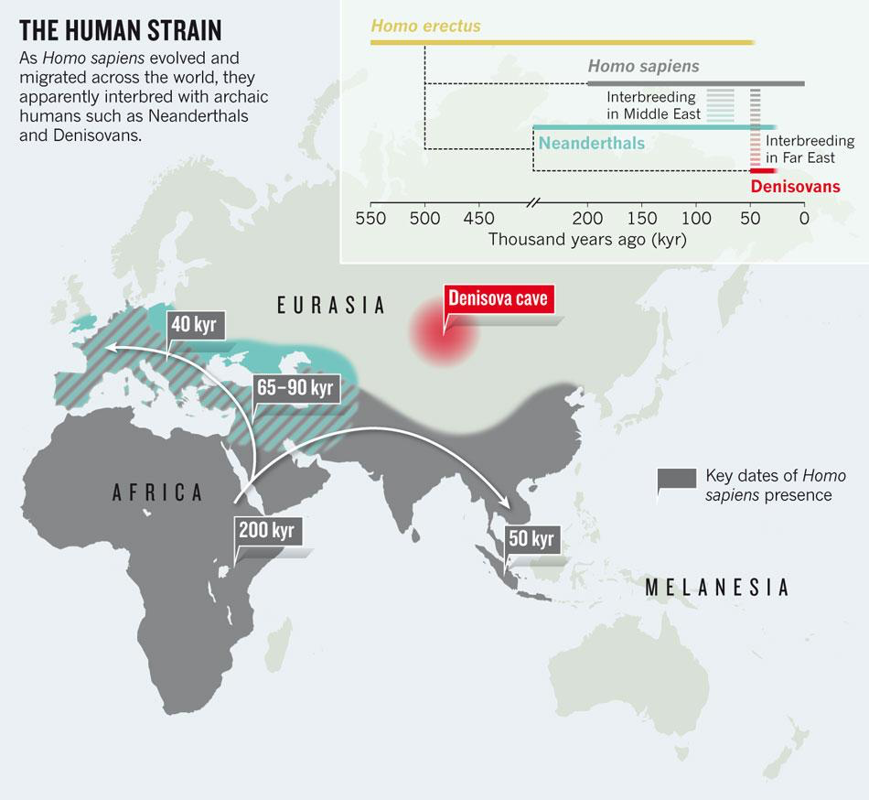
Ancient DNA reveals secrets of human history.
Nature 476, 136-137 (2011) | doi:10.1038/476136a

Slide 4
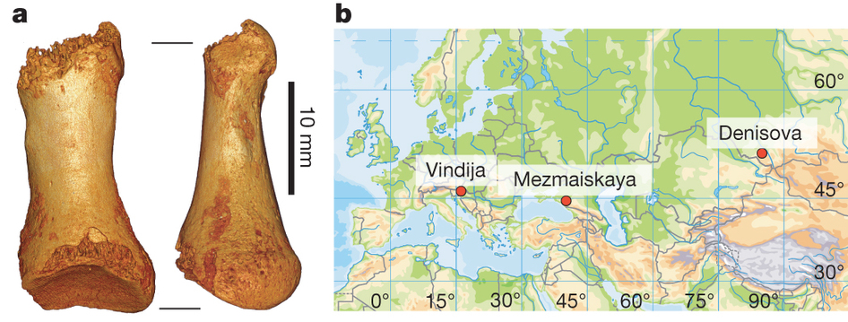
2008: Vindija Cave (Croatia)
21 bones found, 3 had Neanderthal mtDNA (screened by PCR)
3 individuals - 454 sequencing on extracts
95-99% of DNA sequenced in the libraries was derived from non primate organisms!
mtDNA coverage 29-, 35-, and 72-fold respectively.
2010: Neanderthal DNA extracted, sequenced, assembled into the Neanderthal genome sequence¹
Result: Draft Neanderthal genome (1.3x coverage)
1-4% of the genes that modern humans carry, come from Neanderthals
1. Green et al. A draft sequence of the Neandertal Genome. Science. 328, 5979 (2010). doi:10.1126/science.1188021. pmid:20448178

Slide 5
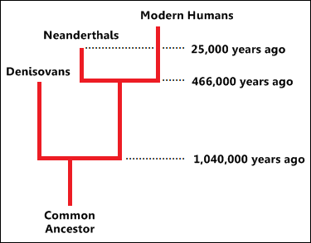
2008: Denisova Cave (Altai Mountains)
Siberia
Hominin Finger Phalanx, layer age 50,000 years
Genome sequence generated at ~1.9x coverage in 2010¹
Denisovan origins (i.e. distinct from both Neanderthals and modern humans)
‘X woman’
1. Reich D, et al. Genetic history of an archaic hominin group from Denisova Cave in Siberia. Nature. 2010;468:1053.

Slide 6
2010: Denisova Cave (Altai Mountains)
Siberia
Hominin toe phalanx, layer age 50,000 years + a little older
Morphology similar to modern humans and Neanderthals
Genomic analysis of DNA from this toe phalanx = this paper!

Slide 7
Neanderthal Fossils and Genomics
Location | Age of sample(s) | Year of Discovery
Vindija (Croatia) | 38-44,000 years old | 2008 (draft genome, mtDNA)
Mezmaiskaya (Caucasus) | 29,000 years old | 2000 (infant sample, mtDNA)
Denisova (Siberia) | 48-52,000 years old | 2010 (genome, mtDNA)

Slide 8
Research Questions at hand:
We have reference Neanderthal and Denisovan sequences, so:
Can we sequence this Altai Mountains sample and tell which type of hominin (human/human ancestor) it is?
What new things about the hominins does this new genome sequence tell us?
How does the modern human genome compare with the Neanderthals or Denisovans?

Slide 9
Methodology
Get high quality, high coverage of the genome (and mtDNA) from the toe phalanx sample in Siberia
Illumina HiSeq, alignment to Human + Chimp + hybrid ancestor genomes
Ibis (ML algorithm) for base calling
Compare with the genome (and mtDNA) of
other Neanderthals (Vindija cave¹)
Denisovans (Altai Mountains)
Modern humans (representative set of 5 different populations)
How do these genomes cluster?
Is the 2010 Siberian sample a Neanderthal?
Then set about interpreting the genome – personalized ancestral genomics!
Green et al. A draft sequence of the Neandertal Genome. Science. 328, 5979 (2010). doi:10.1126/science.1188021. pmid:20448178
Notes:
Treated to remove deamination affected sites; <1% modern human contamination

Slide 10
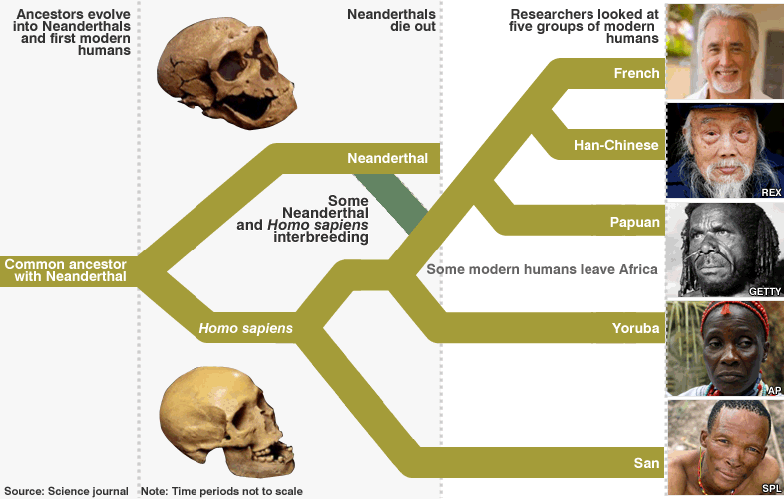
What makes a modern human?
Notes:
To put the divergence of the Neandertal genomes into perspective with regard to present-day humans, we sequenced the genomes of one San from Southern Africa, one Yoruba from West Africa, one Papua New Guinean, one Han Chinese, and one French from Western Europe to 4- to 6-fold coverage on the Illumina GAII platform (SOM Text 9). These sequences were aligned to the chimpanzee and human reference genomes and analyzed using a similar approach to that used for the Neandertal data. Autosomal DNA sequences of these individuals diverged 8.2 to 10.3% back along the lineage leading to the human reference genome, considerably less than the 12.7% seen in Neandertals (SOM Text 10).

Slide 11
Sequencing DNA from fossils
Fragmented DNA (random pieces)
<200 bp fragments of nuclear DNA
Chemical effects (deamination)
Bacterial contamination, modern human contamination
mtDNA is well suited for genome-scale ancient DNA sequencing projects¹
Smaller size relative to nuclear genome
Higher relative abundance (hundreds of mtDNAs per nuclear genome)
Ancestry tracing (track the ‘mothers’ in a lineage) and discrimination between different populations
A. W. Briggs et al., Targeted retrieval and analysis of five Neandertal mtDNA genomes. Science 325, 318 (2009). doi:10.1126/science.1174462 pmid:19608918
Notes:
Only 0.001% of DNA sequences determined from typical well-preserved Neanderthal specimens are derived from mtDNA

Slide 12
Altai Mountain Sample
Initial sequencing of random DNA fragments
mtDNA seemed closely related to the Neanderthal mtDNAs
Aligned to the Neanderthal mitochondrial genome
70% aligned to the human genome!
X chromosome enriched : Female
52 x coverage nuclear genome sequencing
Female Neanderthal sample
How does it cluster (mtDNA)?
Notes:
Only 0.001% of DNA sequences determined from typical well-preserved Neanderthal specimens are derived from mtDNA

Slide 13
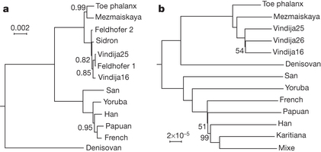
Phylogenetics analysis
Bayesian clustering results:
Build a prior model for substituions
Calculate pairwise mtDNA nucleotide differences between all 13 samples + Chimpanzee outlier
Neanderthals
Modern Humans
Figure 2 | Phylogenetic relationships of the Altai Neanderthal.
Bayesian clustering tree based on mitochondrial DNA
Notes:
MrBayes was then run with default MCMC parameters with the above substitution model for 5,000,000 generations sampling every 1000 generations with a burn-in of 1,000,000 generations.

Slide 14
Studying the Altai Genome
Know that it’s a Neanderthal Female
We essentially have 2 ‘haploid genomes’ partly representing the 2 parents of this Neanderthal
How do we trace back the evolutionary history from these two haploid genomes?
Enter Pairwise Sequentially Markovian Coalescent Model (PSMC)
Notes:
MrBayes was then run with default MCMC parameters with the above substitution model for 5,000,000 generations sampling every 1000 generations with a burn-in of 1,000,000 generations.

Slide 15
PSMC
Call SNPs on input diploid genome using SAMtools
Infer the distribution of ‘merge time’ between the 2 copies of the genome, across all chromosomes
Estimate when the 2 haploid genomes shared a genetic ancestor
Works off of an average mutation rate expectation (0.5 x 10⁻⁹ bp per year)
The faster the merge time, the smaller the effective population size at that point (inverse relationship)
Can also compare two different populations and estimate when they diverged
Results as expected (Denisovian and Neanderthal populations were smaller than Homo sapiens… – can discuss after presentation)

Slide 16
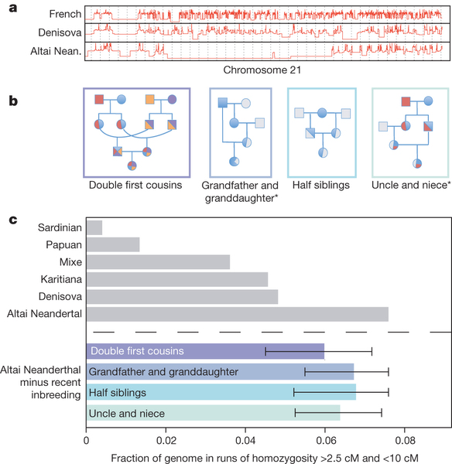
PSMC also revealed this:
Runs of homozygosity in the Altai Neanderthal genome
>50 kb
no heterozygous site
<50% missing data
<70% missing + filtered data
Figure 3a. Time since the most recent common ancestor in log-scale for the two alleles of a French, the Denisovan and the Altai Neanderthal individual along 40 Mb of Chromosome 21
1 cM ~= 1 million bp in the human genome

Slide 17
Inbreeding!
Had 20 homozygous regions of length >10 cM → inbreeding coefficient of 1/8
X chromosome also had long runs of homozygosity (XX sample)
1 X chromosome came from the mother (M)
1 X chromosome came from the father (F)
Father’s mother, or daughter, shared maternal ancestry with M
Scenarios?

Slide 18
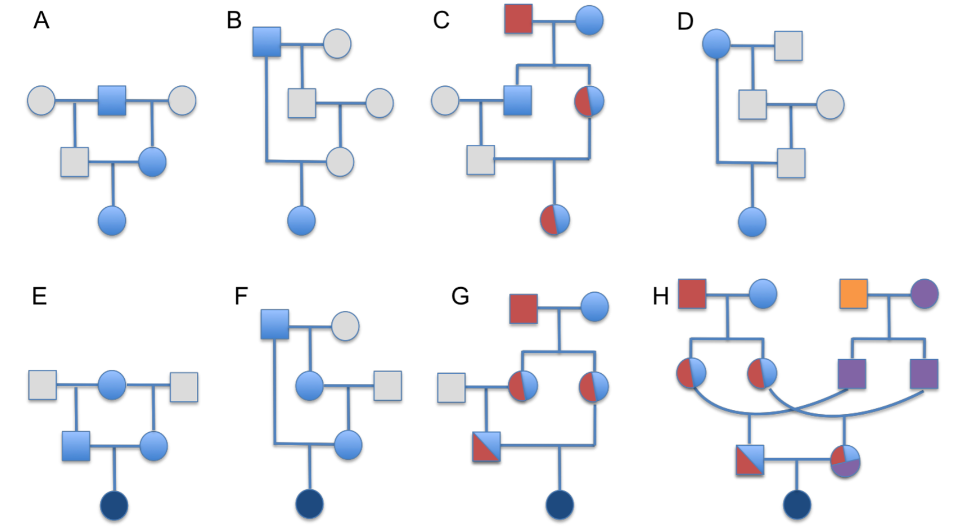
Half-siblings
Grandfather-Granddaughter
Aunt-Nephew
Double-first-cousins
Figure S10.9 Non exhaustive illustration of pedigrees that can be excluded (A-D),
or not excluded (bottom), using X chromosome information.
Gray: absence of X sequence coming from common ancestors
Dark blue: Both parents may carry X chunks inherited from same recent common ancestor
Other colours: potential presence of X sequence coming from common ancestor(s)

Slide 19
Perhaps only a ‘recent’ case of inbreeding?
If inbreeding happened over more than 3 generations
Shorter homozygous stretches (< 10 cM, more time after inbreeding event, to acquire het SNPs in regions of homozygosity)
But not so short as to originate simply by accrual of mutations in two distinct individuals (False Positives, < 2.5 cM)
Considered homozygosity stretches of length 2.5 - 10 cM

Slide 20
Isolated and endogamous group in Brazil
Figure 3c. Fraction of genome in runs of homozygosity between 2.5-10 cM in length for Altai Neanderthal, Denisovan, and the three present-day human individuals with the largest fractions (grey bars)

Slide 21
Perhaps only a ‘recent’ case of inbreeding?
Results:
Altai Neanderthal still had more runs than Denisovan genome (P < 2.2 x 10⁻¹⁶)
Altai Neanderthal and Denisovan both had more runs than the Karitiana tribe
Karitiana tribe has long homozygous stretches
Isolated and endogamous group in Brazil → consanguineous individuals
320 people

Slide 22
Other side of the coin
More homozygous regions = more shared ancestry
What about heterozygous regions?
The more similar the heterozygous regions of 2 populations are, perhaps that means the more they mixed with each other?

Slide 23
Did the Denisovans and Neanderthals ever cross paths?
How different are the Neanderthal and Denisovan genomes?
Compared regions around shared alleles between the two genomes
If population 1 contributed to population 2, you’d expect more heterozygosity around the shared alleles in population 2 than if population 2 was isolated from population 1
Population 1 contributes to Population 2
Population 1
Population 2
Population 1
Population 2
Population 2 contributes to Population 1
Population 1
Single haplotype block, in low divergence area
Population 2

Slide 24
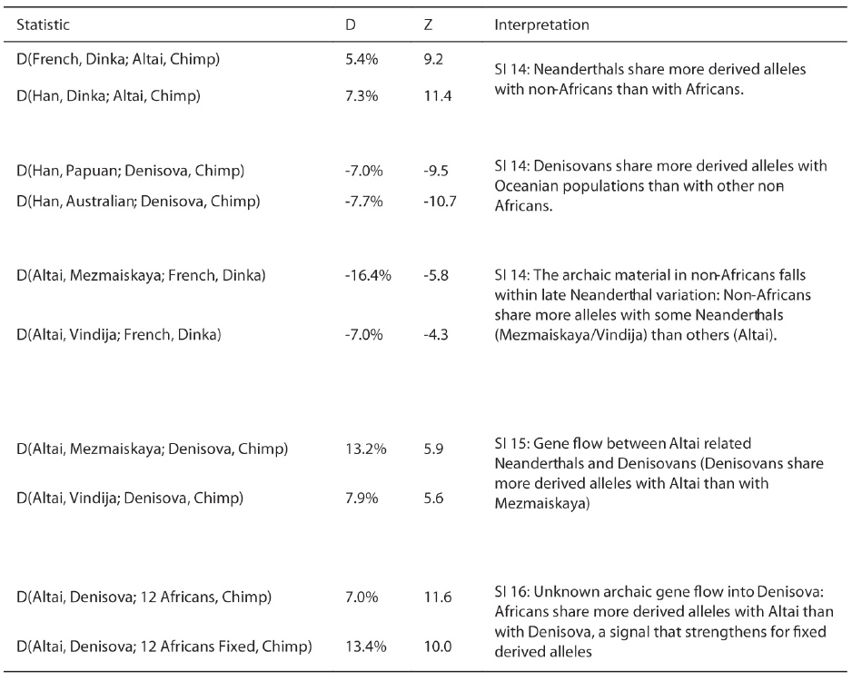
Did the Denisovans and Neanderthals ever cross paths?
D-statistic as a measure of gene flow
Measures the distance between two means,
as (u₁-u₂)/sd_pooled
Extended Table 2. Selected D-statistics supporting inferences of gene flow

Slide 25
Did the Denisovans and Neanderthals ever cross paths?
Found no increases in Neanderthal heterozygosity
Found more heterozygosity in Denisovan genome
Shares more derived alleles with the Altai Neanderthal, than with the Vindija or Mezmaiskaya ones

Slide 26

Oh, the places you’ll go!
Given the two reference Denisovan and Neanderthal genomes, can we predict what parts of a present-day human genome came from which ancestor (if either)?
Hidden Markov Model
Applied to 13 experimentally phased modern human genomes

Slide 27
Oh, the places you’ll go!
Sardinian and French genomes: genomic regions of Neanderthal origins
Han & Dai (China), Karitiana & Mixe (Americas): genomic regions of Neanderthal and Denisovan origin

Slide 28
Oh, the places you’ll go!
Did certain alleles from Neanderthals and Denisovans have functional relevance in modern humans?

Slide 29
Functionally important genes (relevant today?)
Comparison with 1000 Genomes Project samples
96 AA coding changes shared in 1094 modern humans
These are absent in Denisovan and Neanderthal genomes
~3000 mutations fixed in modern humans, that influence gene expression
Found stretches of DNA in non-African genomes that were totally devoid of Neanderthal DNA (genes involved in motor coordination, language, speech)
Several variants shared with the Neanderthal genome
Roles published separately (2 months after this paper¹)
Neanderthal variants in genes that affect the risk of several diseases (lupus, biliary cirrhosis, Crohn’s, type 2 diabetes)
1. The genomic landscape of Neanderthal ancestry in present-day humans. Sankararaman et al. Nature. 2014 Mar 20;507(7492):354-7. doi: 10.1038/nature12961.

Slide 30
Conclusions
The Altai Neanderthal was inbred, and its ancestral population size was small
Neanderthals contributed to our modern day genomes, and our immune system
Strong gene flow from Neanderthals into Denisovans for the Human Leucocyte antigen (HLA) and CRISP cluster regions (immunity and sperm function)!
Caucasus Neanderthal shares more derived alleles with the modern non-Africans than do other Neanderthals
Other mystery humans? (indication of unknown archaic genes in the Denisovans, with gene flow analysis)

Slide 31
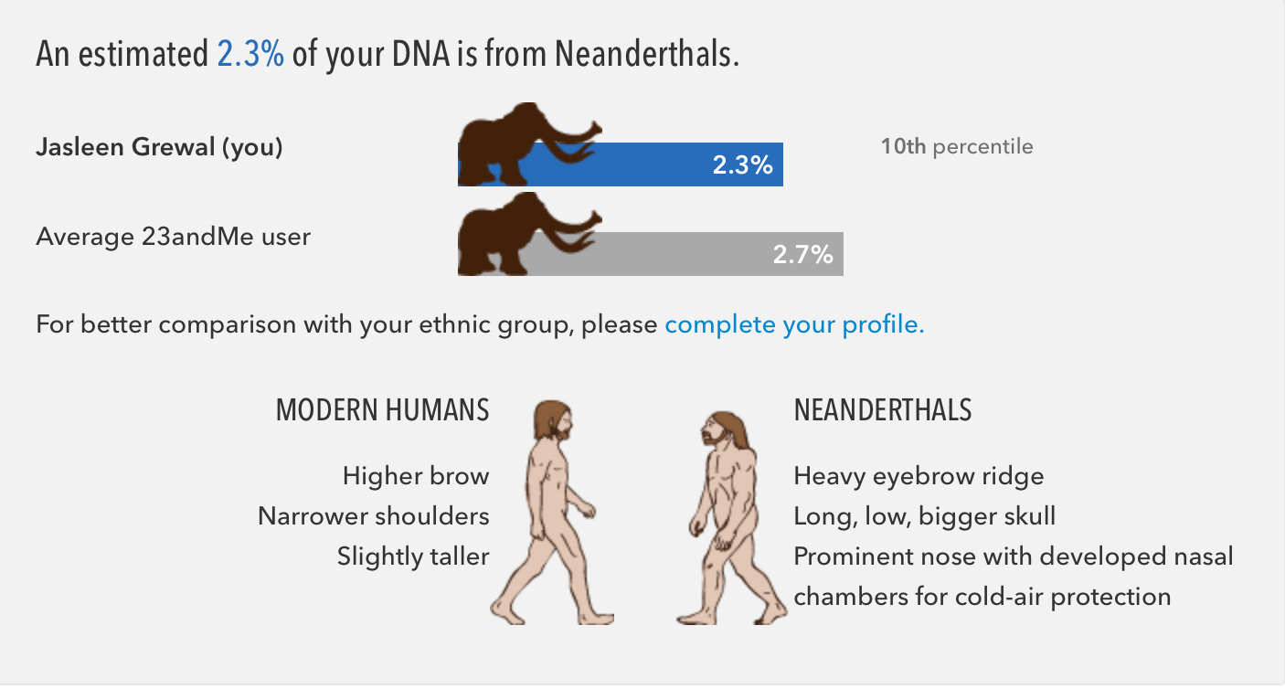
From here, whither?
Qualitative value to knowing how much of your genome is Neanderthal?
Comparative genomics
Neanderthals contributed to our immune systems
A lesson in the value of evolution (presumably, the bad bits of the Homo erectus genome were weeded out with the H. Neanderthalinsis)?

Slide 32
Things to think about - methodology
Why use multiple reference genomes of modern humans, instead of the one established reference genome?
The original Neanderthal genome was aligned partially to the reference human genome, the reference chimpanzee genome, and an inferred common ancestral sequence of humans and chimps. Why would a de novo assembly be restrictive?
Analysis was restricted to certain regions of the genome
non-repetitive (so no tandem repeats)
Would inclusion of tandem repeats be expected to change anything in the results?
(Im)morally speaking, incest is not a good thing
Did the long homozygous stretches kill off the Neanderthals? Can we test out this hypothesis in any way?
Does this further our understanding of modern humans?

Slide 33
Neanderthal Fossils and Genomics
Neanderthals
Modern Humans
Figure 2 | Phylogenetic relationships of the Altai Neanderthal.
Bayesian clustering tree based on mitochondrial DNA
Location | Age of sample(s) | Year of Discovery
Vindija (Croatia) | 38-44,000 years old | 2008 (draft genome, mtDNA)
Mezmaiskaya (Caucasus) | 29,000 years old | 2000 (infant sample, mtDNA)
Denisova (Siberia) | 48-52,000 years old | 2010 (genome, mtDNA)
Notes:
Vindija draft genome did not correct for deamination rates. Denisovan sample did. Also consider Caucasus geographically proximal to Denisovan Cave, than is Vindija -> suggestive of 2 different neanderthal populations

Slide 34
Trivia (if you read the supplementary)
Is it Neanderthal or Neandertal?
“all the cool kids write it with a ‘T’” - John Hawks
(see http://johnhawks.net/weblog/hawks.html)

Slide 36
Did the Denisovans and Neanderthals ever cross paths?
D-statistic as a measure of gene flow
Measures the distance between two means,
as (u₁-u₂)/sd_pooled
Extended Table 2. Selected D-statistics supporting inferences of gene flow

Slide 37
We kept the genes for smartness?
Copy number changes were studies in the two archaic genomes and 25 present day human genomes
Found 3 regions duplicated only on the modern human lineage
BOLA2 had a copy number gain in humans
Is near a microdeletion associated with developmental delay, intellectual disability and autism
Keep in mind that the reference archaic genomes had 1.3-1.8x coverage
Is that sufficient to elicit copy number changes in the archaic genome?
Can this information be interpreted as selective pressure against developmental disorders? Or do we need more data?

Slide 38
Did the Denisovans and Neanderthals ever cross paths?
Found no increases in Neanderthal heterozygosity
Found more heterozygosity in Denisovan genome
Shares more derived alleles with the Altai Neanderthal, than with the Vindija or Mezmaiskaya ones
The modern Africans share more ‘ancestrally fixed’ alleles with the Neanderthals than with the Denisovans, even though both the ancestral species migrated out of Africa around the same time!

Slide 40
cM distance (centimorgans)
Distance between two loci, for which the expected frequency of crossovers in a single generation is 1%
Two loci are 1 centimorgan apart if recombination between them is observed in 1% of meioses.
Higher cM value = ‘closer together’
1 cM ~= 1 million bp in the human genome

Slide 41
Time of population split?
For two chromosomes from 2 different populations,
How long before these two ‘merge’?
Use average mutation rate (0.5 x 10⁻⁹ bp per year)
Apply PSMC
If we randomly choose alleles from an individual,
How often are these different from the apes (derived alleles)
The older the population, the fewer the derived alleles

Slide 42
Time of population split?
Pooled estimates from both these methods
Neanderthals & Denisovans split 381-473 kya
Archaic and Modern Humans split 550-765 kya

Slide 43
Other side of the coin
More homozygous regions = more shared ancestry
What about heterozygous regions?
More variability in these regions means more people were around to carry additional mutations in their genome

Slide 44
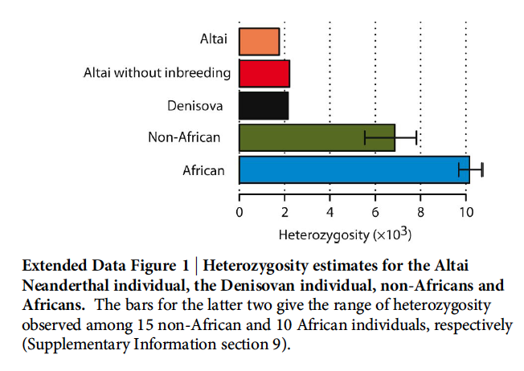
Heterozygosity as a proxy for population size
Remove homozygous stretches > 2.5 cM
Resulting regions have 2.1-2.2 heterozygous sites per 10,000
16-32% of present-day humans
81% of Denisova

Slide 45
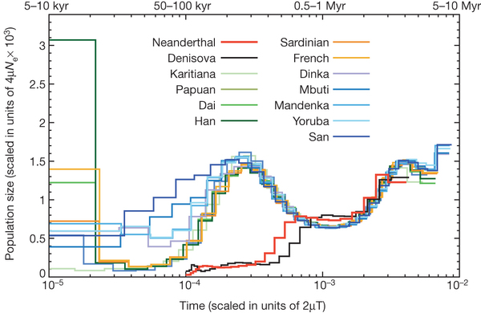
Figure 4. Inference of population size change over time

Slide 46
The tale of 2 chromosomes
Chromosome 2 fusion makes us different from the great apes
Short stretch of telomeric repeat sequence in both directions in the interior of Chr 2, as an artefact of this fusion
Fusion exists in Denisovan and Neanderthal sequence

Slide 47
Problems with DNA from fossils
The DNA is degraded to a small average size < 200 bp
Chemical modification (oxidative processes)
High average coverage of random sequence reads
Small amounts of endogenous DNA, large amounts of DNA from colonizing microbes
comparing the genome sequences of closely related organisms
Modern human contamination (initial Neanderthal fossil extracts had 11-40% DNA contamination)
Measurement of modern human mtDNA fragments pegs contamination in samples at <1%
Amplification and sequencing of low coverage positions
S. Pääbo, Ancient DNA: extraction, characterization, molecular cloning, and enzymatic amplification. Proc. Natl. Acad. Sci. U.S.A. 86, 1939 (1989).doi:10.1073/pnas.86.6.1939 pmid:2928314
A. W. Briggs et al., Patterns of damage in genomic DNA sequences from a Neandertal. Proc. Natl. Acad. Sci. U.S.A. 104, 14616 (2007). doi:10.1073/pnas.0704665104 pmid:17715061

Slide 48
Sequencing DNA from fossils
‘Filter out’ microbial origin fragments by comparing the genome sequences of closely related organisms
restriction enzyme digest to preferentially remove bacterial DNA sequences
Use the finished human genome sequence and the chimpanzee genome to identify Neanderthal DNA sequences.
Green et al. A draft sequence of the Neandertal Genome. Science. 328, 5979 (2010). doi:10.1126/science.1188021. pmid:20448178

Slide 49
From supplementary (Figure S6a.3)
To test the effect of contamination on the signal, we recalculate African-Altai and African-Denisova divergence using reads that show deamination patterns. Deamination has been found to increase with time, so reads containing deamination are more likely endogenous6.
We selected reads with a cytosine to thymine change at the positions where residual deamination is found after uracil removal (last base 5’ end + last two bases 3’ end; see SI1 and SI5). Bases at these positions were required to have a minimum quality score of 30 (corresponding less than 1 error in a 1000 basepairs). The cytosine residue at the corresponding genomic position was required to be present in the consensus sequence (genotype in the VCF). In order to avoid contaminating human molecules to be falsely classified as deaminated read, we further required that no human from the 1000 Genomes Project phase1 data shows the thymine at the position under consideration. With this methodology, new BAM files containing putatively deaminated reads for the Altai Neandertal and the Denisova were obtained and genotyping was performed according to the method of SI 3. The deaminated reads from Altai Neandertal provided an average coverage of 2.4 while those from Denisova gave an average coverage of 2.0.
Using only the deaminated reads, we recalculate divergence (see Figure S6A.3). We find that Denisova continues to show deeper divergence to African individuals compared to the Altai Neandertal. We conclude that the difference is not caused by a difference in contamination.

Slide 50
Phylogenetics analysis
Rate of Transversions (Purine-Pyrimidine differences)
Deamination increases with time (more Transitions {A->G, C->T})
Transversions less likely to be a chemical artifact
Neighbour Joining results:
Figure 2 | Phylogenetic relationships of the Altai Neanderthal.
Neighbour-joining tree based on transversions (Purine-pyrimidine differences)
Notes:
Only 0.001% of DNA sequences determined from typical well-preserved Neanderthal specimens are derived from mtDNA

Slide 51
Testing the effects of filtering
Figure S6a.5
Also tested lack of filters in the estimates; Relative het estimates remained stable with a max difference of 3.5%

Slide 52
http://johnhawks.net/weblog/reviews/neandertals/neandertal_dna/altai-neandertal-genome-2013.html
http://johnhawks.net/weblog/reviews/neandertals/neandertal_dna/sima-de-los-huesos-dna-meyer-2013.html
http://siberiantimes.com/science/casestudy/news/n0356-fresh-discoveries-of-ancient-mans-bone-in-altai-mountains-cave/
http://science.sciencemag.org/content/328/5979/710.full
Supplementary:
http://www.nature.com/nature/journal/v505/n7481/extref/nature12886-s1.pdf

