Slide 1
idna-prot|dis
Critical paper review by
Jasleen Grewal
Ph.D. Student, Steven Jones Lab
Canada’s Michael Smith Genome Sciences Centre

Slide 2
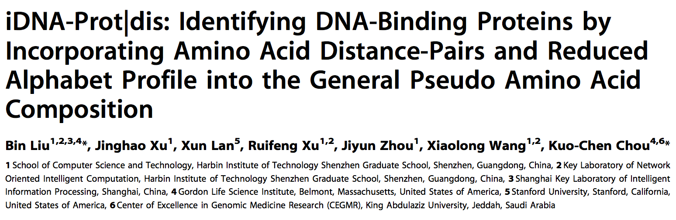

Slide 3
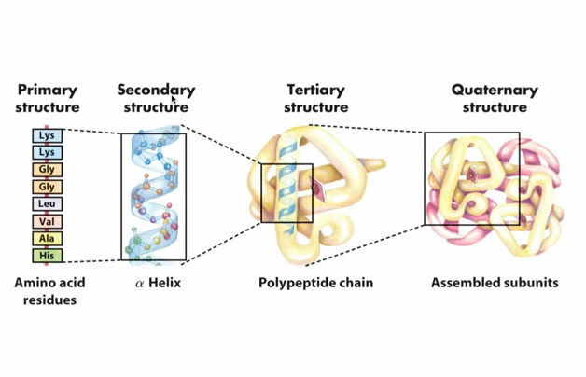
Protein Structure
David L. Nelson, Michael M. Cox. Lehninger Principles of Biochemistry. New York: W. H.Freeman and Company, 2008.

Slide 4
Why study DNA binding proteins

Slide 5
Finding protein sequence & structure
Chromatin Immuno Precipitation
Mass Spectrometry (Nordhoff, 1999)
X-ray crystallography
Machine Learning
Random Forest (DNA-Prot)
Grey Models (iDNA-Prot)
Support Vector Machines (iDNA-Prot|dis)
Neutral networks
Ensemble classifiers (nDNA-Prot)

Slide 6
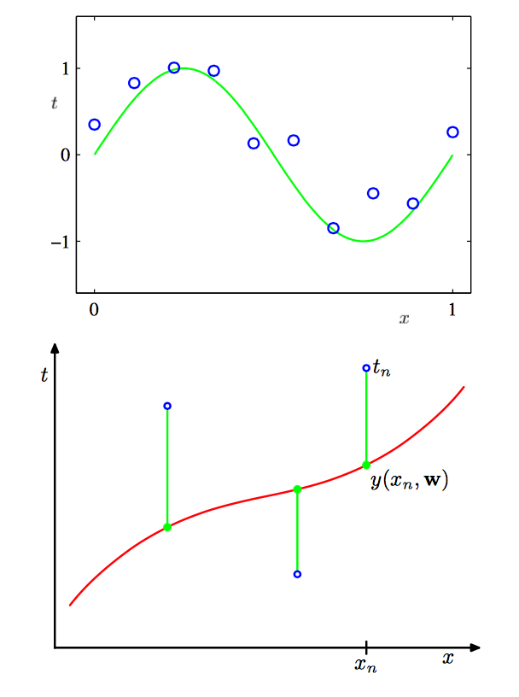
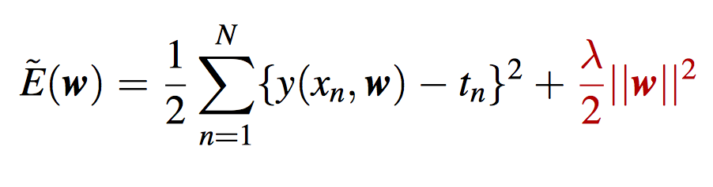
Data points
Have a spread (density distribution)
Optimal fit has an associated error rate
Error calculated as ‘least squares’:

Slide 7
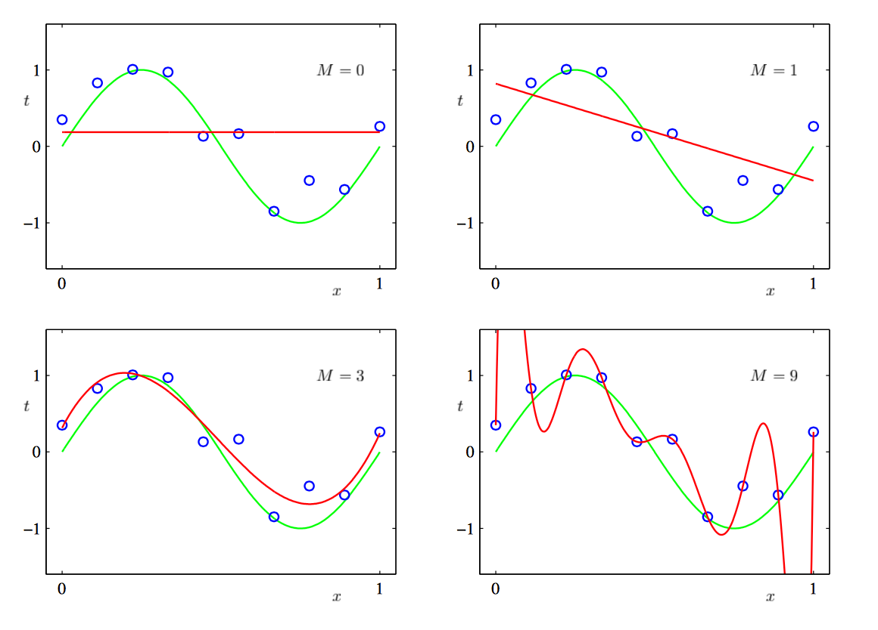
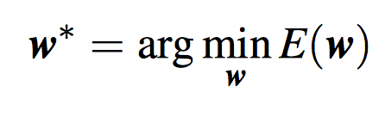
Explaining the data points
Find the best fit for my data, minimize error without getting carried away by the way it looks right now

Slide 8
Preventing over fitting - regularization
Penalize large coefficients
Best coefficients = least error
Least Squares error Regularizer

Slide 9
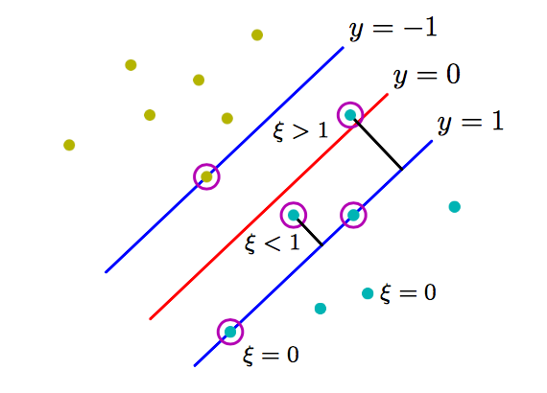
Separating the data points - Perceptrons
2 class problem
Minimize error over ‘mis-classified’ examples only
CMPT 419 Greg Mori, Simon Fraser University

Slide 10
Support Vector Machines
2 class problem
Minimize error over ‘mis-classified’ examples only
SVMs are ‘L2-regularized’ Perceptrons
CMPT 419 Greg Mori, Simon Fraser University

Slide 11
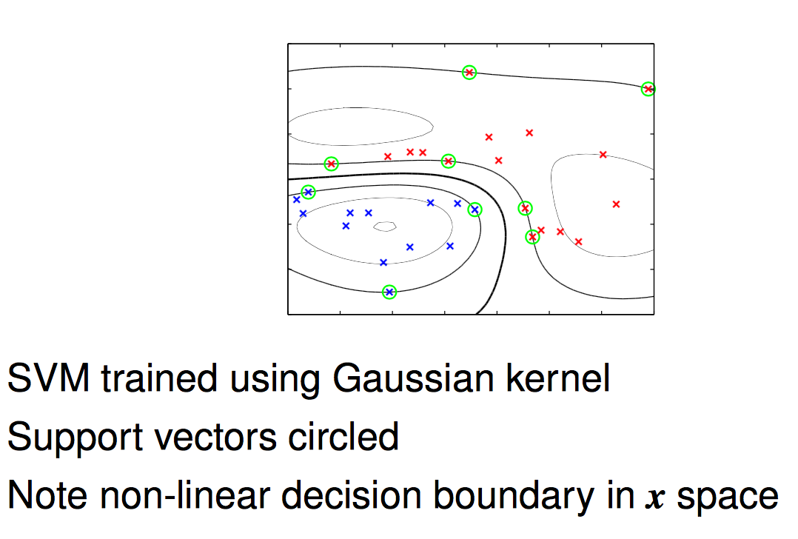
Support Vector Machines
An example of an SVM applied to a non-linear feature space
CMPT 419 Greg Mori, Simon Fraser University

Slide 12


Kernel Functions
Estimate distribution of data (density differences -> clusters)
Estimate density by placing a tiny ‘bump’ around each datapoint – incorporate inherent variability in datapoint
Kernel function k() determines shape of these bumps
Commonly use (Radial) Gaussian Basis Function (RBF)
Can now specify how ‘similar’ two points are, rather than construct an ‘exact comparison’ for every single pair of points.
CMPT 419 Greg Mori, Simon Fraser University

Slide 13
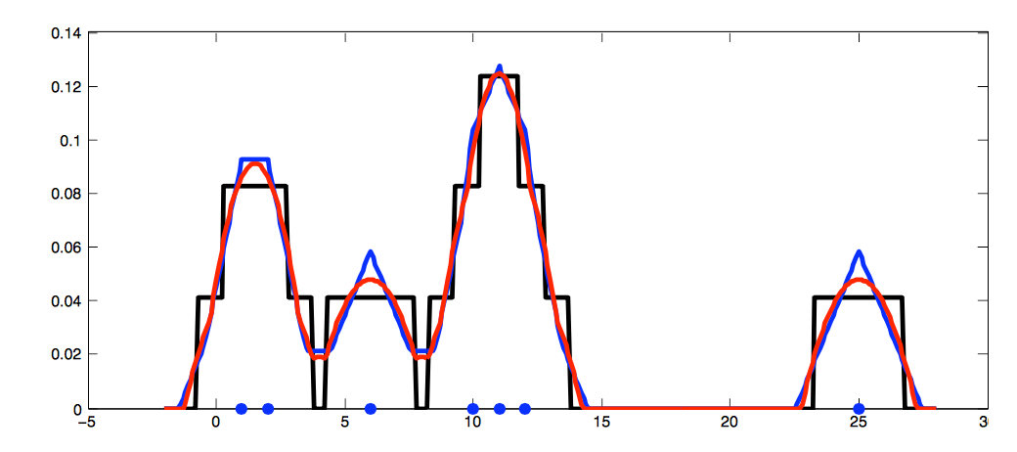
Other types of Kernel Functions
Rectangle, Triangle, Epanechnikov
CMPT 419 Greg Mori, Simon Fraser University

Slide 14
Sequence vs Structure
Protein Structure
Energy state models
Identifying functional domains
Amino Acid Sequence
Sequence evolutionary profiles
Chou’s Pseudo Amino Acid Compositiones (PseAAC)
Combination of the two (ex. iDNA-prot)

Slide 15
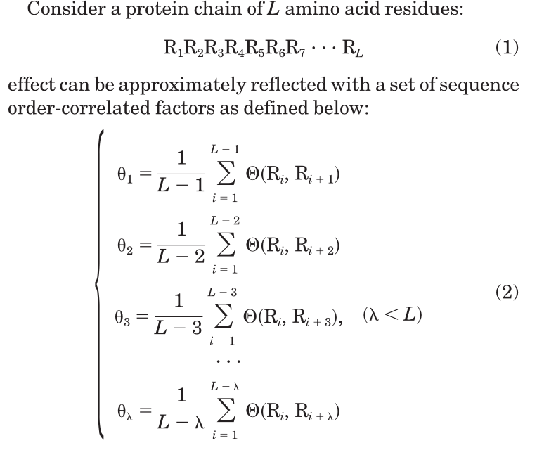
(Good fences make) Good neighbors
Pseudo Amino Acid Compositions
PROTEINS: Structure, Function, and Genetics 43:246-255 (2001)
Notes:
Mending Walls (Robert Frost)

Slide 16
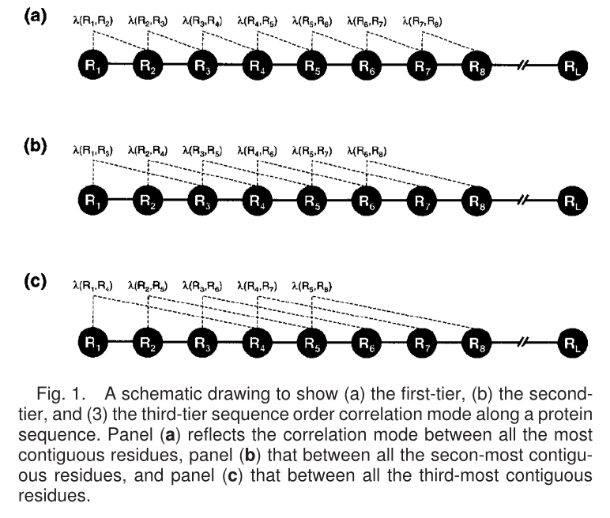
(Good fences make) Good neighbors
Pseudo Amino Acid Compositions
Pairwise Distance
PROTEINS: Structure, Function, and Genetics 43:246-255 (2001)
Notes:
Mending Walls (Robert Frost)

Slide 17
The high dimensionality conundrum
20 Amino Acids
Studying neighbors at distance ‘1’, in a protein of length ‘L’, we get (20 x 20) x (L) pairwise comparisons
Average protein length in eukaryotes?
Feature set is massive!
Increased computational time and resources
Redundancy in associations -> Overfitting

Slide 18
Solutions?
Limit scope of classification?
1 type versus rest – informative?
Reduce the feature vector size?
Use amino acid cluster profiles -> Reduced alphabet

Slide 19
Representative AA cluster profiles
Different proteins have different functions
Functions derived from single amino acids (ex. Lys, Arg)
Functions derived from a cluster of amino acids (ex. )
Analyze protein sequence in terms of these ‘nature defining’ amino acids
Fewer ‘amino acid’ units to compare

Slide 20
Summary - the ‘dis’ in iDNA-Prot|dis
Reduced Amino Acid Alphabets
Clustering of Aas based on some measure of their relative similarity
Selected 3 different alphabet profiles for DNA binding proteins
cp(13)= {MF; IL; V; A; C; WYQHP; G; T; S; N; RK; D; E}
cp(14)= {EIMV; L; F; WY; G; P; C; A; S; T; N; HRKQ; E; D}
cp(19)= {P; G; E; K; R; Q; D; S; N; T; H; C; I; V; W; YF; A; L; M}
n(c) = x, where x defines cp(x)
New dimension size = n(c) + n²(c)d
when considering max pairwise distance = ‘d’

Slide 21
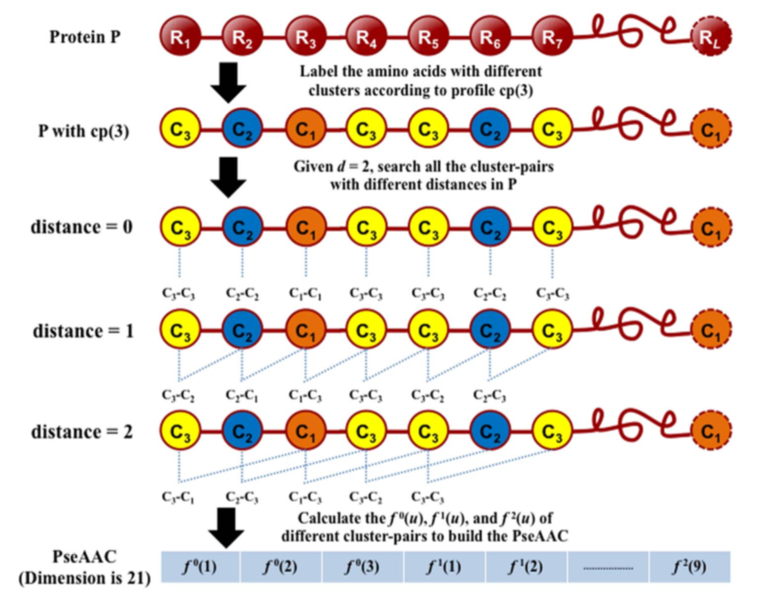
(Fewer = Good) neighbors
Pseudo Amino Acid Compositions
Pairwise Distance
doi:10.1371/journal.pone.0106691.g001

Slide 22
Data + algorithm = results, right?
Method to assess predictor
4 metrics (single label systems – right (1), wrong(0))
Sensitivity – Call 1, 1
Specificity – Call 0, 0
Accuracy – Call 1,1; Call 0,0
Mathew’s correlation coefficient -

Slide 23
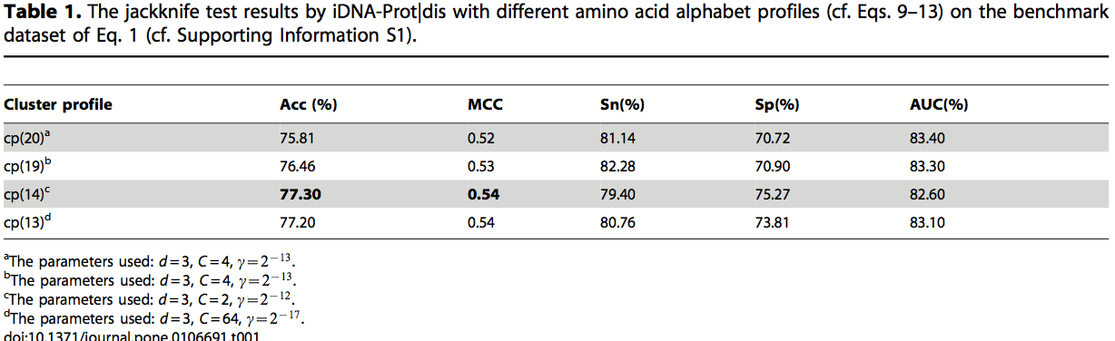
Results – reduced alphabet space
Feature space reduction
cp(20) = 1220 features
cp(14) = 602 features

Slide 24
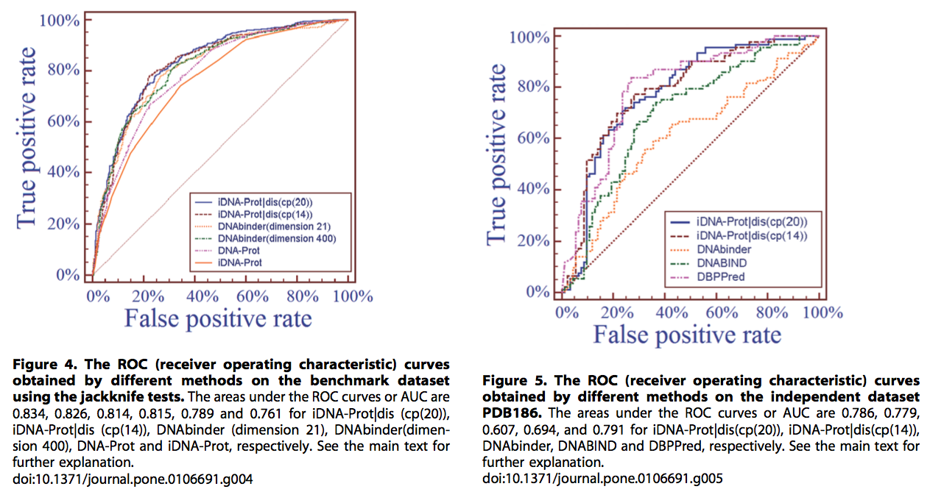
SVM with different feature spaces

Slide 25
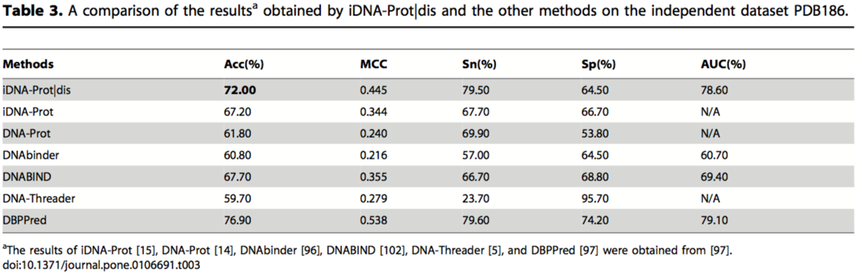
Mirror mirror on the wall…
Comparison with existing methods
DBPPred – random forest, with Gaussian naïve Bayes
GB outperformed decision tree, logistic regression, kNN, SVN (polynomial kernel), SVN (RBF kernel).
Trained on PDB594, tested on PDB186
Doi: 10.1371/journal.pone.0086703

Slide 26
Caveats
Generalize = generally lies?
Works only on well-studied protein functional types
Finding an optimal reduced alphabet set
Other computational tools for getting this set?
Approach works for identifying a single type of protein
Assumption: all amino acid clusters characteristic of ‘protein class X’ being encompassed in the reduced alphabet space

Slide 27
Extensions to current approach
Reduced alphabet set
Learn that through unsupervised clustering analyses
Prediction of co-interacting proteins
Learn about new functional attributes of proteins
Learn about new protein classes?
Multi-class separation using functionally characteristic alphabet sets

Slide 28
Applications
Current anticancer chemotherapy drugs
DNA damaging agents
Gene regulators!
Non-genotoxic DNA binding proteins
Prevent adverse effects of chemotherapy
Alter DNA plasticity and physico-chemical properties.
Classification of new proteins
Single class differentiation -> multi-class differentiation
Notes:
Alkylation agents, intercalators, anticancer agents like TOPOI,II inhibitors. Y irradiation.
Alter DNA plasticitiy – cisplatin.

Slide 29
Questions?

Slide 30
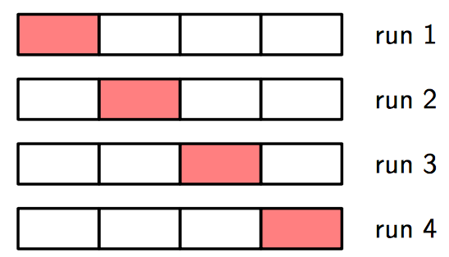
Cross validation - assessing performance
Jackknifing
Bootstrapping
Leave-one-out
Leave-k-out (subsampling)
LOO Cross Validation
Notes:
Training set error is lower with more complex model

Slide 31
Regularization – assessing performance
Train complex model but penalize it getting “too complex”
Sweet spot between error and regularization
Can use cross validation to find optimal regularization coefficient (λ)
Prevent overfitting

