Slide 1
Computational analysis of cell-to-cell heterogeneity in single-cell RNA-seq data
Buettner et al, 2015 Nature 33:3
Critical paper review by
Jasleen Grewal

Slide 2
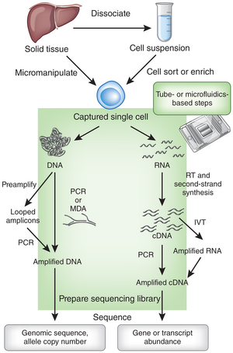
Strides in sequencing
Traditional approach – bulk of cells, ground up and sequenced.
Single cell sequencing¹
Genome
Transcriptome (talk the talk!)
Transcriptomics approaches²
Microarrays (eQTLs)
mRNA in situ hybridization ( # genes =< 32)
Single cell quantitative PCR (gene panel)
(sc)RNA-seq
1. Tal Nawy. Single-cell sequencing. Nature methods 11,18 (2014).
2. Kanter, I & Kalisky, T. Single cell transcriptomics: methods and applications. Front. Oncol., 10 March 2015.

Slide 3
We are all unique snowflakes
Tissues
New snowflakes cell types?
Hidden unknown covariates
Unobserved covariates
Unknown subtle environmental perturbations
1. Deng Q, Ramskold D, Reinius B, Sandberg R. Single cell RNA-seq reveals dynamic, random monoallelic gene expression in mammalian cells. Science (2014) 343:193–6. doi:10.1126/science.1245316

Slide 4
Finding hidden covariates
Bulk sequencing data
Sample handling and protocol adjustments
SNP profiles
BAF Fractions
PANAMA, ICE, PEER (eQTLs)
Single cell sequencing data
???

Slide 5
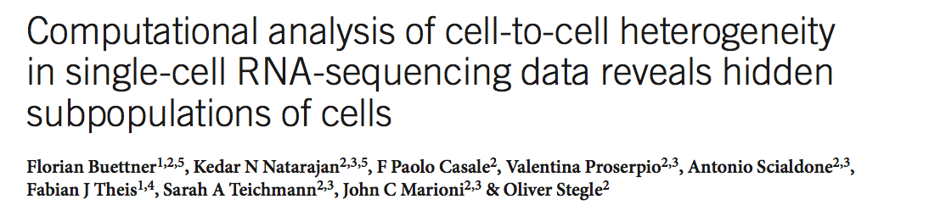
Single cell gene expression measurement (scRNA-seq)
Hidden confounders affect global gene expression
Identify these ‘hidden’ expression signatures
Interpret gene expressions without these confounding biological signatures
Use Gaussian Latent Variable Models

Slide 6
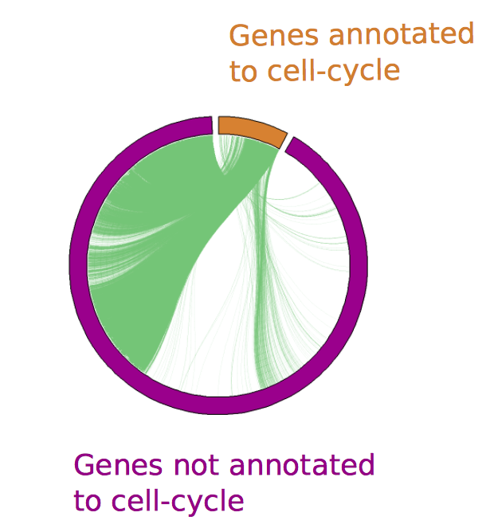
Cell cycle is regulated by multiple(!) genes
Figure 2. Correlation of cell-cycle annotated genes (549) with other genes’ expression levels (6524).
Supplementary Figure 2

Slide 7
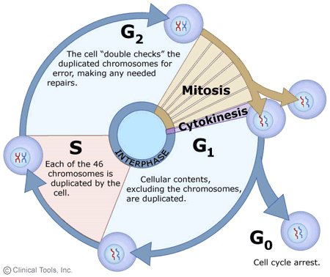
How to study this in single cells?
Have cells at different cellular time points
Annotate different genes based on ‘latent variable’

Slide 8
Validation Data
Source
Mouse Embryonic Stem Cells (mESCs)
Filters
Final set
G1 (59)
Separate G1, S, G2M phases - Hoechst staining + FACS (182 ESCs)
S (58)
G2M (65)
[Read length, coverage, variation above technical noise] filters
Remove abnormally sized cells (use ERCC spike-ins)
Gene annotation
GO category ‘cell cycle’
Top 600 ranked human cell-cycle genes from Cyclebase
Notes:
macromolecular Crystallographic Information File

Slide 9
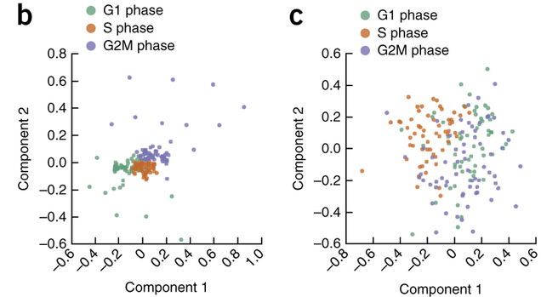
Got the data, now what?
*squeeze your eyes shut and pray real hard*
Figure 2 (paper). Nonlinear PCA based on genes not annotated as cell cycle.
(b) Without correction for cell cycle
(c) After correction for cell cycle, with scLVM

Slide 10

Single cell Latent Variable Model Algorithm
Two Stage Procedure
Covariance Matrix (cell – to – cell) -> Learning
Account for hidden factors, and achieve great things
Reveal new/true associations (cells, genes)
Single cell Gene Expression
Latent variable (ex. Cell cycle)
Technical Variability (Baseline Variance)
Residual Noise (explained by other biological process(es))

Slide 11
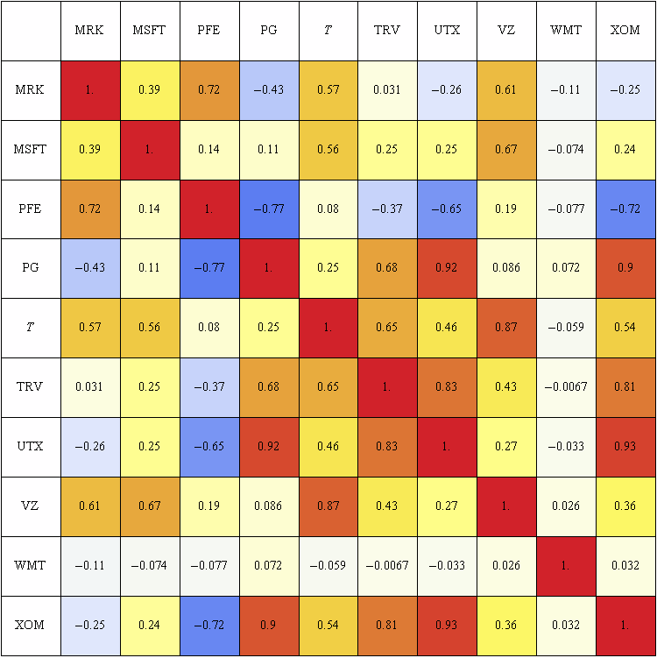
‘Hidden’/latent variable (ex. Cell cycle)
Annotated marker genes for Hidden Variable
Gene expression value in each cell for each marker gene
Covariance matrix accounting for cell-to-cell differences in hidden variable

Slide 12
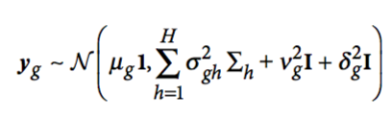
Single cell Gene Expression
Latent variable (ex. Cell cycle)
Technical Variability (Baseline Variance)
Residual Noise (explained by other biological process(es))

Slide 13
Single cell normalized Gene Expression
Latent variable (ex. Cell cycle)
Technical Variability (Baseline Variance)
Residual Noise (explained by other biological process(es))
^{y}_{i}^{* = y}_{i} ^{− ŷ}_{i}.

Slide 14
Comparison of scLVM correction with?
Remove all cell-cycle genes from the analysis, and then compare PCA Distribution of each cell with/without correcting with scLVM
Negative control: Compare to a cell type which is noncycling (terminally differentiated neurons!), and one which is cycling (T cells)

Slide 15
Figure 2 (paper). Nonlinear PCA based on non-cellcycle genes.
(b) Without correction for cell cycle
(c) After correction for cell cycle, with scLVM

Slide 16
Comparison of scLVM correction with?
Remove all cell-cycle genes from the analysis, and then compare PCA Distribution of each cell with/without correcting with scLVM
Negative control: Compare to a cell type which is noncycling (terminally differentiated neurons!), and one which is cycling (T cells)

Slide 17
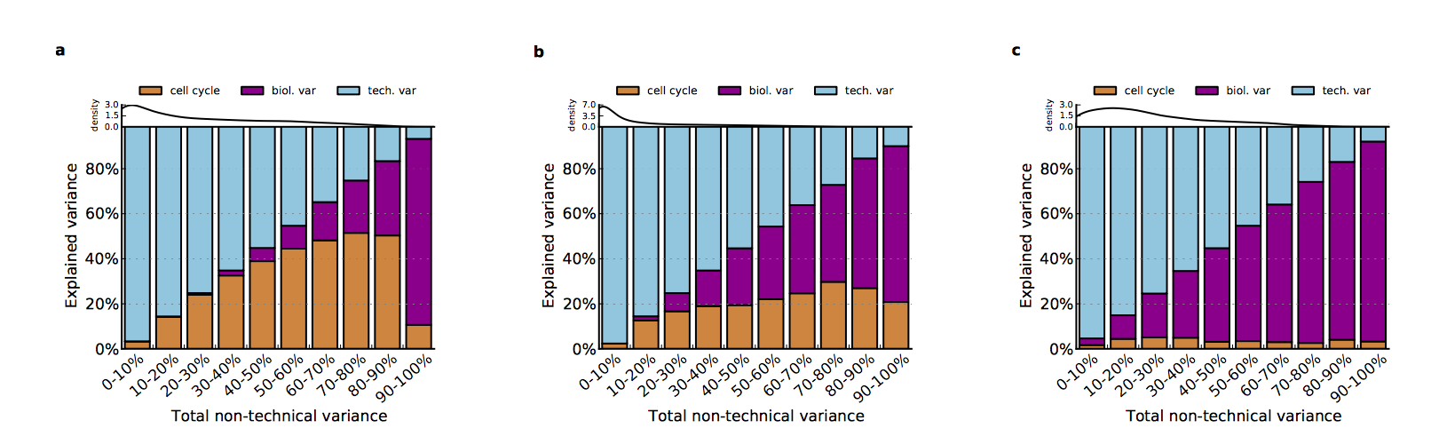
Negative controls : Variance Decomposition by scLVM
(Supplementary Figure 7)
30 terminally differentiated mice neural cells
T-cells
Mice ESCs

Slide 18
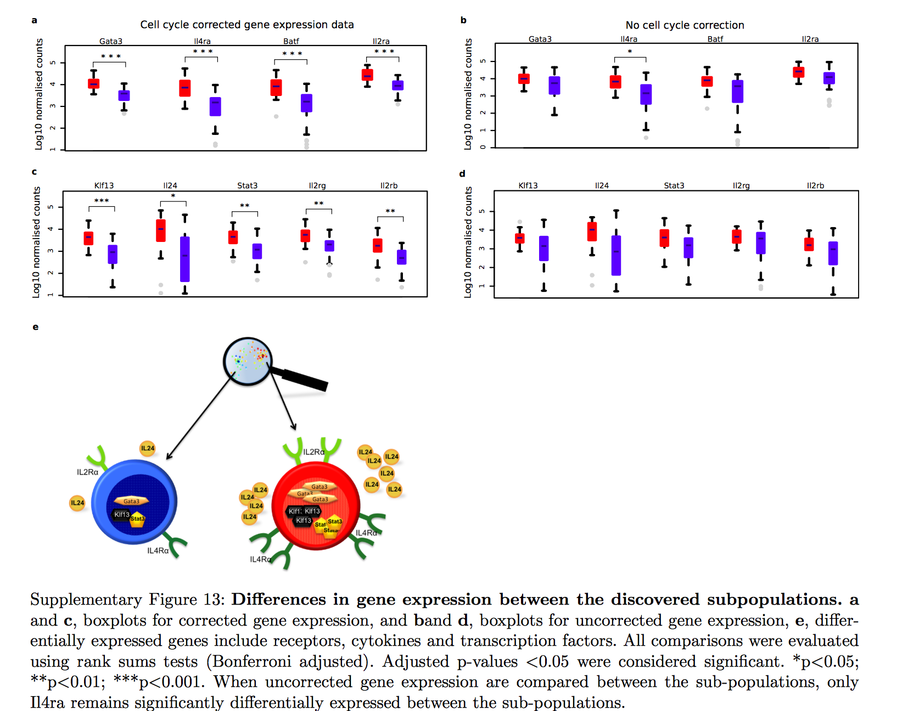
Revelations?
Cell cycle has a huge impact on overall cell expression state in early development
Once you remove the impact of such latent variables, new subpopulations are revealed

Slide 19
Things they already thought of
Methodology adaption: Similar data obtained from a different protocol (Quartz-Seq), cultured under different media conditions that help reduce variability in expression of cell-cycle genes.
Robust to sequencing protocols, studies, experimental batches
Does the size of the set of marker genes have a huge impact? (No... n >= 50)
Can we model multiple latent variables
T_{H}2 differentiation
Tested viability of subgroup identification using hierarchical and k-means clustering as well (data not shown)

Slide 20
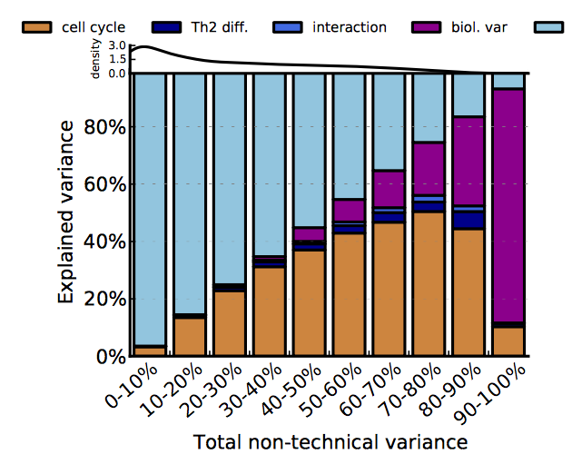
Supplementary Figure 15
For each gene, the proportion of variance explained by cell cycle, T_{H}2 differentiation, a multiplicative interaction between cell cycle and T_{H}2 differentiation as well as technical noise and residual biological variance was estimated.

Slide 21
Caveats & Roadblocks
Need to understand (or atleast have some premonition) of the latent variable(s)
Built up on massive wetlab + bioinformatics research (and not just from scRNA-seq)
Datasets used in this study were from in vitro samples
Several environmental influences in vivo
Formal statistical methods
Currently assume all genes’ expression set follows Gaussian distribution
what is technical noise? Is normalization protocol-specific?
Sample size (number of cells)?

Slide 22
Extensions
Apply latent variable modeling on terminally differentiated cells
For ex., do apoptotis pathways lead to cell-cell heterogeneity in terminally differentiated cells?
Extension of interaction modeling may reveal significant associations between cell processes hitherto understood to be mutually exclusive
Profile tumour heterogeneity
Tumour stem cells
Occam’s razor – is each tumour cell a new subpopulation?
Generate ‘pseudo-temporal’ trajectories
Hematopoetic Stem Cells in Zebrafish – larval stage dependent phenotypes

Slide 23
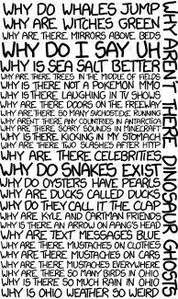
Questions?

Slide 24
ERCC spike-ins
External RNA Controls Consortium
Common set of RNA controls (92 unlabeled, polyadenylated transcripts)
Added to RNA analysis experiment after sample isolation
Ratio of endogenous reads to total number of reads

Slide 25
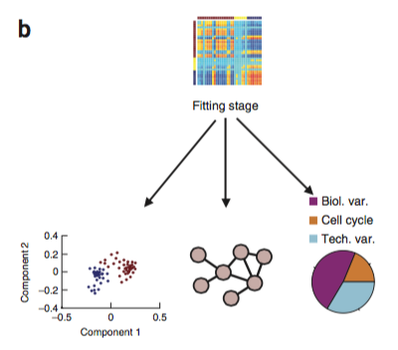
Apply data to model

Slide 26
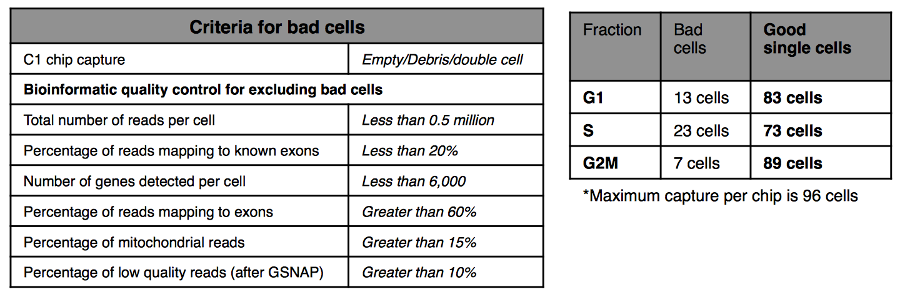
Mouse ESC data Bad Cells Filtering

Slide 27
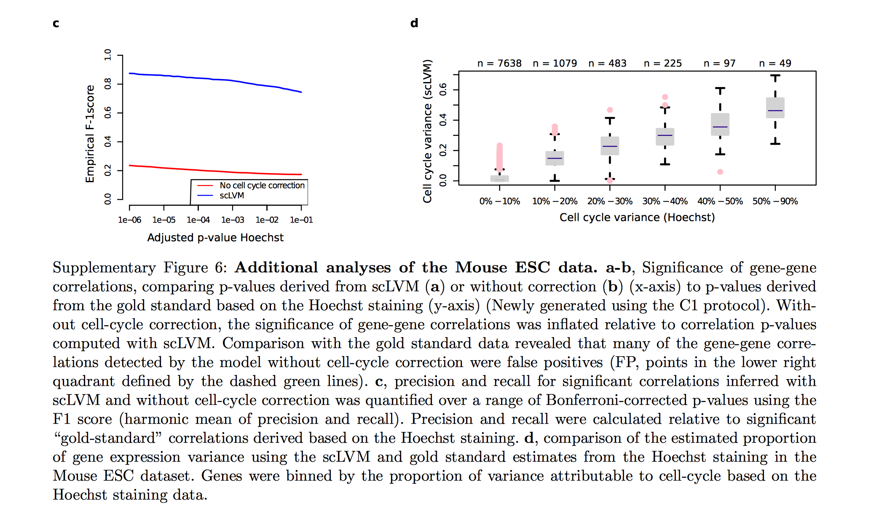
Validation results

Slide 28
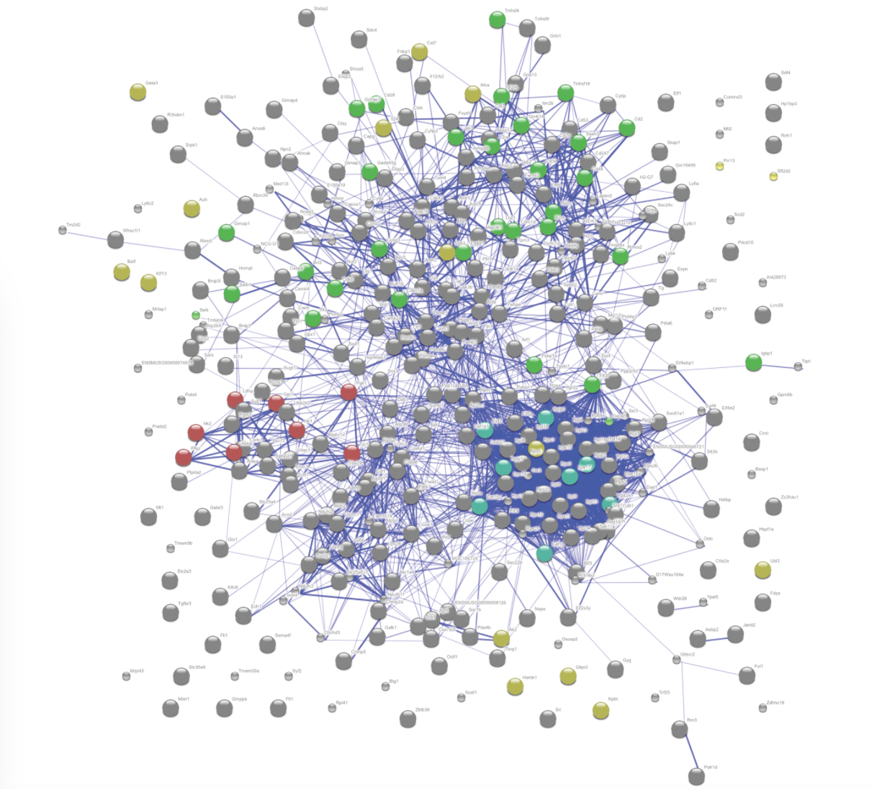
Literature derived networks of genes that are differentially expressed between subpopulations (Supplementary Figure 14)

Slide 29
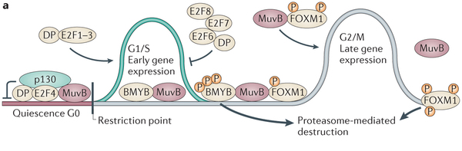
Cell cycle is regulated by multiple(!) genes
Figure 1. The differential regulation of early and late cell cycle gene expression.
Subhashini Sadasivam & James A. DeCaprio. The DREAM complex: master coordinator of cell cycle-dependent gene expression. Nature Reviews Cancer 13, 585-595 (2013)

Slide 30
Experimental Data
Source
scRNA-seq experiment
Mechanical Filters
Pool into G4P (IL-13-GFP⁺) and G2N (IL-13-GFP⁻) groups
Final set
Single Cell RNA-seq
Differentiation of native T cells into T_{H}2 cells
Fluidigm C1 cell sorting (96 asynchronously dividing cells)
Stimulate CD4⁺ T helper cells, sort 4.5 days later
Post-sequencing Filters
Quality Control
Technical Noise Filter
Threshold expression level above technical noise
81 cells
7073 genes
Pool with equal proportion from each group
Notes:
macromolecular Crystallographic Information File

Slide 31
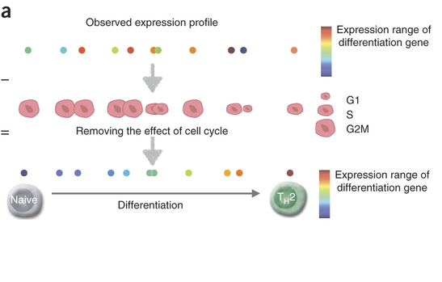

Slide 32
Extensions to current approach
Reduced alphabet set
Learn that through unsupervised clustering analyses
Prediction of co-interacting proteins
Learn about new functional attributes of proteins
Learn about new protein classes?
Multi-class separation using functionally characteristic alphabet sets

Slide 33

Why study single cell heterogeneity
6-7% of eukaryotic proteins are DNA binding¹
Replication, transcription, DNA packaging
Chemotherapy drugs: DNA damaging agents
Identify non-genotoxic DNA binding proteins
CAP is a gene regulatory protein from E.coli. In the absence of the bound protein, this DNA helix is straight.²
1. Kumar et al. Identification of DNA binding proteins using SVMs and evolutionary profiles. 2007, BMC bioinformatics.
2. Molecular Biology of the Cell. 4th edition.
Alberts B, Johnson A, Lewis J, et al.
New York: Garland Science; 2002.

