Slide 1
idna-prot|dis
Critical paper review by
Jasleen Grewal
Ph.D. Student, Steven Jones Lab
Canada’s Michael Smith Genome Sciences Centre

Slide 2
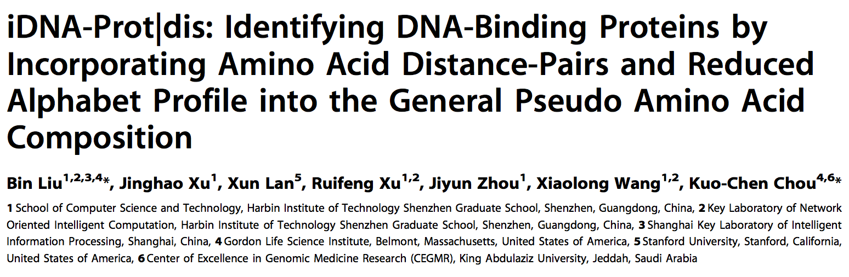
DNA-binding proteins (vs non DNA-binding proteins)
Modification of general pseudo amino acid composition
Classify using Support Vector Machine (SVM)

Slide 3
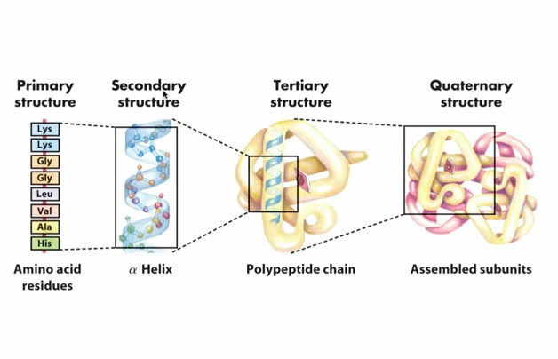
Protein Structure
David L. Nelson, Michael M. Cox. Lehninger Principles of Biochemistry. New York: W. H.Freeman and Company, 2008.

Slide 4
Finding protein sequence & structure
Chromatin Immuno Precipitation
X-ray crystallography
Mass Spectrometry (Nordhoff, 1999)
Machine Learning
Random Forest (DNA-Prot)
Grey Models (iDNA-Prot)
Support Vector Machines (iDNA-Prot|dis)
Ensemble classifiers (nDNA-Prot)

Slide 5
Data
Source
Protein Data Bank (PDB). Dec 2013.
mmCIF keyword “(non) DNA binding protein”
Filters
Keep proteins > 50 residues long
Remove proteins containing residue ‘X’ (unknown)
Final set
525 DNA binding proteins (S⁺)
550 non DNA binding proteins (S⁻)
Remove proteins with sequence similarity > 25% (PISCES)
Notes:
macromolecular Crystallographic Information File

Slide 6
Sequence vs Structure
Protein Structure
Energy state models
Identifying functional domains
Amino Acid Sequence
Sequence evolutionary profiles
Chou’s Pseudo Amino Acid Compositions (PseAAC)
Combination of the two (ex. iDNA-prot)

Slide 7
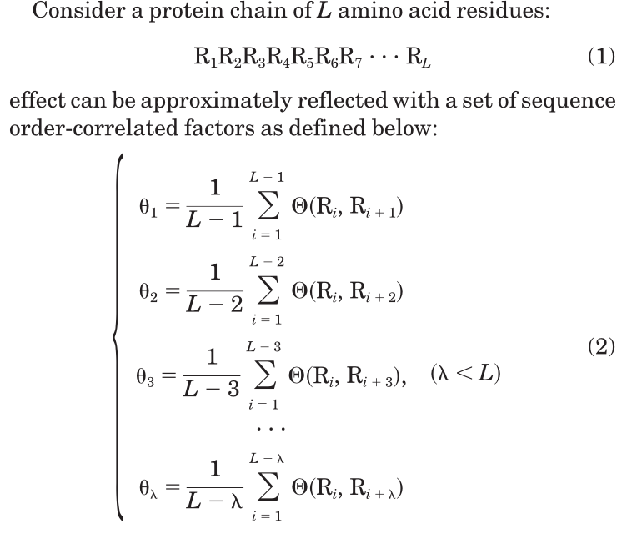
(Good fences make) Good neighbors
Pseudo Amino Acid Compositions
PROTEINS: Structure, Function, and Genetics 43:246-255 (2001)
Notes:
Mending Walls (Robert Frost)

Slide 8
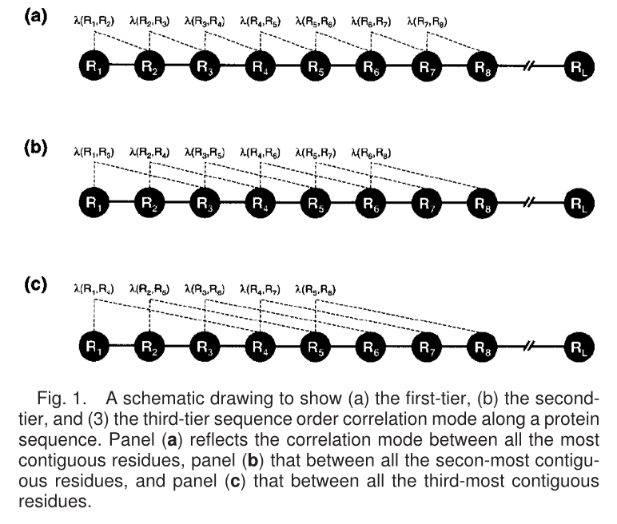
(Good fences make) Good neighbors
Pseudo Amino Acid Compositions
Pairwise Distance
PROTEINS: Structure, Function, and Genetics 43:246-255 (2001)
Notes:
Mending Walls (Robert Frost)

Slide 9
The high dimensionality conundrum
20 Amino Acids
Studying neighbors at distance ‘1’, in a protein of length ‘L’, we get (20 x 20) x (L-1) pairwise comparisons
Average protein length in eukaryotes?
Feature set is massive!
Increased computational time and resources
Redundancy in associations -> Overfitting

Slide 10
Solutions?
Limit scope of classification?
Restrict to a sub-region of proteins – informative?
Reduce the feature vector size?
Use amino acid cluster profiles -> Reduced alphabet

Slide 11
Representative AA cluster profiles
Different proteins have different functions
Functions derived from single amino acids (ex. Lys, Arg)
Functions derived from a cluster of amino acids (ex. Leucine zippers (2 x heptads))
Analyze protein sequence in terms of these ‘function defining’ amino acids
Fewer ‘units’ to compare

Slide 12
Summary - the ‘dis’ in iDNA-Prot|dis
Reduced Amino Acid Alphabets
Clustering of AAs based on some measure of their relative similarity¹
Selected 3 different alphabet profiles for DNA binding proteins (after testing 164 reduced alphabet schemes)¹
cp(13)= {MF; IL; V; A; C; WYQHP; G; T; S; N; RK; D; E}
cp(14)= {EIMV; L; F; WY; G; P; C; A; S; T; N; HRKQ; E; D}
cp(19)= {P; G; E; K; R; Q; D; S; N; T; H; C; I; V; W; YF; A; L; M}
n(c) = x, where x defines cp(x)
New dimension size = n(c) + n²(c)d
when considering max pairwise distance = ‘d’
1. Peterson et al. Reduced Amino Acid Alphabets Exhibit an Improved Sensitivity and Selectivity in Fold Assignment. 2009, Bioinformatics.

Slide 13
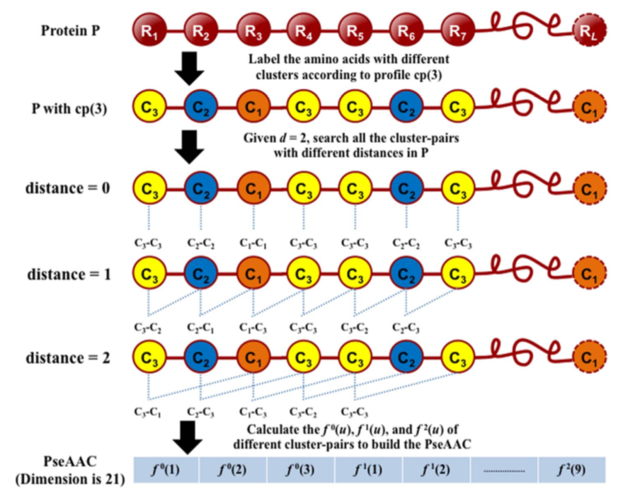
(Fewer = Good?) neighbors
Pseudo Amino Acid Compositions
Pairwise Distance (ex. For n(c) = 3)
doi:10.1371/journal.pone.0106691.g001

Slide 14
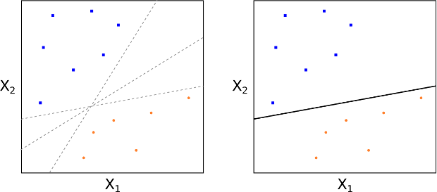
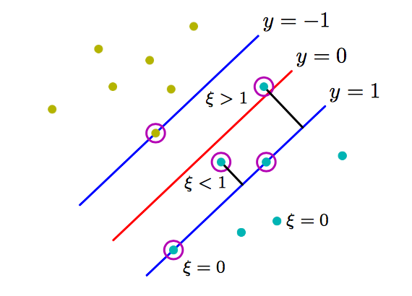
Classification of data - Perceptrons
2 class problem
Minimize error over ‘mis-classified’ examples only
Only classify linearly separable data
CMPT 419 Greg Mori, Simon Fraser University

Slide 15
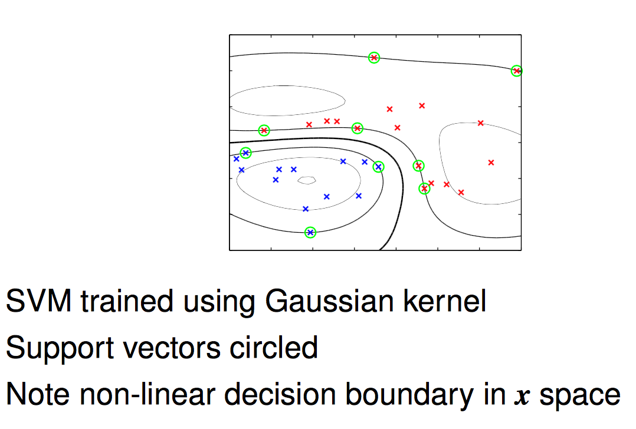
Support Vector Machines
An example of an SVM applied to a non-linear feature space
CMPT 419 Greg Mori, Simon Fraser University

Slide 16
Multiple possible ‘hyperplanes’
Hyperplane with perfect separation
Training dataset

Slide 17
Good Classifier
Learnt optimal hyperplane
Test datapoints
Test dataset 1

Slide 18
Good Classifier
Learnt optimal hyperplane
Test datapoints classified
Test dataset 1

Slide 19
Bad Classifier
Learnt optimal hyperplane
Test datapoints
Test dataset 2

Slide 20
Bad Classifier
Learnt optimal hyperplane
Test datapoints classified
Test dataset 2

Slide 21
Assessing classifier performance
Method to assess predictor
4 metrics (single label systems – right (1), wrong(0))
Sensitivity – Call 1, 1
Specificity – Call 0, 0
Accuracy – Call 1,1; Call 0,0
Mathew’s correlation coefficient
1 : High sensitivity, and High specificity
0 : No different from random prediction
-1 : Total disagreement between prediction and observation

Slide 22
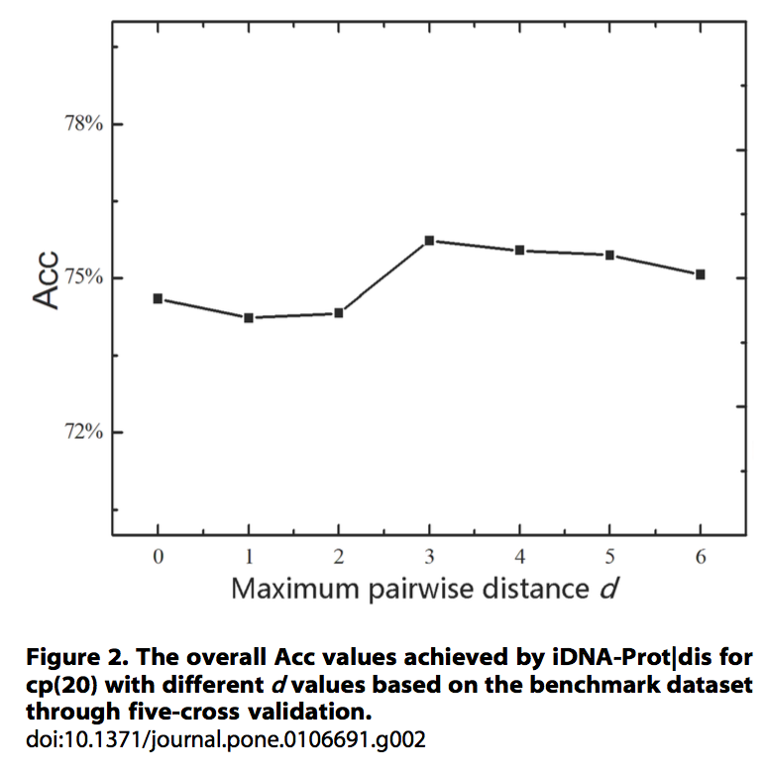
Optimal Maximum Distance ‘d’

Slide 23
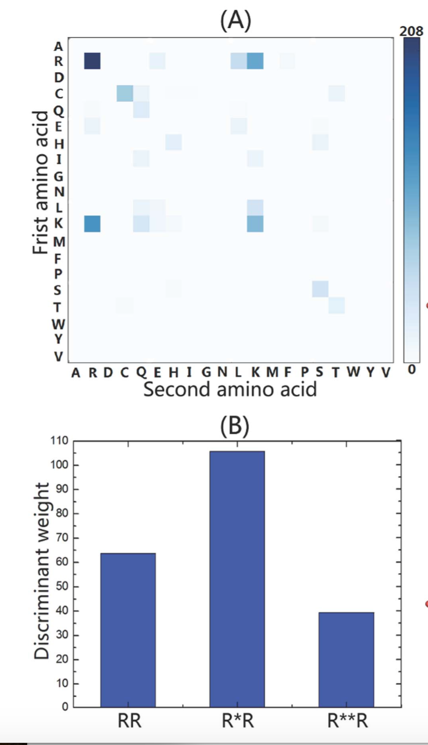
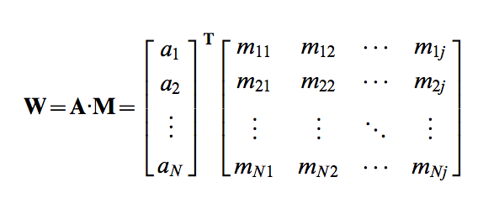
cp(20) with max distance = 3 (400 AA pairs)
N = 1075, j = 1220

Slide 24
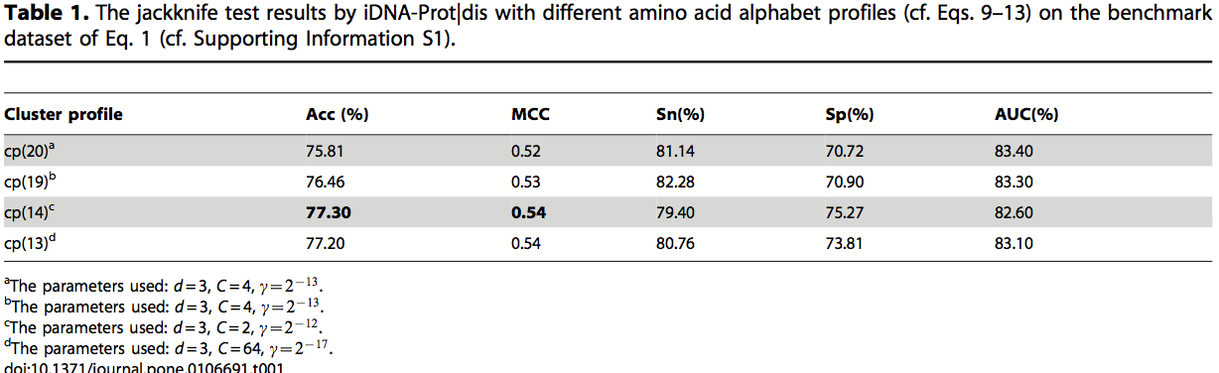
Results – reduced alphabet space
Feature space reduction
cp(20) = 1220 features
cp(14) = 602 features (14+(14²)(3))

Slide 25
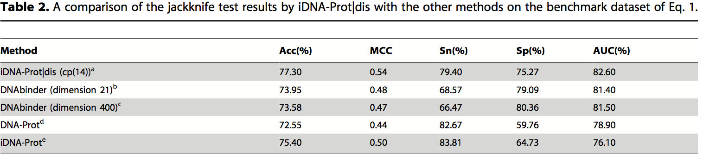
Mirror mirror on the wall…
Comparison with existing methods
Dataset = Benchmark dataset (525 DNABP, 550 non-DNABP)

Slide 26
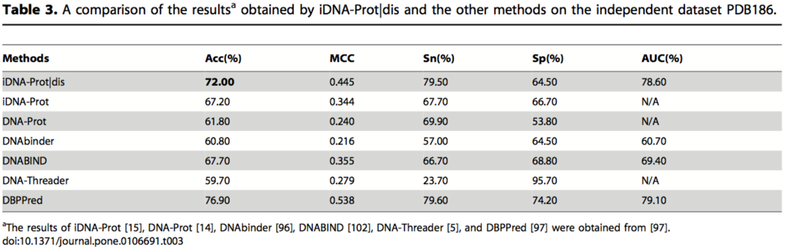
Mirror mirror on the wall…
Comparison with existing methods
Dataset = PDB186 (93 DNABP, 93 non-DNABP)
DBPPred – random forest, with Gaussian naïve Bayes
GB outperformed decision tree, logistic regression, kNN, SVN (polynomial kernel), SVN (RBF kernel).
Trained on PDB594, tested on PDB186
Doi: 10.1371/journal.pone.0086703

Slide 27
Caveats
Works only on well-studied protein functional types
Finding an optimal reduced alphabet set
Other computational tools for getting this set?
Approach works for identifying a single type of protein
Assumption: all amino acid clusters characteristic of ‘protein class X’ being encompassed in the reduced alphabet space

Slide 28
Applications
Current anticancer chemotherapy drugs
DNA damaging agents
Gene regulators!
Non-genotoxic DNA binding proteins
Prevent adverse effects of chemotherapy
Alter DNA plasticity and physico-chemical properties.
Classification of new proteins
Single class differentiation -> multi-class differentiation
Notes:
Alkylation agents, intercalators, anticancer agents like TOPOI,II inhibitors. Y irradiation.
Alter DNA plasticitiy – cisplatin.

Slide 29
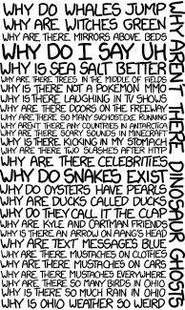
Questions?

Slide 30
Extensions to current approach
Reduced alphabet set
Learn that through unsupervised clustering analyses
Prediction of co-interacting proteins
Learn about new functional attributes of proteins
Learn about new protein classes?
Multi-class separation using functionally characteristic alphabet sets

Slide 31
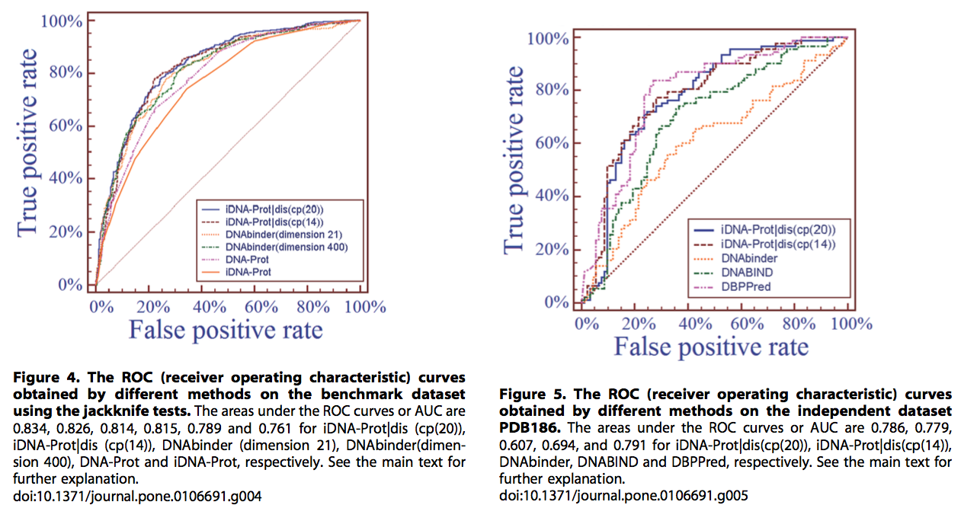
SVM with different feature spaces

Slide 32

Why study DNA binding proteins
6-7% of eukaryotic proteins are DNA binding¹
Replication, transcription, DNA packaging
Chemotherapy drugs: DNA damaging agents
Identify non-genotoxic DNA binding proteins
CAP is a gene regulatory protein from E.coli. In the absence of the bound protein, this DNA helix is straight.²
1. Kumar et al. Identification of DNA binding proteins using SVMs and evolutionary profiles. 2007, BMC bioinformatics.
2. Molecular Biology of the Cell. 4th edition.
Alberts B, Johnson A, Lewis J, et al.
New York: Garland Science; 2002.

Slide 33
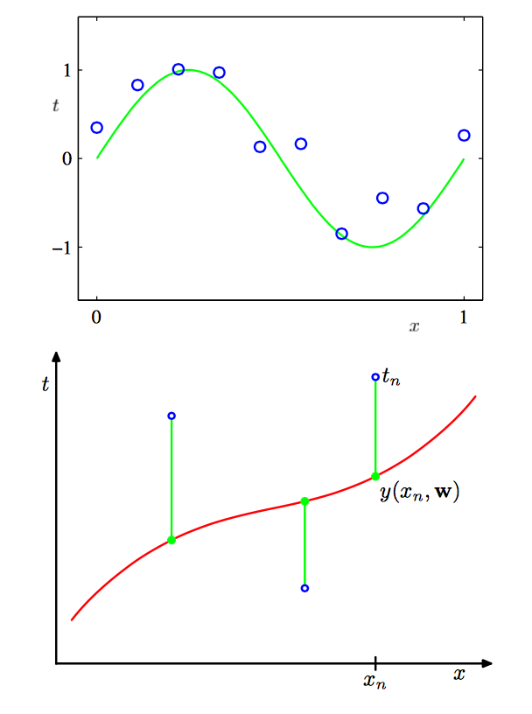
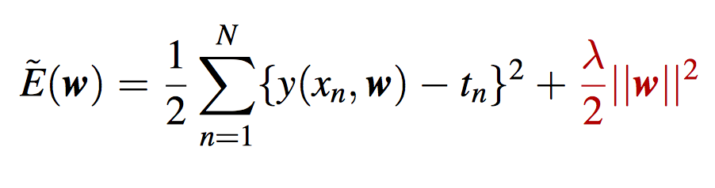
Data points
Have a spread (density distribution)
Optimal fit has an associated error rate
Error calculated as ‘least squares’:

Slide 34
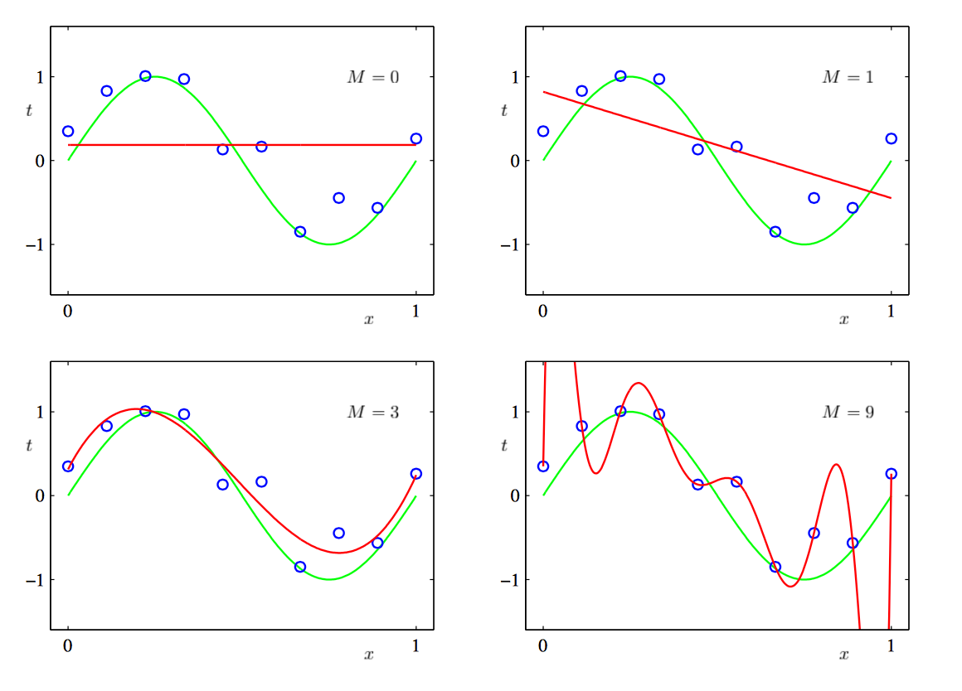
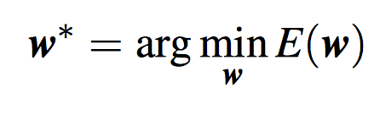
Explaining the data points
Find the best fit for my data, minimize error without getting carried away by the way it looks right now

Slide 35
Preventing over fitting - regularization
Penalize large coefficients
Best coefficients = least error
Least Squares error Regularizer

Slide 36


Kernel Functions
Estimate distribution of data (density differences -> clusters)
Estimate density by placing a tiny ‘bump’ around each datapoint – incorporate inherent variability in datapoint
Kernel function k() determines shape of these bumps
Commonly use (Radial) Gaussian Basis Function (RBF)
Can now specify how ‘similar’ two points are, rather than construct an ‘exact comparison’ for every single pair of points.
CMPT 419 Greg Mori, Simon Fraser University

Slide 37
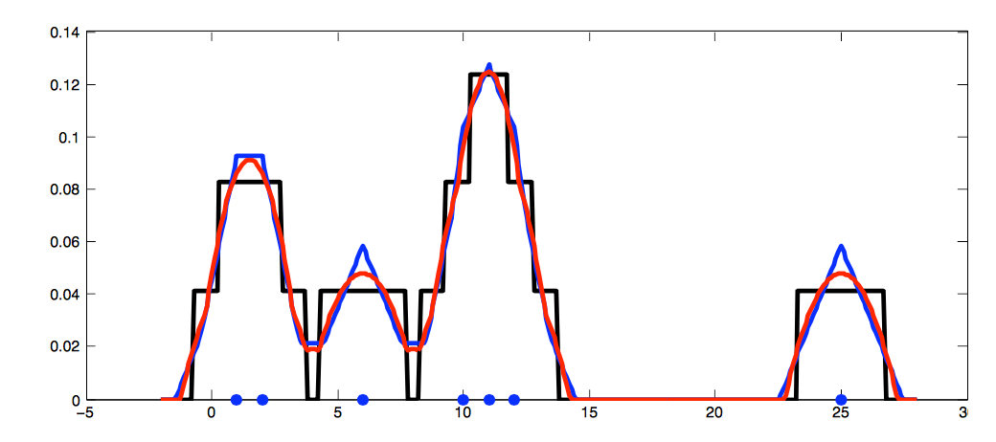
Other types of Kernel Functions
Rectangle, Triangle, Epanechnikov
CMPT 419 Greg Mori, Simon Fraser University

Slide 38
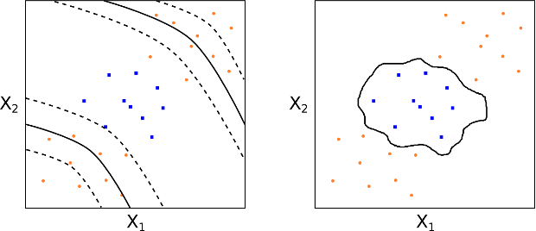
A d-degree polynomial kernel A radial kernel

Slide 39
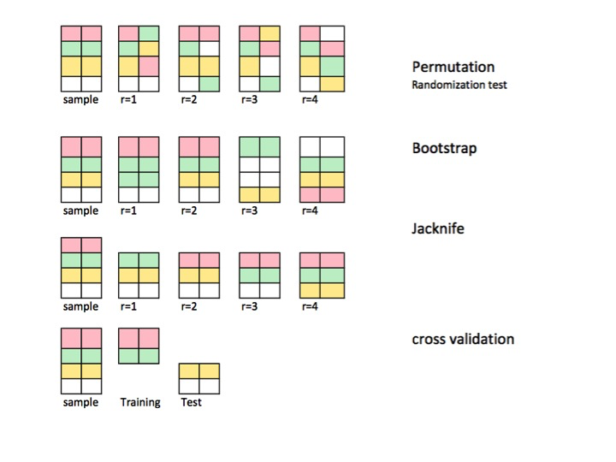
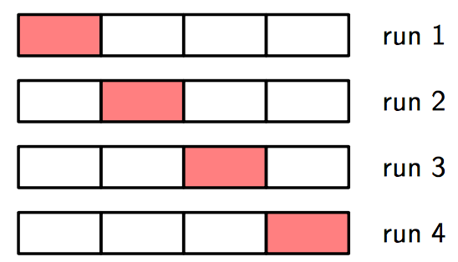
Cross validation - assessing performance
Jackknifing
Bootstrapping
Leave-one-out
Leave-k-out (subsampling)
LOO Cross Validation
Notes:
Training set error is lower with more complex model
http://i.stack.imgur.com/FfXIT.jpg

Slide 40
Regularization – assessing performance
Train complex model but penalize it getting “too complex”
Sweet spot between error and regularization
Can use cross validation to find optimal regularization coefficient (λ)
Prevent overfitting

