Slide 1
Bacterial Genomes
Sequencing and Assembly

Slide 2
Sequencing technologies over the years
Platform | Read length (bp) | Throughput per run | Runtime
Sanger | 1,000 | 100 kb | < 1 day
454 Life Sciences | 1,000 | 500 Mb | 1 day
Illumina HiSeq | 100 | 600 Gb | 11 days
Illumina MiSeq | 300 | 15 Gb | ~ 56 hours
PacBio | 10,000 | 100 Mb | 2 hours
Oxford Nanopore | 7,000 | 500 Mb | Real-time (<48 hours)
Notes:
Paired end data or not?

Slide 3
Bacterial Genomes
130 kbp - 14 Mbp
Permanent draft complete genomes
Genomes Online Database
181 Archaea
3,762 Bacteria
2nd generation sequencing technologies
Rapid and cost-effective genome assemblies
Long repeats, short read lengths mean unfinished, fragmented draft genomes on occasion

Slide 4
Enter 3rd Generation Sequencing Technologies
PacBio (up to 30 kbp long reads)
Oxford Nanopore
High error rates!
Hybrid approaches (short + long reads)
ALLPATHS-LG
PacBio’s corrected reads pipeline
SPAdes
SSPACE-LongRead
Notes:
http://www.nature.com/articles/srep08747

Slide 5
Hybrid approach for de novo assembly?
Reviews (2012-2015)
Long read data combined with short, high accuracy sequences correct inherent errors in long single-moleculre sequences
Overcome risk of missing new synthetic virulent sequences
Long reads produce better assemblies

Slide 6
Suggested route
Celera Assembler (with PBcR pipeline) produced de novo bacterial genome assembly within 30 minutes
Combines long read data with Illumina short-range paired data
Notes:
http://www.nature.com/articles/srep08747

Slide 7
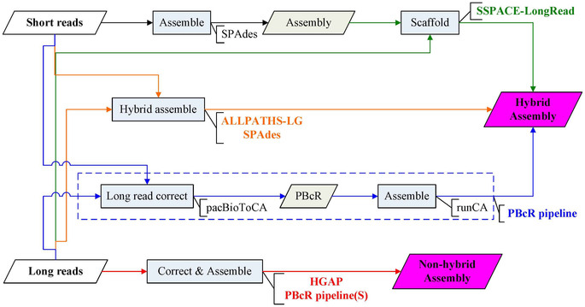
“Completing bacterial genome assemblies: strategy and performance comparisons”
Nature Scientific Reports (5:8747, 2015)

