Slide 1
工程數學--微分方程
Differential Equations (DE)
授課者：丁建均
教學網頁：http://djj.ee.ntu.edu.tw/DE.htm
(請上課前來這個網站將講義印好)
歡迎大家來修課！

Slide 2
課程資訊
上課時間： 星期三 第 3, 4 節 (AM 10:20~12:10)
上課地點： 明達205
(課程將錄影，放在 NTUCool)
課本： "Differential Equations-with Boundary-Value Problem,"
Dennis G. Zill and Michael R. Cullen, 9th edition,
Cengage Learning, 2017.
評分方式：四次作業 15%, 期中考 42.5%, 期末考 42.5%

Slide 3
授課者：丁建均
Office： 明達館723室, TEL： 33669652
Office hour： 週一，二，四，五的下午皆可來找我
老師 E-mail: jjding@ntu.edu.tw
教學網頁：http://djj.ee.ntu.edu.tw/DE.htm
個人網頁：http://disp.ee.ntu.edu.tw/
共同教學網頁： http://cc.ee.ntu.edu.tw/~tomme/DE/DE.html
大助教： 洪聲仰
大助教聯絡方式： shengyang@ntu.edu.tw

Slide 4
注意事項：
本課程採行雙軌制，同學們可以來現場上課，或是可觀看 NTUCool 的影片
請上課前，來這個網頁，將上課資料印好。
http://djj.ee.ntu.edu.tw/DE.htm
(3) 請各位同學踴躍出席 。
(4) 作業不可以抄襲。作業若寫錯但有用心寫仍可以有40%~90% 的分數，但抄襲或借人抄襲不給分。
(5) 每次作業有11題

Slide 5
上課日期
Week Number | Date (Wednesday) | Remark
1. | 9/3
2. | 9/10
3. | 9/17
4. | 9/24: HW1
5. | 10/1
6. | 10/8
7. | 10/15: HW2
8. | 10/22: Midterms | 範圍： (Sections 2-2 ~ 4-5)
9. | 10/29
10. | 11/5
11. | 11/12
12. | 11/19: HW3
13. | 11/26
14. | 12/3
15. | 12/10: HW4
16. | 12/17: Finals | 範圍： (Sections 4-6 ~ 12-4)

Slide 6
課程大綱
Introduction (Chap. 1)
解法 (Chap. 2)
First Order DE
應用 (Chap. 3)
矩陣解 (Chap. 8，範圍外)
解法 (Chap. 4)
Higher Order DE
應用 (Chap. 5，範圍外)
非線性 (Sections 4-10, 5-3, 工數特論)
多項式解法 (Chap. 6)
解法 (Sections 12-1, 12-4)
Partial DE
直角座標 (Chapter 12，工數特論)
圓座標 (Chapter 13，工數特論)
Laplace Transform (Chap. 7 ，範圍外)
Transforms
Fourier Series (Chap. 11)
Fourier Transform (Chap. 14，工數特論)

Slide 7
授課範圍
期中考範圍
Sections 1-1, 1-2, 1-3
Sections 2-1, 2-2, 2-3, 2-4, 2-5, 2-6
Sections 3-1, 3-2
Sections 4-1, 4-2, 4-3, 4-4, 4-5
期末考範圍
Sections 4-6, 4-7
Sections 6-1, 6-2, 6-3, 6-4
Sections 11-1, 11-2, 11-3
Sections 12-1, 12-4
blue colors: 要考的章節

Slide 8
Chapter 1 Introduction to Differential Equations
1.1 Definitions and Terminology (術語)
Differential Equation (DE): any equation containing derivation (text page 3, definition 1.1)
x: independent variable 自變數
y(x): dependent variable 應變數
(2)

Slide 9
Note: In the text book, f(x) is often simplified as f
notations of differentiation
, , , , ………. Leibniz notation
, , , , ………. prime notation
, , , , ………. dot notation
, , , , ………. subscript notation

Slide 10
(3) Ordinary Differential Equation (ODE):
differentiation with respect to one independent variable
(4) Partial Differential Equation (PDE):
differentiation with respect to two or more independent variables

Slide 11
(5) Order of a Differentiation Equation: the order of the highest derivative in the equation
7th order
2nd order

Slide 12
(6) Linear Differentiation Equation:
(i) For y, only the terms appear.
(ii) All of the coefficient terms a_{m}(x) m = 1, 2, …, n are independent of y.
Property of linear differentiation equations:
If
and y₃ = by₁ + cy₂, then
(if y(x) is treated as the input and g(x) is the output)

Slide 13
(7) Non-Linear Differentiation Equation

Slide 14
[Example 1.1.2]
Linear and Nonlinear ODEs
(a) The equations
are, in turn, linear first-, second-, and third-order ordinary differential equations. We have just demonstrated that the first equation is linear in the variable y by writing it in the alternative form 4xy’ + y = x.
(b) The equations
are examples of nonlinear first-, second-, and fourth-order ordinary differential equations, respectively.
nonlinear term:
coefficient depends on y
nonlinear term:
nonlinear function of y
nonlinear term:
power not 1

Slide 15
(8) Explicit Solution (text page 8)
The solution is expressed as y = φ(x)
(9) Implicit Solution (text page 8)
Example: ,
Solution: (implicit solution)
or (explicit solution)

Slide 16
1.2 Initial Value Problem (IVP)
A differentiation equation always has more than one solution.
for ,
y = x, y = x+1 , y = x+2 … are all the solutions of the above differentiation equation.
General form of the solution: y = x+ c, where c is any constant.
The initial value (未必在 x = 0) is helpful for obtain the unique solution.
and y(0) = 2 y = x+2
and y(2) =3.5 y = x+1.5

Slide 17
The k^{th} order linear differential equation usually requires k independent initial conditions (or k independent boundary conditions) to obtain the unique solution.
solution: y = x²/2 + bx + c,
b and c can be any constant
y(1) = 2 and y(2) = 3
y(0) = 1 and y'(0) =5
y(0) = 1 and y'(3) =2
For the k^{th} order differential equation, the initial conditions can be 0th ~ (k–1)^{th} derivatives at some points.
(boundary conditions，在不同點) (10)
(initial conditions ，在相同點) (11)
(boundary conditions，在不同點)

Slide 18
1.3 Differential Equations as Mathematical Model
Physical meaning of differentiation:
the variation at certain time or certain place
[Example 1]:
x(t): location, v(t): velocity, a(t): acceleration
F: force, β: coefficient of friction, m: mass

Slide 19
[Example 2]: 人口隨著時間而增加的模型
A: population
人口增加量和人口呈正比

Slide 20
[Example 3]: 開水溫度隨著時間會變冷的模型
T: 熱開水溫度,
T_{m}: 環境溫度
t: 時間

Slide 21
大一微積分所學的：
的解
例如：
Example:
Problems
(1) 若等號兩邊都出現 dependent variable (如 pages 19, 20 的例子)
(2) 若 order of DE 大於 1 (如 page 18 的例子)
該如何解？

Slide 22
Review
dependent variable and independent variable
DE
PDE and ODE
Order of DE
linear DE and nonlinear DE
explicit solution and implicit solution
initial value; boundary value
IVP

Slide 23
Chapter 2 First Order Differential Equation
2-1 Solution Curves without a Solution
Instead of using analytic methods, the DE can be solved by graphs (圖解)
slopes and the field directions:
y-axis
the slope is f(x₀, y₀)
(x₀, y₀)
x-axis

Slide 24
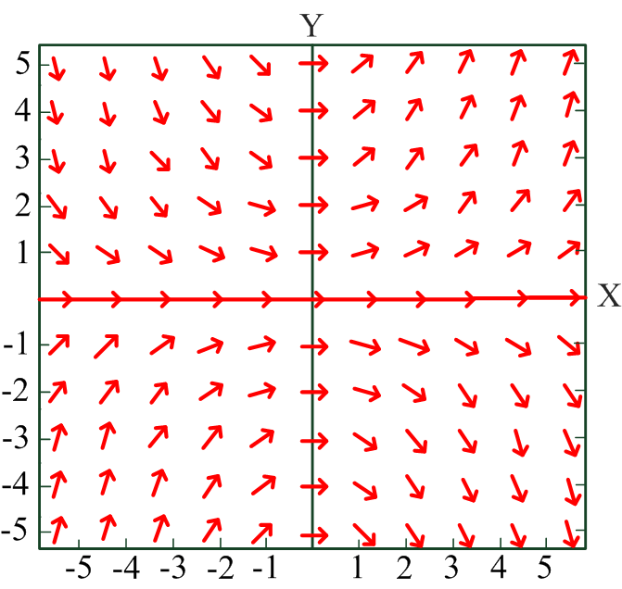

Example 1 dy/dx = 0.2xy
if
y(0) = 2
if
y(0) = -1
From： Fig. 2-1-3(a) in “Differential Equations-with Boundary-Value Problem”, 9th ed., Dennis G. Zill and Michael R. Cullen.

Slide 25
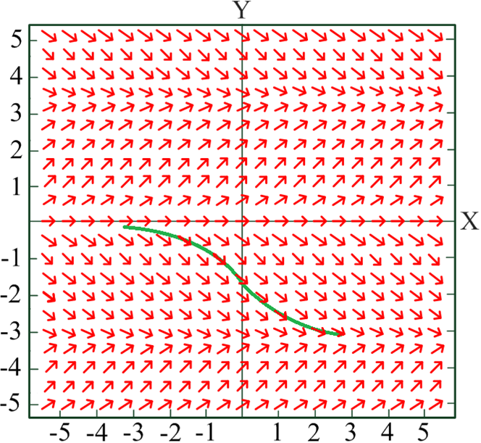
Example 2 dy/dx = sin(y), y(0) = –3/2
With initial conditions, one curve can be obtained
From： Fig. 2-1-4 in “Differential Equations-with Boundary-Value Problem”, 9th ed., Dennis G. Zill and Michael R. Cullen.

Slide 26
Advantage:
It can solve some 1st order DEs that cannot be solved by mathematics.
Disadvantage:
It can only be used for the case of the 1st order DE.
It requires a lot of time

Slide 27
Section 2-6 A Numerical Method
Another way to solve the DE without analytic methods
independent variable x x₀, x₁, x₂, …………
Find the solution of
Since approximation
sampling(取樣)
前一點的值
取樣間格

Slide 28

$If y\left(x_{0}\right)$ is known
:
:
:
:

Slide 29
Example:
dy(x)/dx = 0.2xy y(x_{n+1}) = y(x_{n}) + 0.2x_{n} y(x_{n} )*(x_{n+1} –x_{n}).
dy/dx = sin(x) y(x_{n+1}) = y(x_{n}) + sin(x_{n})*(x_{n+1} –x_{n}).
後頁為 dy/dx = sin(x), y(0) = –1,
(a) x_{n+1} –x_{n} = 0.01, (b) x_{n+1} –x_{n} = 0.1,
(c) x_{n+1} –x_{n} = 1, (d) x_{n+1} –x_{n} = 0.1, dy/dx = 10sin(10x) 的例子
Constraint for obtaining accurate results:
(1) small sampling interval (2) small variation of f(x, y)

Slide 30
Blue line: analytic solution; pink line: numerical solution
(a)
(b)
(c)
(d)

Slide 31
Advantages
-- It can solve some 1st order DEs that cannot be solved by mathematics.
-- can be used for solving a complicated DE (not constrained for the 1st
order case)
-- suitable for computer simulation
Disadvantages
-- numerical error (數值方法的課程對此有詳細探討)

Slide 32
附錄一 Table of Integration
1/x | ln|x| + c
cos(x) | sin(x) + c
sin(x) | –cos(x) + c
tan(x) | –ln|cos(x)| + c
cot(x) | ln|sin(x)| + c
a^{x} | a^{x}/ln(a) + c
x e^{ax}
x² e^{ax}

Slide 33
Exercises for Practicing
(not homework, but are encouraged to practice)
1-1: 1, 13, 19, 23, 37
1-2: 3, 13, 21, 33
1-3: 2, 7, 28
2-1: 1, 13, 25, 33
2-6: 1, 3

