Slide 1
冷凍空調自動控制
- 自控系統設計實例
李達生

Slide 2
Focusing here…
概論
  自動控制理論發展
  自控系統設計實例
  Laplace Transform
自動控制理論
  系統穩定度分析
  系統性能分析
  PID Controller
冷凍空調自動控制
  控制系統範例
  控制元件作動原理
  控制系統除錯
自動控制實務
  節能系統控制
  訊號擷取系統
  訊號雜訊處理
  快速溫控系統

Slide 3
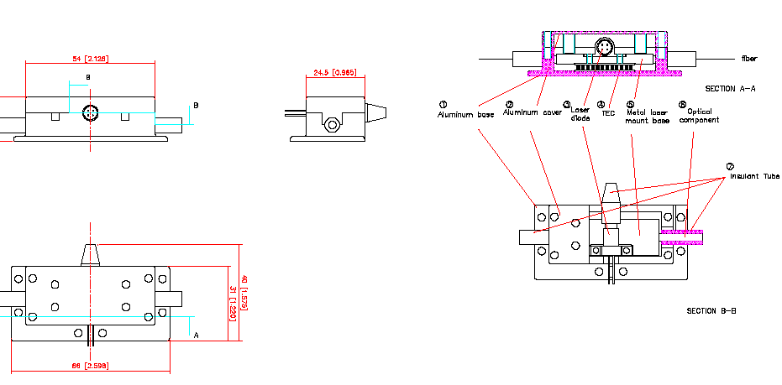
Power Consumption
Traditional Design
New Design
Diode
Laser
Signal Output
DWDM
Signal Monitoring
With the same stability, power consumption just half of the traditional one.

Slide 4
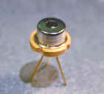
Temperature Effects on
Laser Diode
Wavelength Shift ~ 0.3 nm/ ºC
High Precision Temperature Control is Necessary
Beam Point Stability
~ 1 mrad/ ºC
TEC Thermal Control Module is Widely Employed
0.01 ºC Temperature Control is Achievable but Expensive

Slide 5
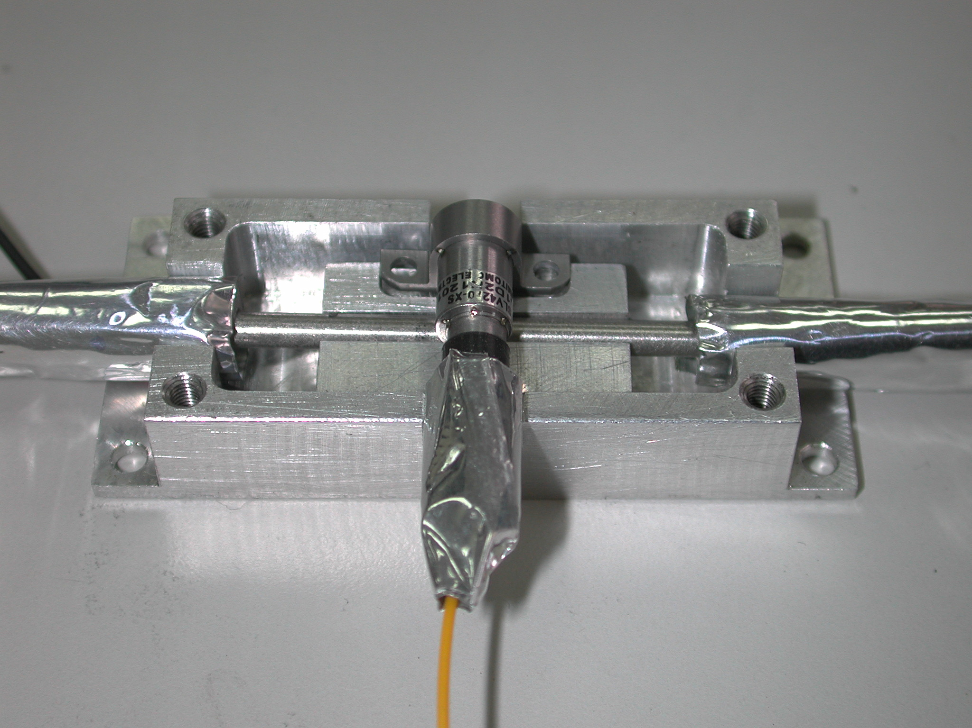
Control for Optical Fiber Communication
多波分工器(DWDM, Dual Wavelength Demultiplex Module)
與半導體雷射(Diode Laser)訊號源整合溫控系統模組之設計

Slide 6

System Modeling
Radiation
Signal Output
Shielding
T
TEC
Signal Monitoring
P
The dominate heat transfer is Radiation
P : TEC (Thermal Electric Cooler) 功率控制
T :光通訊模組溫度

Slide 7
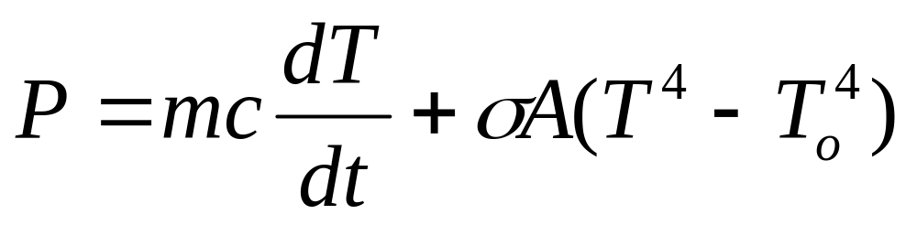
System Modeling
mc : 光通訊模組質量與比熱
P : TEC (Thermal Electric Cooler) 功率控制
該值並已減去光通訊模組額定發熱量
T : 光通訊模組溫度
To: 環境溫度

Slide 8
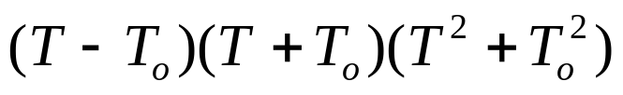
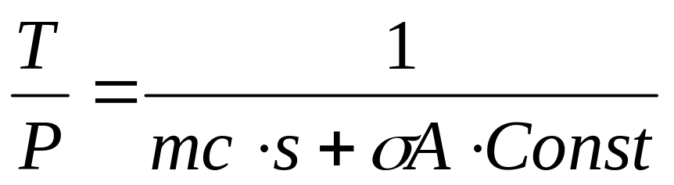
System Modeling
Const
Set T(t) = T(t)-To
We got
0
Open Loop
Transfer Function

Slide 9
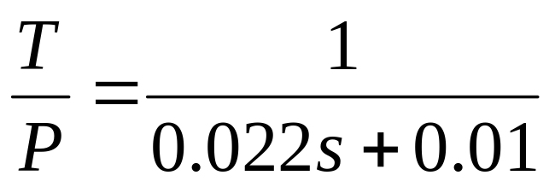
Controller Design
Assuming Aluminum material
A proportional and Integral controller can easily achieve robust control
P
e
a
T
K_{p} + K_{I}/s
Plant
b

Slide 10
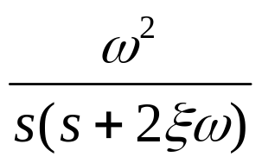
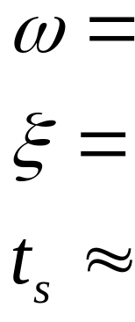
Ideal System Performance
P
e
T
b
0.63
0.37 (under damping)
Steady State Error less than 1% ~ 0.1 degC
20 sec

Slide 11
Real System Requirement
+/-0.2 degC
P
e
T
Stable in 0.01 degC
b
The target can’t be achieved by the traditional control method!!

Slide 12
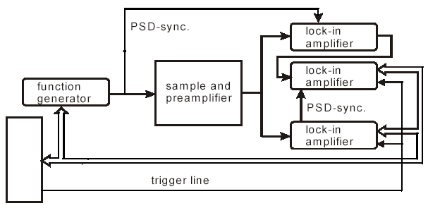
Direct 1/f Noise Spectral Density Control
MCU
I2C Bus
PI Control can achieve relative stable after t_{s} stable time. Then the 0.01 degC control will follow the Impulse Response generate noise power spectrum density

Slide 13
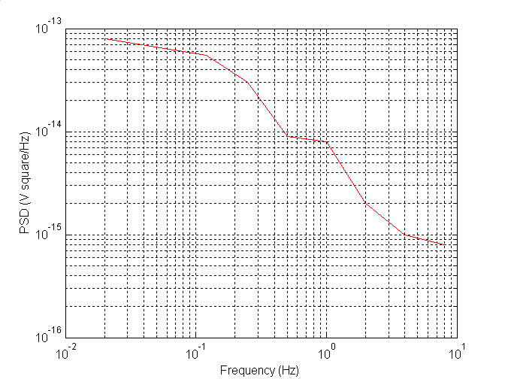
Noise Spectral Density Control
MCU
I2C Bus
According to the spectral density, nano degC resolution could be possible. However, limited by the A/D, 10⁻³ degC resolution is obtained.

Slide 14
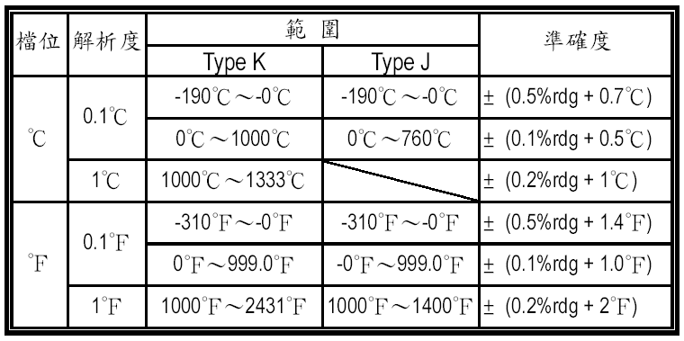
結論
實際測試結果由於作為量測基準之熱電偶精度不足，無法證實溫控系統可達成 +/- 0.01 ºC之測試規範

Slide 15
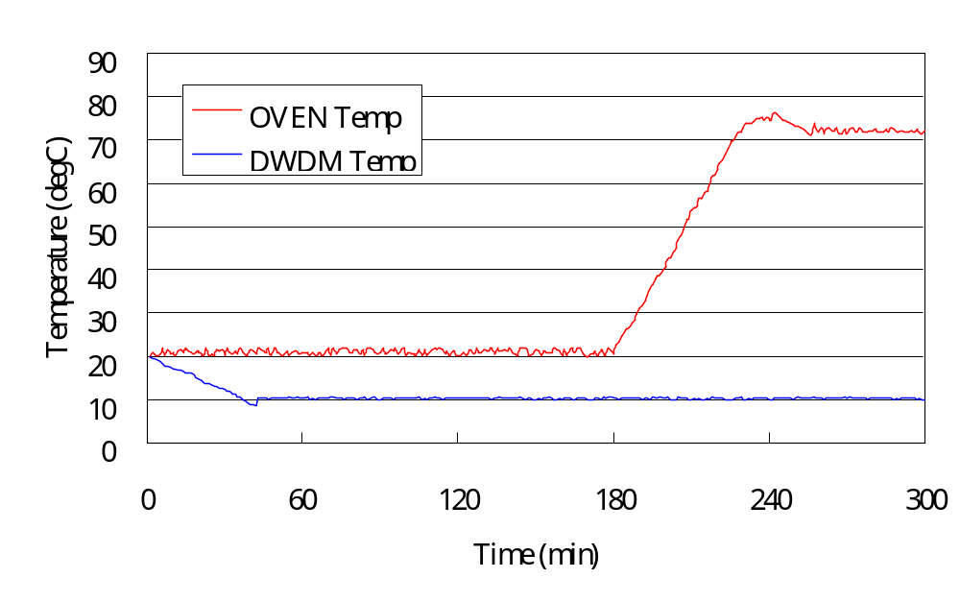
結論
經三小時穩定溫控，熱電偶讀數波動始終低於其額定噪音範圍內，應可視為溫控系統能達成控制要求

Slide 16
結論
Power Spectral Density Control Method is the useful method for over spec accurate control
光通訊設備溫控系統在合理節能設計下，可能於不外加強制冷卻系統下，即能穩定操作，使整體設備之可靠度提升以符合通訊局端設備之要求

