Slide 1
強健控制設計使用MATLAB
李達生

Slide 2
強健控制
在1980年代後期，許多控制理論針對以上雜訊干擾問題，提出解決的方案，主要理論有Mu Analysis、LQG (Linear Quadratic Gaussian) Controller Design及H∞ Theory
這些理論都植基於所有可能之不確定性小於一穩定值，綜合所有不確定度，設計一回授 k 值滿足系統不確定之操控
本章節將以Matlab模擬，實際說明LQG Controller Design以及H∞ Controller Design

Slide 3
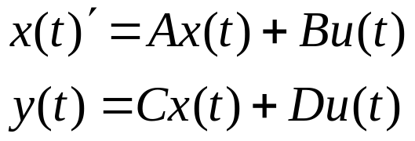
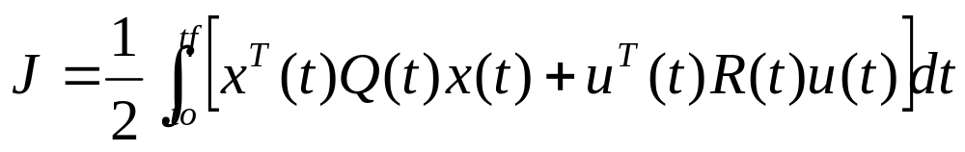
LQ Problem
System in State Space can be expressed by
The optimized control system design can be indicated by the index respect to the input u(t)
For any input u(t), select Q and R to get the minimum J value. It’s so called LQ problem

Slide 4
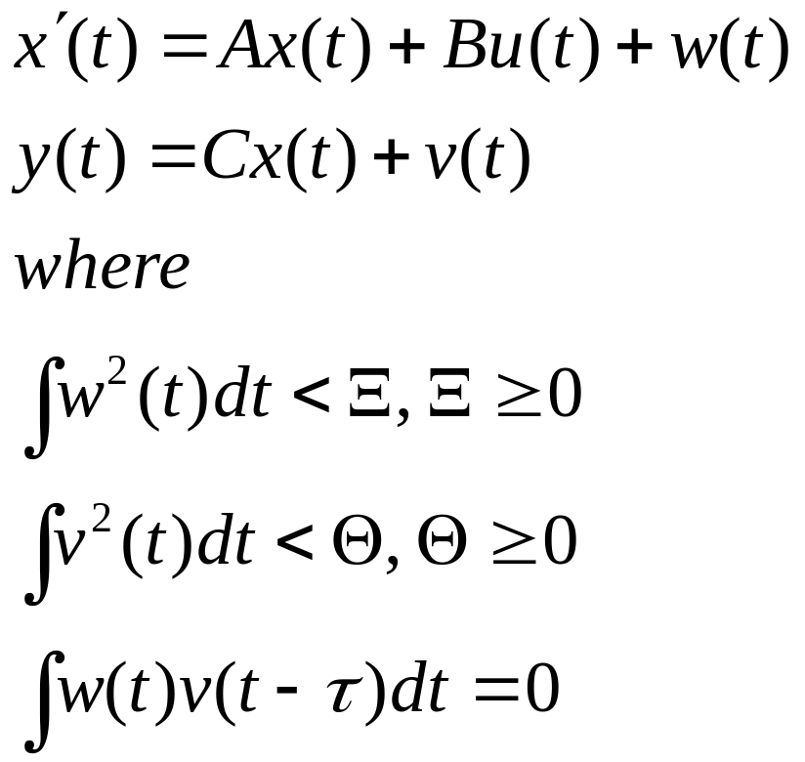
LQG Problem
LQG (Linear Quadratic Gaussian) problem can be described as

Slide 5

LQG Controller
System Noise w(t)
u
LQG Controller F(s)
B
System
C(Is-A) ⁻¹
Y
Sensor Noise v(t)
B
Kf
X’
∫
X
-Kc
u
A
C

Slide 6
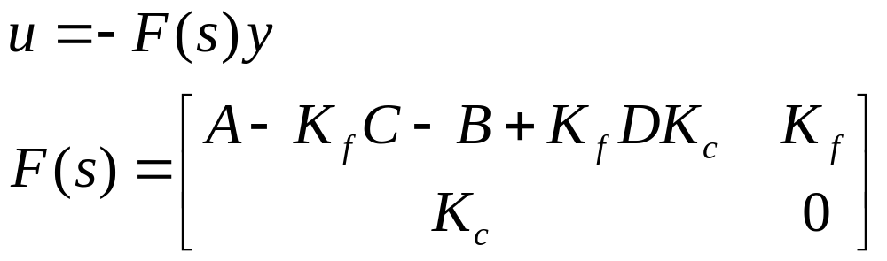

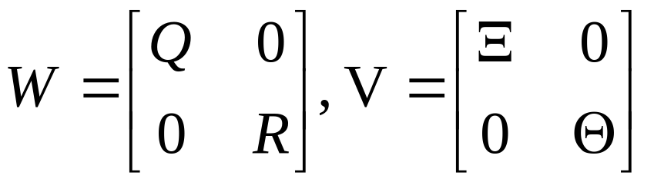
Design a LQG Controller by Matlab
Based on the controller structure, the value Kc and Kf can be determined as
Optimized matrix W and noise matrix V are specified by

Slide 7
Design a LQG Controller by Matlab
Using Matlab index lqg(A,B,C,D,W,V), the optimized LQG controller design can be determined
Calculation example from 俞克維 “控制系統分析與設計使用Matlab”

Slide 8
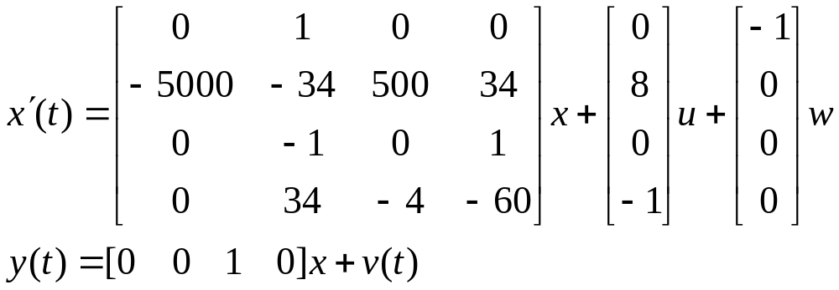
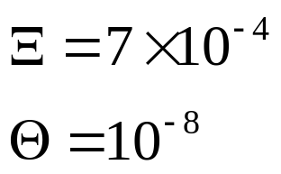
Design a LQG Controller by Matlab
A known system has the state space model as
The LQG controller can be designed by the following!

Slide 9
LQG Controller Design Program
>> [Af,Bf,Cf,Df]=lqg(A,B,C,D,W,V)
Af =
1.0e+004 *
0 0.0001 -0.0099 0
-0.7024 -0.0305 7.5821 0.0359
0 -0.0001 -0.0136 0.0001
0.0253 0.0068 -0.3899 -0.0101
Bf =
1.0e+004 *
0.0099
-1.3169
0.0136
-0.3874
Cf =
1.0e+003 *
0.2530 0.0339 -7.7690 -0.0406
Df =
0
>> figure;
To get started, select "MATLAB Help" from the Help menu.
>> A=[0 1 0 0; -5000 -34 500 34; 0 -1 0 1;0 34 -4 -60];
>> B=[0 8 0 -1]';
>> C=[0 0 1 0];
>> D=0;
>> G=ss(A,B,C,D); %State Space Transfer
>> BB=[-1 0 0 0]; %Noise Coefficeint
>> Q=diag([6000 0 60000 1]); %Q matrix
>> R=0.001;
>> aikxi=7e-4;
>> theta=1e-8;
>> W=[Q,zeros(4,1);zeros(1,4),R];
>> V=[aikxi 0 0 0 0;0 0 0 0 0; 0 0 0 0 0; 0 0 0 0 0; 0 0 0 0 theta];

Slide 10
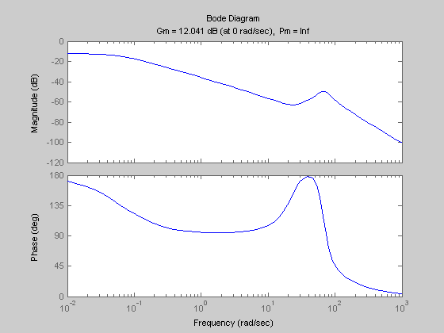
LQG Controller Results-1

Slide 11
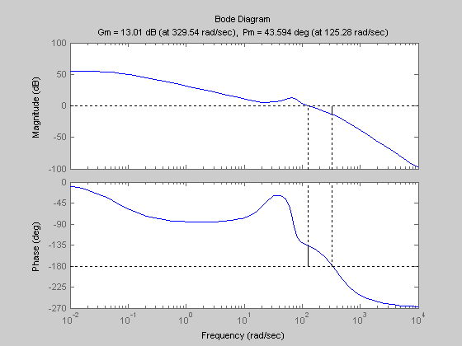
LQG Controller Results-2

Slide 12
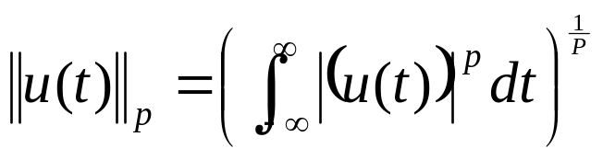
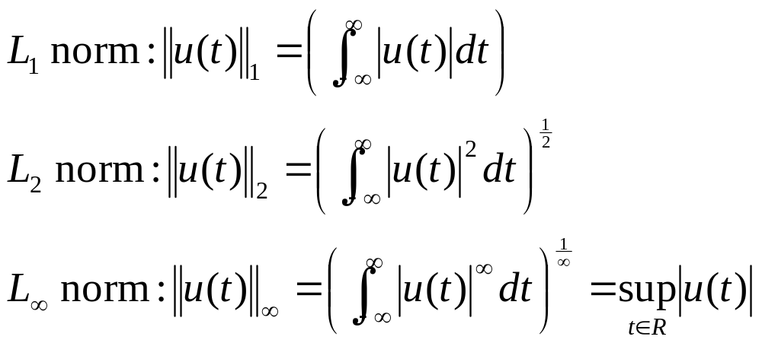
L₁, L₂ and L∞
定義連續變數 x(t) 的norm值為
常用norm的定義有

Slide 13
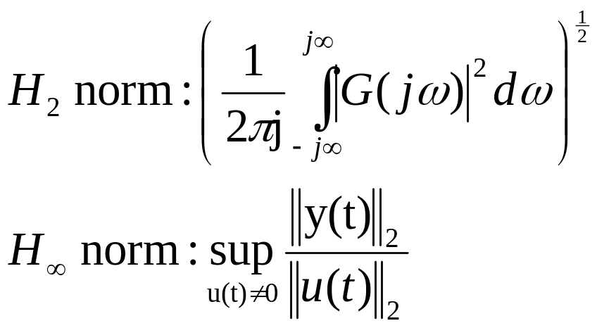
The norm of a Matrix
當控制系統有一轉移函數 G(s) 時，其norm值定義為
H₂定義代表了系統在Impulse Function響應下的噪音均方根，而H∞則是全頻響應的噪音能量

Slide 14
H∞ Controller Design Problem
在求取 H∞ 值最小的過程中，取得了對系統全頻干擾的最小靈敏度，因此 H∞ Controller Design 純粹在於取得一靈敏度最小化系統
Noise
K
System
u
Y

Slide 15
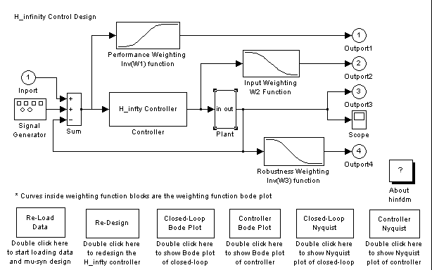
H∞ Controller Design Example

