Slide 1
數位控制設計使用MATLAB
李達生

Slide 2
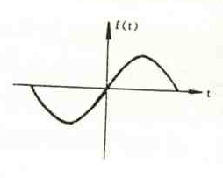
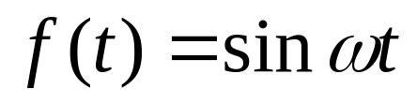
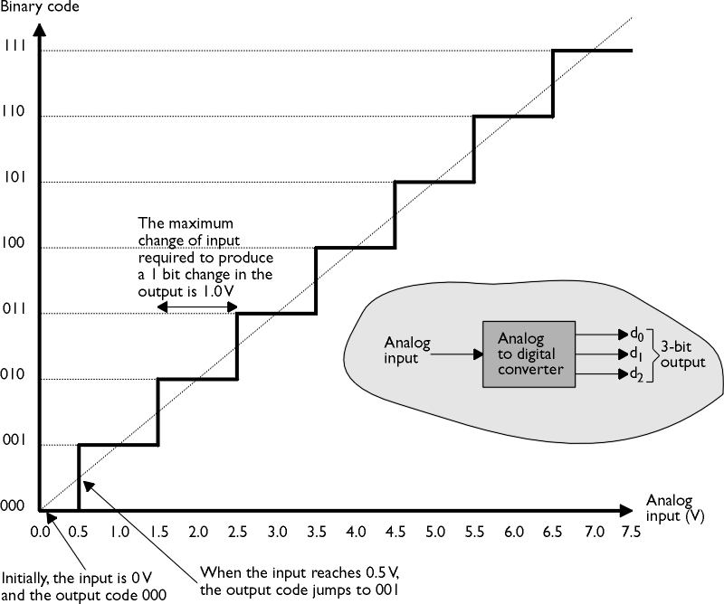

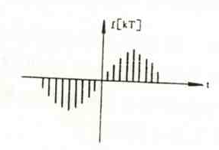
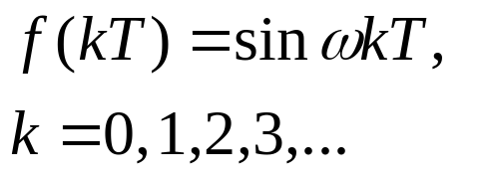
Continuous Signal, Discrete Signal and Digital Signal
f(t) =
0000
0001
0010
0011
….
Sampling
ADC

Slide 3
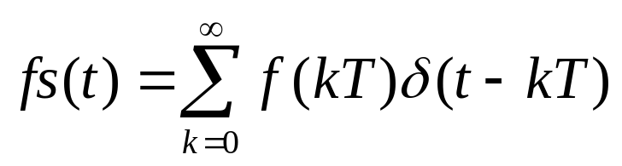
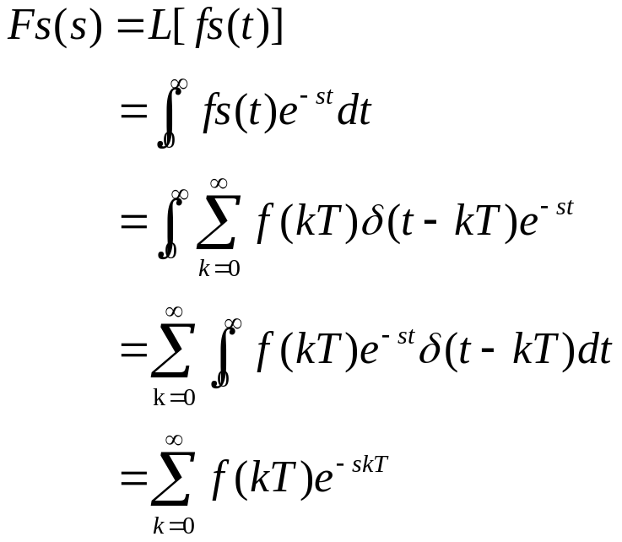
Z Transform v.s. Laplace Transform
For a discrete signal
Laplace Transform can be written as

Slide 4
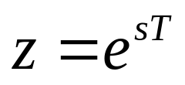
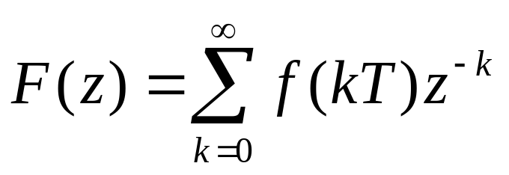
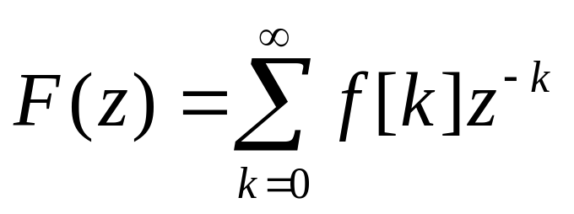
Z Transform v.s. Laplace Transform
If we define
The Z transform can be expressed as
For a sampling time equals to 1 sec, Z transform can be expressed as

Slide 5
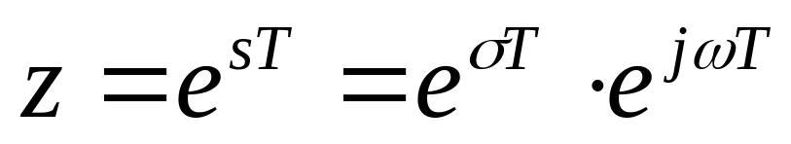
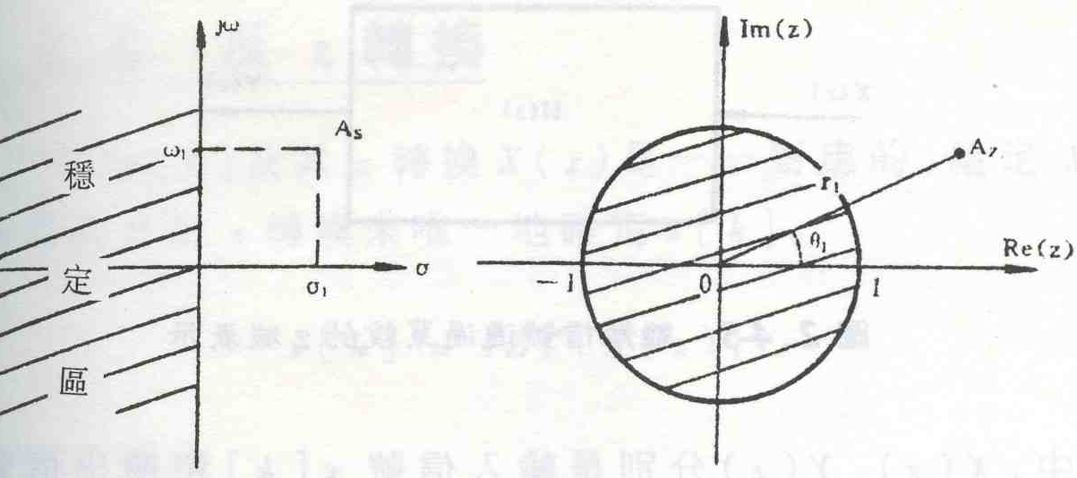
Z Transform mapping

Slide 6
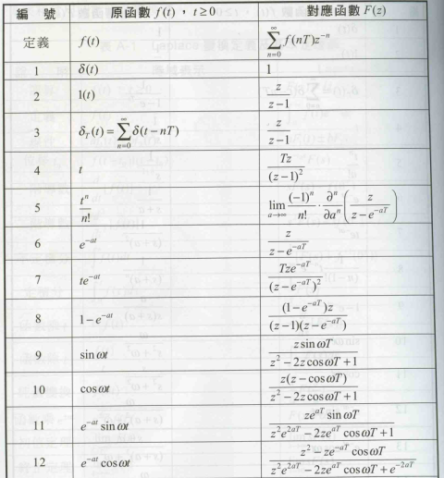
Z Transform

Slide 7
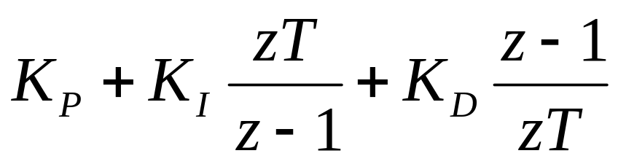
PID controller in Z domain
A PID controller can be expressed in Z domain by
T is the sampling time. i.e. the control performance can be influenced by sampling time

Slide 8
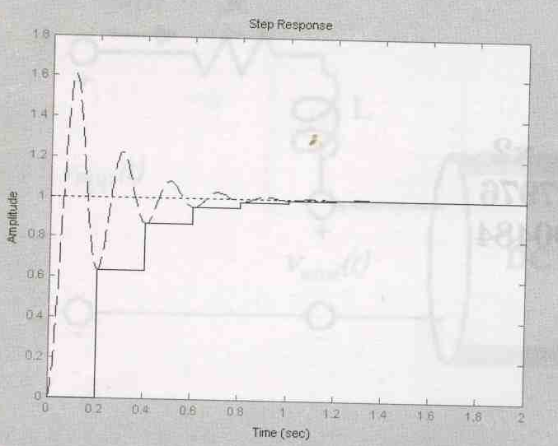
PID controller in Z domain

Slide 9
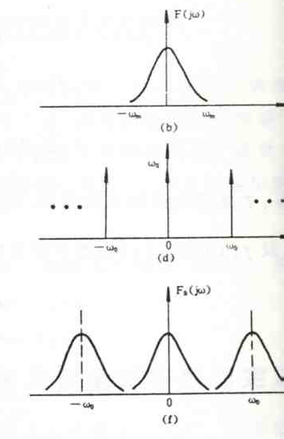
Nyquist sampling frequency
The sampling frequency should exceed the signal frequency at least two times.
The frequency is called Nyquist Frequency

Slide 10
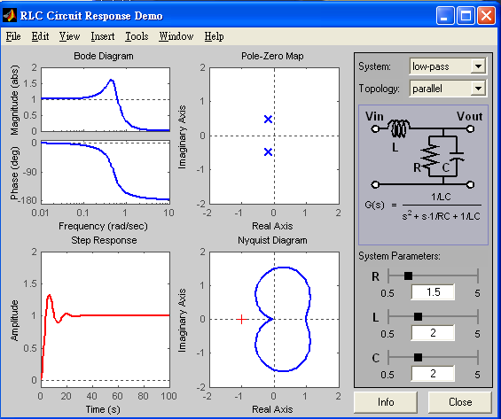
RLC Circuit Response Design

Slide 11
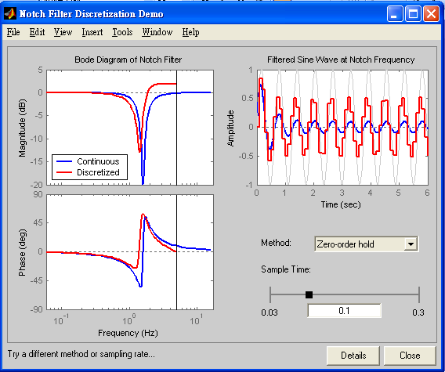
Sampling and Notch Filter

Slide 12
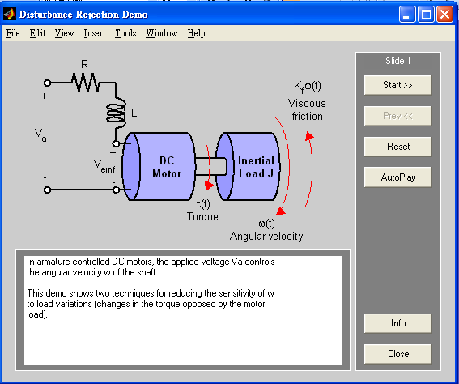
DC Motor Control

