Slide 1
Programming for Windows
OpenGL
周國和 2005.10.01

Slide 2
Main Items
OpenGL Introduction
3D Graphics
Visual C++ 6.0 Introduction
Rendering with OpenGL
Basic Function
Advanced Function

Slide 3
OpenGL Introduction

Slide 4

What OpenGL ?
3D Graphics Library
By Silicon Graphics Incorporated in the year 1992
Software Interface for Graphics Hardware

Slide 5
Why OpenGL ?
Device independence
Cross-platform portability
Simple, easy to learn
Powerful, flexible feature set
Performance
many tools and resources already available

Slide 6
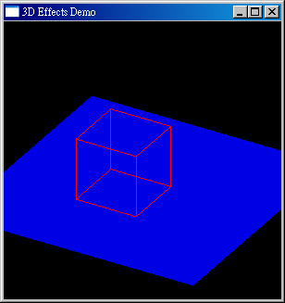

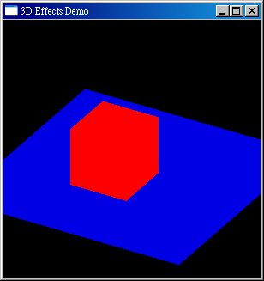
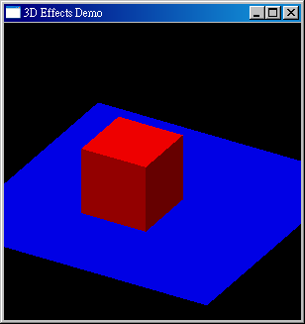
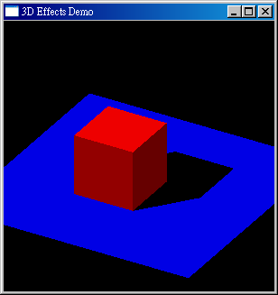
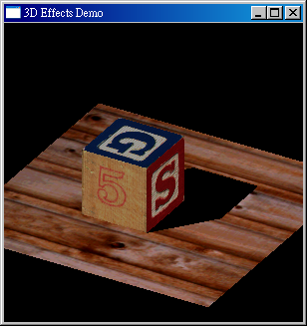
What Can OpenGL Do ?
Drawing Points、Lines 、Polygons 、Curves 、 Surface
Shading 、 Lighting
Texture mapping
Antialiasing
Blending & Tranparency
Fog
Motion blur
Almost everything in 3D graphics !!

Slide 7
How OpenGL Works
Generic Implementations
Application Program
OpenGL
GDI
Software
Rasterizer
Display

Slide 8
How OpenGL Works
Accelerated Implementations
Application Program
OpenGL
GDI
Hardware
Driver
Display

Slide 9
Support on Windows
Main Library (gl-)
  gl.h 、opengl32.lib 、 opengl32.dll
Utility Library (glu-)
  gul.h 、 glu32.lib、 glu32.dll
Auxiliary Library (glut-)
  glut.h 、 glut32.lib、 glut32.dll
Binding GDI & OpenGL (wgl-)
C:\Program Files\Microsoft Visual Studio\VC98\Lib
C:\Program Files\Microsoft Visual Studio\VC98\Include\GL
C:\WINDOWS\system32

Slide 10
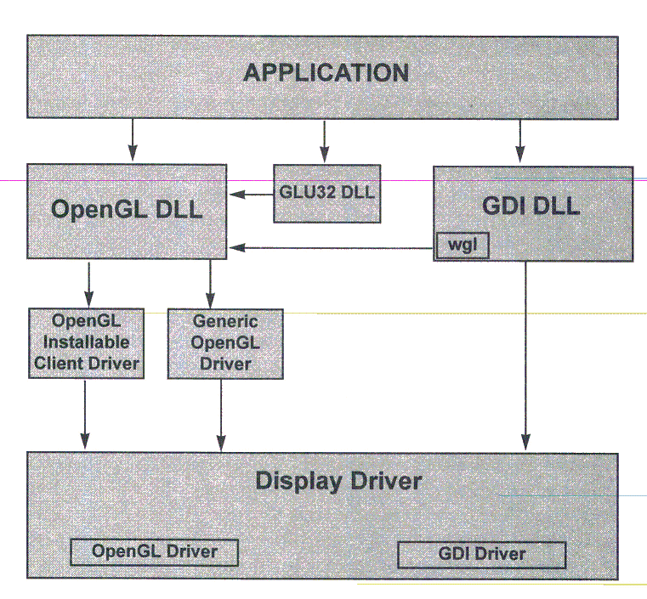
OpenGL Architecture

Slide 11
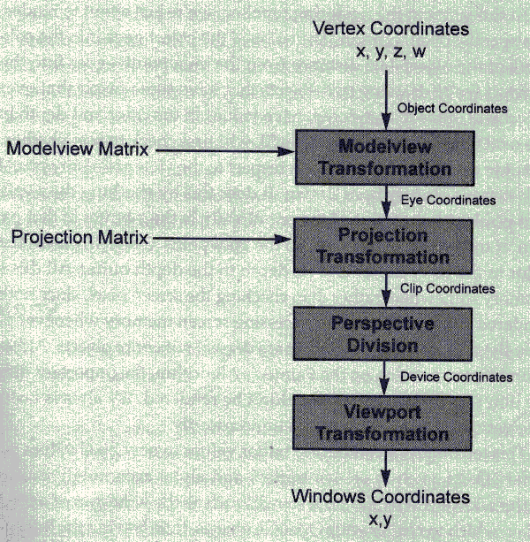
OpenGL Process Pipeline

Slide 12
3D Graphics

Slide 13
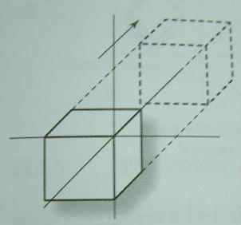
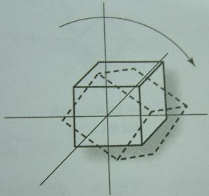
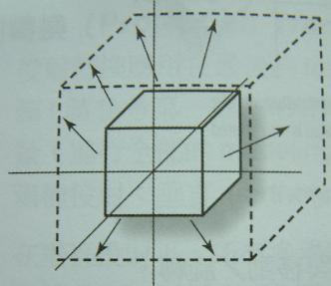
Transformations

Slide 14
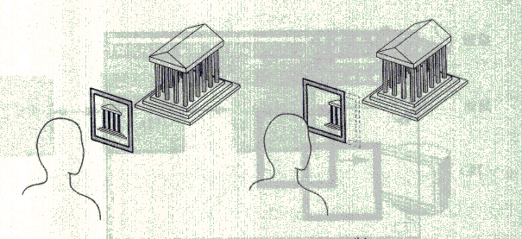
Clip

Slide 15
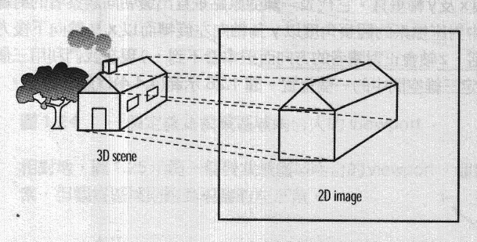
Projection

Slide 16
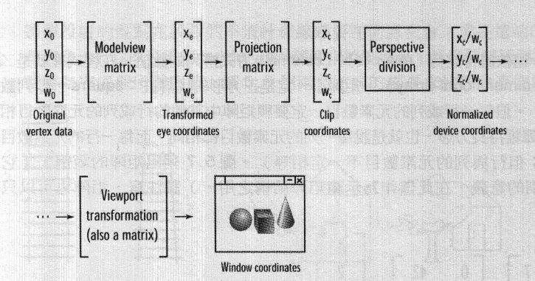
OpenGL Process Pipeline

Slide 17
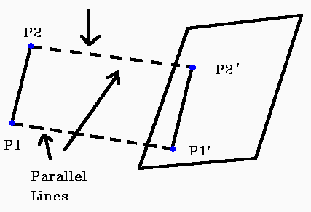
Orthographic Projections

Slide 18
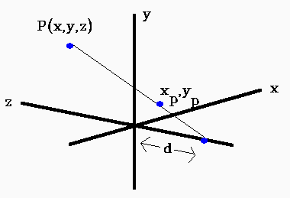
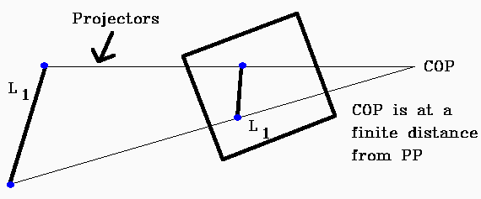
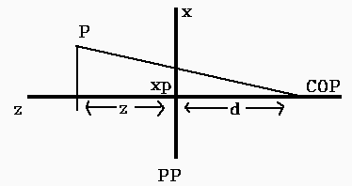
Perspective Projections

Slide 19
Visual C++ 6.0 Introduction

Slide 20
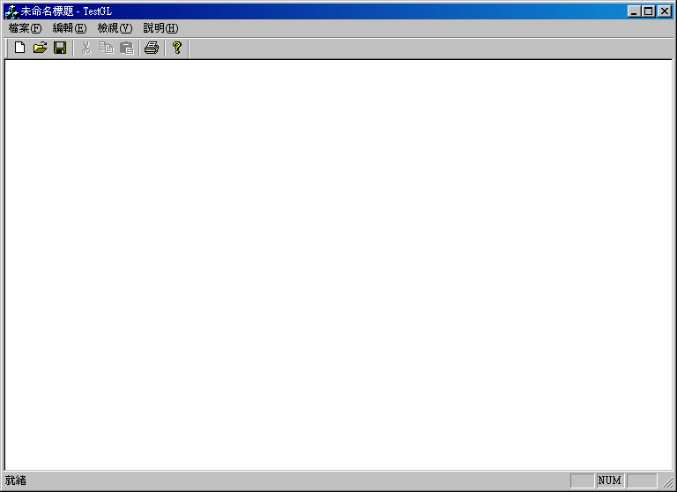
A Simple Windows Program

Slide 21
Rendering with OpenGL

Slide 22
MFC Application
1. New project
2. Build and run the empty application
3. Add includes for OpenGL header files
4. Add context handles
5.Add windows message handlers for
  WM_CREATE
  WM_DESTROY
  WM_ERASBKGRND
  WM_SIZE

Slide 23
MFC Application
6. OnCreate
  get device context;
  select and set pixel format
  create and activate OpenGL context
  initialise OpenGL state (clear colour, etc.)
7. OnDestroy
  deselect OpenGL context and delete
8.OnSize
  pass width, height to glViewPort, recalc project matrix

Slide 24
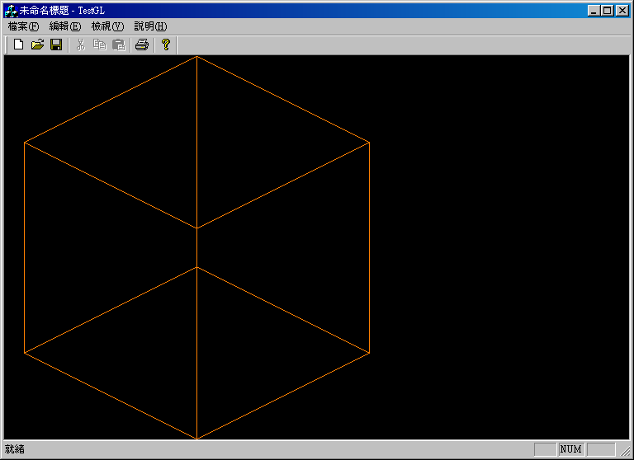
MFC Application
9. OnEraseBkgnd
  return TRUE
10. PreCreateWindow
11.OnDraw
12.Add the libraries
13. Build and run

Slide 25
New Client DC
CDC* m_pDC
  GDI Device Context
HGLRC m_hRC
  GL Rendering Context Handle
m_pDC=new CClientDC(this)
HDC m_hDC
  GDI Device Context Handle
m_hDC=m_pDC->GetSafeHdc()

Slide 26
HGLRC wglCreateContext
HDC hdc
  GDI Device Context Handle
wglCreateContext(m_hDC)

Slide 27
BOOL wglMakeCurrent
HDC hdc
  GDI Device Context Handle
HGLRC hglrc
  GL Rendering Context Handle

Slide 28
Int ChoosePixelFormat
HDC hdc
  device context to search for a best pixel format match
CONST PIXELFORMATDESCRIPTOR * ppfd
  pixel format for which a best match is sought

Slide 29
BOOL SetPixelFormat
HDC hdc
  device context to search for a best pixel format match
int iPixelFormat
  pixel format index
CONST PIXELFORMATDESCRIPTOR * ppfd
  pixel format for which a best match is sought

Slide 30
void glClearColor
GLclampf red
GLclampf green
GLclampf blue
GLclampf alpha

Slide 31
void glClearDepth
GLclampd depth

Slide 32
void glEnable & void glDisable
GLenum cap
  GL_DEPTH_TEST
  GL_LINE_SMOOTH
  GL_LIGHTING
  GL_LIGHTi
  GL_LINE_STIPPLE
  GL_CULL_FACE

Slide 33
void glMatrixMode
GLenum cap
  GL_MODELVIEW
  GL_PROJECTION
  GL_TEXTURE

Slide 34

void glLoadIdentity
glMatrixMode(GL_PROJECTION);
glLoadIdentity();
glMatrixMode(GL_MODELVIEW);
glLoadIdentity();

Slide 35
BOOL wglDeleteContext
HGLRC hglrc
  GL Rendering Context Handle

Slide 36
void glViewport
GLint x
GLint y
GLsizei width
GLsizei height

Slide 37
void glOrtho
GLdouble left
GLdouble right
GLdouble bottom
GLdouble top
GLdouble near
GLdouble far

Slide 38
void glFlush
forces execution of OpenGL functions in finite time.

Slide 39
void glClear
GLbitfield mask
  GL_COLOR_BUFFER_BIT
  GL_DEPTH_BUFFER_BIT
  GL_ACCUM_BUFFER_BIT
  GL_STENCIL_BUFFER_BIT

Slide 40
BOOL SwapBuffers
HDC hdc
  device context to search for a best pixel format match

Slide 41
void glColor
glColor3b, glColor3d, glColor3f, glColor3i, glColor3s, glColor3ub, glColor3ui, glColor3us, glColor4b, glColor4d, glColor4f, glColor4i, glColor4s, glColor4ub, glColor4ui, glColor4us, glColor3bv, glColor3dv, glColor3fv, glColor3iv, glColor3sv, glColor3ubv, glColor3uiv, glColor3usv, glColor4bv, glColor4dv, glColor4fv, glColor4iv, glColor4sv, glColor4ubv, glColor4uiv, glColor4usv

Slide 42
void glRotated & void glRotatef
GLdouble angle
GLdouble x
GLdouble y
GLdouble z
GLfloat angle
GLfloat x
GLfloat y
GLfloat z

Slide 43
void glTranslated & void glTranslatef
GLdouble x
GLdouble y
GLdouble z
GLfloat x
GLfloat y
GLfloat z

Slide 44
void glScaled & void glScalef
GLdouble x
GLdouble y
GLdouble z
GLfloat x
GLfloat y
GLfloat z

Slide 45
void glBegin & void glEnd
GLenum mode

Slide 46
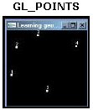
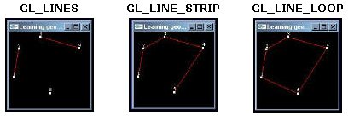
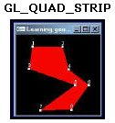
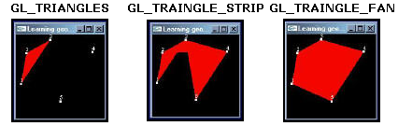
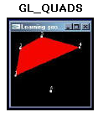
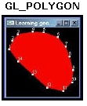
Primitive Types

Slide 47
glVertex
glVertex2d, glVertex2f, glVertex2i, glVertex2s, glVertex3d, glVertex3f, glVertex3i, glVertex3s, glVertex4d, glVertex4f, glVertex4i, glVertex4s, glVertex2dv, glVertex2fv, glVertex2iv, glVertex2sv, glVertex3dv, glVertex3fv, glVertex3iv, glVertex3sv, glVertex4dv, glVertex4fv, glVertex4iv, glVertex4sv

Slide 48
void glPushMatrix & void glPopMatrix
glMatrixMode(GL_MODELVIEW);
glPushMatrix();
GLRender();
glPopMatrix();

Slide 49
Basic Function

Slide 50
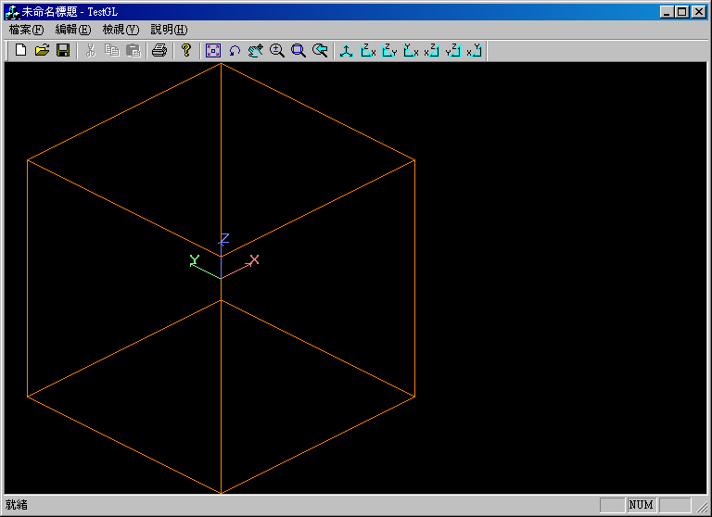
What Basc Functions ?
Translate or Move
Rotate
Scale or Zoom
Window Zoom
Previous View
Zoom All

Slide 51
void glGetDoublev
GLenum pname
  GL_MODELVIEW
  GL_PROJECTION_MATRIX
GLdouble * params
GLdouble a[16];
glMatrixMode(GL_MODELVIEW);
glGetDoublev(GL_MODELVIEW_MATRIX,a);

Slide 52
void glNewList & void glEndList
GLuint list
GLenum mode
  GL_COMPILE_AND_EXECUTE
  GL_COMPILE

Slide 53
void glDeleteLists
GLuint list
GLsizei range

Slide 54
void glRasterPos
glRasterPos2d, glRasterPos2f, glRasterPos2i, glRasterPos2s, glRasterPos3d, glRasterPos3f, glRasterPos3i, glRasterPos3s, glRasterPos4d, glRasterPos4f, glRasterPos4i, glRasterPos4s, glRasterPos2dv, glRasterPos2fv, glRasterPos2iv, glRasterPos2sv, glRastePos3dv, glRasterPos3fv, glRasterPos3iv, glRasterPos3sv, glRasterPos4dv, glRasterPos4fv, glRasterPos4iv, glRasterPos4sv

Slide 55
void glListBase
GLuint base

Slide 56
void glCallLists & void glCallList
GLsizei n
GLenum type
const GLvoid * lists

Slide 57
BOOL wglUseFontBitmaps
HDC hdc
  device context handle
DWORD first
  glyph that is the first of a run of glyphs to
DWORD count
  number of glyphs to turn into bitmap display lists
DWORD listBase
  specifies starting display list
wglUseFontBitmaps(m_hDC,0,255,FontList);

Slide 58
void glGetIntegerv
GLenum pname
  GL_VIEWPORT
GLint * params
GLint c[4];
glGetIntegerv(GL_VIEWPORT,c);

Slide 59
int gluProject
GLdouble objx
GLdouble objy
GLdouble objz
const GLdouble modelMatrix[16]
const GLdouble projMatrix[16]
const GLint viewport[4]
GLdouble * winx
GLdouble * winy
GLdouble * winz

Slide 60
int gluUnProject
GLdouble winx
GLdouble winy
GLdouble winz
const GLdouble modelMatrix[16]
const GLdouble projMatrix[16]
const GLint viewport[4]
GLdouble * objx
GLdouble * objy
GLdouble * objz

Slide 61
Trace Ball

Slide 62
Advanded Function

Slide 63
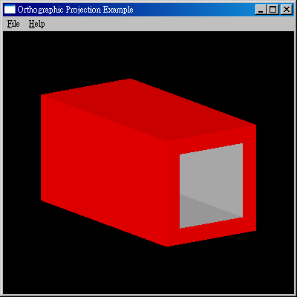
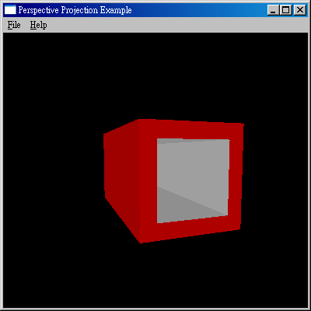
Orthographic & Perspective

Slide 64
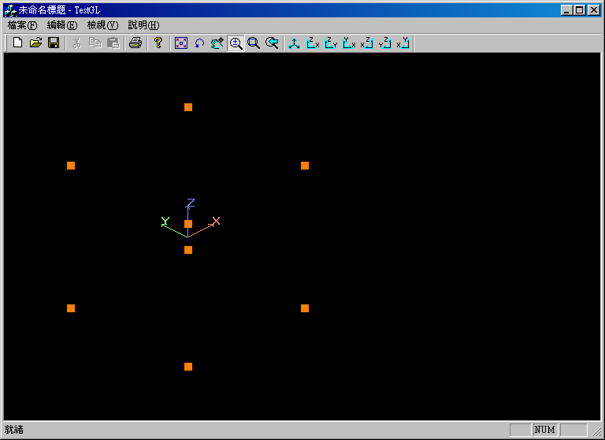
Change Point Size

Slide 65
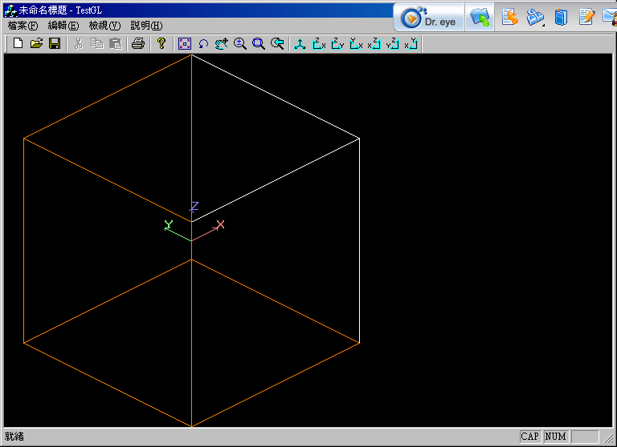
Select Objects with Mouse

Slide 66
Read & Write Pixels
Output to Clipboard
Output to BMP File
Read a BMP File

Slide 67
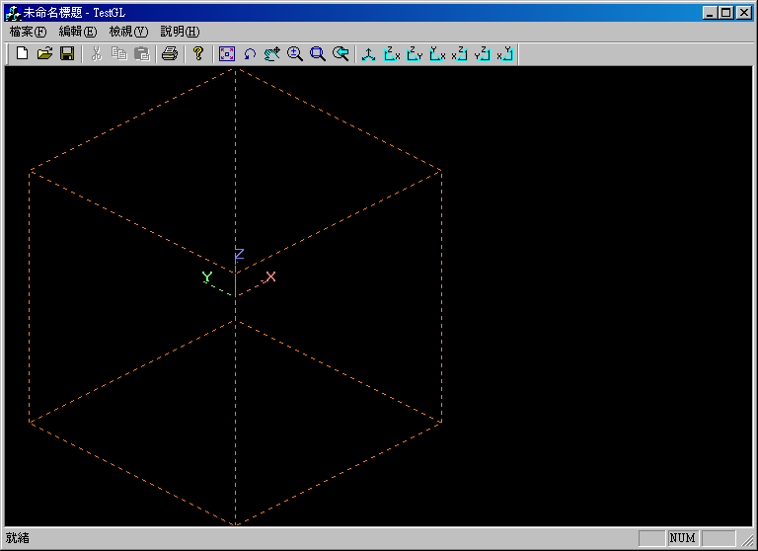
Line Stipple

Slide 68
Use List
Fast , but not all
Use GLuint glGenLists( GLsizei range ) to get a list num
Delete list

Slide 69
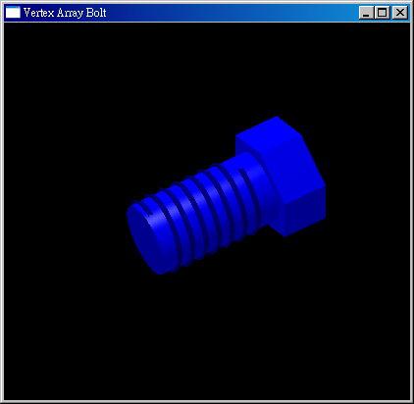
Vertex Array

Slide 70
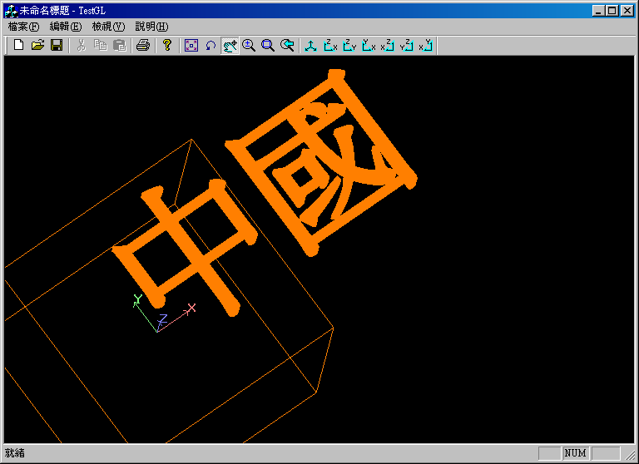
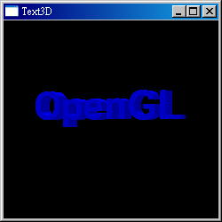
wglUseFontOutlines

Slide 71
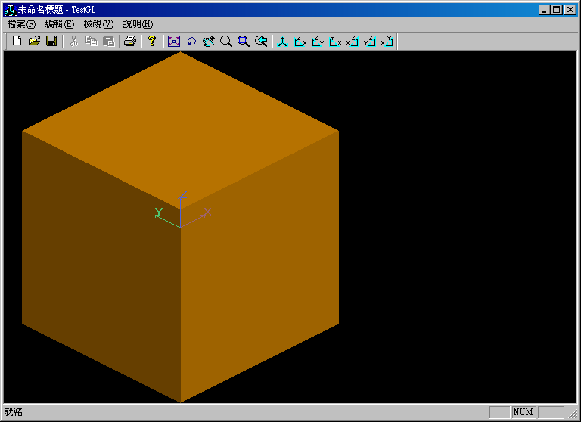
Shading

Slide 72
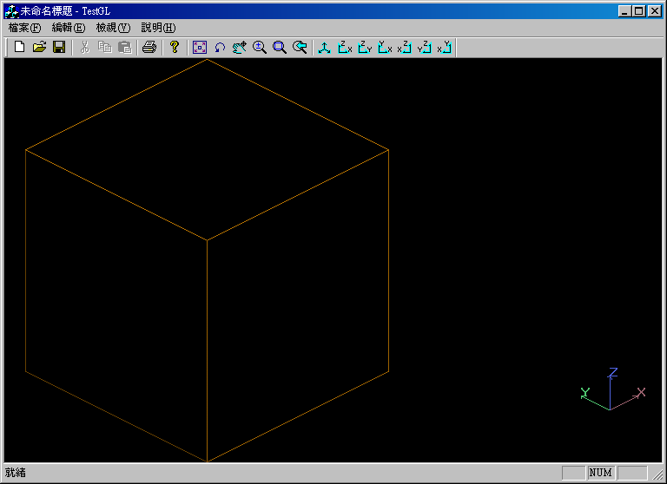
Remove Hidden Lines

Slide 73
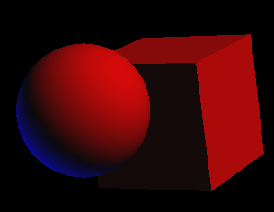
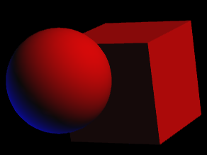
Antialiase

Slide 74

Blending & Transparency

Slide 75
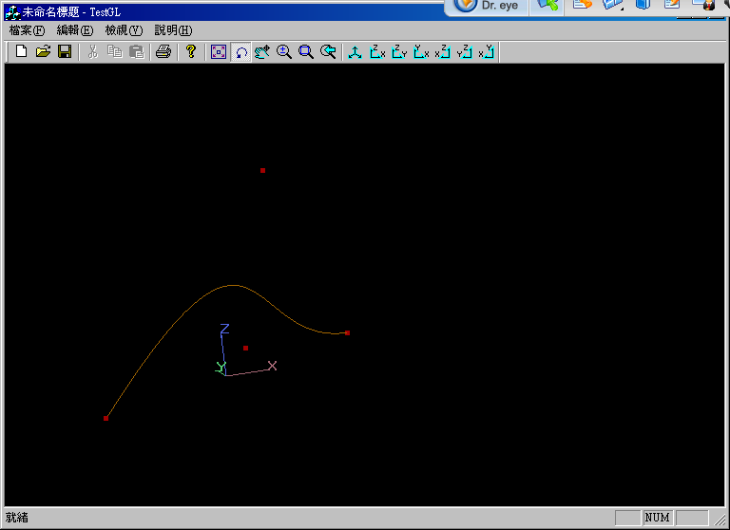
Nurbs Curves

Slide 76
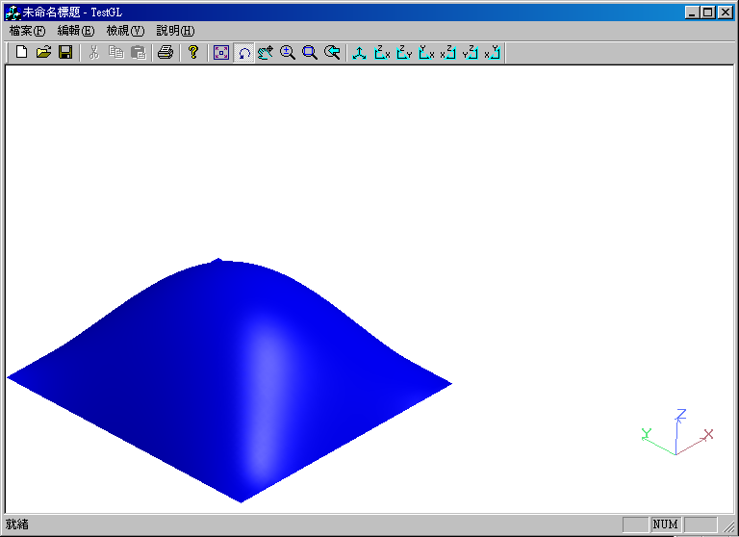
Nurbs Surface

Slide 77
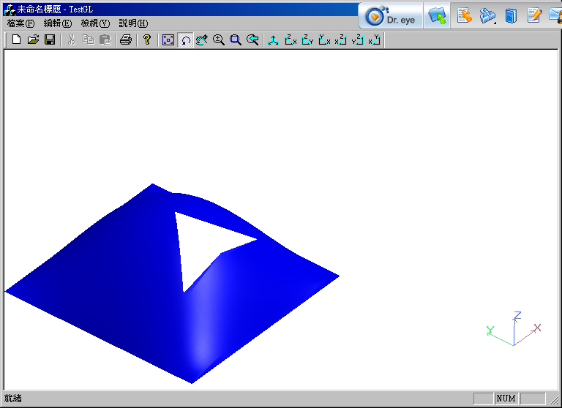
Trimed Nurbs Surface

Slide 78
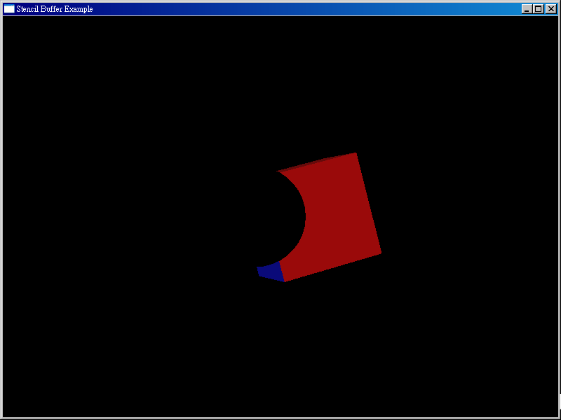
Stentil

Slide 79
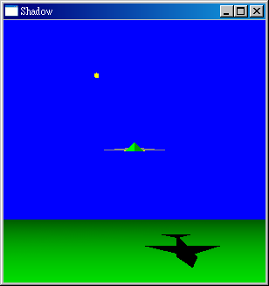
Shadow

Slide 80
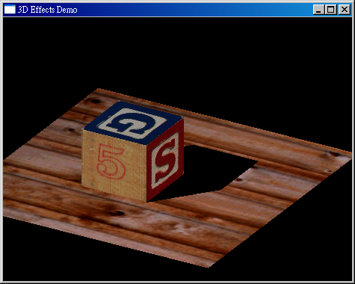
Texture

Slide 81
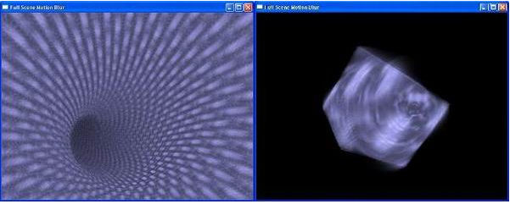
Motion Blur

Slide 82
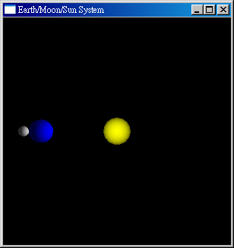
Animation

Slide 83
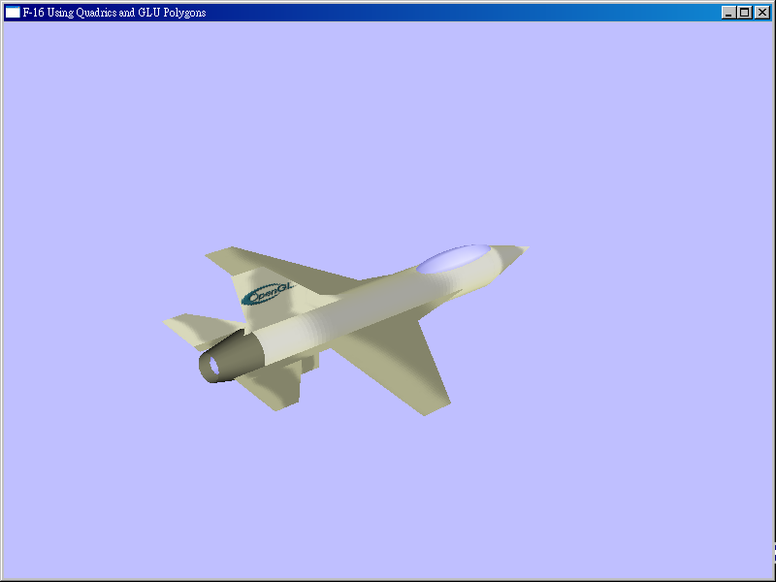
Tessellator

Slide 84
Visual Basic

Slide 85
謝謝!!
請指教

