Slide 1
Chap5
Graph

Slide 2
圖形(Graph)
graph G 包含兩部分
  頂點, vertices V(G)
  邊edges E(G)
  G(V,E)表示a graph

Slide 3
Graph
0
0
0
1
2
1
2
1
3
3
4
5
6
G1
2
G2
G3
V(G1)={0,1,2,3} E(G1)={(0,1),(0,2),(0,3),(1,2),(1,3),(2,3)}
V(G2)={0,1,2,3,4,5,6} E(G2)={(0,1),(0,2),(1,3),(1,4),(2,5),(2,6)}
V(G3)={0,1,2} E(G3)={<0,1>,<1,0>,<1,2>}

Slide 4
Figure 6.3
0
0
2
1
3
1
2
(a)
有Cycle圖
(b)
多重圖

Slide 5
子圖subgraphs of G₁ and G₃
0
0
0
1
2
0
1
2
1
2
3
1
2
3
3
G1
(i) (ii) (iii) (iv)
(a) Some of the subgraph of G₁
0
0
0
0
0
單一
1
1
1
1
分開
2
2
(i) (ii) (iii) (iv)
(b) Some of the subgraph of G₃
2
G3

Slide 6
Connected graph 連通圖
0
0
1
2
1
2
3
3
4
5
6
G1
G2
tree

Slide 7
Degree
degree分支度:附著在頂點的邊數
in-degree 內分支度
  頂點V的內分支度是指以V為終點(即箭頭指向V)的邊數
out-degree 外分支度
  頂點V的外分支度是指以V為起點的邊數

Slide 8
undirected graph無向圖
degree
3
0
0
2
1
2
3
1
2
3
3
3
3
4
5
6
3
3
1
G1
1
G2
1
1
0
in:1, out: 1
directed graph有向圖
in-degree
out-degree
1
in: 1, out: 2
2
in: 1, out: 0
G3

Slide 9
Graph表示法
Adjacency Matrix 相鄰矩陣
Adjacency Lists 相鄰串列

Slide 10
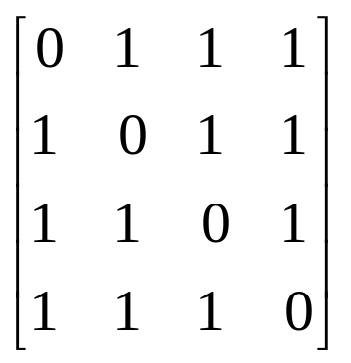
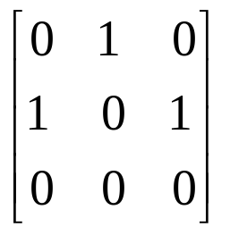
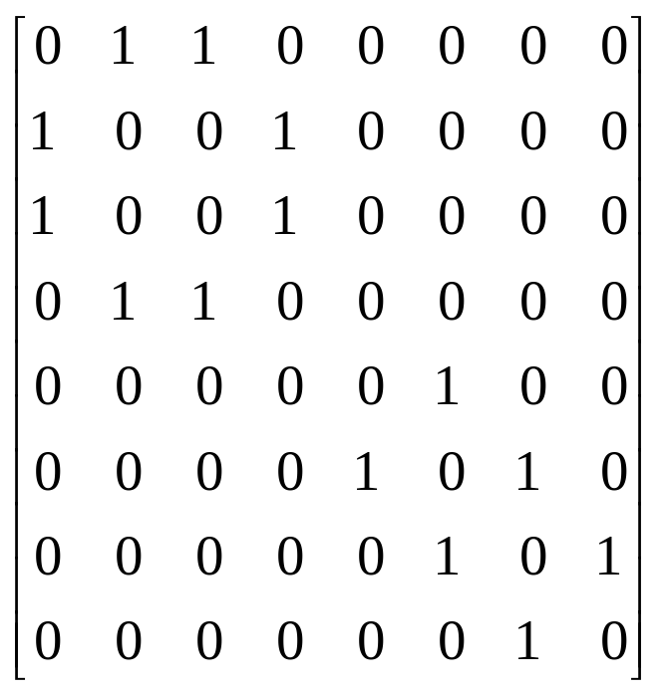
Adjacency Matrix
0
0
4
0
2
1
5
1
2
3
6
3
1
7
2
G2
G1
symmetric
G4

Slide 11
Data Structures for Adjacency Lists
#define MAX_VERTICES 50
typedef struct node *node_pointer;
typedef struct node {
int vertex;
struct node *link;
};
node_pointer graph[MAX_VERTICES];
int n=0; /* vertices currently in use */

Slide 12
0
0
4
2
1
5
1
2
3
6
3
7
0
1
2
3
1
2
3
0
1
2
3
4
5
6
7
1
2
0
2
3
0
3
0
1
3
0
3
0
1
2
1
2
G1
0
5
4
6
0
1
2
1
5
7
0
2
1
6
G3
G4
2

Slide 13
Graph的基本運作
Traversal拜訪
  Depth First Search (DFS)縱向優先搜尋
  preorder tree traversal
  Breadth First Search (BFS) 橫向優先搜尋
  level order tree traversal
Spanning Trees生成樹

Slide 14
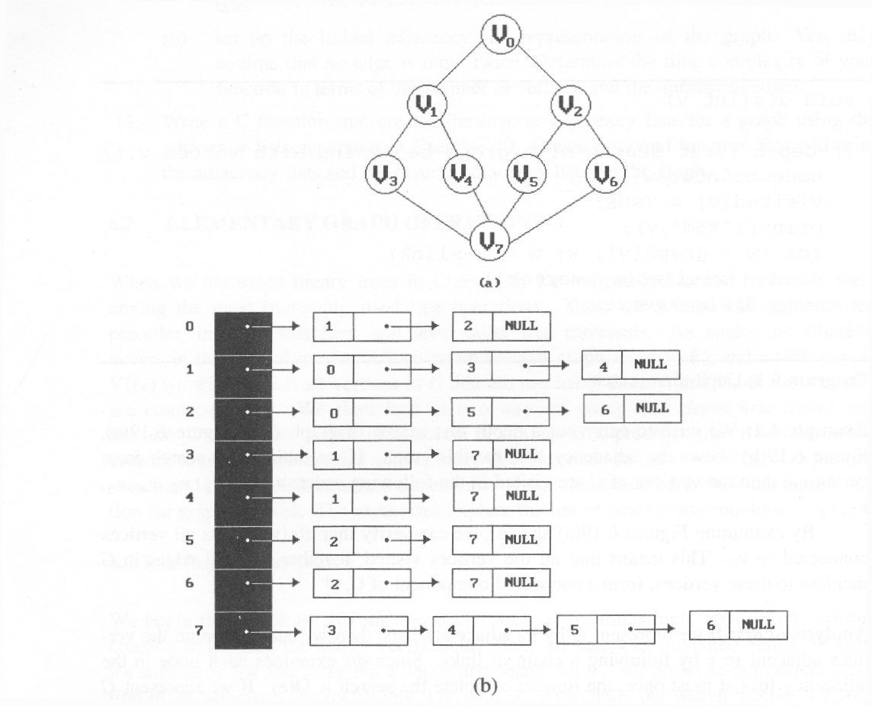
depth first search: v0, v1, v3, v7, v4, v5, v2, v6
breadth first search: v0, v1, v2, v3, v4, v5, v6, v7

Slide 15
Spanning Trees生成樹
Spanning Tree: 以最少的邊數, 來連接圖形中所有的頂點, 且不能有迴圈(Cycle)
|E| = |V| -1 (邊數 = 頂點數 -1)
Kruskal’s Algorithm
  將所有的邊由小到大排列, 依序加入最小的邊, 但不可以造成迴路(Cycle)
Prim’s Algorithm
  每次向外長出目前最小的邊,有走一步算一步的味道,
  但不可以造成迴路(Cycle)

Slide 16
Spanning Tree生成樹
0
0
0
0
1
2
1
2
1
2
1
2
3
3
3
3
G1

Slide 17
DFS vs BFS Spanning Tree
0
0
0
1
2
1
2
1
2
3
4
5
6
3
4
5
6
3
4
5
6
7
7
7
DFS Spanning
BFS Spanning

Slide 18
Kruskal’s Algorithm
10
0 5
2 3
1 6
1 2
3 6
3 4
4 6
4 5
0 1
12
14
0
0
0
28
16
1
1
10
1
10
14
16
18
6
2
5
6
2
5
6
2
5
24
22
25
18
12
4
4
4
22
3
3
3
24
25
6/9
28

Slide 19
0 5
2 3
1 6
1 2
3 6
3 4
4 6
4 5
0 1
10
12
14
16
0
0
0
10
1
10
1
10
1
18
14
14
16
22
5
6
2
5
6
2
5
6
2
12
12
12
24
4
4
4
3
3
3
25
28
+
3 6
cycle

Slide 20
0 5
2 3
1 6
1 2
3 6
3 4
4 6
4 5
0 1
10
12
14
0
0
16
10
1
10
1
18
14
16
14
16
5
6
2
5
6
2
22
25
12
12
4
4
24
22
+
4 6
22
3
3
25
cycle
cost = 10 +25+22+12+16+14
28

Slide 21
Prim’s Algorithm
0
28
10
1
14
16
5
6
2
24
25
0
18
12
0
0
4
10
1
22
3
1
10
1
10
5
6
2
5
6
2
5
6
2
25
25
4
4
4
3
3
22
3

Slide 22
0
28
10
1
14
16
5
6
2
24
25
18
12
4
22
3
0
0
0
10
1
10
1
10
1
16
14
16
5
6
2
5
6
2
5
6
2
25
25
25
4
12
4
12
4
12
22
3
22
3
22
3

Slide 23
The Shortest Path最短路徑
Boston
4
1500
San
Francisco
Chicago
Denver
1200
3
250
800
2
1000
1
5
New
York
300
1000
1400
1700
New Orleans
900
0
7
1000
Los Angeles
6
Miami
0 1 2 3 4 5 6 7
0 0
1 300 0
2 1000 800 0
3 1200 0
4 1500 0 250
5 1000 0 900 1400
6 0 1000
7 1700 0
Cost adjacency matrix

Slide 24
(a)
(b)
(c)
4
1500
4
1500
4
250
3
3
5
250
250
5
1000
5
900
6
選5
4到3由1500改成1250
4到6由∞改成1250
4
4
(d)
(f)
4
(e)
3
250
250
1000
250
5
5
7
1400
5
7
1400
7
1400
900
6
1000
900
6
4到7由∞改成1650
選6
4-5-6-7比4-5-7長

Slide 25
(g)
(h)
4
4
3
1200
3
250
2
1000
250
5
1000
7
5
1400
7
1400
900
900
6
6
選3
4到2由∞改成2450
(i)
4
4
2
1200
3
(j)
250
250
1000
0
5
5
7
1400
7
1400
900
6
4到0由∞改成3350
選7

Slide 26
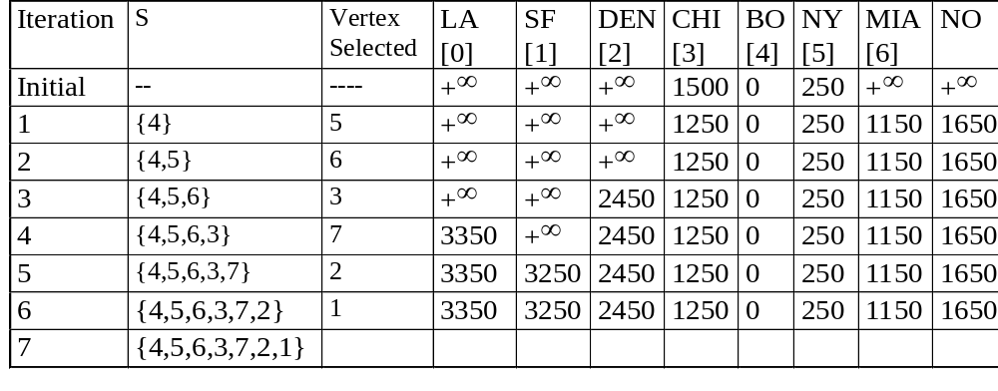
Example for the Shortest Path

