Slide 1
Chap6
Sorting

Slide 2
Sorting Algorithm
Bubble Sort
Selection Sort
Insertion Sort
Merge Sort
Quick Sort
Heap Sort
Shell Sort
Radix Sort

Slide 3
Bubble Sort
又稱 Interchange Sort
相鄰2個相比, 如果前一個比後一個大時, 則相互對調.
通常有N個資料時就需要作N-1次掃描, 一次掃描後, 資料量會減少1.當沒有對調時, 教表示已經排序好了.

Slide 4
Bubble Sort
56
34
12
77
25
41
12
56
34
25
77
41
12
25
56
34
41
77
12
25
34
56
41
77
12
25
34
41
56
77
12
25
34
41
56
77
12
25
34
41
56
77

Slide 5
範例：
bubble ( int A[], int N )
{
int i, j, temp;
for ( i = 1; i < N; i++ )
for ( j = N; j > i; j-- )
if ( A[j-1] > A[j] )
{
temp = A[i];
A[i] = A[j];
A[j] = temp;
}
}
i
12 25 8 44 5 78 44 36
1
5 12 25 8 44 36 78 44
2
5 8 12 25 36 44 44 78
3
5 8 12 25 36 44 44 78
4
5 8 12 25 36 44 44 78
5
5 8 12 25 36 44 44 78
6
5 8 12 25 36 44 44 78
7
5 8 12 25 36 44 44 78

Slide 6
Selection Sort
先選再資料中挑選最小的一個放在第1個位置(由小到大)
再從第2個開始挑選最小的一個放在第2個位置
………一直下去,
如果有N個數字, 則最多需要N-1次對調

Slide 7
Selection Sort
從尚未排序的元素中選出最小者，附加在已排序的部份之後。
未排序
已排序
56, 34, 12, 77, 25, 41
56, 34, 77, 25, 41
12
56, 34, 77, 41
12, 25
56, 77, 41
12, 25, 34
56, 77
12, 25, 34, 41
77
12, 25, 34, 41, 56
12, 25, 34, 41, 56, 77

Slide 8
selection ( int A[], int N )
{
int i, j, min, t, temp;
for ( i = 1; i < N; i++ )
{
min = i;
for ( j = i + 1; j <= N; j++ )
if ( A[j] < A[min] ) min = j;
{
temp = A[i];
A[i] = A[j];
A[j] = temp;
}
}
}
範例：
12 25 8 44 5 78 44 36
5 25 8 44 12 78 44 36
5 8 25 44 12 78 44 36
5 8 12 44 25 78 44 36
5 8 12 25 44 78 44 36
5 8 12 25 36 44 78 44
5 8 12 25 36 44 78 44
5 8 12 25 36 44 44 78

Slide 9
Insertion Sort
從尚未排序的元素中選出一個元素，插在已排序的部份
中適當的位置。
未排序
已排序
56, 34, 12, 77, 25, 41
34, 12, 77, 25, 41
56
12, 77, 25, 41
34, 56
77, 25, 41
12, 34, 56
25, 41
12, 34, 56, 77
41
12, 25, 34, 56, 77
12, 25, 34, 41, 56, 77

Slide 10
insertion ( int A[], int N )
{
int i, j, v;
A[0] = 0;
for ( i = 2; i <= N; i++ ) {
v = A[i]; j = i;
while ( A[j-1] > v ) {
a[j] = a[j-1];
j--;
}
A[j] = v;
}
}
範例：
i
0 12 25 8 44 5 78 44 36
2
0 12 25 8 44 5 78 44 36
3
0 8 12 25 44 5 78 44 36
4
0 8 12 25 44 5 78 44 36
5
0 5 8 12 25 44 78 44 36
6
0 5 8 12 25 44 78 44 36
7
0 5 8 12 25 44 44 78 36
8
0 5 8 12 25 36 44 44 78

Slide 11
Merge Sort
將2個或2個以上以排序好的File, 合併成1個以排序好的File

Slide 12
a
5, 15, 26, 52, 67
b
8, 29, 33, 42, 75, 86
c
5, 8, 15, 26, 29, 33, 42, 52, 67, 75, 86

Slide 13
範例：Merge two sorted data array
a
b
c
5, 15, 26, 52, 67
8, 29, 33, 42, 75, 86
15, 26, 52, 67
8, 29, 33, 42, 75, 86
5
15, 26, 52, 67
29, 33, 42, 75, 86
5, 8
26, 52, 67
29, 33, 42, 75, 86
5, 8, 15
52, 67
29, 33, 42, 75, 86
5, 8, 15, 26
52, 67
33, 42, 75, 86
5, 8, 15, 26, 29
52, 67
42, 75, 86
5, 8, 15, 26, 29, 33
52, 67
75, 86
5, 8, 15, 26, 29, 33, 42
67
75, 86
5, 8, 15, 26, 29, 33, 42, 52
75, 86
5, 8, 15, 26, 29, 33, 42, 52, 67
86
5, 8, 15, 26, 29, 33, 42, 52, 67, 75
5, 8, 15, 26, 29, 33, 42, 52, 67, 75, 86

Slide 14
1
M
1
N
1
M+N
Merging two sorted data arrays a and b needs O(M+N)

Slide 15
範例：Mergesort
26 5 37 1 61 11 59 15 48 19
26 5 37 1 61
11 59 15 48 19
26 5 37
1 61
11 59 15
48 19
26 5
37
1
61
11 59
15
48
19
26
5
11
59
1 5 11 15 19 26 37 48 59 61
1 5 26 37 61
11 15 19 48 59
5 26 37
1 61
11 15 59
19 48
5 26
37
1
61
11 59
15
48
19
26
5
11
59

Slide 16
Merge_Sort
void merge_sort(element list[], int n)
{
int length=1;
element extra[MAX_SIZE];
while (length<n) {
merge_pass(list, extra, n, length);
length *= 2;
merge_pass(extra, list, n, length);
length *= 2;
}
}
l
l
l
l
...
2l
2l
...
4l
...

Slide 17
Recursive Formulation of Merge Sort
26 5 77 1 61 11 59 15 48 19
5 26 11 59
copy
copy
copy
copy
5 26 77 1 61 11 15 59 19 48
1 5 26 61 77 11 15 19 48 59
⎣(1+5)/2⎦
⎣(6+10)/2⎦
1 5 11 15 19 26 48 59 61 77
⎣(1+10)/2⎦
Data Structure: array (copy subfiles) vs. linked list (no copy)

Slide 18
Nature Merge Sort
26 5 77 1 61 11 59 15 48 19
5 26 77
1 11 59 61
15 19 48
1 5 11 26 59 61 77
15 19 48
1 5 11 15 19 26 48 59 61 77

Slide 19
Quick Sort
又稱 Partition Exchange Sort
假設有n個 R1, R2,….., Rn, 其鍵值為K1, K2……Kn,
步驟如下:
  以第1個數字的鍵值K1為基準W,
  由左至右 I = 2,3,…..,n, 一直找到Ki >= W
  由右至左 J = n, n-1, n-2….,2,一直找到Ki <= W
  當I <J時Ri與Rj互換, 否則R1與Rj互換(I>J)

Slide 20
i
j
56, 25, 45, 77, 69, 59, 12, 27 , 67, 41, 34
27, 25, 12, 34, 69, 59, 45, 56 , 67, 41, 77

Slide 21
範例：
26 5 37 1 61 11 59 15 48 19
15 5 11 1
19
37 59 26 48 61
1
5 11 15
37 59 26 48
61
5 11
15
37 26
48
59
5
11
26
37
59
5
37
1 5 11 15 19 26 37 48 59 61

Slide 22
範例：
1
2
3
4
5
6
7
8
9
10
l
r
26 5 37 1 61 11 59 15 48 19 1 10
15 5 11 1 19 37 59 26 48 61 1 4
1 5 11 15 19 37 59 26 48 61 1 0
1 5 11 15 19 37 59 26 48 61 2 4
1 5 11 15 19 37 59 26 48 61 2 3
1 5 11 15 19 37 59 26 48 61 2 2
1 5 11 15 19 37 59 26 48 61 4 3
1 5 11 15 19 37 59 26 48 61 4 5

Slide 23
1
2
3
4
5
6
7
8
9
10
l
r
1 5 11 15 19 37 59 26 48 61 6 10
1 5 11 15 19 37 59 26 48 61 6 9
1 5 11 15 19 37 26 48 59 61 6 7
1 5 11 15 19 26 37 48 59 61 6 5
1 5 11 15 19 26 37 48 59 61 6 5
1 5 11 15 19 26 37 48 59 61 7 7
1 5 11 15 19 26 37 48 59 61 9 9
1 5 11 15 19 26 37 48 59 61 11 10

Slide 24
Heap Sort
1 2 3 4 5 6 7 8 9 10
26 5 77 1 61 11 59 15 48 19
input file
[1]
26
[2]
5
[3]
77
[4]
1
[5]
61
[6]
11
[7]
59
[8]
15
[9]
48
[10]
19

Slide 25
Heap Sort
initial heap
[1]
77
[2]
61
[3]
59
exchange
[4]
48
[5]
19
[6]
11
[7]
26
[8]
15
[9]
1
[10]
5

Slide 26
Heap Sort
[1]
61
[2]
48
[3]
59
15
19
11
[7]
26
[4]
[5]
[6]
[8]
5
[9]
1
[10]
77
(a)
[1]
59
[2]
48
[3]
26
15
19
11
[7]
1
[4]
[5]
[6]
[8]
5
[9]
61
[10]
77
(b)

Slide 27
Heap Sort
[1]
48
[2]
19
[3]
26
15
5
11
[7]
1
[4]
[5]
[6]
59
59
61
[8]
[9]
61
[10]
77
(c)
[1]
26
[2]
19
[3]
11
48
15
5
1
[7]
48
[4]
[5]
[6]
59
[8]
59
[9]
61
[10]
77
(d)

Slide 28
Heap Sort
void adjust(element list[], int root, int n)
{
int child, rootkey; element temp;
temp=list[root]; rootkey=list[root].key;
child=2*root;
while (child <= n) {
if ((child < n) &&
(list[child].key < list[child+1].key))
child++;
if (rootkey > list[child].key) break;
else {
list[child/2] = list[child];
child *= 2;
}
}
list[child/2] = temp;
}
i
2i
2i+1

Slide 29
Heap Sort
void heapsort(element list[], int n)
{
int i, j;
element temp;
for (i=n/2; i>0; i--) adjust(list, i, n);
for (i=n-1; i>0; i--) {
SWAP(list[1], list[i+1], temp);
adjust(list, 1, i);
}
}
ascending order (max heap)
bottom-up
n-1 cylces
top-down

Slide 30
Shell sort
Shell sort 先將交換的距離增大，使得元素能比較快地移近正確位置，然後再逐漸減小交換的距離，使元素得以更接近或換至正確位置。藉著減少資料交換的次數以增快執行速度。
若交換的距離是 h 則稱 h-sort。當 h = 1 時，即為Insertion sort。

Slide 31
範例：4-sort
56, 34, 45, 77, 25, 59, 12, 27 , 67, 41, 68
25, 34, 45, 77, 56, 59, 12, 27 , 67, 41, 68
25, 34, 45, 77, 56, 41, 12, 27 , 67, 59, 68
25, 34, 12, 77, 56, 41, 45, 27 , 67, 59, 68
25, 34, 12, 27, 56, 41, 45, 77 , 67, 59, 68

Slide 32
範例：4-sort
56, 34, 45, 77, 25, 59, 12, 27 , 67, 41, 68
25, 34, 45, 77, 56, 59, 12, 27 , 67, 41, 68
25, 34, 45, 77, 56, 59, 12, 27 , 67, 41, 68
25, 34, 12, 77, 56, 59, 45, 27 , 67, 41, 68
25, 34, 12, 27, 56, 59, 45, 77 , 67, 41, 68
25, 34, 12, 27, 56, 59, 45, 77 , 67, 41, 68
25, 34, 12, 27, 56, 41, 45, 77 , 67, 59, 68

Slide 33
範例：
56, 34, 45, 77, 25, 59, 12, 27 , 67, 41, 68
4-sort
25, 34, 12, 27, 56, 41, 45, 77 , 67, 59, 68
25, 34, 12, 27, 56, 41, 45, 77 , 67, 59, 68
25, 34, 12, 27, 56, 41, 45, 77 , 67, 59, 68
12, 25, 34, 27, 56, 41, 45, 77 , 67, 59, 68
1-sort
12, 25, 27, 34, 56, 41, 45, 77 , 67, 59, 68
12, 25, 27, 34, 41, 45, 56, 59, 67, 68, 77

Slide 34
Radix Sort
Sort by keys
K⁰, K¹, …, K^{r-1}
Most significant key
Least significant key
R₀, R₁, …, R_{n-1} are said to be sorted w.r.t. K₀, K₁, …, K_{r-1} iff
0≤i<n-1
Most significant digit first: sort on K⁰, then K¹, ...
Least significant digit first: sort on K^{r-1}, then K^{r-2}, ...

Slide 35
Radix Sort
0 ≤ K ≤ 999
(K⁰, K¹, K²)
MSD
LSD
0-9
0-9
0-9
radix 10 sort
radix 2 sort

Slide 36
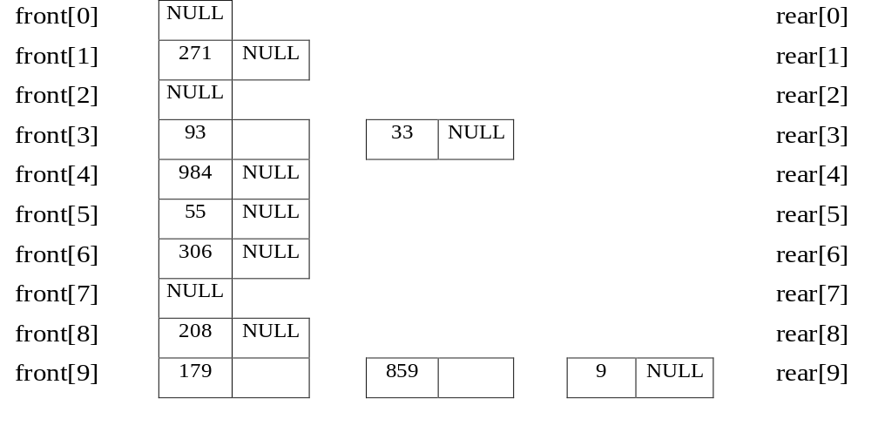
Example for LSD Radix Sort
d (digit) = 3, r (radix) = 10 ascending order
179, 208, 306, 93, 859, 984, 55, 9, 271, 33
Sort by digit
concatenate
271, 93, 33, 984, 55, 306, 208, 179, 859, 9 After the first pass

Slide 37
front[0]
306
208
9
null
rear[0]
front[1]
null
rear[1]
front[2]
null
rear[2]
front[3]
33
null
rear[3]
front[4]
null
rear[4]
front[5]
55
859
null
rear[5]
front[6]
null
rear[6]
front[7]
271
179
null
rear[7]
front[8]
984
null
rear[8]
front[9]
93
null
306, 208, 9, 33, 55, 859, 271, 179, 984, 93 (second pass)
rear[9]

Slide 38
front[0]
9
33
55
93
null
rear[0]
front[1]
179
null
rear[1]
front[2]
208
271
null
rear[2]
front[3]
306
null
rear[3]
front[4]
null
rear[4]
front[5]
null
rear[5]
front[6]
null
rear[6]
front[7]
null
rear[7]
front[8]
859
null
rear[8]
front[9]
984
null
9, 33, 55, 93, 179, 208, 271, 306, 859, 984 (third pass)
rear[9]

Slide 39
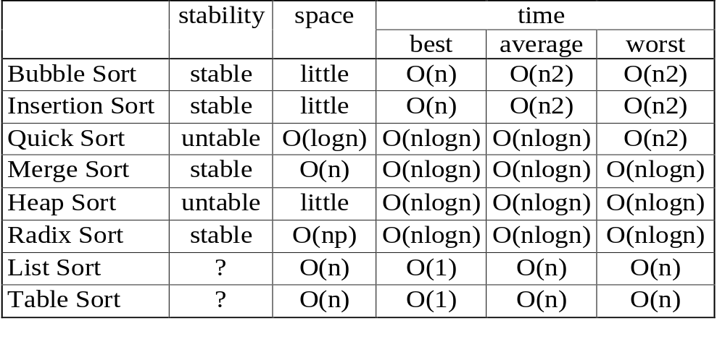
Complexity of Sort

