Slide 1

MONTHLY WEBSITE HEALTH & MAINTENANCE
Website Health & Monthly Maintenance Report
Our Green House | www.ourgreenhouse.com
Reporting month: October 2026
Prepared by WebDesk Solution | webdesksolution.com

Slide 2

MONTHLY OVERVIEW
This month at a glance
378
8
3
Navigation pages checked for availability
Customer journeys reviewed
Screen sizes reviewed (desktop, tablet, mobile)
19
23
4
Pages sampled for SEO and content structure
Observations documented for follow-up
Critical or high-priority issues found
Reviewed this month: functionality, user experience, responsive layout, technical health, SEO, performance, integrations and safe security checks. The same areas were reviewed in September, when 32 observations were documented.
Prepared by WebDesk Solution | Our Green House | October 2026
2

Slide 3






WEBSITE HEALTH
Website health & stability
Availability
Navigation
All 378 pages linked from the main navigation loaded successfully, with no server errors observed.
Header, menus and footer links were reviewed, including 3 pages that redirect to their current versions.
Search
Error handling
Valid, partial, no-result and unusual searches were all handled gracefully.
A missing page correctly shows a friendly "not found" page.
Cart & checkout
Sign-in
Adding, changing and removing items worked, with correct totals.
Empty and invalid sign-in details produce clear, helpful messages.
Key journeys were reviewed to help maintain reliable day-to-day operation.
Prepared by WebDesk Solution | Our Green House | October 2026
3

Slide 4
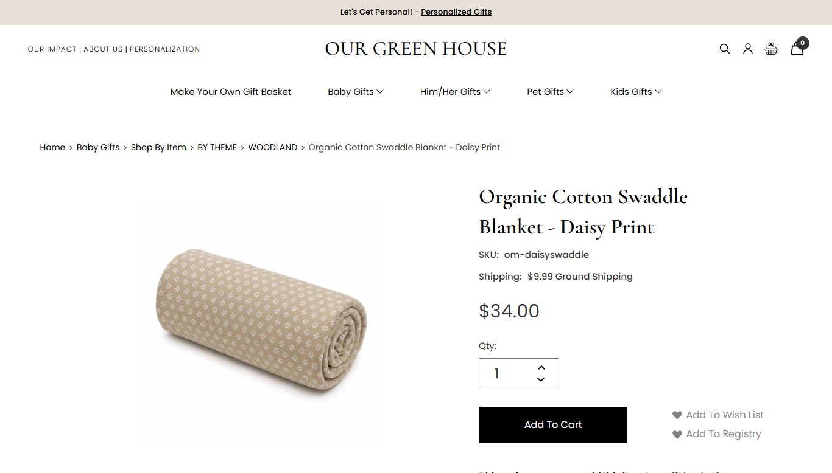

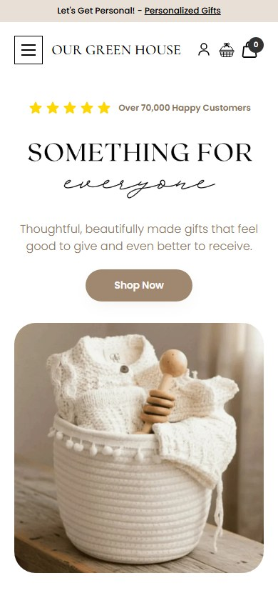
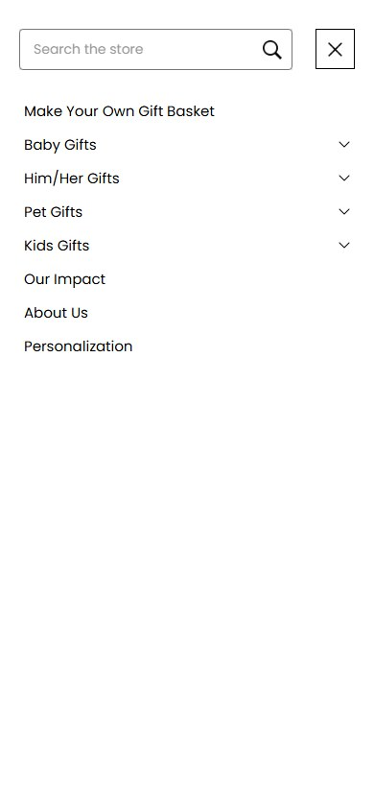
USER EXPERIENCE & RESPONSIVE QUALITY
Experience across devices
Tested in a Chrome-based browser. Other browsers are recommended for next month.
Desktop
Tablet
Mobile
Layouts adapt cleanly at desktop, tablet and mobile sizes, with no sideways scrolling.
Mobile menu, cart and product pages remain easy to use.
Buttons, forms and calls to action were reviewed for consistent behaviour.
The gift-basket builder works on mobile.
Prepared by WebDesk Solution | Our Green House | October 2026
4

Slide 5


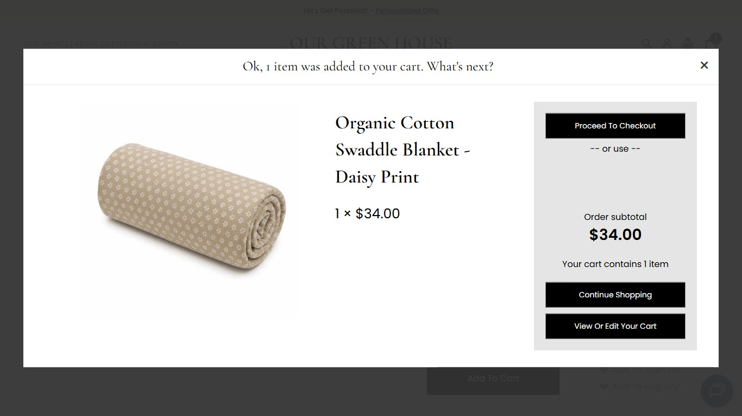
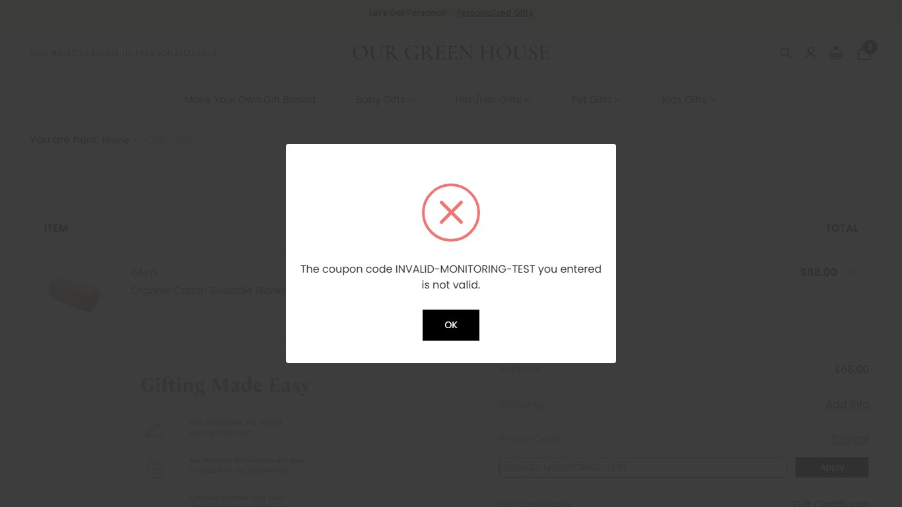
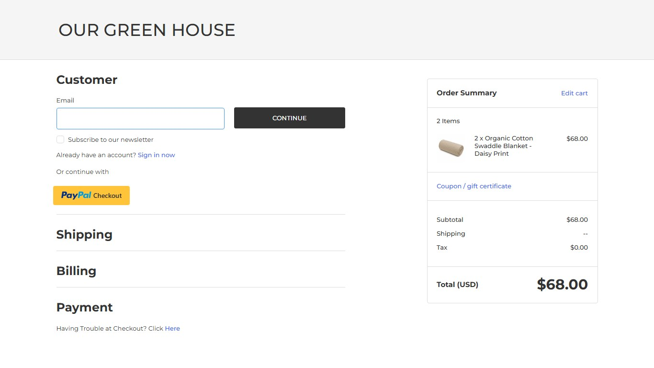
FUNCTIONAL & BUSINESS FLOW VALIDATION
Business-critical journeys reviewed
Discover
Choose
Cart
Checkout
Search and category browsing
Product pages and the Make Your Own Gift Basket builder
Add, update quantity, remove, coupon check
Reviewed up to the payment boundary
Add to cart
Invalid coupon message
Guest checkout
The customer journey from product discovery through checkout was reviewed, with payment submission excluded from the live store. Contact and newsletter form submissions were also excluded to avoid sending real communications.
Prepared by WebDesk Solution | Our Green House | October 2026
5

Slide 6
TECHNICAL HEALTH
Technical health monitoring
Technical check
What it means for you
Website pages and redirects
Helps confirm visitors reach the right page without errors
Browser activity and script behaviour
Helps spot issues that can quietly affect page features
Network and service responses
Helps identify potential integration interruptions early
Third-party tools (analytics, ads, chat, video)
Confirms marketing and support tools are loading as expected
Error pages and invalid addresses
Supports a smooth experience when a link is mistyped
Secure connection (HTTPS)
Helps protect visitors and their data in transit
Some technical items were noted for follow-up and are listed on the Issues & Improvements slide.
Prepared by WebDesk Solution | Our Green House | October 2026
6

Slide 7
PERFORMANCE AND SEO
Performance & SEO health
Performance health reviewed
SEO health reviewed
Search-engine files (robots.txt and sitemap) are in place and valid
2 sampled pages missing canonical addresses or social sharing tags
Structured data present (organisation, product, breadcrumbs)
No pages blocked from search engines in the sample
Layout stability on the homepage measured at 0.020 (no unexpected shifting).
Homepage full load took about 5 seconds in a single test run, which is acceptable; the main content appears sooner.
The main content of the homepage appeared in about 1.4 s on desktop.
3 of 19 sampled pages have no meta description
A few pages have missing or repeated headings
Amber items are recommendations, not confirmed problems for visitors.
Prepared by WebDesk Solution | Our Green House | October 2026
7

Slide 8


SECURITY CHECKS
Security & website protection
Routine, non-destructive security checks were performed across observable website behaviour.
Observed in good order
Recommended hardening
Secure connection (HTTPS) active; visitors on the plain-web address are redirected to it
No insecure content found loading on the pages checked
Unusual characters typed into search were not displayed back unsafely
Sign-in and checkout forms validate input and show clear messages
Strengthen the browser security settings the site sends (for example, enforce secure connections for returning visitors)
Add optional extra privacy and protection headers
Update an older script library (jQuery) that has known security notices
Add email sender protection (DMARC and DKIM records) so the shop's emails are trusted
Prepared by WebDesk Solution | Our Green House | October 2026
8

Slide 9




MAINTENANCE SUMMARY
Maintenance activities completed
Website
Technical
Experience
Functional health review
Navigation review
Sign-in and checkout validation checks
Link availability checks (378 pages)
Browser and script monitoring
Network and service checks
Third-party tool review
Resource loading review
Desktop, tablet and mobile review
Layout consistency
Mobile menu and cart usability
Basic accessibility checks
SEO & performance
Preventive
Not part of this review
Live payments, backups, updates and form submissions were outside this month's scope.
Search-engine file review
Page title and description review
Structured data check
Page speed observations
Baseline established for future comparison
Safe security observations
Test data cleaned up after review
Follow-up list prepared
Prepared by WebDesk Solution | Our Green House | October 2026
9

Slide 10
FINDINGS AND NEXT STEPS
Issues & improvements
Area
Finding
Status
Client value
Security settings
Some browser protection settings and older scripts need attention
Recommended
Stronger protection for visitors
Page speed
A few pages were slower to respond in testing
Monitor
Faster experience, better search ranking
Email settings
Email sender protection records are missing
Recommended
Shop emails are more likely to reach the inbox
23 observations
Accessibility
Some labels, link text and colour contrast need attention
Recommended
Easier for all visitors to use
4 high-priority items are included in the table below. No changes were applied to the live site during this review, so items below are open and documented for follow-up.
Search metadata
Some pages lack descriptions or clear headings
Recommended
Clearer listings in search results
Addressed this month: none applied (review only). Full details are in the internal audit.
Prepared by WebDesk Solution | Our Green House | October 2026
10

Slide 11
HEALTH SUMMARY
Monthly health summary
Website availability
Functionality
UI / UX
Healthy
Healthy
Healthy
All 378 checked pages loaded
Core journeys work; builder has minor script errors
Consistent; small accessibility points noted
Responsive experience
Technical health
Performance
Healthy
Needs attention
Healthy
Desktop, tablet and mobile reviewed
Some configuration items to tidy
Pages respond quickly
SEO
Integrations
Security checks
Needs attention
Healthy
Needs attention
Metadata gaps on some pages
Third-party tools loading as expected
Hardening recommended
Statuses reflect this month's review only. Other browsers, forms and payments were not tested.
Prepared by WebDesk Solution | Our Green House | October 2026
11

Slide 12








Next month: continuous care
Continuous monitoring helps identify functional, technical, performance and user-experience issues early, supporting a stable and reliable website.
Business-critical journeys
Responsive experience
Performance
SEO health
Integrations
Security observations
Follow-up on this month's findings
New website changes
Recommended next: browser testing beyond Chrome, and checkout validation in a safe test environment.

Slide 13



Contact WebDesk Solution
Let's keep your website healthy
Email
sales@webdesksolution.com
Phone (Toronto)
647-547-2249
Toll-free
Questions about this report, or ready to act on the recommendations? Our team is happy to walk you through the findings and next steps.
877-536-3789
Website
webdesksolution.com
AI-first digital growth agency for eCommerce brands and home services. New York + Toronto.
Offices
New York | Toronto

