Slide 1

Predictive Modeling for Financial Failure
Prepared by
Instructor
Piro Dhimitri
24 April 2024
Aayush Chhaperwal | I Lun Wu | Jash Bikash
Johnny Nguyen |  | Maher Alqarra

Slide 2
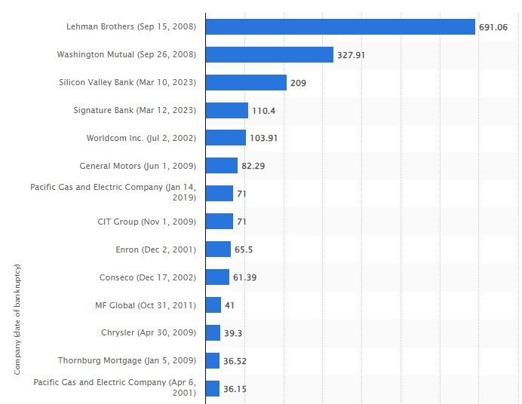
Predictive Modeling for Financial Failure
Introduction:
Importance of Predicting Financial Failure
Financial failure has significant negative impacts on economies and businesses.
Impact on Economies and Businesses
Historical cases like Lehman Brothers ($ 691 B) and Silicon Valley Bank ($ 209 b) demonstrate the widespread consequences.
Most companies went bankrupt in the last two decades

Slide 3
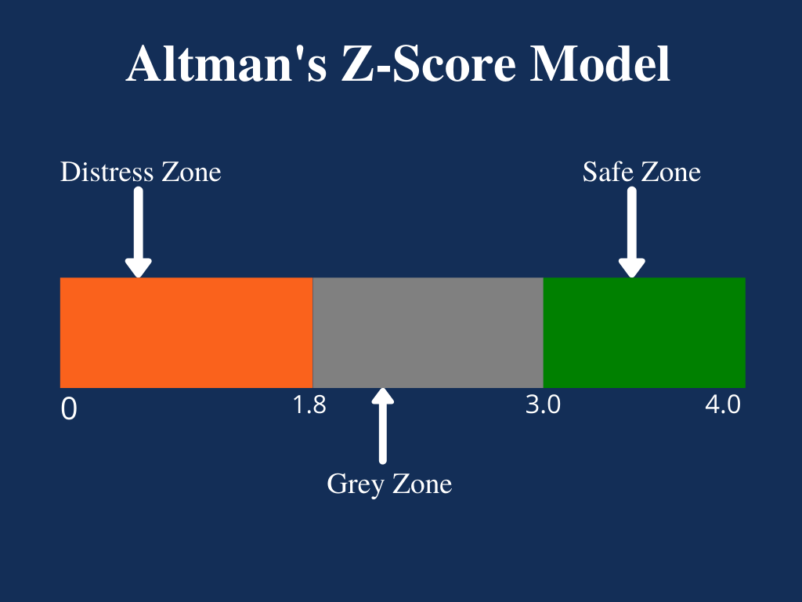
Predictive Modeling for Financial Failure
Historical Context
Evolution of Financial Failure Prediction Models
From the Beavers model in 1966 to Altman Z-Score model in 1968.
Various models have been developed to predict financial failure.
Altman's Z-Score model
Predicts business bankruptcy within two years.
Three different Z-scores for different business types.
72 % accuracy in predicting bankruptcy two years
6 % false positives.
False positives are higher (15-20%) when predicting bankruptcy one year in advance.

Slide 4
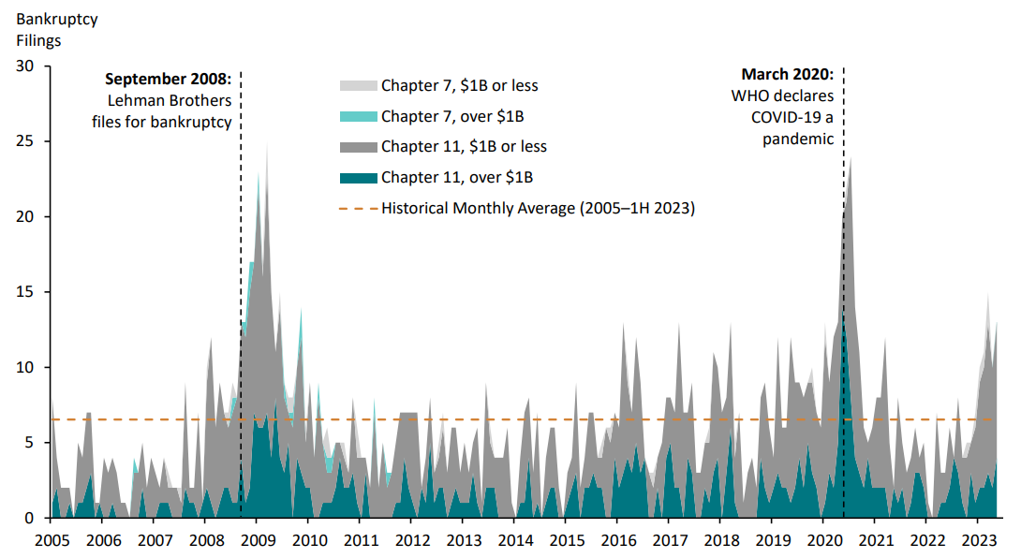
Predictive Modeling for Financial Failure
Problem Statement:
Consequences of Financial Failure:
Economic downturn, job losses, market instability.
Historical Cases:
Lehman Brothers, Washington Mutual, Silicon Valley Bank
Notable examples of financial failure and bankruptcy.
The number of companies that filed for bankruptcy from the year 2005 to 2023

Slide 5
Predictive Modeling for Financial Failure
Problem Statement:
Consequences of Financial Failure:
Economic downturn, job losses, market instability.
Historical Cases:
Lehman Brothers, Washington Mutual, Silicon Valley Bank
Notable examples of financial failure and bankruptcy.
Economic Impacts:
Unemployment, Market Fluctuations
Financial failures of large companies have far-reaching effects on employment and market stability.

Slide 6

Predictive Modeling for Financial Failure
Project Overview
Prediction Models:
Artificial Neural Networks
Linear Regression
Decision Tree
Tools Used:
ML, Tensorflow, Flask, JavaScript, SQL databases.
Sample Size:
200 Canadian companies listed on the Canadian stock market

Slide 7
Predictive Modeling for Financial Failure
Objectives of the project:
Main Objective:
Developing a Model for Predicting Financial Failure using Artificial Neural Networks
Sub-Objectives:
Reviewing AI Applications in Financial Failure Prediction
Testing Accuracy of Proposed Model
Identifying Optimal Financial Indicators Combination
Providing Recommendations for Mitigating Financial Failure

Slide 8
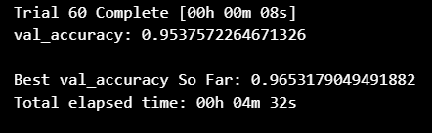
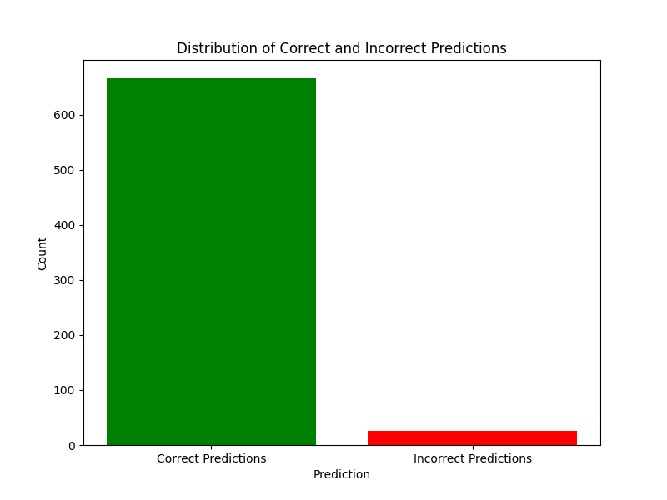
Predictive Modeling for Financial Failure
The Results:
Accuracy Rates of Neural Networks vs. Other Models:
Neural network (NN) Results:
Artificial neural networks demonstrated a 96.53% accuracy rate.

Slide 9
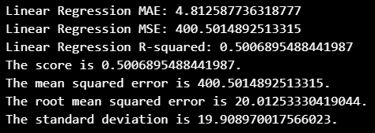
Predictive Modeling for Financial Failure
The Results:
Accuracy Rates of Neural Networks vs. Other Models:
Linear Regression (LR) Results:
Mean Absolute Error (MAE): 4.81
Measures average prediction error. Lower values indicate better accuracy.
Mean Squared Error (MSE): 400.50
Measures average squared prediction error. Lower values indicate better accuracy.
R-squared: 0.50
Indicates how well the model fits the data. Higher values indicate better fit.
Root Mean Squared Error (RMSE): 20.01
Measures average prediction error. Lower values indicate better accuracy.
Standard Deviation: 19.91
Measures variability of prediction errors. Lower values indicate more consistent predictions.

Slide 10
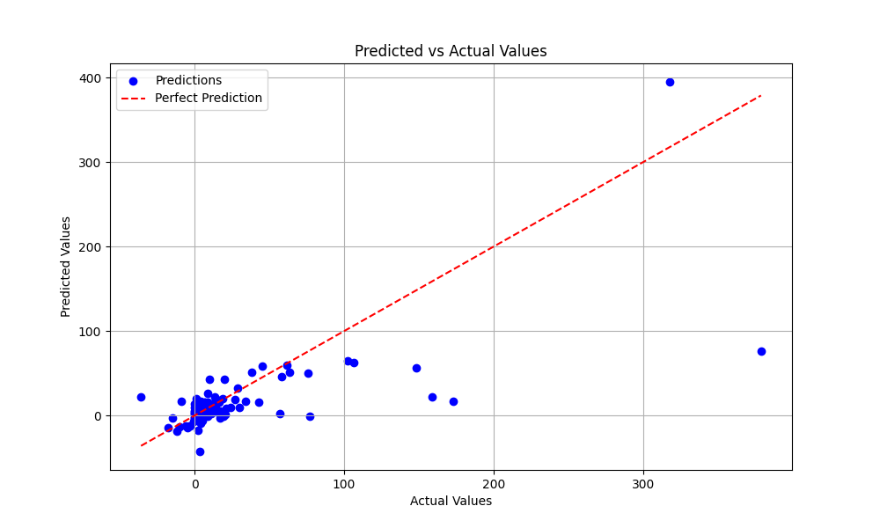
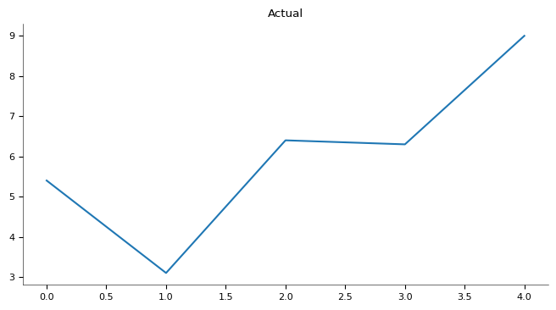
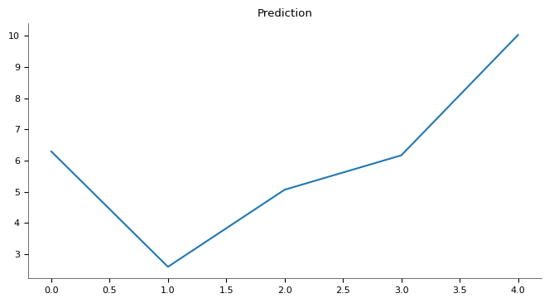
Predictive Modeling for Financial Failure
The Results:
Linear Regression (LR) Results:

Slide 11
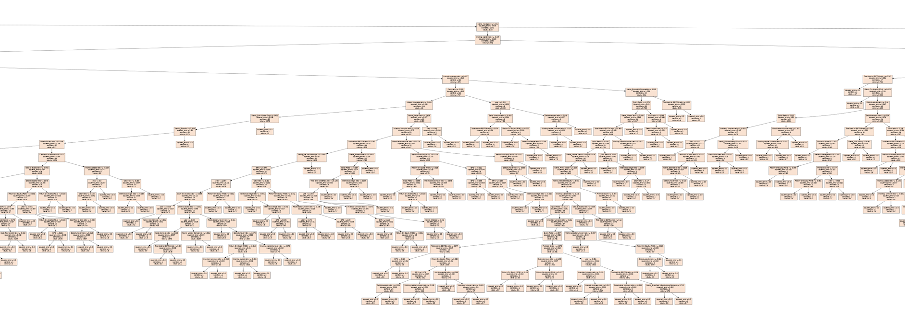
Predictive Modeling for Financial Failure
The Results:
Decision Tree Analysis:
provided valuable insights into the hierarchical structure of the data and the decision-making process.
Visualization of the decision tree facilitated interpretation of key factors influencing financial failure prediction.
Examination of branches and nodes identified significant variables, refining the predictive model.

Slide 12


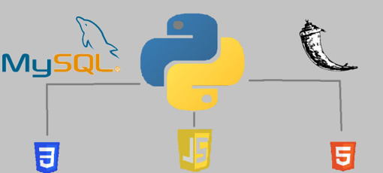
Predictive Modeling for Financial Failure
Implementation Overview
Machine Learning and Neural Networks:
Leveraged for predictive modeling and analysis.
Linear Regression:
Utilized for establishing predictive relationships between variables.
TensorFlow:
Employed for implementing neural networks and deep learning models.
Flask Framework:
Overview of Flask for web application development.
JavaScript:
Role in dynamic interactions and data visualization.
SQL Databases:
Storage and retrieval of data for analysis.

Slide 13
Predictive Modeling for Financial Failure
Summary:
Comparison with Historical Models (e.g., Altman's Model)
The advancements and improvements achieved with artificial neural networks compared to traditional models.
Practical Implications for Businesses and Investors
Importance of implementing predictive models to mitigate financial risks.
Future Research Directions
Trying to reach more accurate results through Providing the network with more data to help it in the training process more accurately
Research for other financial indicators

Slide 14


