Slide 1

Technology Titans Project
Prepared by
Instructor
Piro Dhimitri
06 Mar 2024
Aayush Chhaperwal | Jash Bikash
Johnny Nguyen | Maher Alqarra
I Lun Wu

Slide 2
Technology Titans Project
Project Overview
Objective:
Help investors make informed decisions about technology sector investments worldwide.
Methodology:
Analyze macroeconomic and microeconomic indicators.
Tools Used:
Flask, JavaScript, SQL databases.

Slide 3
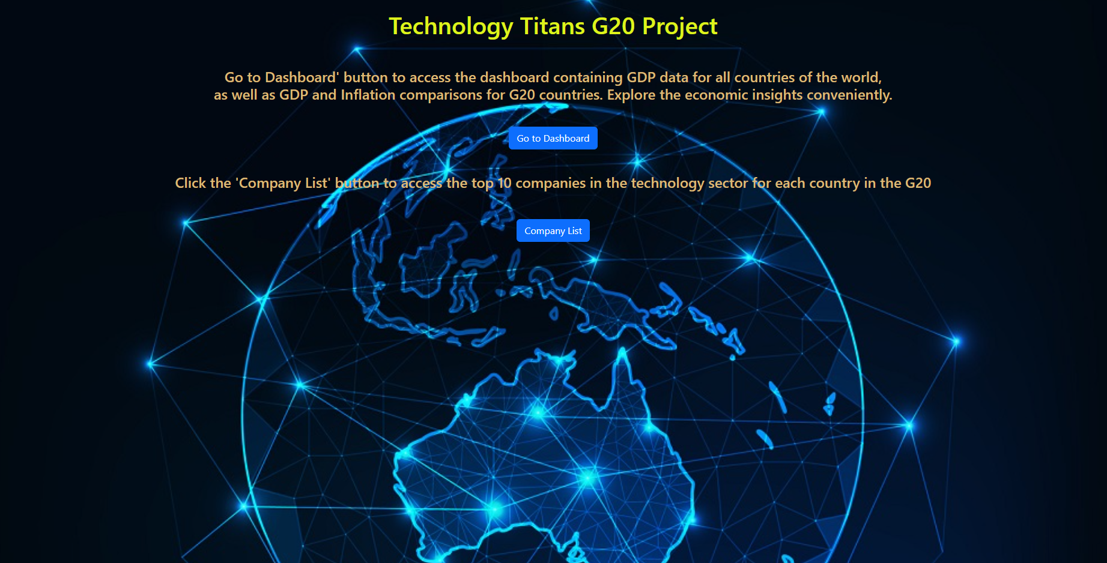
The Main Page

Slide 4
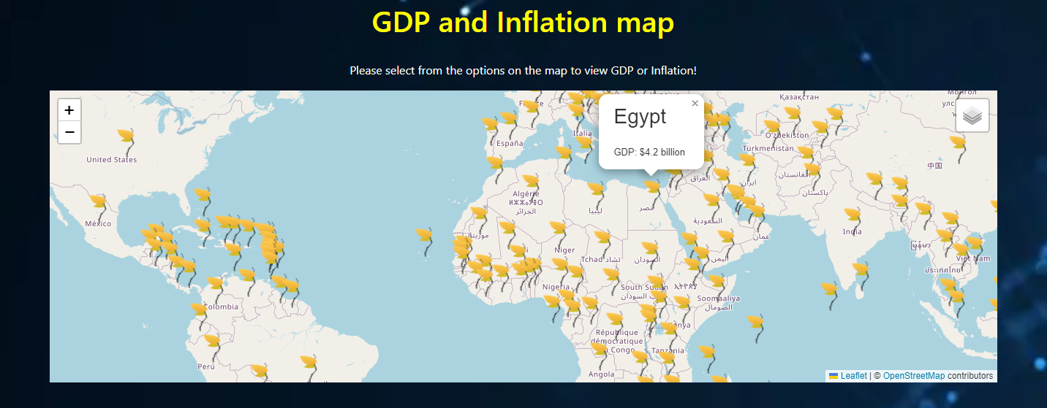
Macroeconomic Analysis
GDP Analysis:
Display of GDP for all countries and G20 nations.

Slide 5
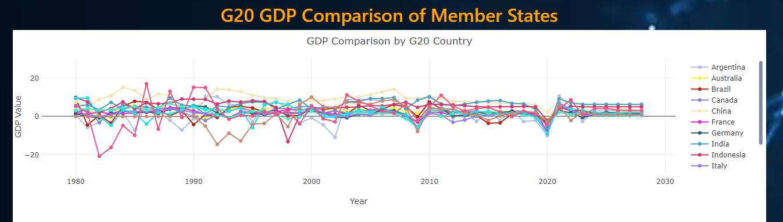
Macroeconomic Analysis
GDP Analysis:
Line chart comparing G20 GDP across member states from 1980 to 2023.
with a projection to 2028.

Slide 6
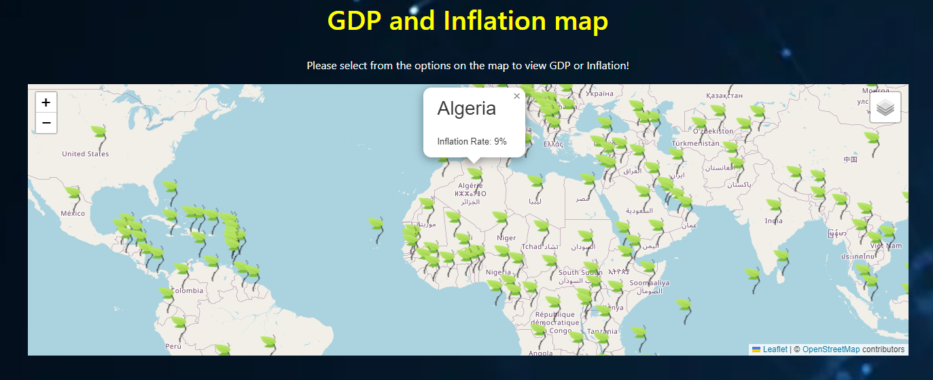
Macroeconomic Analysis
Inflation Rate:
Visualization of inflation rates globally and among G20 countries.

Slide 7
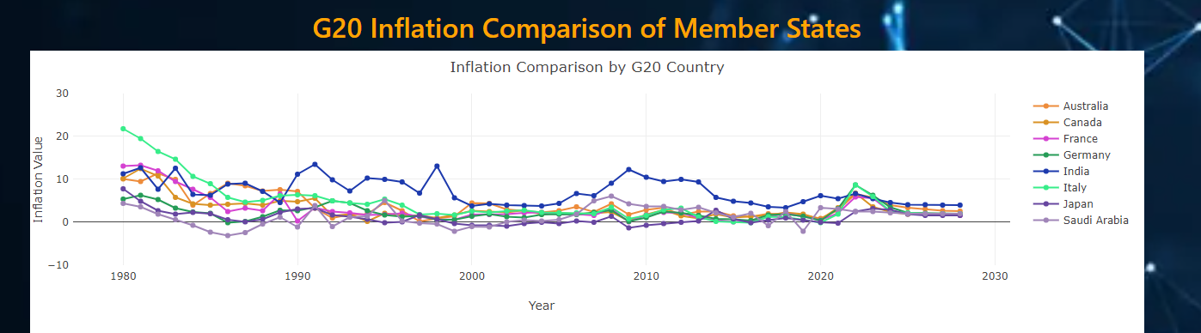
Macroeconomic Analysis
Inflation Rate:
Line chart comparing G20 GDP across member states from 1980 to 2023.
with a projection to 2028.

Slide 8
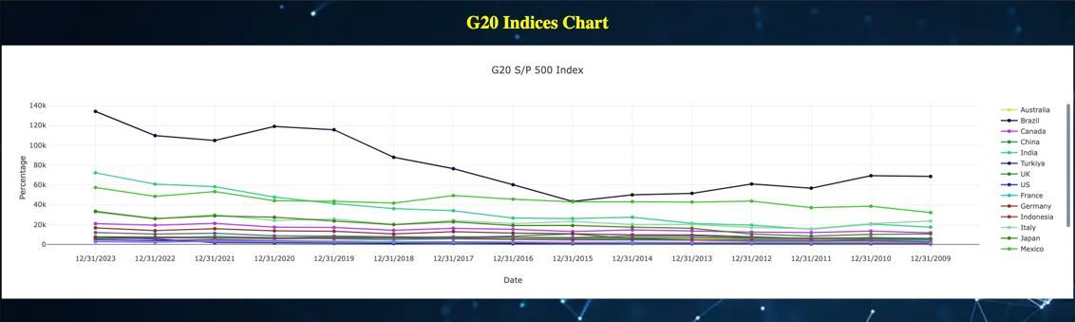
Microeconomic Analysis
Stock Market Performance:
Showcase performance of stock market indices for G20 countries.
Economic Stability:
Link between stock market performance and economic stability.

Slide 9
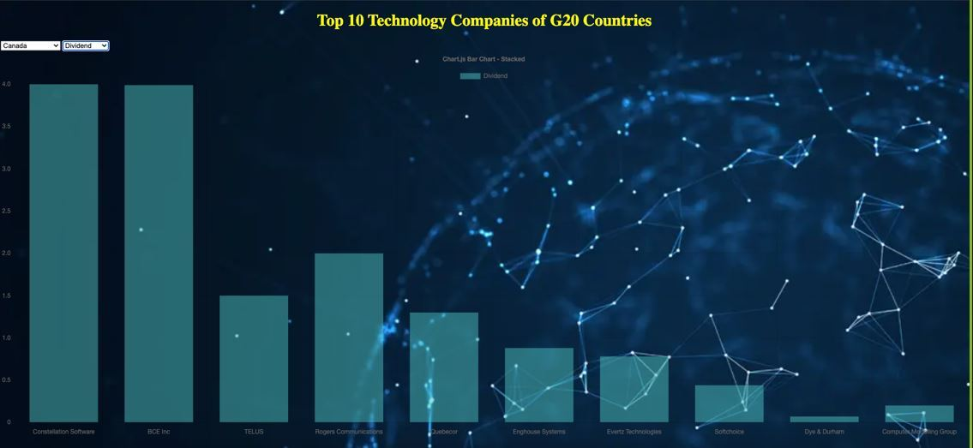
Top Technology Companies Analysis
Selection Criteria:
Market size, Cash dividends, Dividend-to-price ratio.
Presentation:
Display of top 10 technology companies in each G20 country.

Slide 11

Implementation Overview
Flask Framework:
Overview of Flask for web application development.
JavaScript:
Role in dynamic interactions and data visualization.
SQL Databases:
Storage and retrieval of data for analysis.

Slide 12


