Slide 1

Technology Titans Project
Prepared by
Instructor
Piro Dhimitri
06 Mar 2024
Aayush Chhaperwal | I Lun Wu | Jash Bikash
Johnny Nguyen |  | Maher Alqarra

Slide 2
Technology Titans Project
Project Overview
Objective:
Help investors make informed decisions about technology sector investments worldwide.
Methodology:
Analyze macroeconomic and microeconomic indicators.
Tools Used:
Flask, JavaScript, SQL databases.

Slide 3
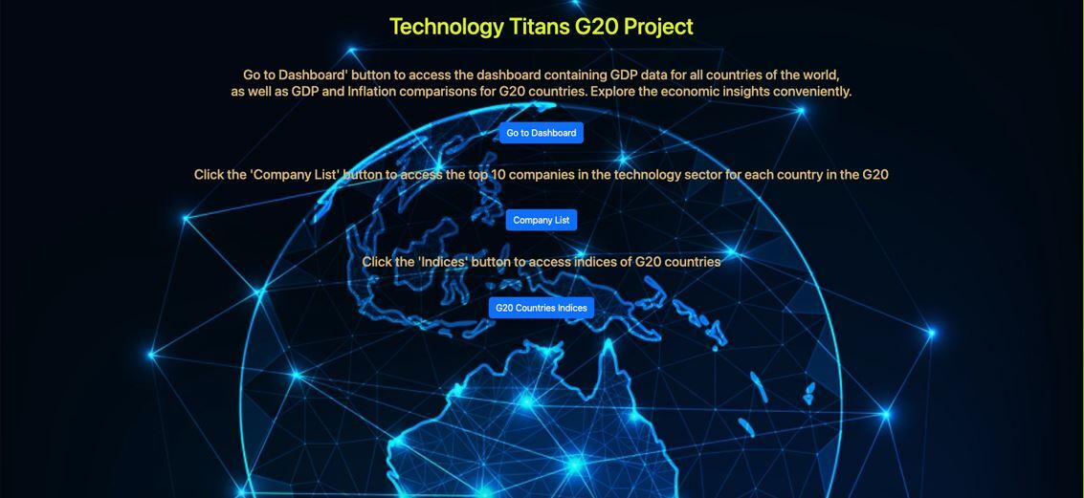
The Main Page

Slide 4
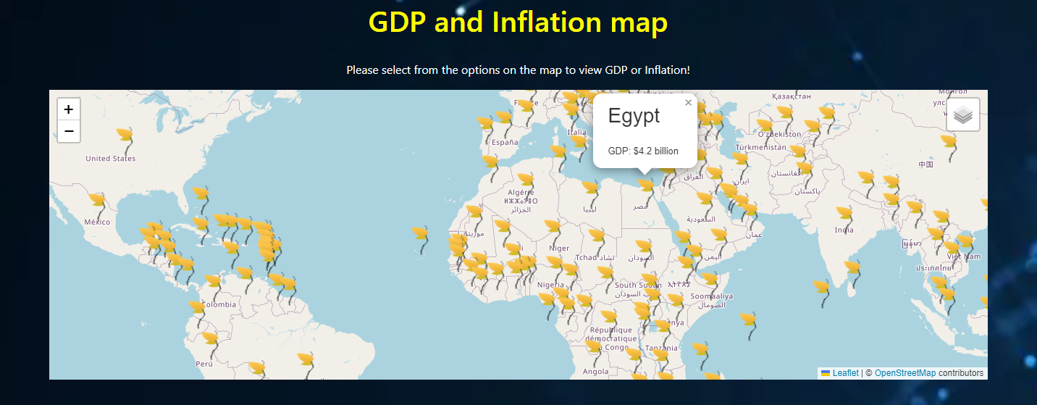
Macroeconomic Analysis
GDP Analysis:
Display of GDP for all countries and G20 nations.

Slide 5
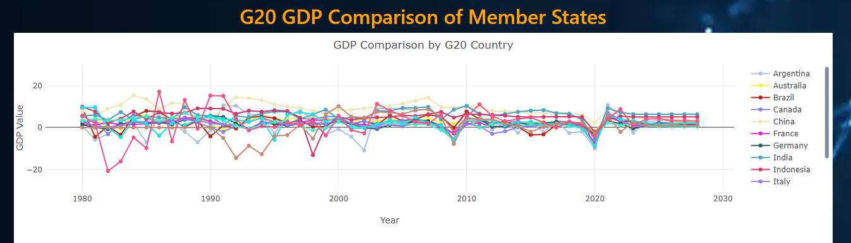
Macroeconomic Analysis
GDP Analysis:
Line chart comparing G20 GDP across member states from 1980 to 2023.
with a projection to 2028.

Slide 6
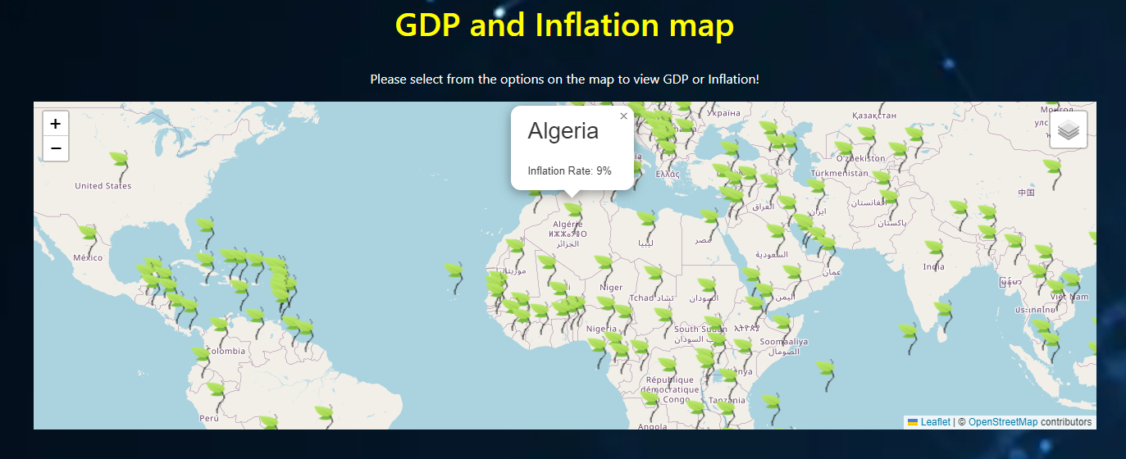
Macroeconomic Analysis
Inflation Rate:
Visualization of inflation rates globally and among G20 countries.

Slide 7
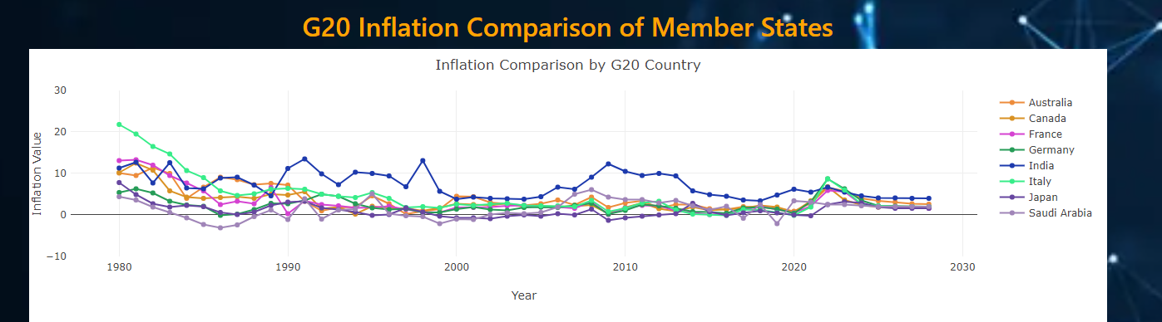
Macroeconomic Analysis
Inflation Rate:
Line chart comparing G20 GDP across member states from 1980 to 2023.
with a projection to 2028.

Slide 8
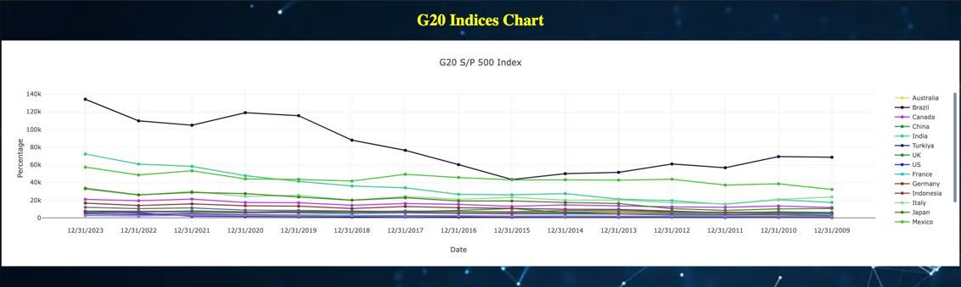
Microeconomic Analysis
Stock Market Performance:
Showcase performance of stock market indices for G20 countries.
Economic Stability:
Link between stock market performance and economic stability.

Slide 9
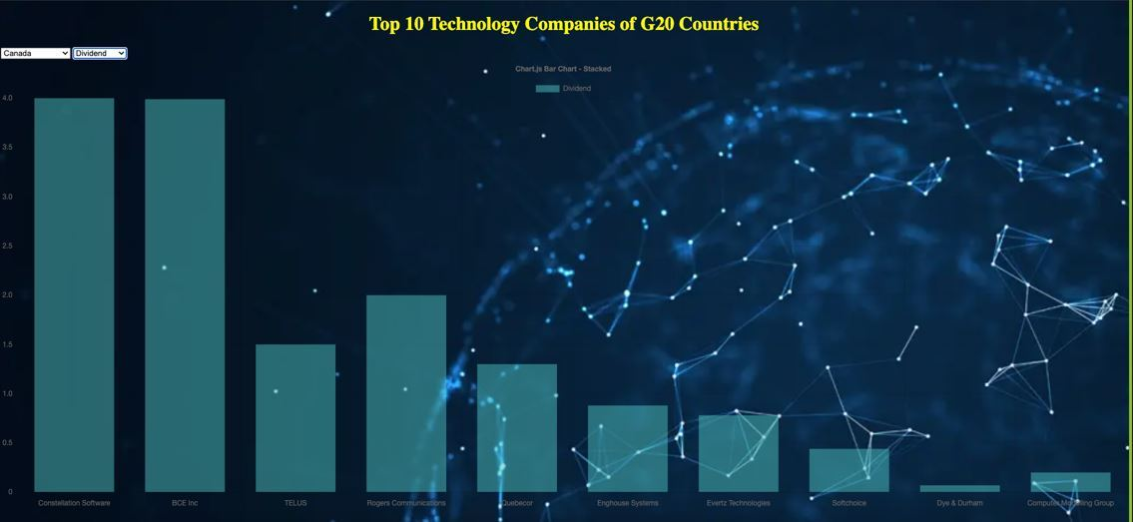
Top Technology Companies Analysis
Selection Criteria:
Market size, Cash dividends, Dividend-to-price ratio.
Presentation:
Display of top 10 technology companies in each G20 country.

Slide 10
Top Technology Companies Analysis
Selection Criteria:
Market size, Cash dividends, Dividend-to-price ratio.
The result:
Display of top 15 technology companies based on composite score:
# | Company name | # | Company name
01 | Apple (Mexico) | 02 | NVIDIA (Mexico)
03 | Oracle (Mexico) | 04 | Qualcomm (Italy)
05 | Nokia Oyj (France) | 06 | Rakus Co Ltd (Japan)
07 | SAP (Italy) | 08 | Infomart (Japan)
09 | Panasonic (United Kingdom) | 10 | Broadcom (Brazil)
11 | Fast Accounting (Japan) | 12 | Constellation Software (Canada)
13 | Sopra Steria (France) | 14 | Capgemini (France)
15 | BCE Inc (Canada)
Note: The data contained in this table is for educational purposes only. We do not bear responsibility for the sale or purchase of any security.

Slide 11
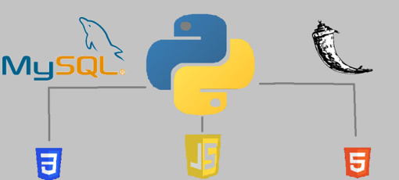
Implementation Overview
Flask Framework:
Overview of Flask for web application development.
JavaScript:
Role in dynamic interactions and data visualization.
SQL Databases:
Storage and retrieval of data for analysis.

Slide 12
Future Development Plan
Objective:
Enhance analysis of technology sector investments and other sectors.
Plan:
Establish additional financial indicators to better evaluate securities.
Utilize artificial intelligence through machine learning for advanced analysis.
Benefits:
Improved decision-making for investors.
Enhanced accuracy and efficiency in security selection.

Slide 13


