Slide 1

Technology Titans Project
Project Overview
Objective:
Help investors make informed decisions about technology sector investments worldwide.
Methodology:
Analyze macroeconomic and microeconomic indicators.
Tools Used:
Flask, JavaScript, SQL databases.

Slide 2
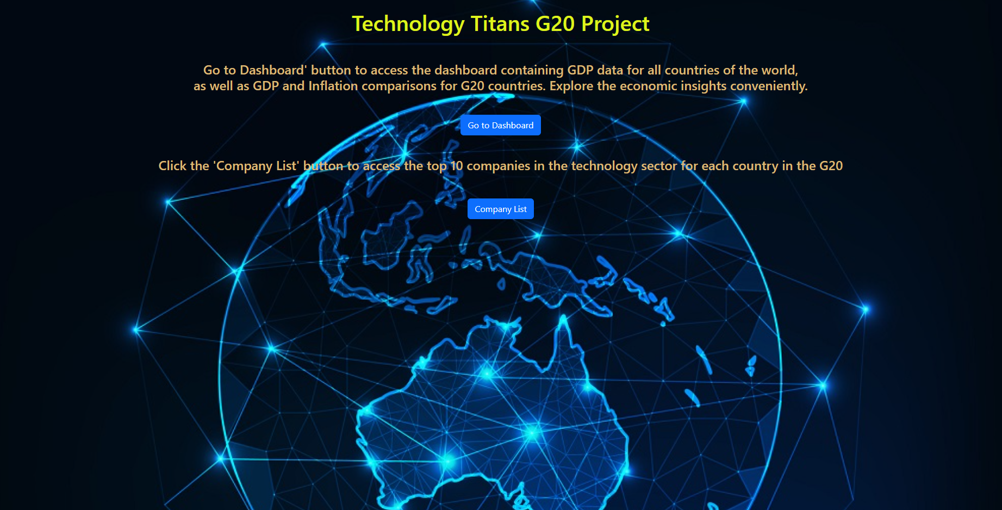
The Main Page

Slide 3
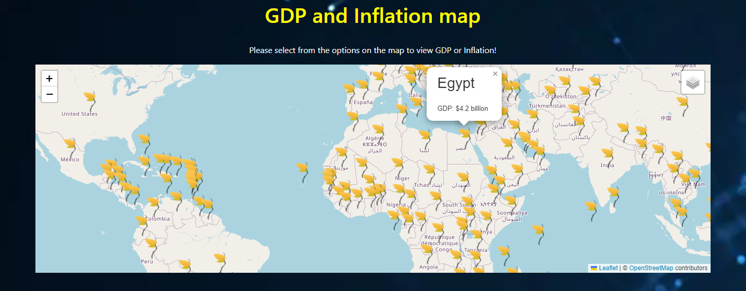
Macroeconomic Analysis
GDP Analysis:
Display of GDP for all countries and G20 nations.

Slide 4
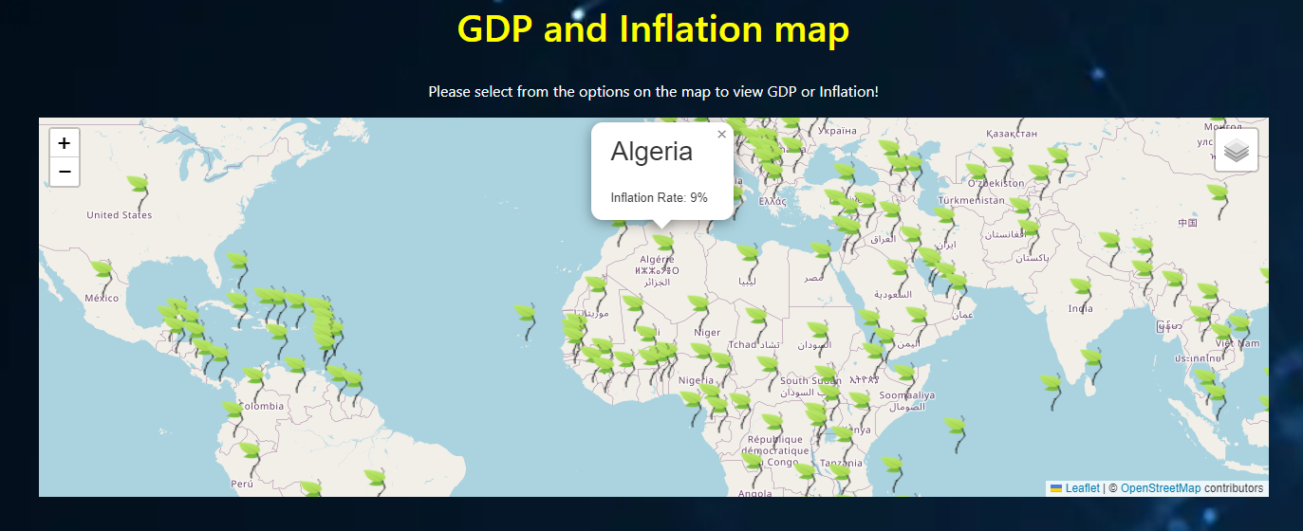
Macroeconomic Analysis
Inflation Rate:
Visualization of inflation rates globally and among G20 countries.

Slide 5
Macroeconomic Analysis
Inflation Rate:
Visualization of inflation rates globally and among G20 countries.

