Slide 1

✦ airbnb
NYC Airbnb
45,923
$119.97
Market Analysis
Total Listings
Avg. Price
23.94
70.07%
Helping users find the best Airbnb listings
based on price, location, reviews & availability
Avg. Reviews
Occupancy Rate
NEW YORK CITY · INSIDE AIRBNB · 2019 DATASET

Slide 2
Agenda
01
Problem Statement
Why analyzing NYC Airbnb data matters for travelers
02
Dataset Overview
45,923 listings across 5 NYC boroughs
03
Price Analysis
Price distribution, room types & neighborhood pricing
04
Location Analysis
Geographic spread, availability & top-value listings
05
Demand Analysis
Demand scores, occupancy & premium zones
06
Key Insights & Recommendations
Actionable findings for better booking decisions

Slide 3
PROBLEM STATEMENT
The Challenge
This project aims to analyze the Inside Airbnb NYC dataset to help users identify the most suitable Airbnb listings based on pricing, neighborhood, reviews, availability, and stay preferences — enabling better booking decisions.
🏙️
NYC has 45,923+ listings across 5 boroughs — overwhelming for travelers
💰
Prices range from budget to luxury with no easy way to compare value
⭐
Review patterns vary significantly by neighborhood & room type
📅
Availability and minimum-night restrictions affect booking flexibility

Slide 4
DATA PREPROCESSING
Data Cleaning Process
01
Initial Data Inspection
06
Feature Engineering
Loaded AB_NYC_2019.csv (48,895 rows × 16 cols). Checked shape, dtypes, null counts via df.info() and df.isnull().sum().
New column: price_per_person = price / (minimum_nights + 1), rounded to 2 decimal places.
02
Handle Missing Values
07
Column Standardization
name (16 nulls) → 'Unknown'. host_name (21) → 'Unknown'. last_review (10,052) → 'No Review'. reviews_per_month (10,052) → 0.
All column names → lowercase + underscores via str.lower().str.replace(' ','_').
03
Remove Duplicates
08
Final Verification
Applied df.drop_duplicates() — no duplicate rows found post-check.
Post-cleaning: 0 nulls, 0 duplicates. Final shape: 45,923 rows × 15 columns.
04
Data Type Conversion
09
Data Export
last_review converted to datetime using pd.to_datetime(errors='coerce').
Saved as processed_AB_NYC_2019.csv for Tableau visualization.
05
Outlier Treatment (IQR)
Removed price outliers outside Q1−1.5×IQR to Q3+1.5×IQR range.
NYC AIRBNB MARKET ANALYSIS · 2019 · INSIDE AIRBNB DATASET

Slide 5
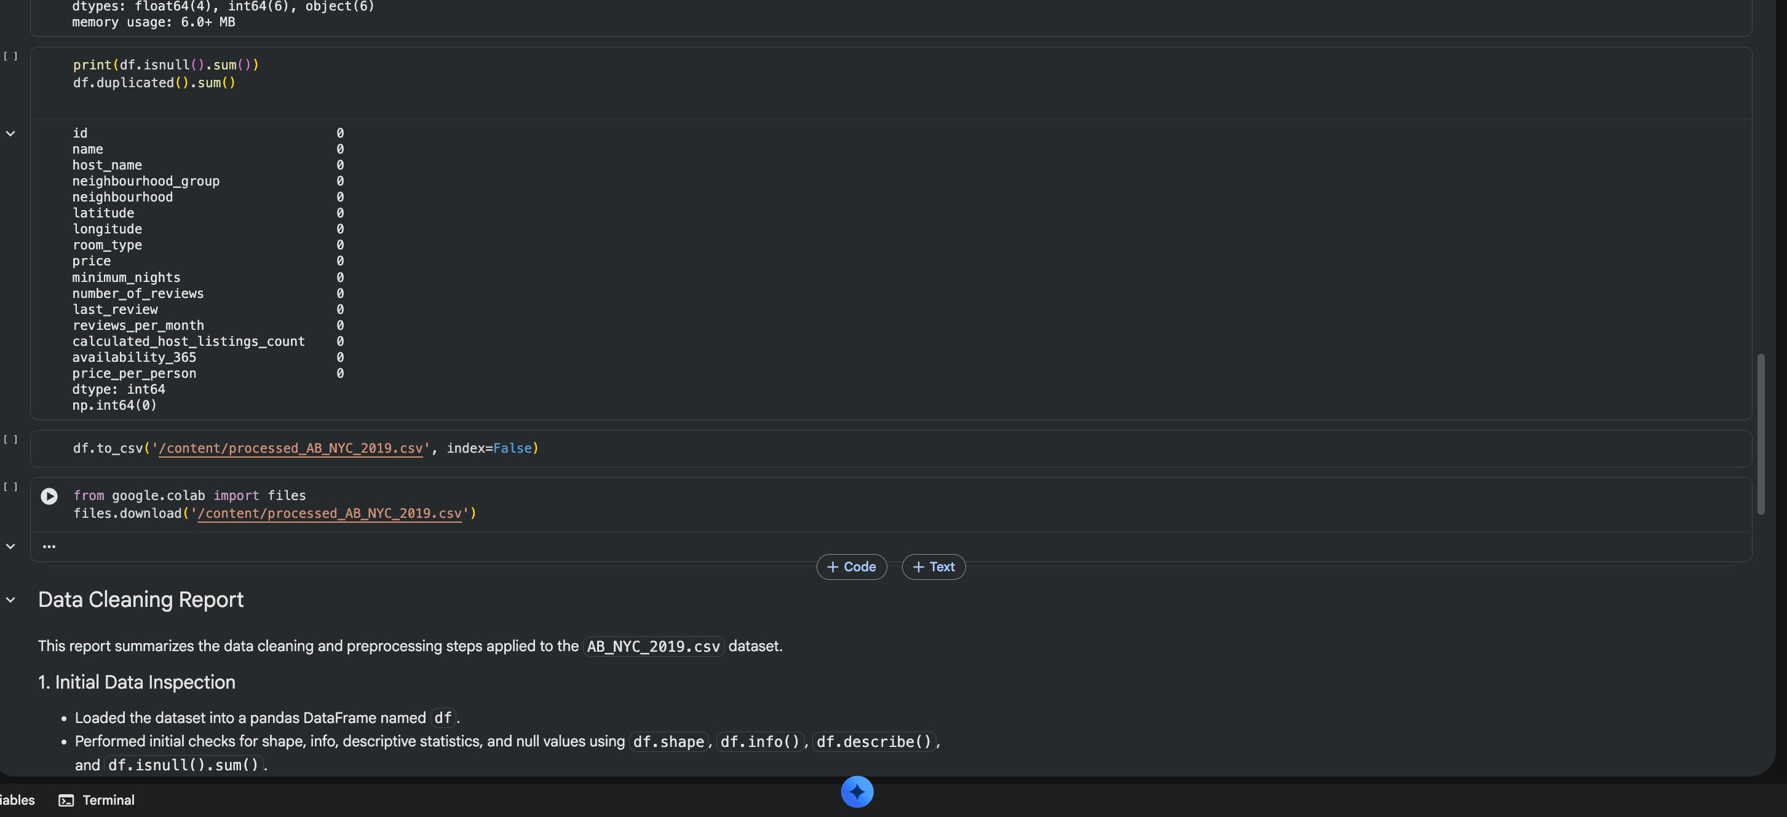
DATA PREPROCESSING
Raw Data → Clean Data
BEFORE CLEANING
AFTER CLEANING
✗ 48,895 rows × 16 columns
✓ 45,923 rows × 15 columns
✗ 16 nulls in name
✓ 0 nulls — all resolved
✗ 21 nulls in host_name
✓ 0 nulls — all resolved
✗ 10,052 nulls in last_review
✓ Filled with 'No Review'
✗ 10,052 nulls in reviews_per_month
✓ Filled with 0
Raw data — df.head()
✗ Price outliers present
✓ IQR outlier removal applied
✗ Mixed date formats (string)
✓ Proper datetime dtype
✗ Spaces in column names
✓ Clean snake_case names
✗ No price_per_person column
✓ price_per_person added
Post-cleaning: 0 null values
NYC AIRBNB MARKET ANALYSIS · 2019 · INSIDE AIRBNB DATASET

Slide 6
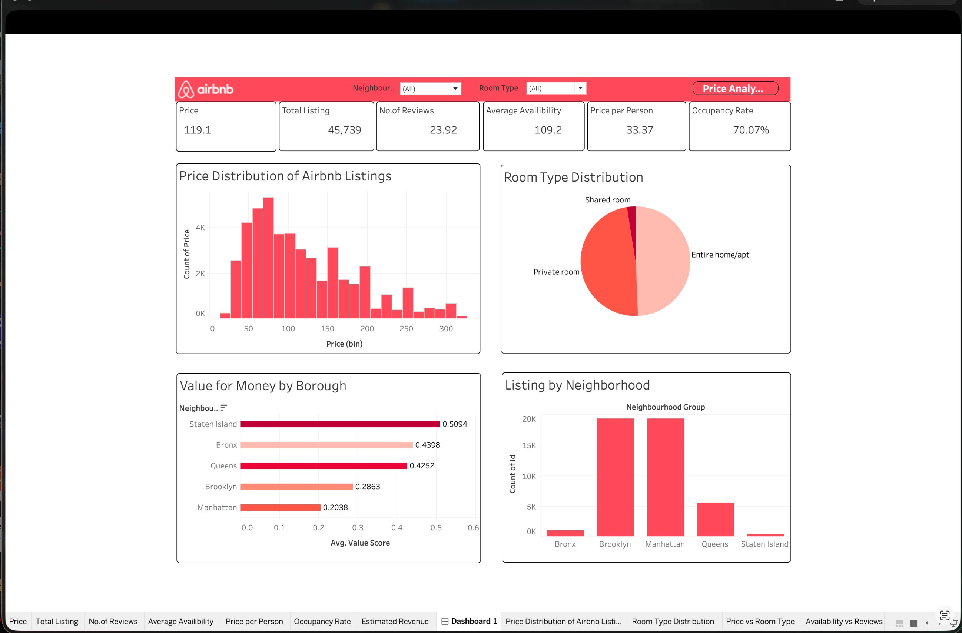
DATASET OVERVIEW
NYC Airbnb — At a Glance
45,923
5
$119.97
23.92
109.2 days
70.07%
Total Listings
NYC Boroughs
Avg. Price/Night
Avg. Reviews
Avg. Availability
Occupancy Rate
Tableau Dashboard 1 — Overview

Slide 7
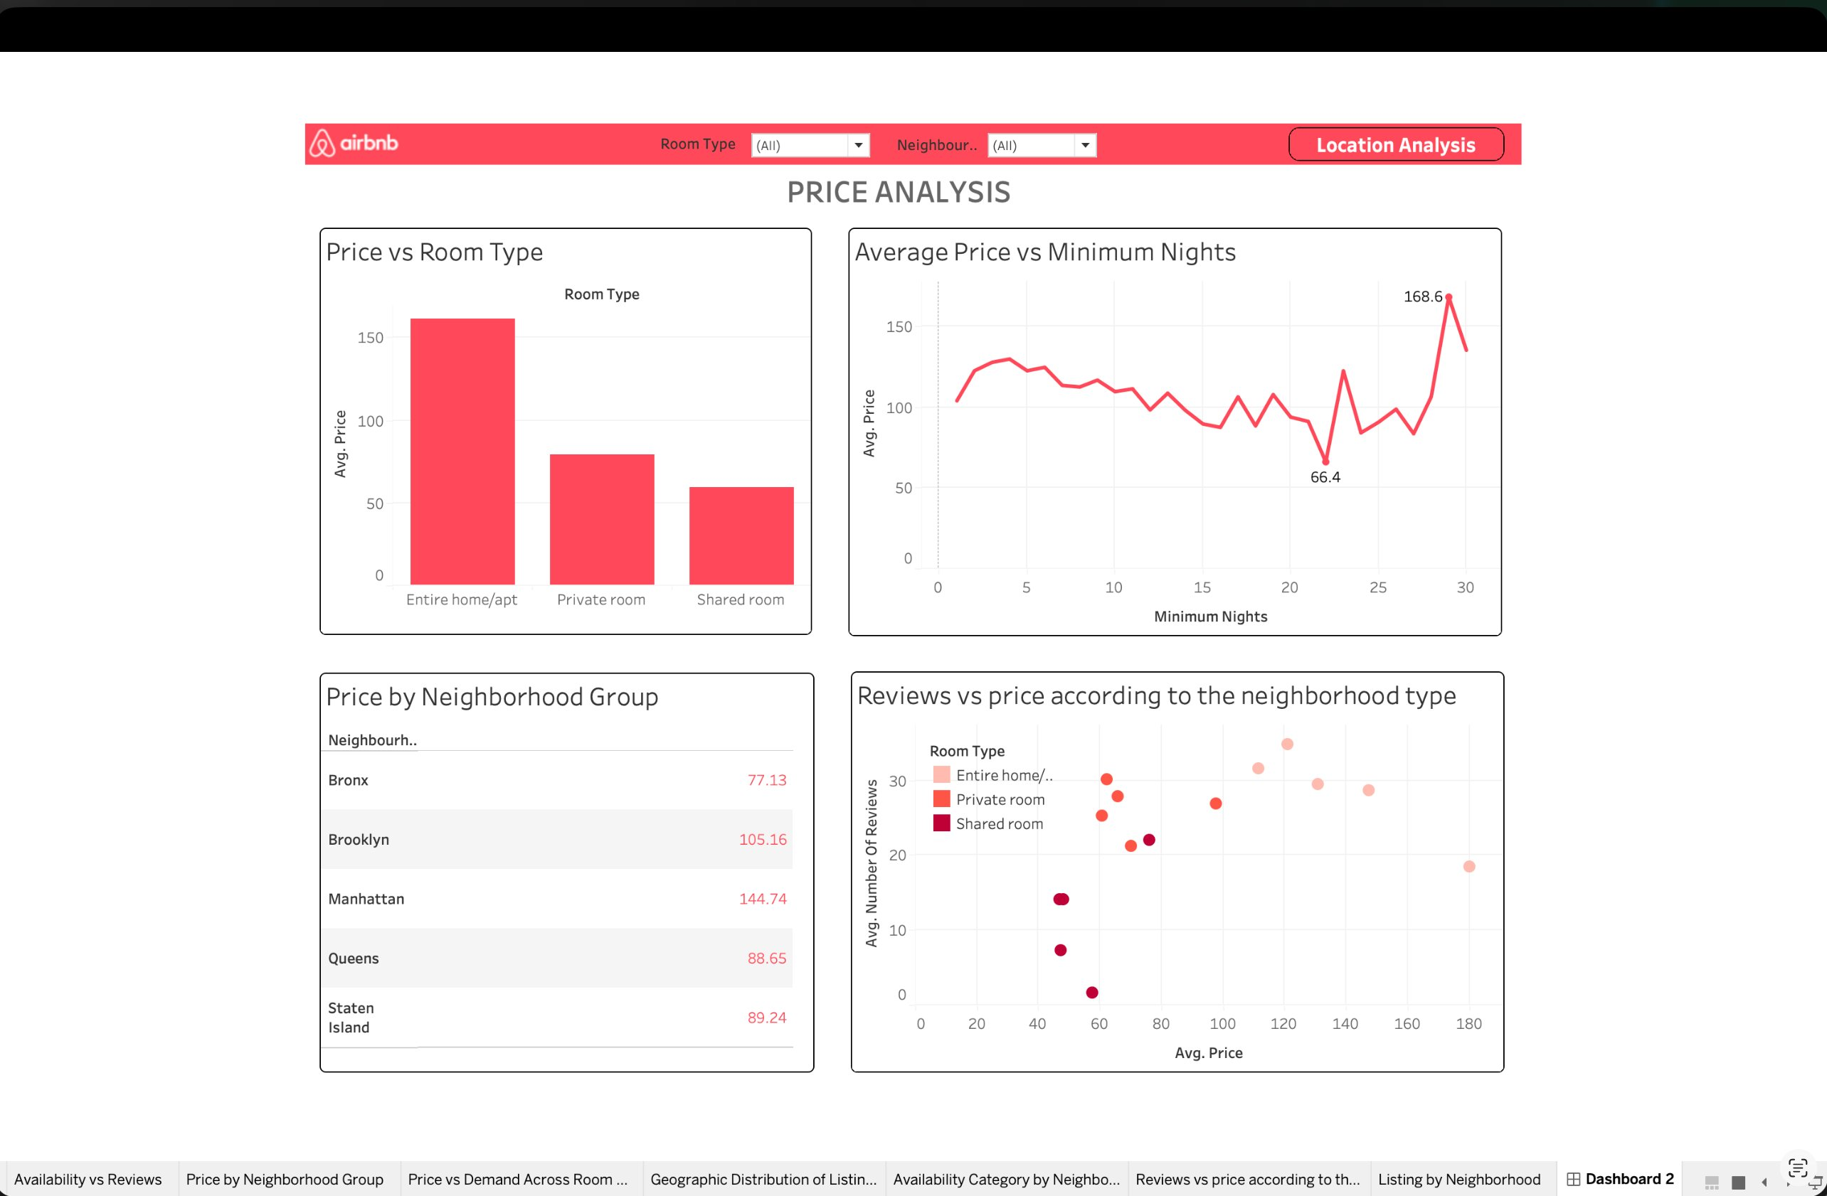
PRICE ANALYSIS
Pricing Across NYC
Key Findings
Manhattan leads at $145.95/night
Highest-priced borough — 22% above NYC avg
Bronx is most affordable at $77.37
Best value for budget-conscious travelers
Entire homes cost 2× private rooms
$160 vs $80/night avg — room type dominates price
Reviews drop with price
Higher-priced listings get fewer monthly reviews
Min-nights spike above $168 avg
Longer minimum stays push prices up significantly

Slide 8
PRICE ANALYSIS
Price by Borough & Room Type
Value for Money Score by Borough (higher = better value)

Slide 9
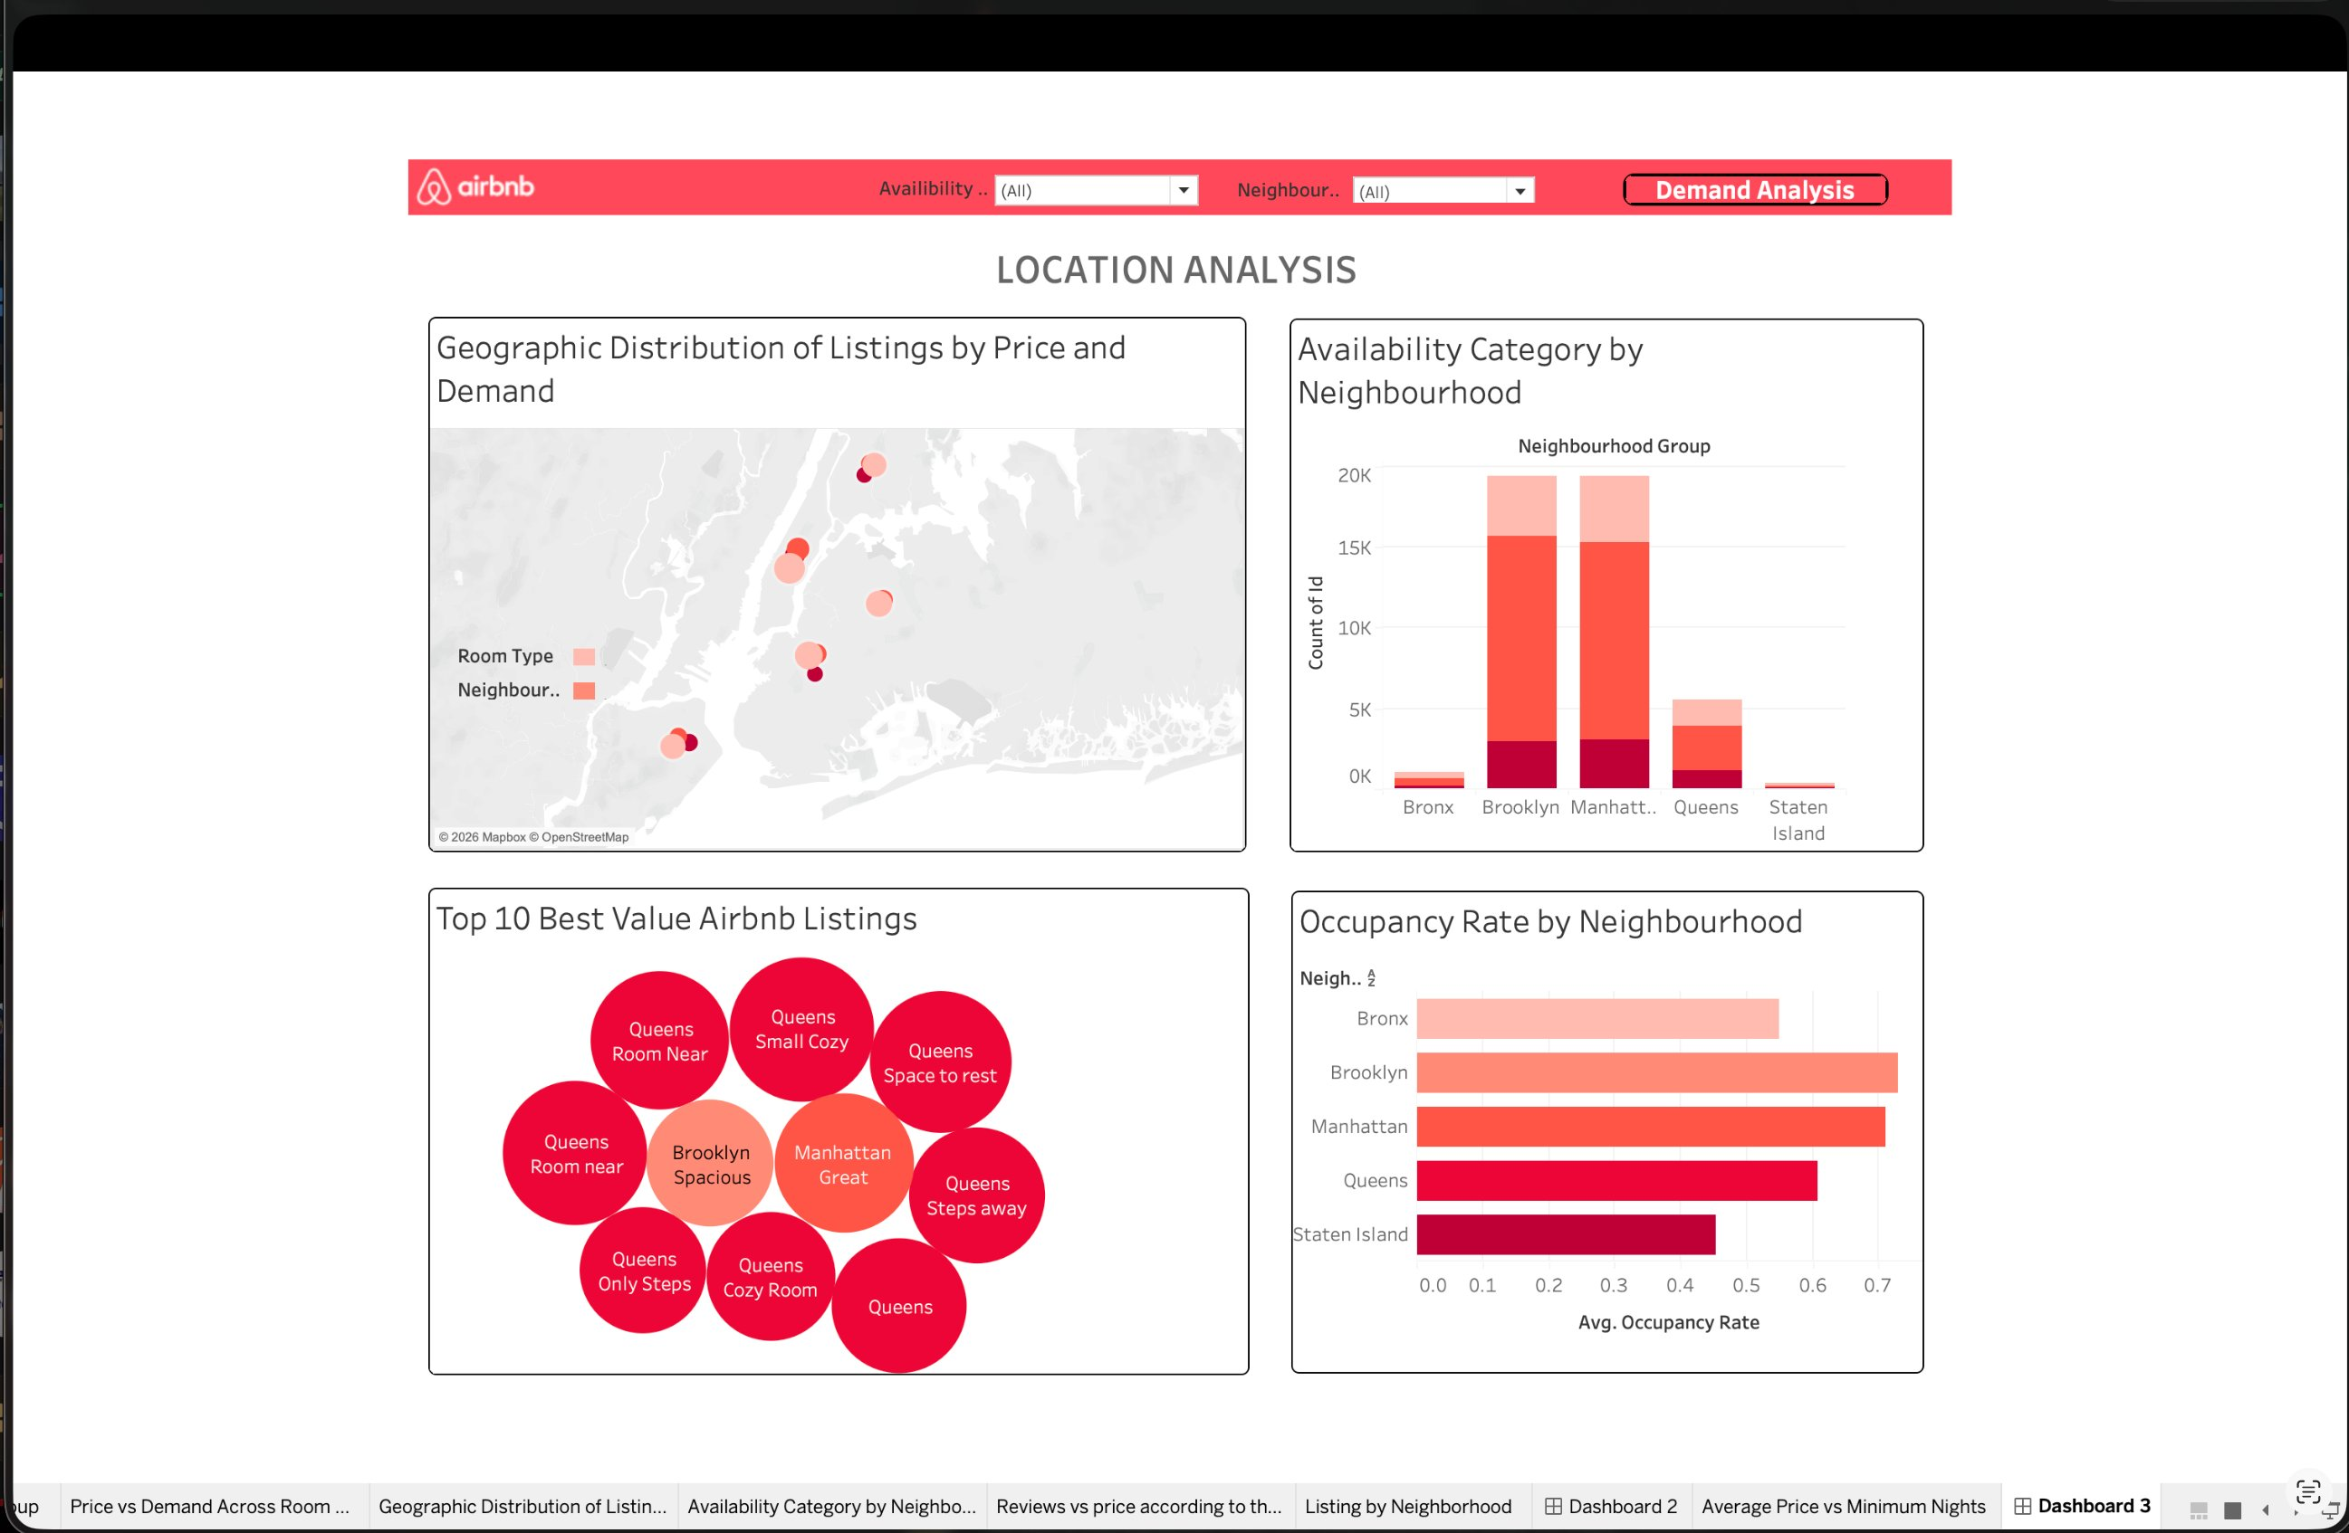
LOCATION ANALYSIS
Where Are the Listings?
Tableau Dashboard 3 — Location Analysis | Geographic distribution, availability by borough, top-value listings & occupancy rates
Brooklyn & Manhattan
Queens leads occupancy
Top 10 value listings
Dominate the market with ~42% of all listings each
Highest avg. occupancy rate at ~70% annually
Mostly Queens & Brooklyn — best price-to-quality ratio

Slide 10
LOCATION ANALYSIS
Listings & Occupancy by Borough
Insight:
Brooklyn and Manhattan dominate with 42% of listings each, but Queens delivers the highest occupancy rate at ~70%. Staten Island and Bronx remain underserved — lower competition means better availability for travelers seeking budget options.

Slide 11
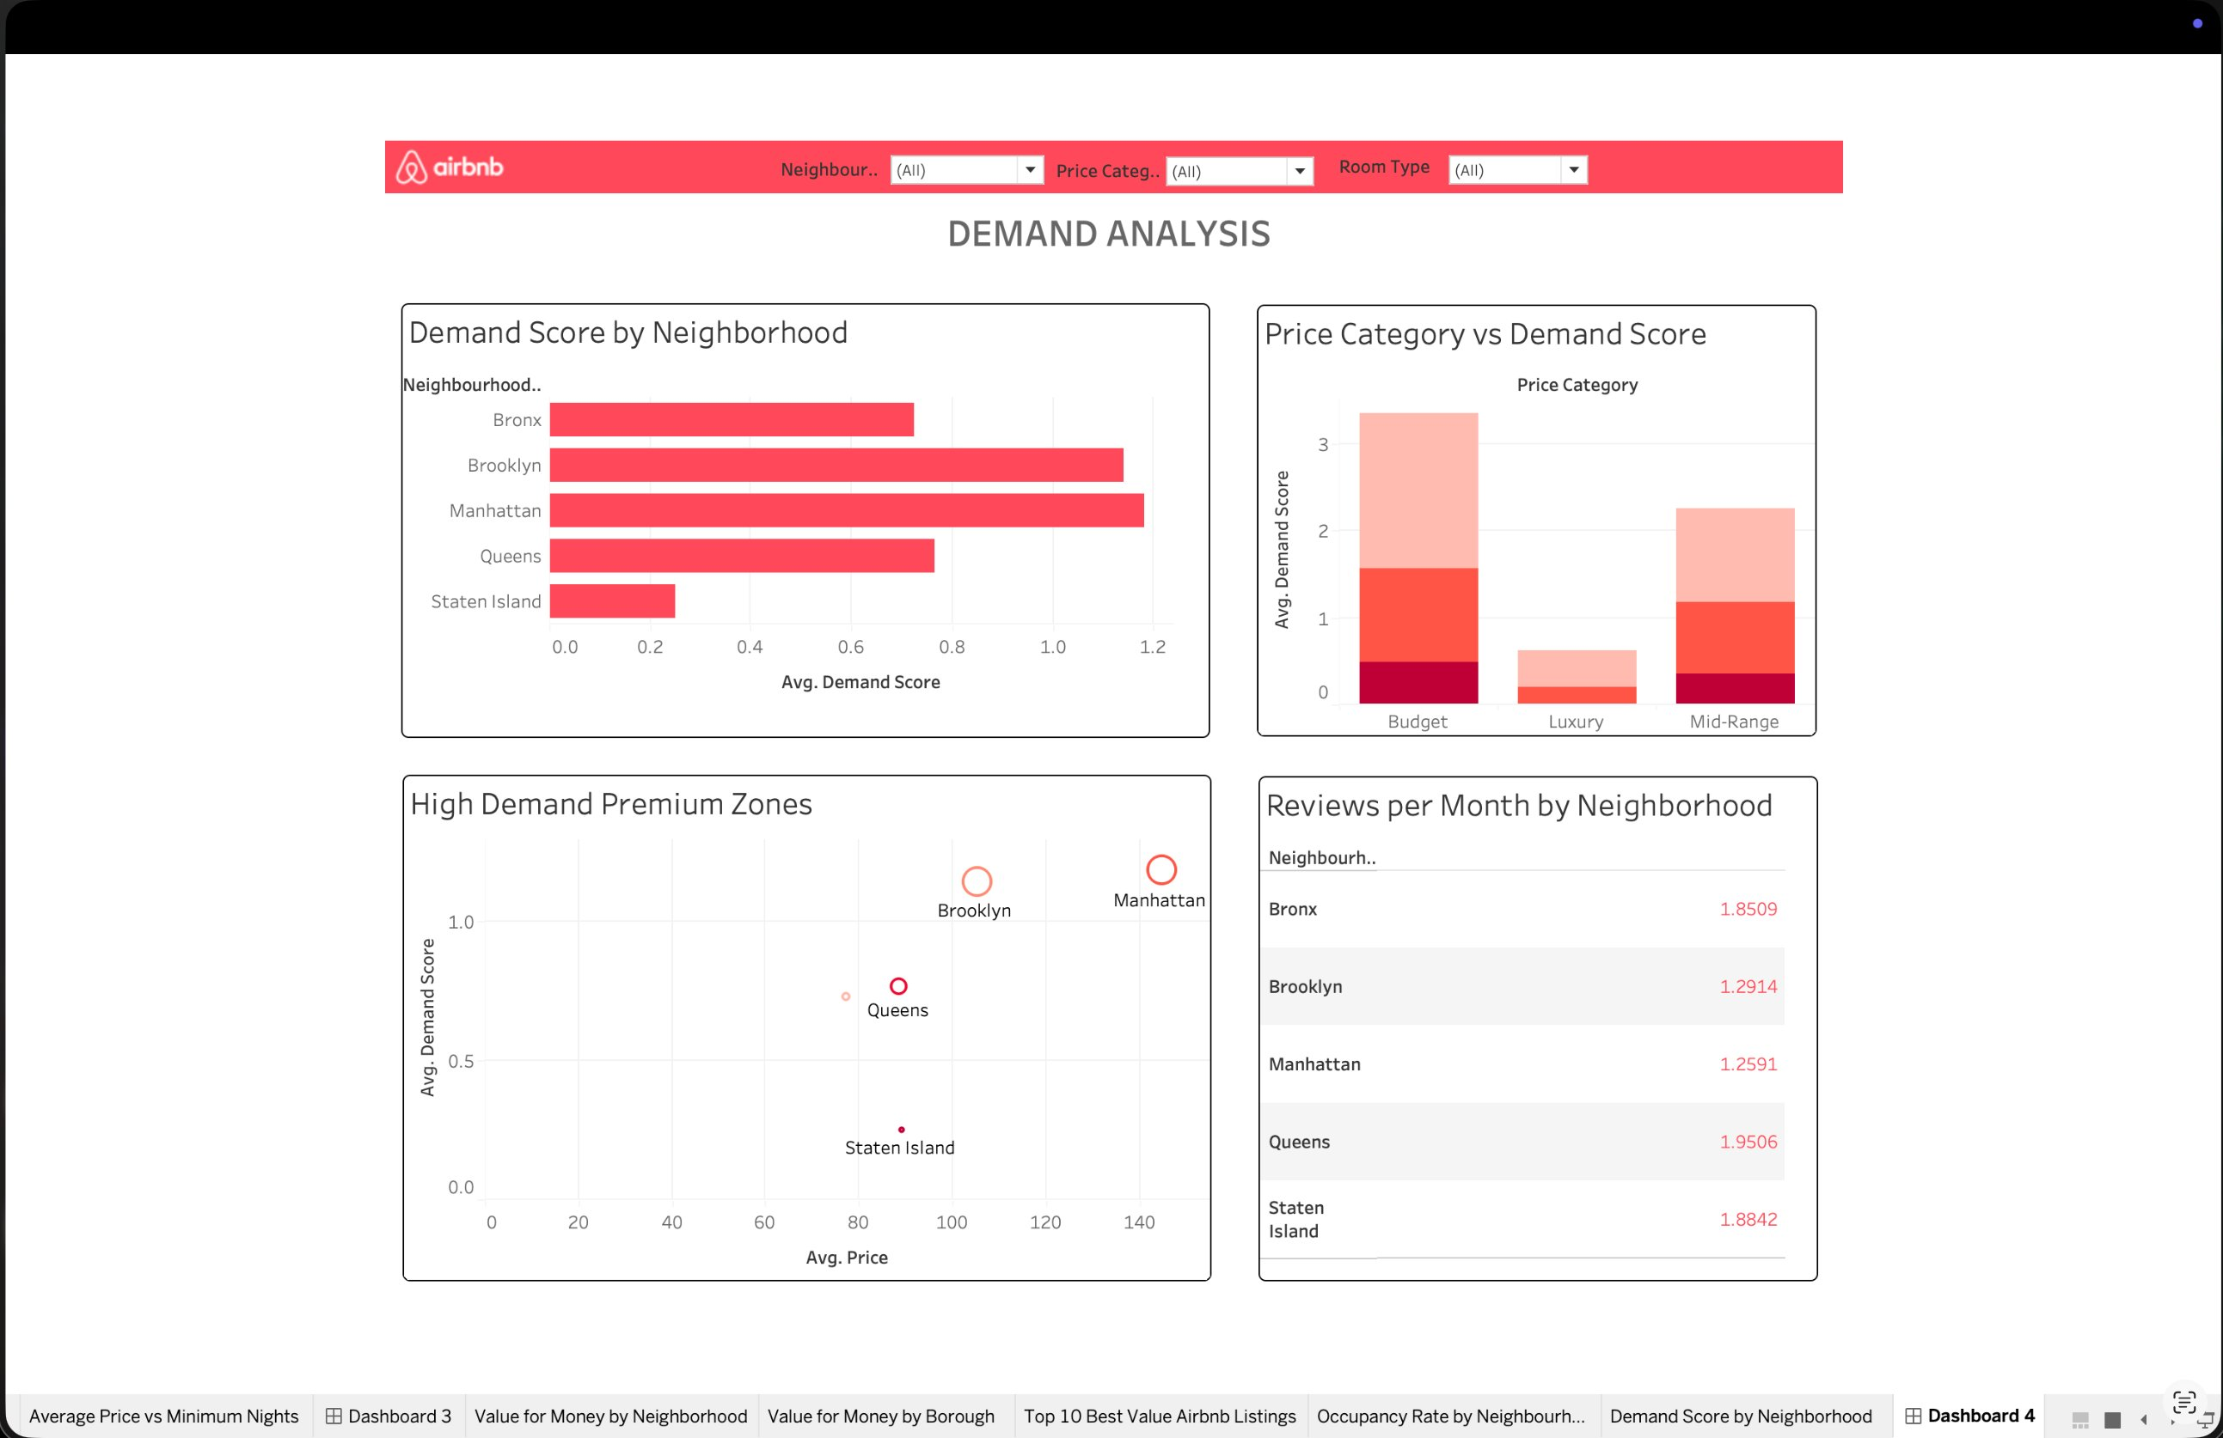
DEMAND ANALYSIS
Demand & Review Patterns
Tableau Dashboard 4 — Demand Analysis | Demand scores, price vs demand, premium zones & reviews per month
Manhattan highest demand
Budget = highest demand score
Bronx reviews/month = 1.85
Score ~1.2 — premium zone status
More bookings at lower price points (~3.5 avg)
Most reviewed per month — active engagement

Slide 12
DEMAND ANALYSIS
Demand Score & Reviews by Borough
Insight:
Manhattan and Brooklyn are high-demand premium zones — ideal for hosts seeking revenue. For budget travelers, Budget-category listings score highest in demand (~3.5 avg demand score). Queens has the most reviews/month (1.95), suggesting active, satisfied guests. Bronx and Staten Island offer low-competition opportunities with decent review rates.

Slide 13
KEY INSIGHTS
What the Data Tells Us
💎 01
⭐ 02
🏡 03
Manhattan = Highest Price & Demand
Queens = Best Value for Travelers
Staten Island = Hidden Gem
At $145.95 avg, Manhattan listings command the highest rates. Demand score (1.22) confirms premium status. Ideal for luxury travelers.
Avg price $88.90 + highest occupancy (70%) + most reviews/month (1.95). Queens offers the best combination of affordability and quality.
Highest value-for-money score (0.51) at low competition. Perfect for budget-conscious travelers avoiding tourist density.
📊 04
🏠 05
🔍 06
Budget Listings Drive Demand
Entire Homes Cost 2× More
Bronx = High Reviews, Low Traffic
Budget price category has the highest avg demand score (~3.5) — demand inversely correlates with price. More affordable = more booked.
Entire home/apt: ~$160/night vs Private room: ~$80/night. Choice of room type is the single biggest lever on price.
1.85 reviews/month despite just 1,070 listings. High satisfaction rate in an underexplored borough.

Slide 14
RECOMMENDATIONS
Who Should Book What?
💼 Business Traveler
$80-120/night
Central location, high availability, professional reviews
Manhattan · Private Room
👨‍👩‍👧 Family / Group
$100-140/night
More space, high occupancy signal, diverse neighborhoods
Brooklyn · Entire Home/Apt
🎒 Budget Backpacker
$50-80/night
Lowest prices, highest reviews/month, underexplored local culture
Queens or Bronx · Shared or Private Room
🏖️ Weekend Getaway
$70-100/night
Best value-for-money score (0.51), low competition, peaceful stays
Staten Island · Entire Home/Apt

Slide 15
✦ airbnb
Thank You
Questions & Discussion
Dataset: Inside Airbnb NYC 2019 · 45,923 Listings · 5 Boroughs
Tableau: public.tableau.com/app/profile/jashvitha.omkaram/viz/BNBnycalmostfinal/Dashboard1
NYC AIRBNB MARKET ANALYSIS · 2019 · INSIDE AIRBNB DATASET

Slide 16
✦ airbnb
Meet the Team
Role
Name
Project Lead
Data Lead
ETL Lead
Analysis Lead
Visualization Lead
Strategy Lead
PPT and Quality Lead
Jashvitha
Krish
Akhil
Aditya
Jashvitha
Abhishek
Chaitanya
NYC AIRBNB MARKET ANALYSIS · 2019 · INSIDE AIRBNB DATASET

