Slide 1

#Team-22
aligned to Saraswati Seva Foundation

Slide 2


Don’t worry ! I have got you Saraswati Seva Foundation that will cover whatever your need is.
I need to gain confidence and get resources to upskill for my interview and there is no such platform
Arjun
Rahul

Slide 3
Our Challenge:
The organization would like to use technology to help facilitate skilling-up, recruitment opportunity awareness and drives.
The students facing lack of confidence to express themselves for the interviews.
The students unable to easily access the desired resources to get them industry ready.
The students were not getting feedback for their performance

Slide 4
You just need to log in into the platform and after that you have a lots of wonderful features in it
Let me walk you through that
what are the features on that platform? Can you please explain it to me
Rahul
Arjun

Slide 5
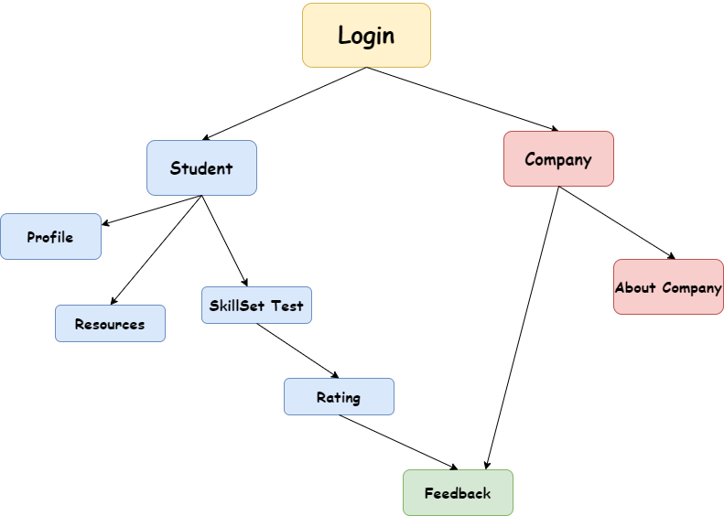
Roadmap

Slide 6







Tech Stacks used:

Slide 7

Future Scope
ML Integration for Questions in the Test Skills Page.
Trending Technologies Can be Shown on the Portal Of Students & that they can access resources of different domains and platforms.

