Slide 1
SIGNAL CONTROLLER
Developed By
J042 Divy Pashine
J054 Jashan Shah
J067 Arijit Srivastava
Under the Guidance of
Prof. Dattatray Sawant
Sem : VI Subject : SCADA
B Tech Data Science
Academic Year : 2025 -2026

Slide 2
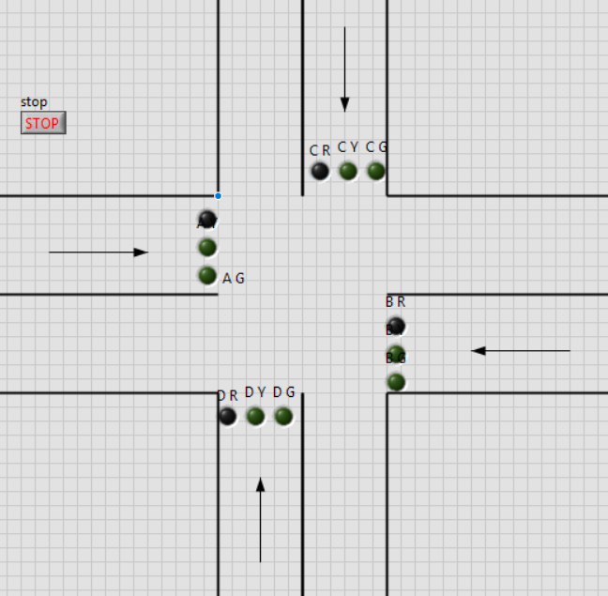
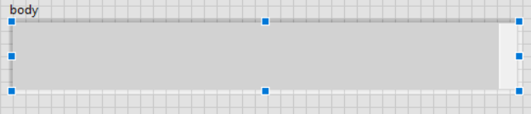
VI’s used in Front Panel
Boolean Indicator: Used to simulate traffic lights
Stop button: To Exit the simulation
String Indicator: To print the response from the server for debugging

Slide 3
VI’s used in Block Diagram
WHILE loop with shift register: Loops the simulation and remembers the previous value
CASE STRUCTURE: Decides which case to go to
LOCAL VARIABLE: Controls the LED
LINX: Used to write n channels in Arduino all in one go to control the physical LEDs
ACQUIRE SOUND: Uses microphone to record surrounding audio for five seconds
SOUND FILE WRITE: Converts raw audio into a .wav file
POST: Uses the Labview HTTP client to send a post request to “/predict” with the location of the .wav file for prediction.
MATCH PATTERN: Compares the response from the server with “true” to check if the sound is a siren or not.

Slide 4
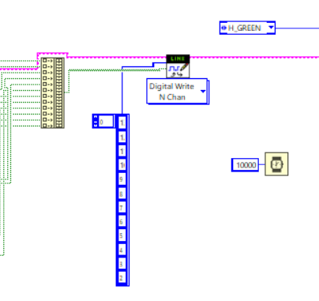
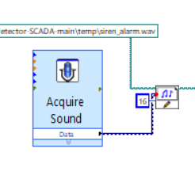
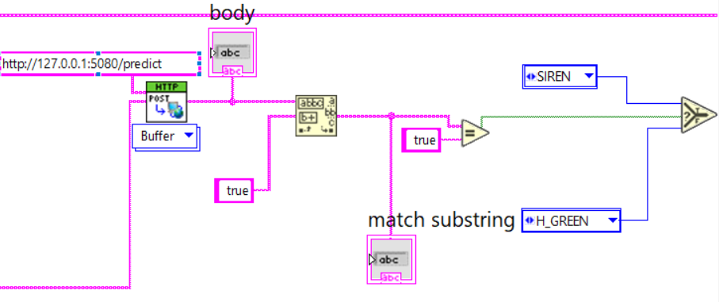

Slide 5

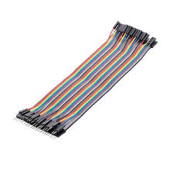
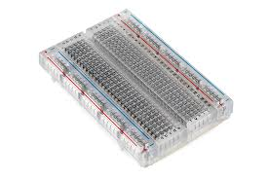
Components used in Hardware
Breadboard: Connects everything
LED: Simulates traffic signal
Jumper Cables: Connects LEDs with Arduino
Arduino UNO: Handles the transfer of data from Labview to hardware and vice a versa.
Microphone: Used to collect audio

Slide 6
Mic
Collects audio
Labview
Creates .wav file
Server
Predict whether siren or not
LED
Shows predicted output
Posts request to server
Sends response to Labview
Labview
Handles response
Sends output to arduino

Slide 7
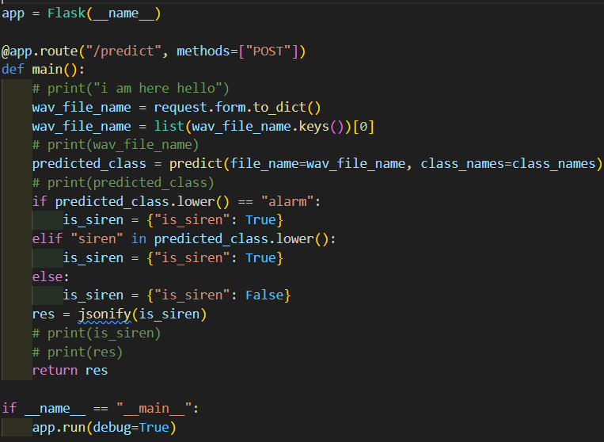
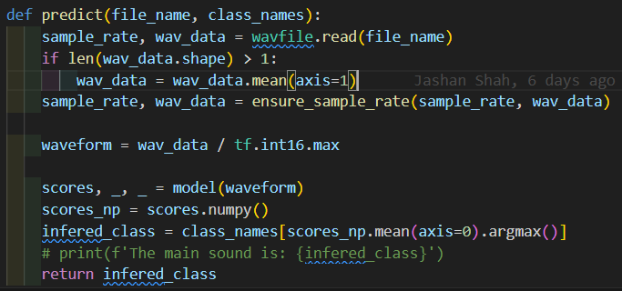
Python Server
Creates a Flask server in python
Exposes “/predict” route to the host
The server allows a POST request from labview with the file location
Based on the audio predicts whether it is a siren or not, and sends the prediction as a response.

Slide 8
THANK YOU

