Slide 1
University Administrative Copilot
A reusable NLP asset for the AI University platform
Group 10 · J054, J055, J056, J057, J059
NLP Course Project 2026 · SVKM's NMIMS, MPSTME
Notes:
Introduce the team. One line: we built an NLP component that understands and routes administrative requests, and an elective advisor on top of it, both reusable through an API.

Slide 2
The problem
1
2
3
Answers are scattered
Requests reach the wrong office
Electives are a rules puzzle
Rules live in the Student Resource Book, circulars, forms and web pages. Students do not know where to look.
The same questions hit the help desk again and again, and staff route them by hand.
Eligibility depends on programme, semester, slots and prerequisites, and new courses are in no catalogue yet.
Notes:
Institutional problem from the handout: students and faculty ask administrative questions in natural language while processes are spread across documents and offices.

Slide 3
Who uses it, and what they get
1
Students
Student asks
ask in their own words; get the office, documents, next step and elective advice
“I lost my ID card, my roll no is J054. It's urgent”
Copilot returns
Staff and coordinators
2
Intent: ID cards → duplicate ID card (0.90)
Office: School Academic Office
Entities: roll no J054, priority high
Answer and next step, with official sources
receive pre-routed requests; uncertain ones are referred to them
3
Other groups' apps
call the same API (Group 4, 6, 9, 12)
Notes:
Users: students, administrative staff and course coordinators, and other AI University components through the API.

Slide 4
Data: built from official NMIMS sources
66
269
5,863
727
official sources
verified facts
labelled queries
cited passages
web pages, Student Resource Book, circulars, 28 PDFs (OCR where scanned)
each with page and exact quote, auto-checked
1,973 from the facts + 3,890 rule-based rewordings
the knowledge base the copilot searches
12 intents · 95 services · out-of-scope from CLINC150 (real public queries) · group-aware split: train 3,953 / validation 965 / test 945 · questions are built from official facts, not collected from students
Notes:
Be clear about provenance: facts and passages are official; questions were built from the facts; rewordings are rule-generated; off-topic queries are real (CLINC150).

Slide 5
NLP approach: baseline → improved
Task | Baseline | Improved (final)
Intent + routing (95 services) | TF-IDF + logistic regression | Fine-tuned BGE-small transformer, blended with an embedding ensemble
Entity extraction | Dictionary + regex rules | Transformer NER + rules
Retrieval (RAG) | BM25 keyword search | BM25 + fine-tuned vectors, fused, intent-boosted
Answer | Lead sentences | Query-focused extractive summary (MMR) with citations; LLM compared
Elective advice | - | Syllabus + identity parsing, 7 rule checks with sources, ranking
Notes:
Explain why each technique fits: classification for routing, NER for request details, hybrid retrieval for grounded answers, extractive answers to avoid hallucination.

Slide 6
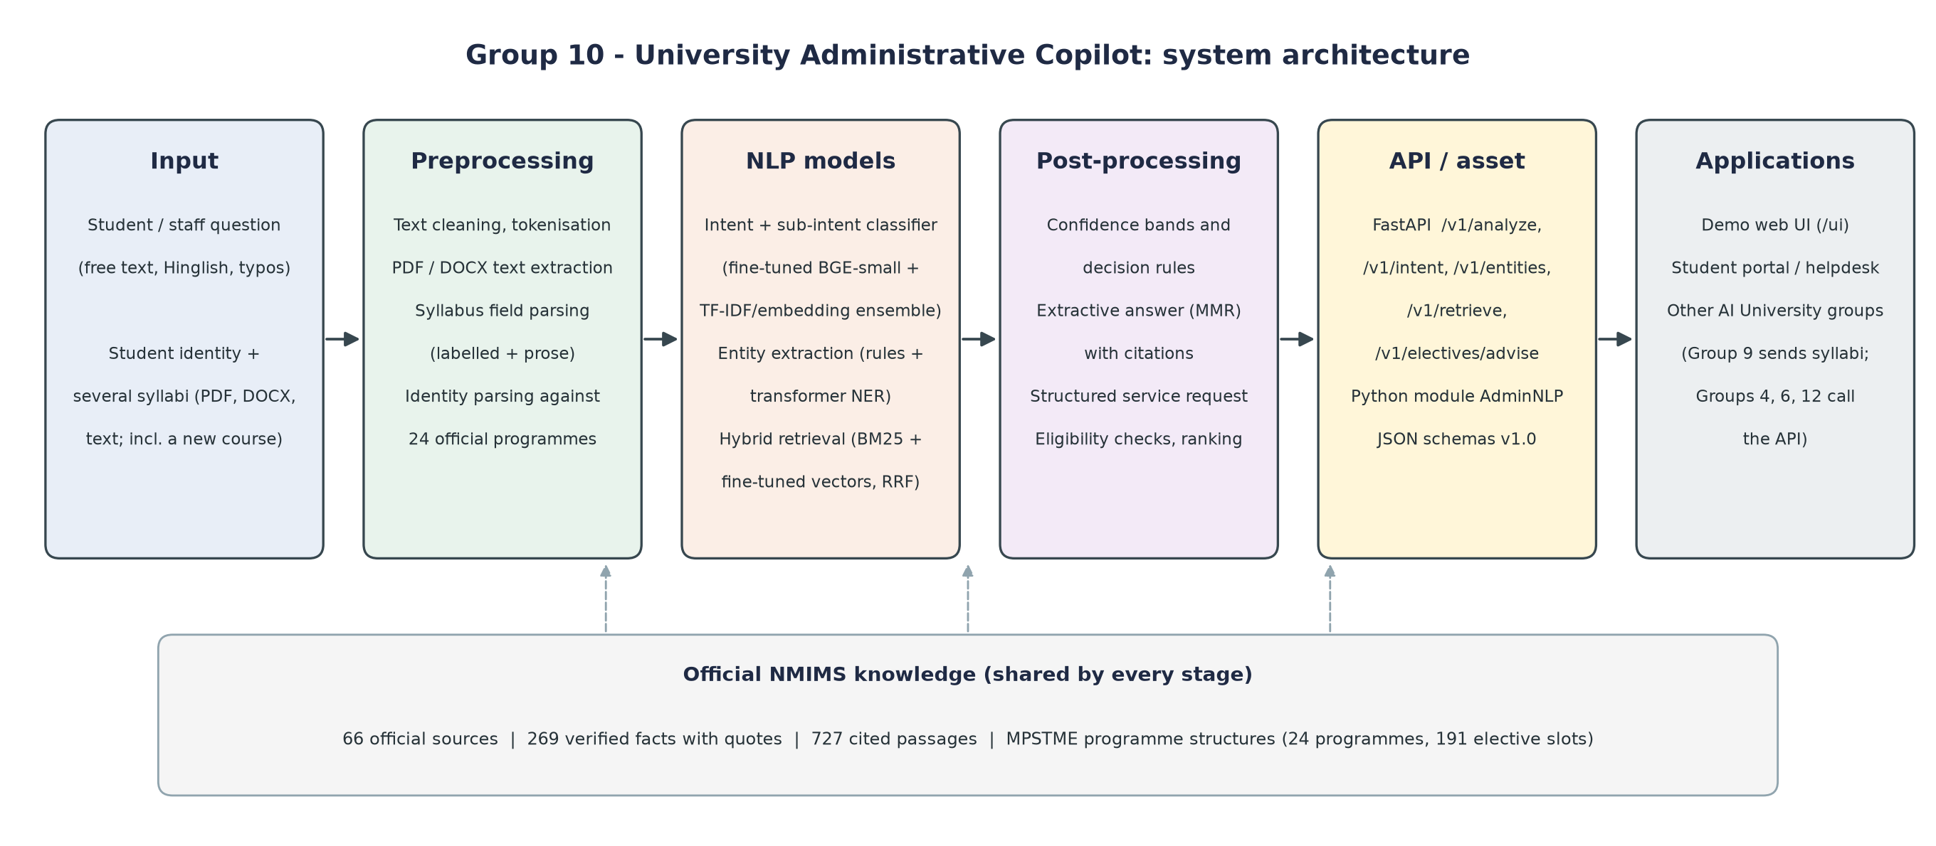
Architecture
Notes:
Walk left to right: input, preprocessing, models, post-processing (confidence, decisions, citations), the /v1 API and Python module, and the applications that use it.

Slide 7
Results: baseline vs final
Baseline
Final
90.7%
routing accuracy on the 63.6% of questions answered automatically
0.80
0.79
0.72
0.72
98.5%
0.39
0.42
held-out elective decisions correct; 12/12 recommendations
0 / 230
counterfactual tests changed the advice (fairness)
Routing accuracy
Retrieval Recall@3
Answer similarity
Notes:
Routing beats the TF-IDF baseline significantly (McNemar p = 0.00047). Gain over Week 3 is small and not significant (p = 0.6875) - say so. Retrieval Recall@3 0.385 -> 0.787.

Slide 8
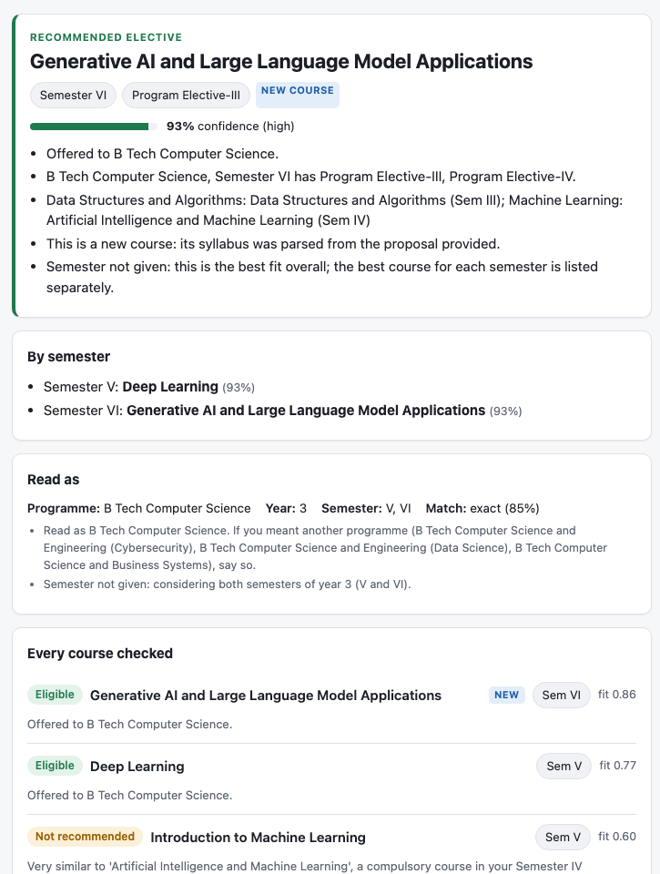
Demonstration
Elective advisor: third-year CS student + 5 AI syllabi (incl. a new course) → recommends Generative AI & LLM Applications, every other course excluded with a sourced reason
Ask the copilot: an ID-card question → office, documents, entities, cited answer, decision
Partner integration: syllabi and student record fetched from partner services through the API
Failure case: “I am not asking about revaluation, I want a photocopy” → routed to revaluation (keywords beat negation)
Notes:
Run the live demo at http://127.0.0.1:8000/ui/ (not screenshots). Show one failure and explain why (handout Part G).

Slide 9
A reusable asset, not just an app
1
Typed HTTP API + Python module
POST /v1/analyze
{"text": "I lost my ID card"}
→ {"intent": "ID_CARDS", "confidence": 0.90,
"routing": {"department": ...},
"entities": [...], "sources": [...],
"decision": "auto_route",
"schema_version": "1.0"}
/v1/analyze, /intent, /entities, /retrieve, /electives/advise; OpenAPI docs and JSON schemas
2
Confidence and decisions
every output has a score; 365/365 outputs schema-valid; ~113 ms per call
3
Integration
Group 9 syllabi in → our advice; Group 4 / 6 call us; Group 12 can screen input
Interactive docs at /docs (OpenAPI) · JSON schemas in docs/schemas · same contract for the web UI and other groups
Notes:
Show /docs in the browser and one curl call. Another group needs only the endpoint and the JSON schema, not our source code.

Slide 10
Limitations and future work
What it does not do well
Towards production
Questions built from official facts, not real student traffic
Accepts some off-topic academic questions (IIT cut-offs)
Negation, follow-ups, heavy typos and Hinglish
Real NMIMS syllabus formats only partly parsed
Consented, anonymised student queries; re-evaluate
Near-domain off-topic data; slang and Hinglish normaliser
Multi-turn clarification
Auth behind the gateway, monitoring, yearly rule re-ingestion
Live links to Groups 9, 4 and 12
Notes:
Close with the handout's message: a smaller, well-evaluated, reusable NLP asset. Invite questions.

