Slide 1
KAN: Kolmogorov–Arnold Networks
Learnable activation functions on edges, not fixed ones on nodes
Liu, Wang, Vaidya, Ruehle, Halverson, Soljačić, Hou, Tegmark · ICLR 2025 · arXiv:2404.19756
Presenter: ____________________
Notes:
Introduce the paper: ICLR 2025, MIT/Caltech/Northeastern. One-line pitch: move the nonlinearity from the nodes to the edges and make it learnable.

Slide 2
Outline
1. Motivation: limits of MLPs and the Kolmogorov–Arnold theorem
2. The KAN architecture and parametrisation
3. Theory: approximation bound and scaling laws
4. Grid extension, sparsification, pruning, symbolification
5. My from-scratch PyTorch reproduction and results
6. Paper's science results: knot theory, Anderson localization
7. Critique, limitations and takeaways
Notes:
Roadmap. About 15 minutes: 3 on motivation, 5 on method, 4 on results, 3 on critique.

Slide 3
Motivation: what is wrong with MLPs?
MLP(x) = (W_{L−1}∘σ∘…∘σ∘W₀)(x): fixed σ on nodes, learned linear W on edges
Justified by the Universal Approximation Theorem: f(x) ≈ Σ aᵢσ(wᵢ·x+bᵢ)
UAT gives no bound on N(ε); width can grow exponentially with input dimension d (curse of dimensionality)
In transformers MLPs consume almost all non-embedding parameters
MLPs are hard to interpret without post-hoc tools (attribution, sparse autoencoders)
Question: can we build a better nonlinear regressor that is also interpretable?
Notes:
UAT says width exists but not how it scales. In transformers MLP blocks hold most non-embedding parameters.

Slide 4
The Kolmogorov–Arnold representation theorem
f(x₁,…,xₙ) = Σ_{q=1}^{2n+1} Φ_q( Σ_{p=1}^{n} φ_{q,p}(x_p) )
Every smooth multivariate function = sums and compositions of univariate functions: addition is the only true multivariate operation
Naively: high-dimensional learning reduces to learning O(n²) one-dimensional functions
Historical objection: inner functions can be fractal, so the theorem was called 'theoretically sound but practically useless'
Paper's response: (1) generalise to arbitrary width and depth, (2) science functions are usually smooth with sparse compositional structure
Notes:
Stress that the theorem is exact but the inner functions may be non-smooth; the paper's contribution is making it practical.

Slide 5
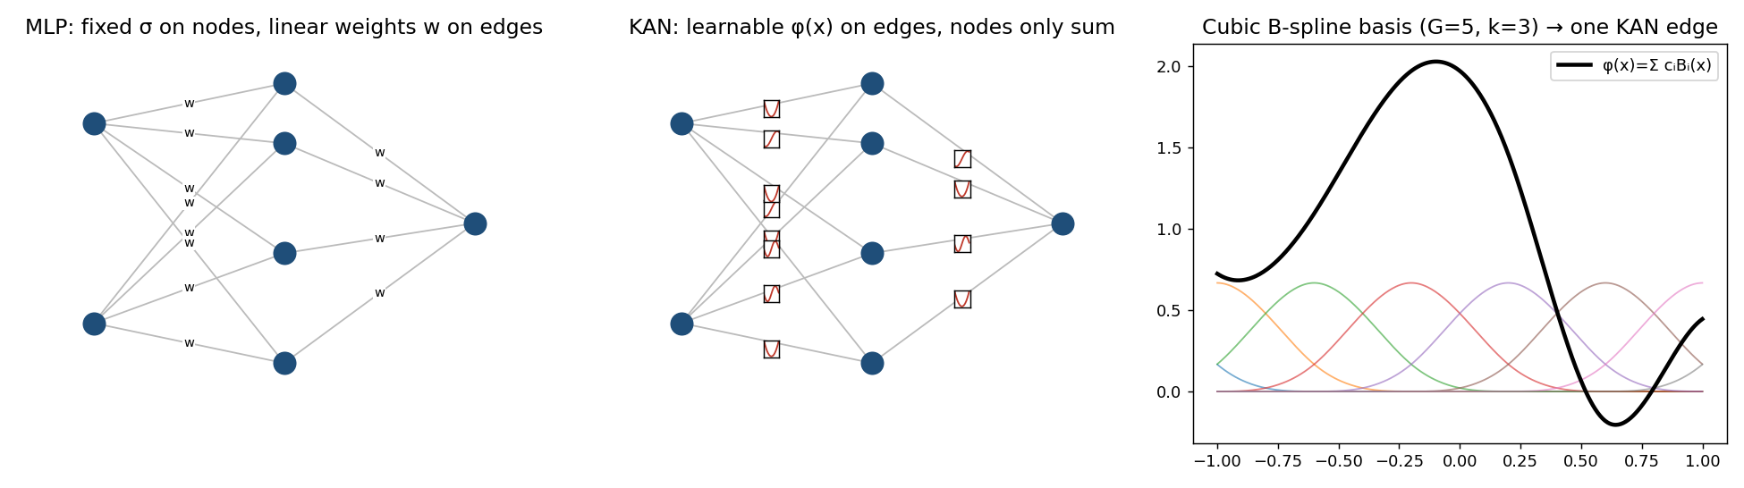
KAN vs MLP at a glance
MLP
σ on nodes (fixed); linear weights on edges (learnable)
KAN
φ on edges (learnable splines); nodes only sum
Notes:
Use the figure: left is MLP with fixed activation and weights, middle is KAN with a spline on every edge, right is the basis.

Slide 6
KAN layers and deep KANs
Layer: matrix Φ = {φ_{j,i}}, i=1..n_in, j=1..n_out
Node value: x_{l+1,j} = Σᵢ φ_{l,j,i}(x_{l,i}); no nonlinearity at nodes
Network: KAN(x) = (Φ_{L−1}∘…∘Φ₁∘Φ₀)(x), shape [n₀,n₁,…,n_L]
Original KA theorem = two layers, shape [n, 2n+1, 1]
Example: exp(sin(x₁²+x₂²)+sin(x₃²+x₄²)) fits a [4,2,1,1] KAN smoothly but may have no smooth 2-layer form
All operations differentiable → trained with back-propagation
Notes:
A KAN layer is just a matrix of 1D functions. Deeper KANs: stack layers. The original theorem is the [n,2n+1,1] special case.

Slide 7
Parametrising one edge
φ(x) = w_b · silu(x) + w_s · Σᵢ cᵢ Bᵢ(x)
Bᵢ: cubic (k=3) B-splines on a grid of G intervals → G+k trainable coefficients per edge
Residual base silu(x), like a skip connection, helps optimisation
Initialisation: spline ≈ 0 (cᵢ ~ N(0,0.1²)), w_s=1, w_b Xavier
Grid update: grids adapt on the fly to the observed input range
Parameters: O(N²L(G+k)) for KAN vs O(N²L) for MLP, but KANs usually need much smaller N
For 1-D inputs a KAN is just a spline
Notes:
Walk through the three implementation tricks; mention footnote: coefficients ~ N(0, 0.1²), Xavier for w_b.

Slide 8
Theory: approximation bound and scaling laws
‖ f − (Φ^G_{L−1}∘…∘Φ^G₀)x ‖_{C^m} ≤ C · G^{−k−1+m}
Theory | Scaling exponent α (loss ∝ N^−α)
Sharma & Kaplan: data manifold dim d | (k+1)/d
Michaud et al.: max arity 2 | (k+1)/2
Poggio et al.: compositional sparsity, W^m | m/2
KAN (Theorem 2.1), cubic k=3 | k+1 = 4
Proof idea: apply 1-D B-spline theory to each Φ_{l,i,j}, then sum the residuals of the layers (telescoping).
Notes:
Emphasise that alpha=4 needs a smooth KA representation to exist; constant C may hide dimension dependence.

Slide 9
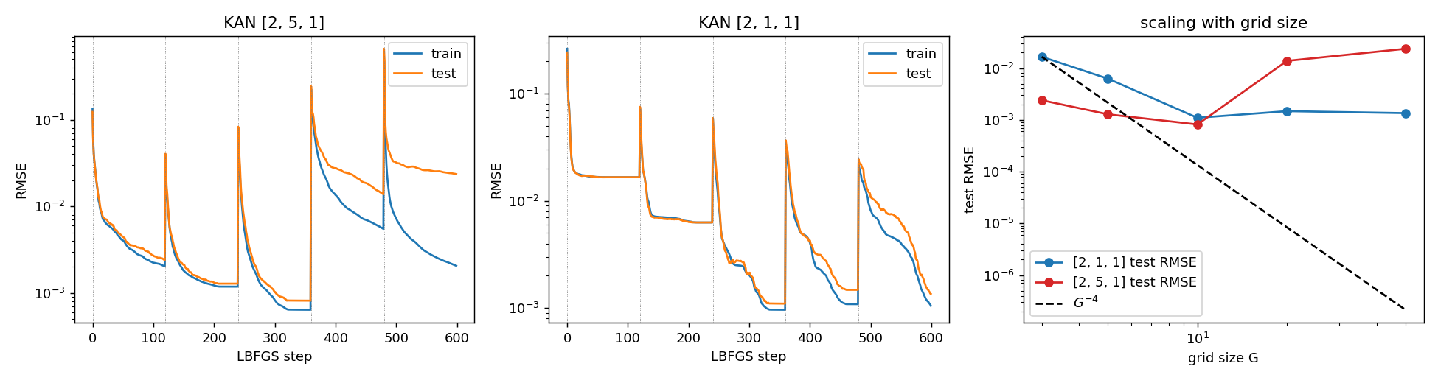
Grid extension: improve accuracy without retraining
Train a small-grid KAN, then refine every spline grid (G₁→G₂)
New coefficients from least squares: c′ = argmin E_x[(Σc′ⱼB′ⱼ − ΣcᵢBᵢ)²]
Loss shows 'staircases': drop after each extension, then plateau
Paper: small KANs generalise better; test-loss U-shape at interpolation threshold G≈1000/15
My run on exp(sin πx + y²): staircase visible; RMSE plateaus ~1e-3 (no G⁻⁴).
Notes:
MLPs have no equivalent of fine-graining. Show staircase figure; point out spikes after extension in my implementation.

Slide 10
Interpretability pipeline
1 Sparsify
L1 + entropy on |φ|
2 Prune
drop nodes, θ=10⁻²
3 Symbolify
snap to sin, exp, x²…
4 Fine-tune
affine (a,b,c,d)
5 Formula
SymPy closed form
ℓ_total = ℓ_pred + λ(μ₁Σ|Φ_l|₁ + μ₂ΣS(Φ_l)); |φ|₁ = mean |φ(x)| over the batch
Symbolic fit: y ≈ c·f(ax+b)+d by grid search on (a,b) + linear regression
Unlike classic symbolic regression, the search is continuous and users can 'operate' on the KAN
Notes:
This is Alice's workflow in the paper's Figure 2.4. Stress human-in-the-loop.

Slide 11
My implementation (PyTorch, from scratch)
File | Contents
kan/layer.py | Cox–de Boor B-splines, φ(x), grid update, least-squares grid extension
kan/model.py | KAN, L1+entropy reg., pruning, fix/suggest/auto symbolic, MLP baseline
kan/symbolic.py | Function library + affine grid-search fitter
kan/train.py | LBFGS/Adam loops, data generator
experiments/ | 5 experiments: grid ext., scaling, symbolic, continual, PDE
tests/ | Partition of unity, parameter count, extension fidelity, backprop
Deviations: blended adaptive/uniform grid update; best-iterate LBFGS safeguard; far smaller step budgets than the paper.
Notes:
Mention four unit tests pass; spline partition of unity verified.

Slide 12
Result 1: symbolic regression recovers the formula
Target: f(x,y) = exp(sin(πx) + y²); trained [2,5,1] with sparsity λ=3×10⁻³
Automatic pruning → [2,1,1] KAN, as the paper reports
suggest_symbolic: sin and x² found; outer edge ambiguous (tanh R²=0.99997 vs exp 0.99976)
Human sets exp from prior knowledge (paper step 3)
f̂ = 1.082·exp(0.956 y²)·exp(0.958 sin(3.144 x)) − 0.078
≈ true function (sin(3.144x) ≈ sin(πx)); test RMSE 0.022 on a target spanning ~0.4–7.4. No gradient fine-tuning of affine terms, so not exact.
Notes:
Prune took 5 hidden nodes to 1. Auto-suggest preferred tanh over exp on a narrow range; human override as in the paper.

Slide 13
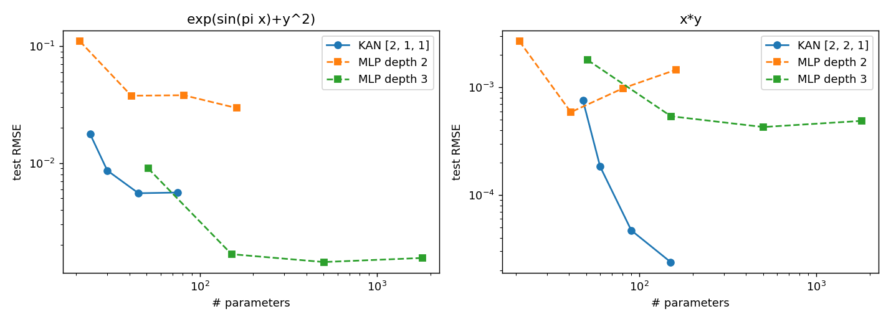
Result 2: KAN vs MLP scaling
x·y: KAN [2,2,1] 150 params → 2.4e-5; best MLP 1,801 params → 4.9e-4 (20× better, 12× fewer params)
exp(sin πx+y²): KAN beats depth-2 MLPs and small depth-3 MLPs, but plateaus ~5e-3; larger depth-3 MLPs win
Paper's α=4 line not reproduced (limited LBFGS budget, single seed)
Notes:
Mixed result: strong on x*y, weaker on exp(sin)+y^2 once MLPs grow.

Slide 14
Result 3: Poisson PDE with a PINN
Model | Parameters | Test L² MSE
KAN [2,5,1], G=5 | 150 | 7.4e-5
KAN [2,10,1], G=5 | 300 | 4.7e-6
MLP [2,10,1] tanh | 41 | 6.8e-3
MLP [2,100,100,100,1] tanh | 20,601 | 6.7e-5
u_xx+u_yy=f on [−1,1]², u=sin(πx)sin(πy²); loss = 0.01·interior + boundary; 40 LBFGS steps
KAN [2,10,1]: 69× fewer parameters and ~14× lower error than the big MLP
Caveats: single seed; KANs ~10× slower per parameter
Notes:
Direction matches paper (1e-7 vs 1e-5, 1e2 vs 1e4 params); my absolute errors are higher. Ground truth is symbolic, which may favour KANs.

Slide 15
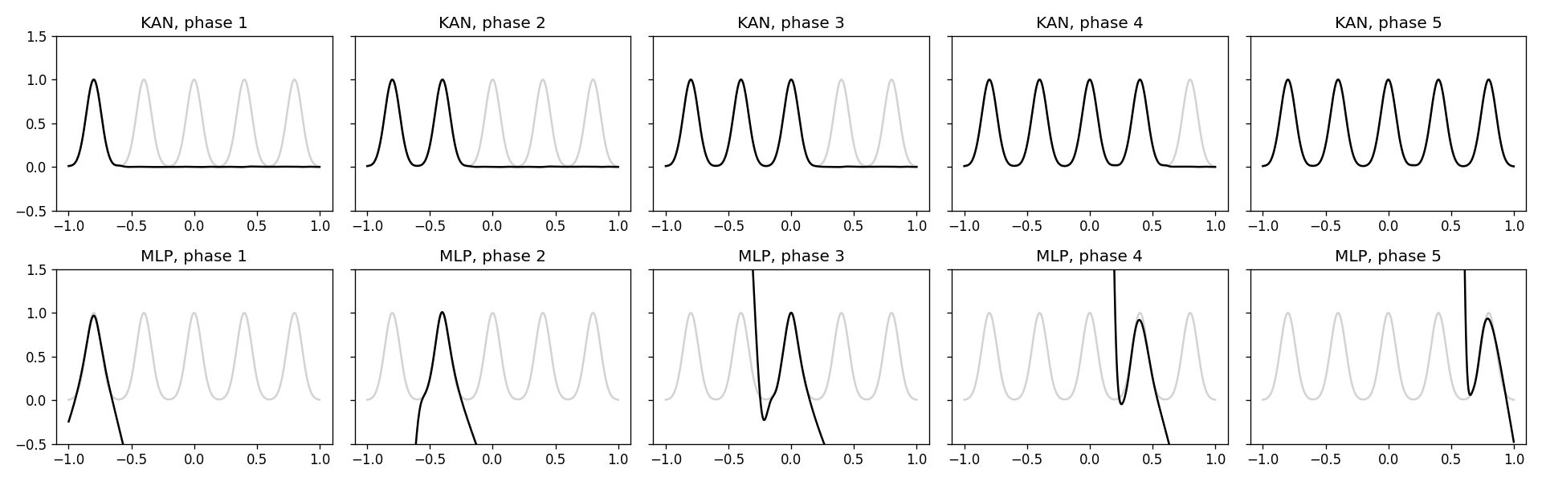
Result 4: continual learning
Five Gaussian peaks, one per phase (Adam, 800 steps). Spline-only KAN: RMSE 0.001 on all peaks afterwards
MLP [1,64,64,1]: old-peak RMSE 484, 396, 282, 113 (extrapolation blow-up) → catastrophic forgetting
Finding: locality comes from spline coefficients; global w_s/w_b must be frozen
Notes:
Locality of splines; but must freeze w_b and w_s. With w_s trainable I saw forgetting (peak 1 RMSE 0.535).

Slide 16
Paper: knot theory (AI for math)
Method | Architecture | Parameters | Accuracy
DeepMind MLP | 4 layers, width 300 | 3×10⁵ | 78.0%
KAN | [17,1,14], G=3, k=3 | ≈2×10² | 81.6%
Signature depends mostly on real meridinal translation μ_r (DeepMind: μ_i); ablation: μ_r alone 65.0%, μ_i alone 43.8%
Symbolic formulas: a Pareto family; formula using only μ_r and λ reaches 77.8%
Unsupervised mode (18 inputs, Gaussian output) rediscovered: signature relation, V=μ_r·λ, 2r ≥ g_r; nothing new
Later: a 60-parameter MLP reportedly reached 80%, weakening the efficiency claim
Notes:
DeepMind's Nature 2021 study found signature relates to slope; KANs reproduced via visual inspection.

Slide 17
Paper: Anderson localization (AI for physics)
Model | KAN setup | Outcome
Mosaic | [2,1], sigmoid output, linear λ edge | recovers mobility edge E(λ) for κ=2..5
Generalised Aubry–André | [4,2,1,1], auto snap to linear/quadratic | 98.7→98.9%; formula 99.0% vs theory 99.2%; ϕ ignored
Modified Aubry–André | [4,3,1,1]→[4,2,1,1], manual hints | cosh 96.6%, quadratic 95.4%, auto 97.1%, theory 98.6%
More human input → simpler formula, slightly lower accuracy: a 'knob' between simplicity and accuracy
Also: 15 special functions → better Pareto frontier than MLPs; Feynman equations → roughly comparable
Notes:
Mobility edges separate extended and localized states; KAN gives qualitative plus quantitative output.

Slide 18
Critique and limitations
Strengths
• Simple, well-motivated idea
• Real interpretability on small symbolic tasks
• Open-source library
• Honest about limitations
Weaknesses / open questions
• ~10× slower training
• Needs a smooth KA representation to exist
• α=4 shown on synthetic data only
• Weak MLP baselines (plain LBFGS)
• Interpretability depends on λ, G, seeds
• Scaling to language/vision unknown
Notes:
Be balanced: authors are candid about speed and toy continual learning.

Slide 19
Takeaways
KANs move learnable nonlinearity to edges: spline φ replaces every weight
Strongest case: small, compositional, scientific problems where interpretable or symbolic output matters
My reproduction: symbolic recovery, PDE efficiency, continual learning confirmed; G⁻⁴ scaling not matched
Use MLPs when training speed matters; try KANs when accuracy/interpretability matters and compute is small
Future: kansformers, adaptive grids, faster implementations
Notes:
Close with Figure 6.1 decision rule from the paper.

