Slide 1
Supply Chain Management
By Group – 7
Jashan Kamboj
Priyanshu Garg
Jatin Singh
Sahil Merothia

Slide 2
Problem Statement
The Core Issue: Traditional supply chain management systems heavily rely on non-AI methods such as historical averages, moving averages, or manual forecasting techniques. While these approaches worked in simpler supply chains, modern-day complexities make them insufficient.
They fail to consider dynamic market changes, seasonality, customer preferences, and external disruptions like economic shifts or natural disasters.
As a result, businesses face critical issues such as overstocking, which increases storage costs, or understocking, which leads to revenue loss and poor customer satisfaction.
Limitations of Non-AI Methods:
Inflexibility: Fixed statistical models cannot adjust to changing demand patterns.
Data Volume: They struggle with large datasets and cannot process the complexity of multi-variable relationships.
Low Accuracy: Predictions are often imprecise, especially in volatile or uncertain market conditions.
Why AI is the Solution: AI and machine learning offer significant advantages:
Data-Driven Insights: Machine learning models analyze large, multi-dimensional datasets to uncover hidden patterns and correlations that non-AI methods overlook.
Adaptability: AI models can dynamically adjust to new data, ensuring predictions remain relevant as market conditions change.
Automation and Speed: Reduces human intervention and accelerates decision-making processes.
The Problem We Are Solving: By introducing AI into sales forecasting for supply chains, we address critical challenges such as:
Predicting sales with higher accuracy, reducing inefficiencies.
Improving inventory management to strike a balance between supply and demand.
Enabling businesses to respond proactively to market trends and consumer behaviour changes.

Slide 3
Objective
Primary Objective: To build a machine learning model that predicts sales accurately using historical data, addressing inefficiencies in supply chain management.
Specific Goals:
Enhance Forecasting Accuracy:
Leverage AI to improve prediction reliability compared to traditional methods.
Optimize Inventory Management:
Reduce overstocking and understocking by aligning supply with demand.
Enable Data-Driven Decisions:
Provide actionable insights for businesses to respond proactively to market dynamics.
Scalability and Adaptability:
Create a model that adapts to changing trends and works across different supply chain scenarios.

Slide 4
Methodology
Data Collection & Preprocessing:
Data Cleaning: We cleaned the data by fixing missing values, removing duplicates, and ensuring consistency across the dataset.
Data Visualization:
Visualizing trends in the data helped understand key patterns , identify correlations , and detect outliers.
Sales distribution: Histogram and Box Plot.
Correlation Heatmap: For Visualizing correlations between numerical features.
2.Model Selection & Training:
Machine Learning Models:
Random Forest: A powerful model that uses multiple decision trees to predict sales by averaging their results.
Gradient Boosting: This model builds predictions step-by-step, focusing on fixing the errors made by previous steps.
Decision Tree: A simpler model used to compare how well the more complex models perform.
Time Series Models (ARIMA & SARIMA):
ARIMA (Autoregressive Integrated Moving Average): ARIMA is a time series model that works well when the data shows trends or patterns over time. We used ARIMA to predict future sales based on past sales, considering how much the data changes over time.
SARIMA (Seasonal ARIMA): SARIMA is an advanced version of ARIMA that also considers seasonal patterns, like higher sales in certain months. We used SARIMA to capture these seasonal trends and improve predictions.
3.Model Evaluation:
Performance Metrics: We measured how well the models predicted sales using metrics like:
Mean Absolute Error (MAE): Shows how far off our predictions were from the actual sales.
R² Score: Tells us how well the model explains the variation in sales.
Root Mean Squared Error (RMSE): Measures the size of the errors in predictions.

Slide 5
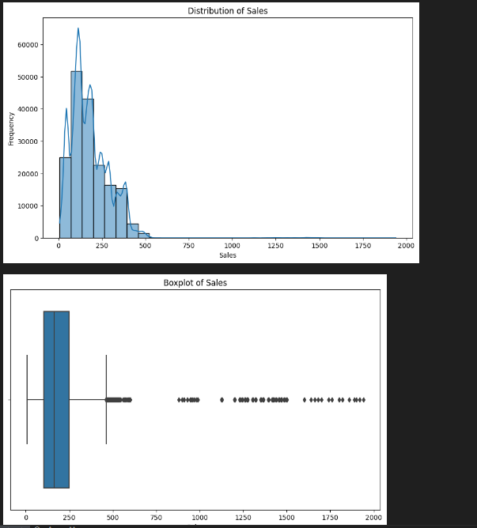
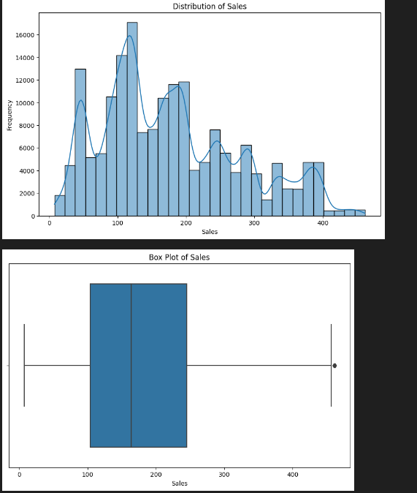
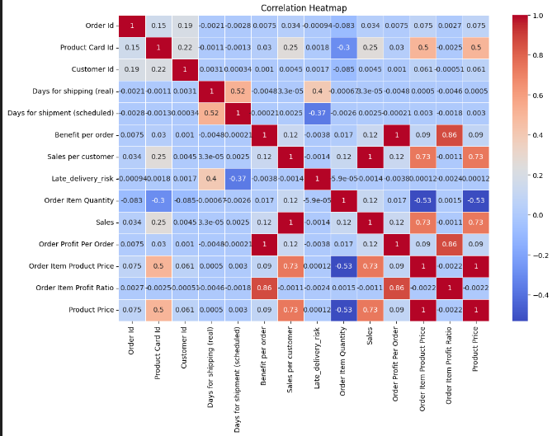
Data Visualization
Before Pre Processing of Data
Correlation Heatmap
After Pre Processing of the Data

Slide 6
Model Overview
Random Forest Regressor:
An ensemble method that uses multiple decision trees to make predictions. It works by averaging the outputs of several trees to reduce overfitting and improve accuracy.
Use in the Project:
Random Forest was used to predict sales based on historical data, considering factors like product type, quantity, and pricing.
Advantages:
Handles non-linear relationships well.
Robust to outliers and noisy data.
Gradient Boosting Regressor:
A boosting algorithm that builds models sequentially, where each model attempts to correct the errors of the previous one. This leads to better performance, especially for complex patterns.
Use in the Project:
Used to capture more intricate relationships between sales data and other features (like customer demographics).
Advantages:
High accuracy and effectiveness in predictive tasks.
Decision Tree Regressor:
A decision tree is a simple, interpretable model that splits the data into different branches based on feature values. Each decision node in the tree corresponds to a feature and a decision rule.
Use in the Project:
Decision Tree was chosen because it is highly interpretable and can model complex, non-linear relationships. It was used to predict sales based on factors like price, quantity, and promotions.
Why We Used It:
Interpretability: Decision Trees are easy to understand and visualize, which helps to explain how the model makes predictions.
Non-linearity: They are good for capturing complex relationships between features that might not be linear, such as price and demand.
Advantages:
Simple to understand and visualize.
Handles both numerical and categorical data.

Slide 7
Time Series Models
ARIMA (Autoregressive Integrated Moving Average):
ARIMA is a statistical model used for time series forecasting. It captures patterns in the data by combining autoregression, differencing, and moving averages.
Use in the Project:
ARIMA was applied to sales data to identify trends and make future sales predictions.
Advantages:
Effective when data shows clear trends and patterns but doesn't have strong seasonality.
SARIMA (Seasonal ARIMA):
SARIMA is an extension of ARIMA that also considers seasonality. It adds seasonal autoregressive and moving average components.
Use in the Project:
Given the seasonal nature of sales data (e.g., holiday seasons), SARIMA was used to improve accuracy in predictions by modelling both trends and seasonal patterns.
Advantages:
Better at handling seasonal trends and cyclical patterns.

Slide 8
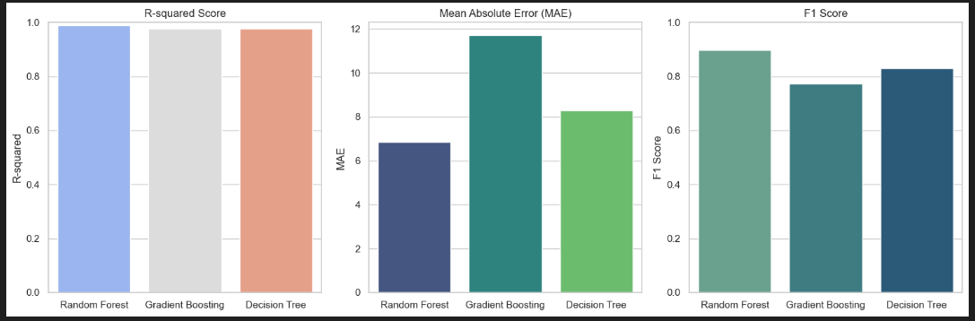
Results And Conclusion
Model Performance Comparison (Bar chat):
Lower MAE values are better as they indicate that the model is making predictions closer to the actual values
Higher R² values are better (closer to 1). A high R² means the model is able to explain a large portion of the variance in the data.
Higher F1 Score values are better. The maximum value of the F1 score is 1 (perfect precision and recall), and the minimum value is 0 (no correct predictions).
.

Slide 9
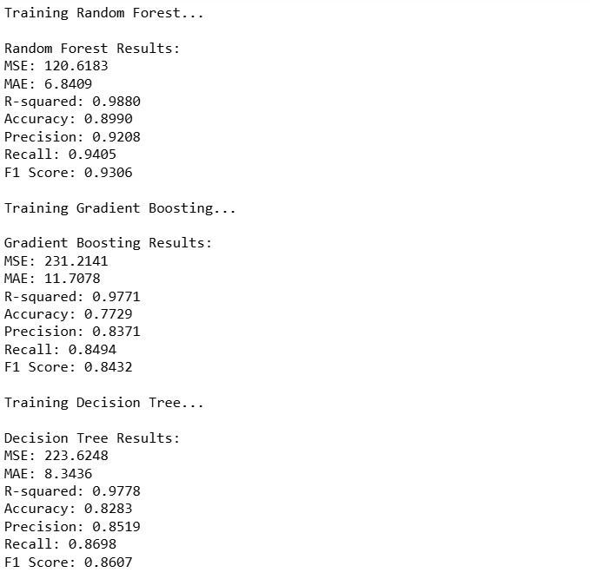

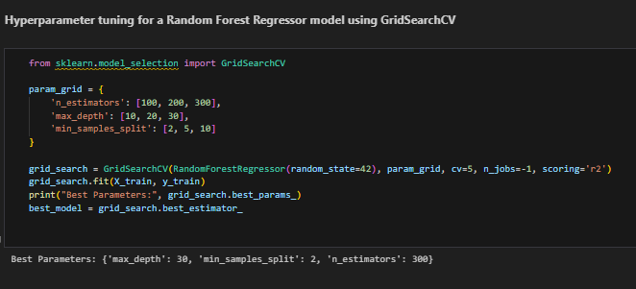
By looking at the graph and results we choose random forest model which was performing good overall with accuracy: 89%
Hyperparameter tuning is the process of finding the best settings (called "hyperparameters") for a machine learning model. These hyperparameters control how the model learns and how it behaves during training. By adjusting these settings, we can improve the model's performance.
n_estimators (Number of Trees): 300
max_depth (Maximum Depth of Each Tree):30
min_samples_split (Minimum Samples to Split a Node): 2
To increase the Performance Hyper Parameter tuning using GridSearchCV was done
After Hyper Parameter Training Accuracy Increased by: 1%

Slide 10
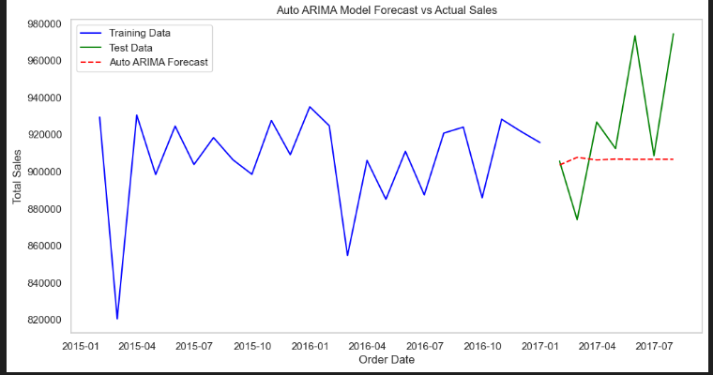
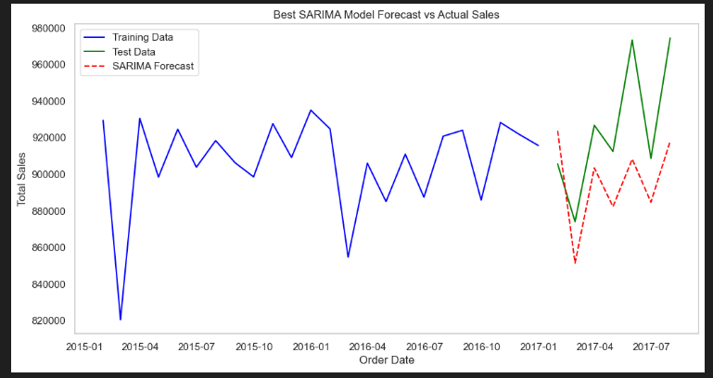
Time Series Plot: ARIMA And SARIMA
Graphs for ARIMA And SARIMA
1. ARIMA (Autoregressive Integrated Moving Average):
ARIMA is a statistical model used for time series forecasting. It captures patterns in the data by combining autoregression, differencing, and moving averages.
Use in the Project:
ARIMA was applied to sales data to identify trends and make future sales predictions.
Advantages:
Effective when data shows clear trends and patterns but doesn't have strong seasonality.
2. SARIMA (Seasonal ARIMA):
SARIMA is an extension of ARIMA that also considers seasonality. It adds seasonal autoregressive and moving average components.
Use in the Project:
Given the seasonal nature of sales data (e.g., holiday seasons), SARIMA was used to improve accuracy in predictions by modeling both trends and seasonal patterns.
Advantages:
Better at handling seasonal trends and cyclical patterns.

Slide 11
Future Outlook
Sales Forecasting Integration: The sales predictions made by the model can be used as inputs for inventory management systems to forecast demand and optimize stock levels. By predicting how much of a product will be sold in the coming weeks, businesses can adjust their inventory levels accordingly, ensuring they don’t overstock or understock products.
Demand-Supply Matching: By using accurate sales predictions, businesses can optimize their entire supply chain—from raw material procurement to production scheduling—based on expected demand.
Real-Time Data Streams: Integrating real-time sales data (e.g., from e-commerce platforms, retail point-of-sale systems) could allow the model to provide dynamic, real-time predictions. This would help businesses make immediate adjustments to stock levels, pricing, and production plans.
Automated Stock Replenishment: The model can be linked with automated stock replenishment systems. Based on predicted sales, the system can automatically reorder products, reducing human intervention and improving efficiency.
Dynamic Pricing Models: The model could also be expanded to predict the best pricing strategy based on expected demand and customer behaviour, optimizing both revenue and customer engagement. Ving efficiency.

