Slide 1
Secure Runtime Shield
for Agentic Systems
Hardening Autonomous Agents with Zero-Trust Workload Identity and Multi-Layer Defense

Slide 2
Work Done — Core Architecture & Policy Discovery
Building the Interception Engine
The Secure Bridge (bridge.py)
Stateful JSON-RPC middleware intercepting stdin/stdout in real-time. Async multi-threaded I/O ensures 100% inspection coverage with zero-latency impact on the AI user experience.
Automated Security Scanning (mcpwn)
Pre-production vulnerability scanner identifies insecure tool definitions — e.g. shell execution or unsafe path access — before deployment.
Policy Learning Mode
Passive monitoring state logs unknown or risky tools to discovery.log. Automated Discovery Mode generates new firewall rules, reducing manual policy configuration labor significantly.

Slide 3
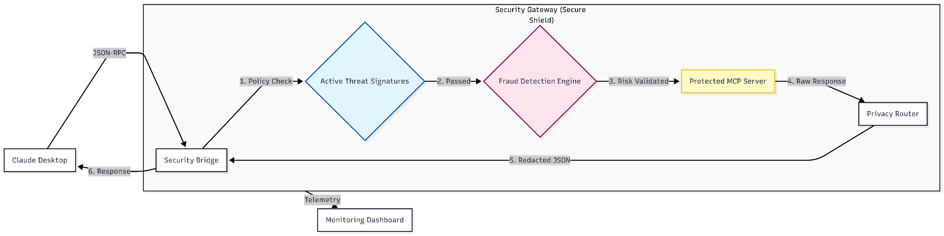
Architecture

Slide 4
Work Done — The Dual Identity Model
Unified IAM & Cryptographic Trust
User Identity (Keycloak)
Agent Identity (SPIFFE SVID)
Centralized IAM for human operators and client roles
Ensures the human operator has the necessary permissions before any tool executes
Analysts can call list_users; only authorized roles can invoke revoke_sessions
Cryptographically asserts that the AI agent itself is authenticated — not a rogue process
Tools cannot be executed by a compromised agent even from a valid user session
Identity-Aware RBAC maps roles to tool permissions dynamically

Slide 5
Work Done — Runtime Protection & Visibility
Resilience, DLP, and Monitoring
Dynamic Firewall & DLP
Path Guardrails use glob-pattern matching to block directory traversal (e.g. ../../etc/passwd). In-Flight Redaction scrubs PII — emails, secrets — from tool outputs before the LLM can access them.
Behavioral Fraud Detection Engine
Stateful Risk Scoring tracks violations across Agent and User layers with a 50-point quarantine threshold. Risk Deduplication prevents lockout from rapid AI retries; Risk Decay (5 pts/min) rewards stable behavior.
Security Observability
Real-time dashboard plus comprehensive audit logs (bridge.log, audit.log) provide immediate visibility and post-incident forensics.

Slide 6
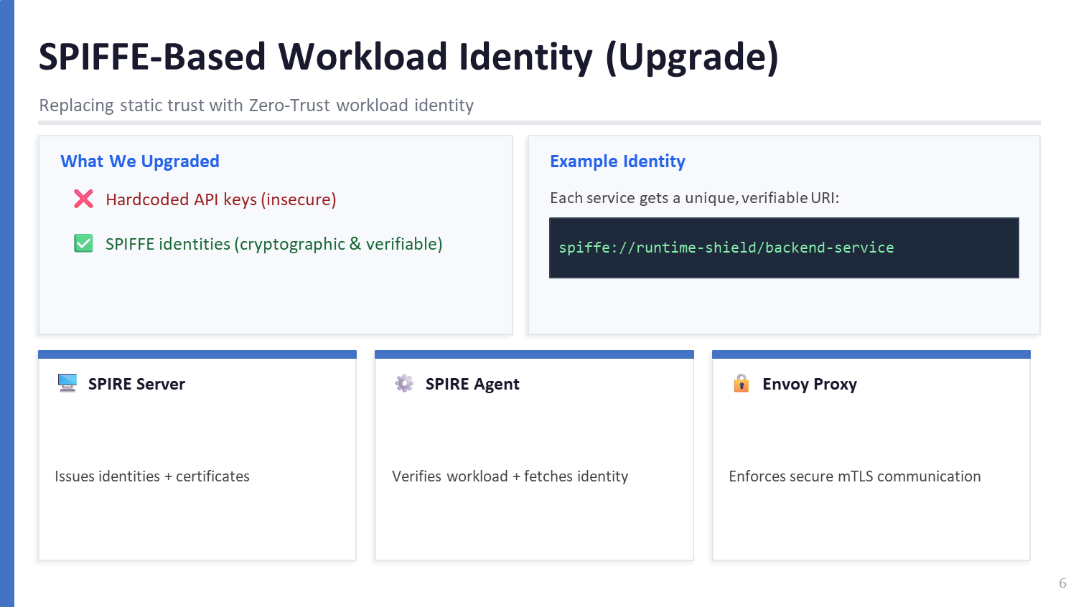

Slide 7
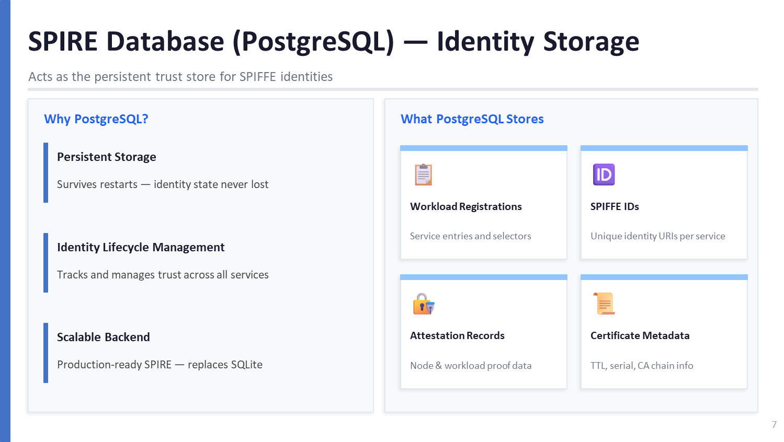

Slide 8
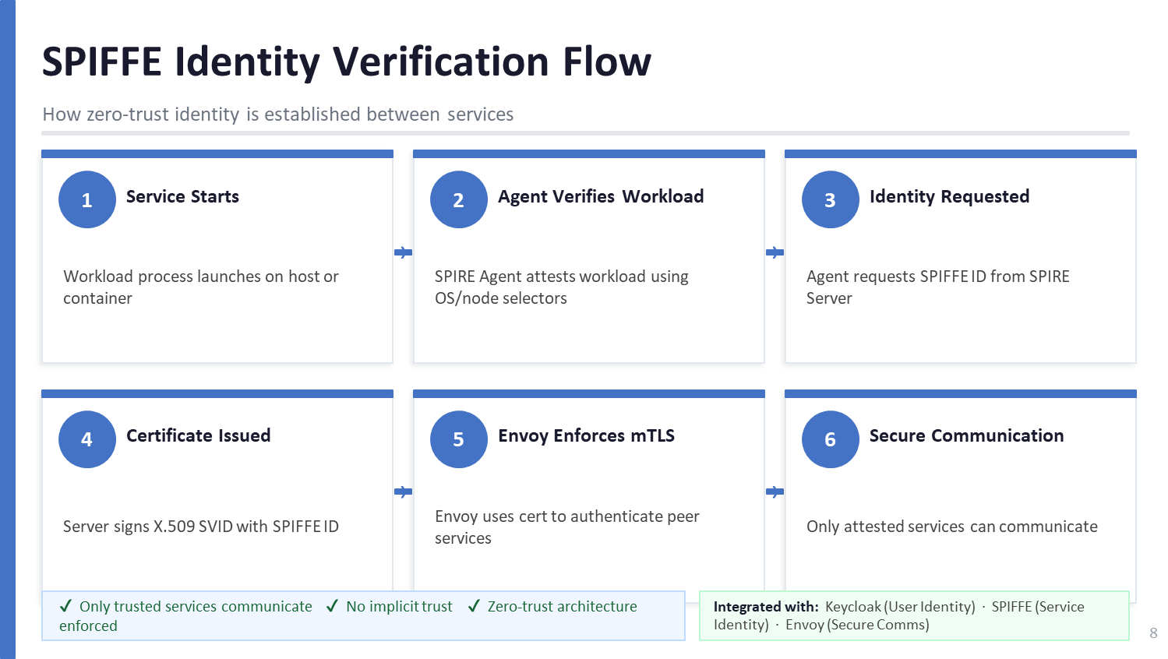

Slide 9
Future plan: 5-Layer Defense Model
Achieving the 'Nemo-Safe OpenClaw' vision requires a 5-layer defensive model:
Kernel-Level Sandboxing
Landlock and seccomp-bpf to enforce OS-level isolation, containing tool execution within a hardware-locked 'cell'.
Identity-Aware Skill Loading
Mapping tools ('skills') to Keycloak roles, ensuring agents only 'discover' the capabilities they are authorized to use.
Encrypted Secret Injection
Delivering credentials securely in-memory via OIDC-bound tokens, eliminating any persistent secret exposure on disk.
Privacy-Aware Redaction
Multi-stage filtering in the Secure Bridge to detect and mask PII and tokens before they reach the cloud.
Context-Aware HITL
Final control layer requiring Dashboard approval for high-risk actions (e.g., rm -rf), neutralizing autonomous risk.

Slide 10
Future Plan — Implementing the 5 Layers
Layer 1 — Infrastructure
Deploying Landlock LSM for kernel-level sandboxing — restricting file-system access at the OS level.
Layer 2 — Identity
Scaling from SPIFFE to Cross-Domain Identity Orchestration for multi-org trust.
Layer 3 — Firewall
Declarative Policy Engine with Human-in-the-Loop (HITL) approval workflows.
Layer 4 — Fraud Engine
Behavioral Analytics with real-time Risk Decay to distinguish confused AI from malicious actors.
Layer 5 — Privacy
Google Presidio NLP integration for automated PII discovery and scrubbing of multi-modal outputs.

Slide 11
The Next Frontier — SCION & Agent Identity
SCION Integration (Layer 1)
Decentralized Agent Identity (Layer 2)
Moving to Path-Aware Networking for cryptographic proof of network paths taken by agent traffic
Immunity to internet-scale routing hijackings
DDoS resilience via verifiable path selection
Adopting W3C Decentralized Identifiers (DIDs) and Verifiable Credentials
Agents prove identity & liability across org boundaries — no central authority required
Enables the Agentic Economy with self-sovereign, interoperable trust

Slide 12
Developing into a Product
Commercial Roadmap for Enterprise AI Security
Enterprise Security Dashboard
Compliance-as-Code for AI
Central Control Room: real-time agent risk scores and security event heatmaps for security teams
No-Code Policy Builder: UI to manage mcp-firewall.yaml across an entire fleet of MCP servers
IDE Plugins & SDKs: security sidecar for Cursor, VS Code, and Claude Desktop
Cryptographically signed audit trails for every AI tool interaction — SOC2, HIPAA, GDPR ready
Explainable Blocking: detailed defensive reports for developers and compliance teams when an AI action is blocked
Edge Deployment: proxy at enterprise API gateways (Envoy, Kong) for consistent coverage across all approved AI tools

Slide 13
Summary
Accomplishments
Hardened identity foundation (SPIRE + Keycloak) and real-time interception bridge with fraud detection and PII redaction.
Future Vision
A world-first, 5-layer security runtime for Self-Sovereign AI Agents — from local sandbox to global verifiable fabric.
Outcome
Enabling safe, compliant, and enterprise-ready agentic automation at scale.

