Slide 1
CAPSTONE PROJECT 1
Predictive Modeling of D.C. Residential Housing Prices
Julia Sheriff
Springboard | Data Science Career Track

Slide 2
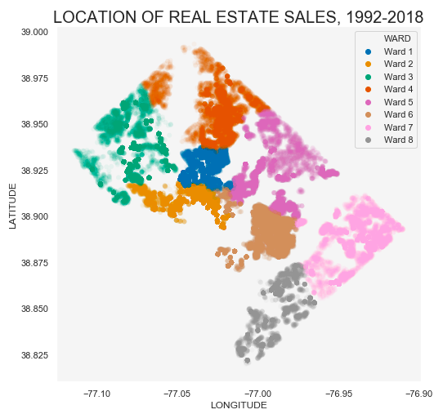
Real Estate Sale Locations, by WARD

Slide 3
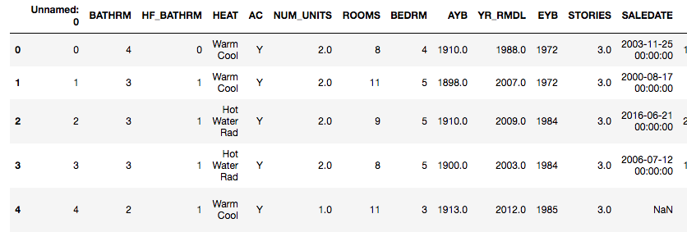
RESIDENTIAL HOUSING DATA: 158,957 observations, 49 FEATIRES
CONTENTS:
PRICE
QUALITY AND SIZE FEATURES
GEOGRAPHICAL LOCATION
SALE DATE

Slide 4
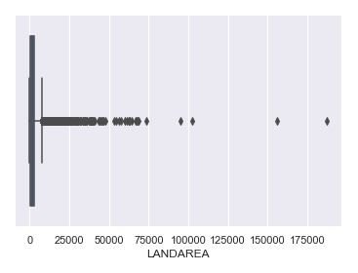
DATA WRANGLING
removed redundant columns.
used IQR to estimate outliers for nonparametric data
grouped by neighborhood to impute missing values with median and mode
concatenated housing data with census data to explore affordability

Slide 5
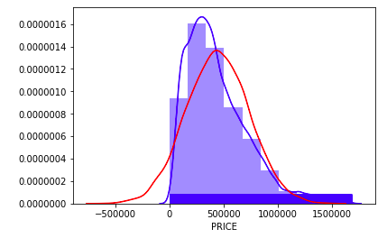
Housing prices
does not follow a normal distribution
Some properties are sold under-value for personal reasons
This is time series data, so we face limitations with using a more generalized approach

Slide 6
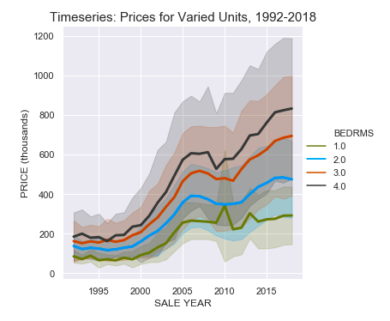
PRICE OVER TIME
Housing prices have approximately tripled in a span of 26 years.
The range of property values have increased.

Slide 7
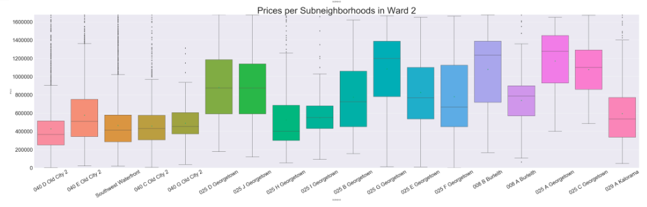
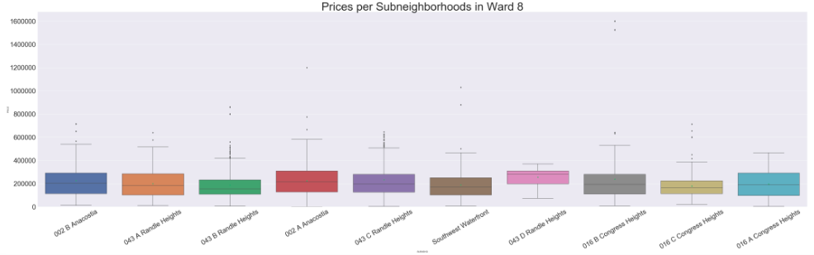
GEOGRAPHICAL LOCATON IMPACTS PRICE.
Example 2: subneighborhoods in ward 2 and ward 8

Slide 8
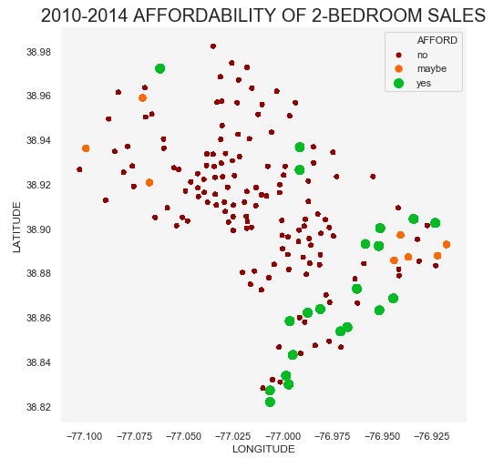
AFFORDABILITY FOR LOCAL REsIDENTS
Housing is generally not affordable for local residents
Housing is most affordable for residents in southeast DC (Wards 7 and 8)
Housing is somewhat more affordable for local residents in northwest DC (Wards 2 and 3).

Slide 9
Linear regression
Best models: ridge regression to predict log 10 (‘PRICE’)
 | With Outliers | Without Outliers
Mean Absolute Percentage Error in dollars | 24.48% | 23.73%
R^2 | 0.77 | 0.84

Slide 10
Random forest regressor
This is the best performing model.
Type | MAPE
Log10(‘PRICE’) | 17.01%

Slide 11
VARIATION IN PREDICTIVE ACCURACY DEPENDING ON PROPERTY VALUE
Predictions tend to be too high for low-value properties,
and too low for high-value properties.

Slide 12
TAKEAWAYS:
USEFUL ADDITIONAL DATA:
What type of sale (standard, short sale, foreclosure)?
Was this a private home sale?
A more detailed model with a time series approach, subset by geographical location could improve predictive power.

