Slide 1
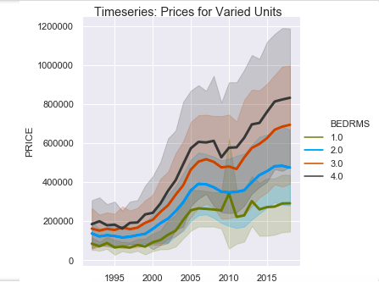
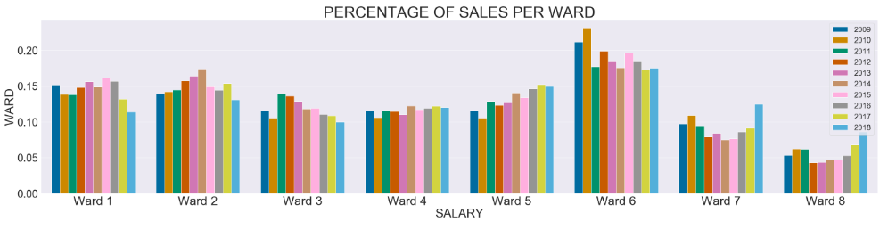
D.C. Residential Housing Data
D.C. housing prices have increased dramatically over the last 25 years.
- The average four-bedroom unit has
quadrupled in price.
- The average three-bedroom unit has
more than tripled in price.
- Sales are growing fastest in the lower
south-east corner of the district (Wards 7 and 8).

Slide 2
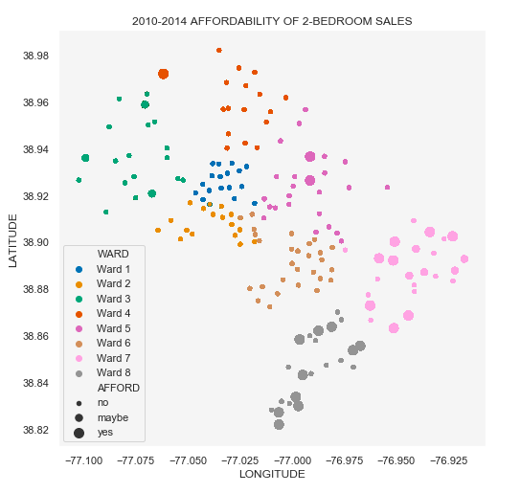
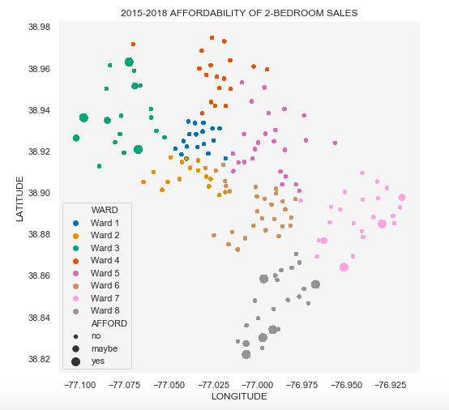
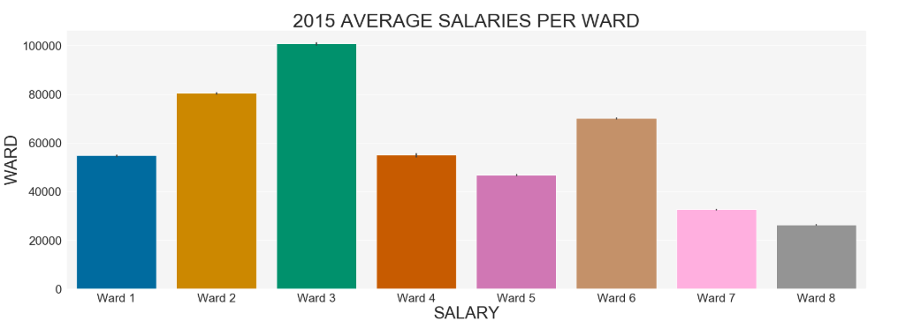
What can the average D.C. resident afford?
Most residents cannot afford to a two-bedroom unit in their neighborhood.
- Aside from Ward 1, all wards became more unaffordable in the past five years.
- Wards 7 and 8 saw the greatest change between local incomes and estimated
mortgage payments over the past five years.
The wealthiest ward increased in affordability for its current residents, while the poorest wards decreased in affordability.

Slide 3
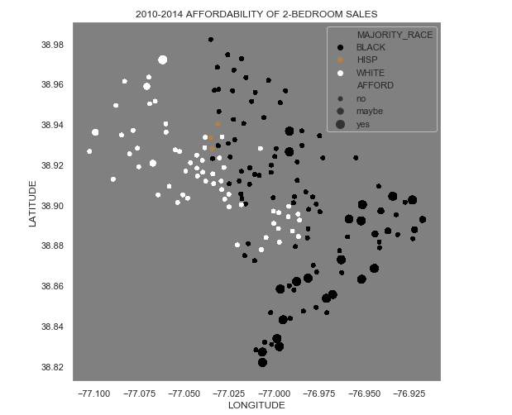
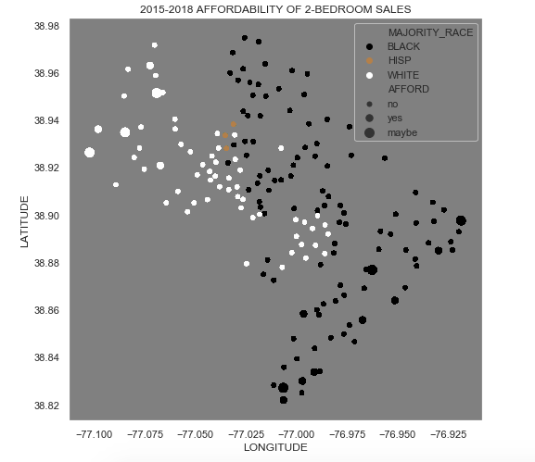
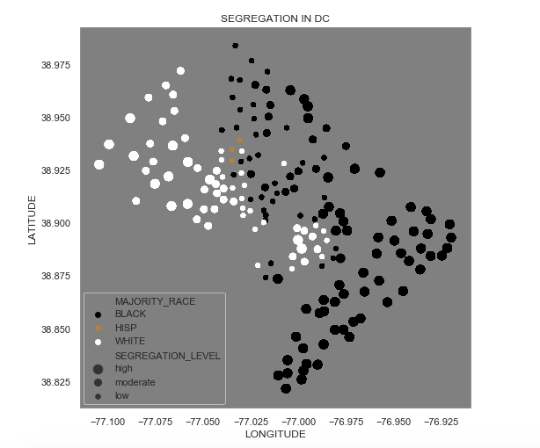
Many areas in Wards 7 and 8 that used to be affordable are now unaffordable to local residents.
Changes in housing prices in the past five years have particularly affected black communities.
- D.C. is most segregated towards its NE and SW corners.
- Census tracts with a hispanic population majority are in a less-segregated area

