Slide 1
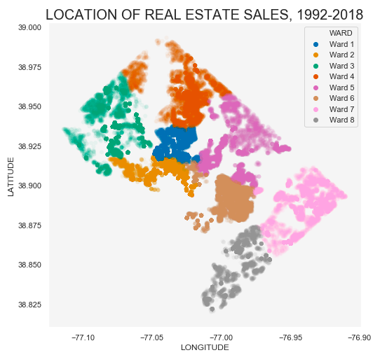
D.C. Residential Housing Data

Slide 2
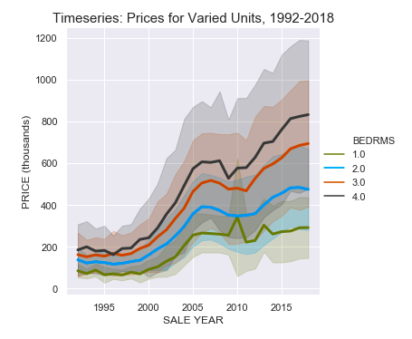
How have property prices changed over time?
Housing prices have approximately tripled in a span of 26 years.
The range of property values have increased.
There was a decrease in housing prices between 2006-2011.

Slide 3
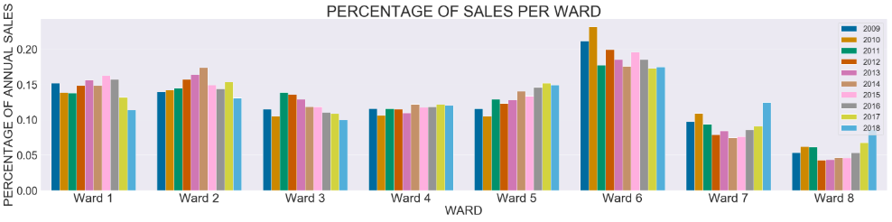

Which areas have the highest number of sales?
- Wards 7 and 8 have generally had the lowest number of sales,
- Wards 7 and 8 had a dramatic increase in sales in 2016-2018.
- Ward 6 consistently has the highest number of sales.
- Wards 1, 2, and 3 had a significant decrease in sales in 2014-2018.

Slide 4
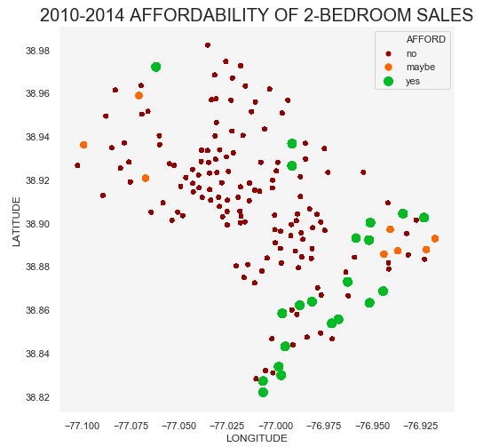
Which areas of DC are affordable for local residents?
- Housing is generally not affordable for local residents.
- Housing is most affordable for residents in southeast DC (Wards 7 and 8)
- Housing is somewhat more affordable for local residents in northwest DC
(Wards 2 and 3).

