Slide 1
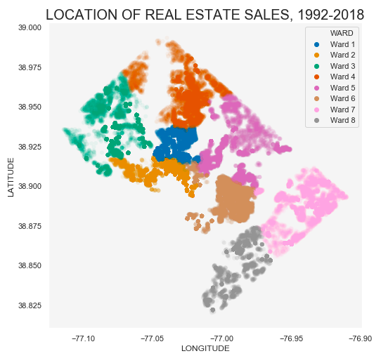
D.C. Residential Housing Data
A predictive analysis of housing costs

Slide 2
Milestone Report
Introduction
Data Wrangling
Exploratory data analysis
Next steps

Slide 3
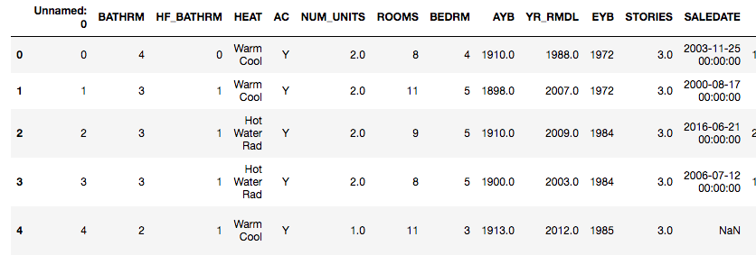
The data:
Dimensions: (158957, 49)
Columns describe the following:
Price
Housing features
Geographical location
Housing quality
Housing history
Sale date

Slide 4
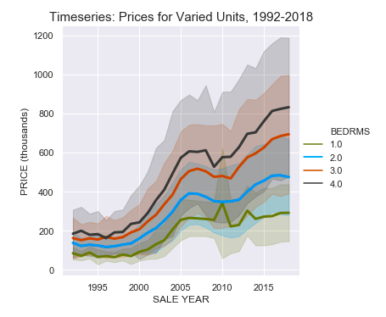
How have property prices changed over time?
Housing prices have approximately tripled in a span of 26 years.
The range of property values have increased.
There was a decrease in housing prices between 2006-2011.

Slide 5
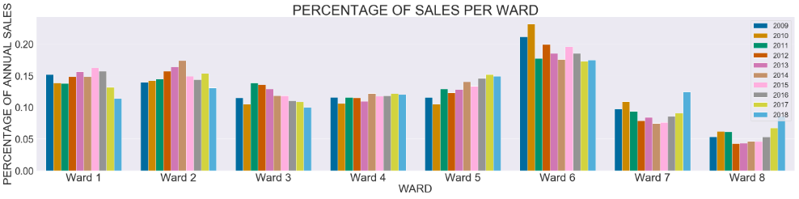
Which areas have the highest number of sales?
- Wards 7 and 8 have generally had the lowest number of sales,
- Wards 7 and 8 had a dramatic increase in sales in 2016-2018.
- Ward 6 consistently has the highest number of sales.
- Wards 1, 2, and 3 had a significant decrease in sales in 2014-2018.

Slide 6
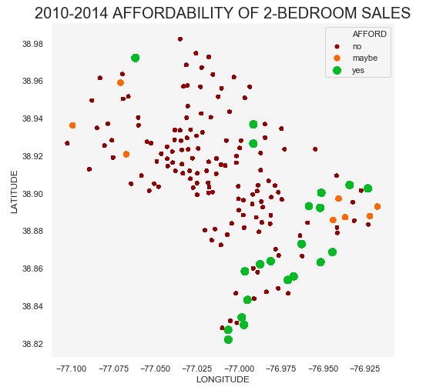
WHICH AREAS ARE AFFORDABLE FOR RESIDENTS?
- Housing is generally not affordable for local residents.
- Housing is most affordable for residents in southeast DC (Wards 7 and 8)
- Housing is somewhat more affordable for local residents in northwest DC
(Wards 2 and 3).

Slide 7
Data Wrangling
- cleaning
- outlier treatment
- missing values
-concatenation

Slide 8
Cleaning
Removed redundant geographical columns
Removed “unnamed” column, index alias
Combined bathroom and half-bathroom columns
Corrected rounding errors in categrocial variables

Slide 9
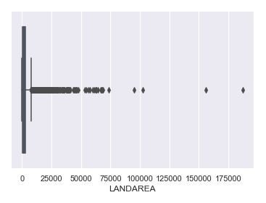
Outlier treatment
Found categorical outliers via value_counts and removed observations
Tested for normality in continuous variables:
GBA and GBBA_LIVING were normal, so I removed values outside q1+1.5*IQR and q3+1.5*iqr
LANDAREA AND PRICE were not gaussian and skewed right, so I removed values below q1-1.5*IQR and above Q3+ 4.5*iqr

Slide 10
Missing values
Removed all observations with missing price, since we are predicting price
Continuous variable treatment:
Grouped by ward and neighborhood
Filled with rolling mean
Categorical variable treatment:
Grouped by neighborhood
Filled with mode

Slide 11
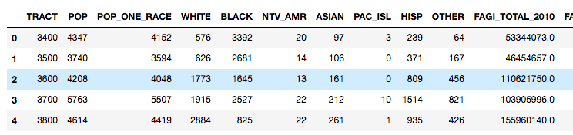
concatenation
Concatenated with census data to study social issues of race and affordability surrounding dc housing costs.

Slide 12
Exploratory data analysis
Distribution of housing prices
Tests applied
Significant variables
Geographical
Sale year
Other: rooms, stories, grade

Slide 13
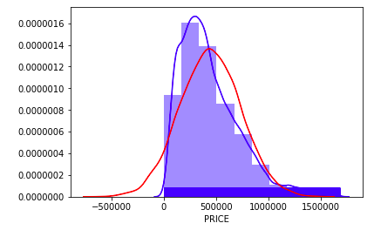
Distribution of housing prices
Housing prices do not follow a normal distribution, so we must use nonparametric analysis

Slide 14
Categorical variable tests: does pricing data from various subsets follow the same distribution?
SUBSET PRICE ACCORDING TO UNIQUE VALUES WITHIN A CATEGORICAL VARIABLE
APPLY TEST:
Mann whitney u test for variables with two unique values
Kruskall wallis test for variables with multiple unique values

Slide 15
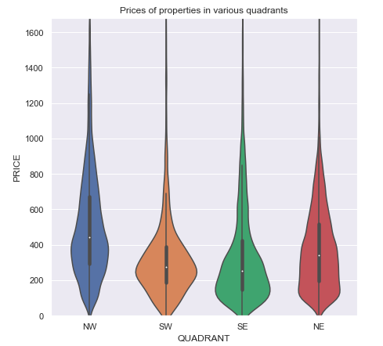
GEOGRAPHICAL LOCATON IMPACTS PRICE.
EXAMPLE 1: WARDS

Slide 16
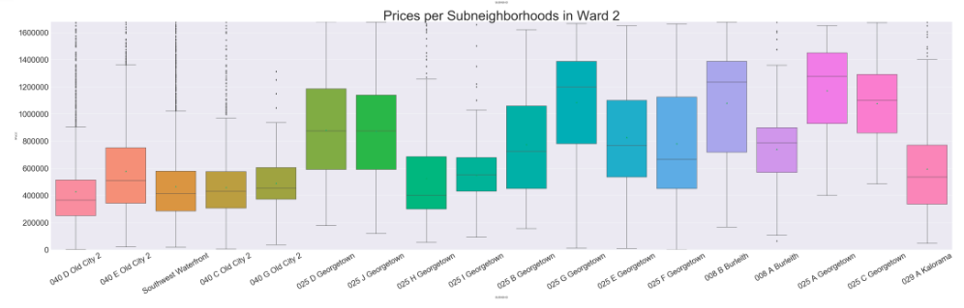
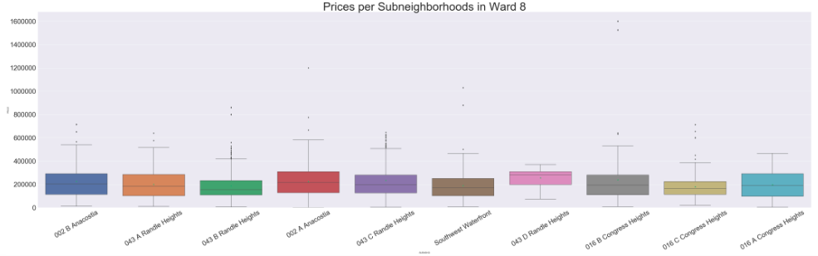
GEOGRAPHICAL LOCATON IMPACTS PRICE.
Example 2: subneighborhoods in ward 2 and ward 8

Slide 17
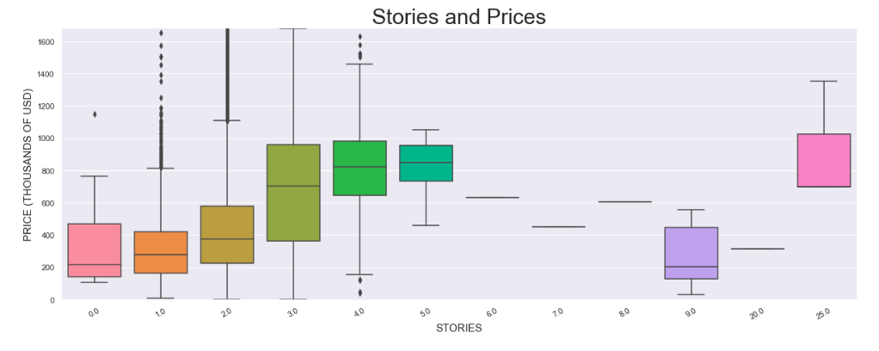
NUMBER OF STORIES IMPACTs PRICE

Slide 18
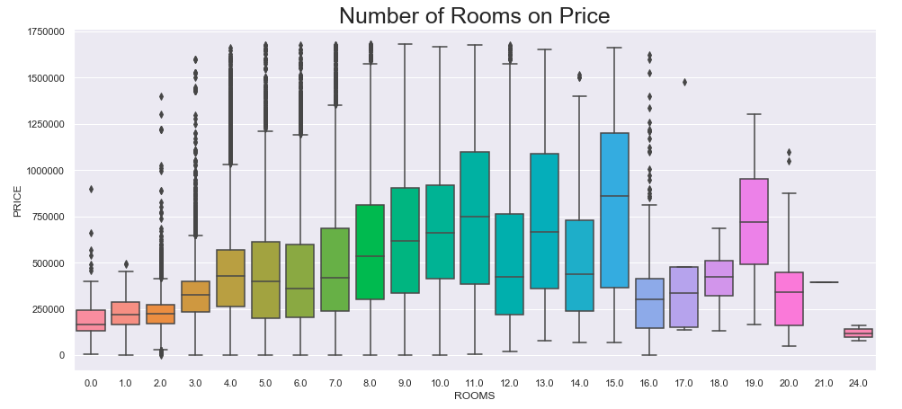
NUMBER OF ROOMS IMPACTS PRICE

Slide 19
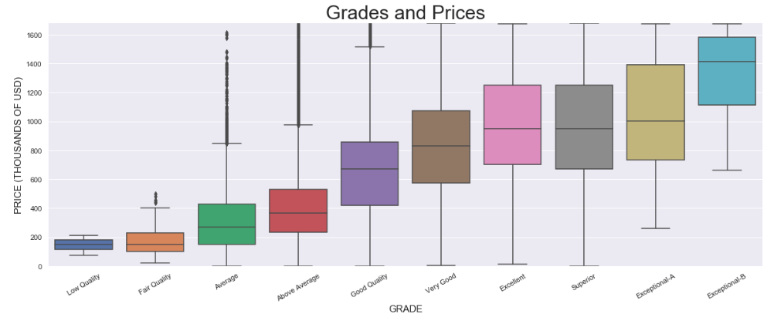
GRADE IMPACTS PRICE

Slide 20
continuous variable tests: does pricing data from various subsets follow the same distribution?
Levine test for homogeneity in variance
If homogeneous:
Compute pearson correlation coefficient for linear relationship.
If not homogeneous:
compute spearman correlation coefficient for monotonic relationship.

Slide 21
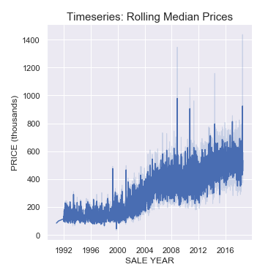
SALE YEAR IMPACTS PRICE

Slide 22
NExT STEPS:
APPLY MACHINE LEARNING APPLICATIONS TO DEVELOP PRICE PREDICTION MODEL:
linear regression
logistic regression
Clustering
random forest

