Slide 1
CAPSTONE PROJECT 2
PREDICTIVE MODELING OF FRAUDULENT HEALTHCARE PROVIDERS
Julia Sheriff | Springboard, Data Science Career Track

Slide 2
HOW CAN WE PREDICT POTENTIALLY FRAUDULENT MEDICARE PROVIDERS?
Source: Medicare Data:
Beneficiary Claims
Outpatient Claims
Inpatient Claims
Provider Potential Fraud Status

Slide 3
BENEFICIARY DATA
138,556 BENEFICIARIES
27 FEATURES:
Demographics
Chronic health conditions
Insurance
DATA WRANGLING:
Created binary variables for gender, death, and chronic health conditions
Removed strings from beneficiary id

Slide 4
OUTPATIENT CLAIMS
517,737 OUTPATIENT CLAIMS
25 FEATURES:
Claim Information (Location, Date, Time, Beneficiary, Provider)
Charges and Payments
Diagnosis and Procedure Codes
Physicians
DATA WRANGLING:
Dropped procedure codes 4-6 due to missing data
Time variables converted to datetime objects
String parsing to remove redundant letters in provider id, beneficiary id, claim id, and physician id.

Slide 5
INPATIENT CLAIMS
40,474 INPATIENT CLAIMS
29 FEATURES:
Included all features from outpatient claims
Additional features:
Admission and Discharge Date
Diagnosis Group Code
DATA WRANGLING:
New variable: duration
Dropped procedure codes 4-6 due to large quantities of missing data
Time variables converted to datetime objects
String parsing to remove redundant letters in provider id, beneficiary id, claim id, and physician id.

Slide 6
AGGREGATED DATAFRAME
5,410 PROVIDERS
168,888 FEATURES:
Measures of central tendency of other variables
Distributions of demographic variables
Diversity in number of physicians per provider
Maximum mean insurance claim amount reimbursed for various diagnostic codes
Counts per procedure and diagnostic codes
Used beneficiary and provider to merge all datasets

Slide 7
CLASS IMBALANCE: FRAUD ON THE PROVIDER AND CLAIMS LEVEL
A few providers are responsible for the majority of fraudulent claims.

Slide 8
IMBALANCE: INPATIENT VERSUS OUTPATIENT CLAIMS
The claims data used to describe providers is more influenced by outpatient claims.

Slide 9
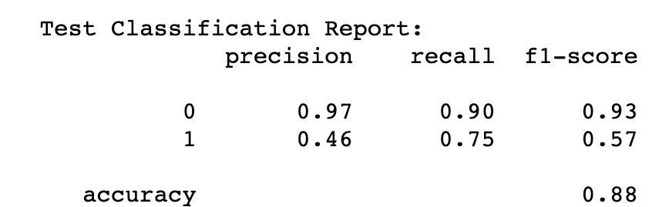
LOGISTIC REGRESSOR
The best model with ridge penalty and the best model with lasso penalty had the same class 1 recall and accuracy.

Slide 10
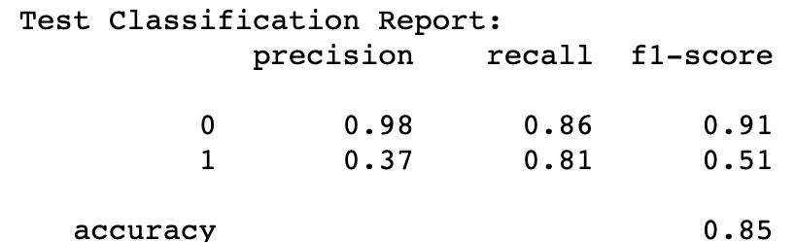
RANDOM FOREST CLASSIFIER
6% improvement in class 1 recall from the best logistic regression model.
3% decrease in accuracy from the best logistic regression model.

Slide 11
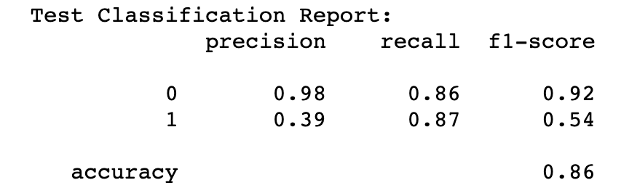
TOP PERFORMING MODEL: EXTREME GRADIENT BOOSTED (XGB) TREE CLASSIFIER
6% improvement in recall from the best random forest model.
2% decrease in accuracy from the best logistic regression model.

Slide 12
MODELING NOTE: RANDOM UNDER-SAMPLING
How it works: The algorithm takes the minority class (potentially fraudulent providers) and resamples with replacement until the size of the resampled class matches the size of the majority class
Improved Class 1 recall across all models and decreased accuracy.
The large gains in recall were beneficial in identifying more fraudulent providers

Slide 13
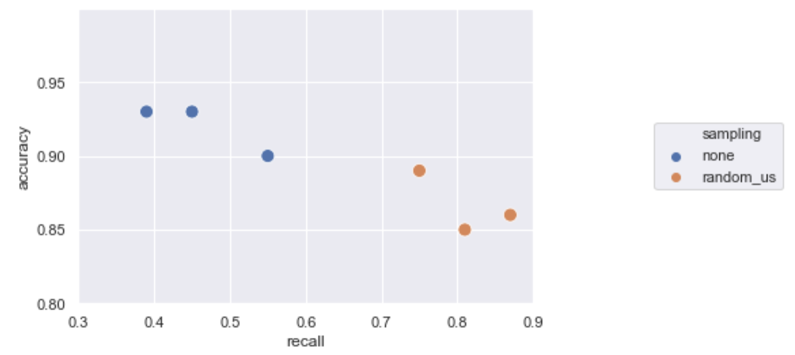
EFFECT OF RANDOM UNDERSAMPLING:
Recall is higher and accuracy is lower when implementing undersampling on the same models.
Accuracy-recall tradeoffs were greater in XGB and random forest models than in logistic models.

Slide 14
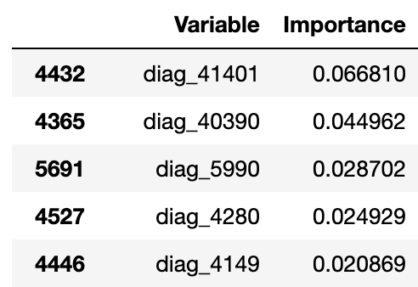
SUMMARY
XGB Feature Importances:
Mean Insurance Claim Amount Reimbursed was important in predicting potential fraud across all models
Mean duration was one of the most important features in random forest models and XGB models.
Counts of the following ICD-9 Diagnostic Codes indicated potential fraud in random forest and XGB models:
Coronary atherosclerosis of native coronary artery (41401)
Hypertensive chronic kidney disease, unspecified, with chronic kidney disease stage I through stage IV, or unspecified (40390)
Urinary tract infection, site not specified (5990)

Slide 15
CONCLUSIONS
The top-performing model was an XGB Trees classifier with a Class 1 recall of 87% and accuracy of 86% in predicting potential provider fraud.
The model with higher accuracy and the least comparative loss in recall was a Logistic Regressor with a recall of 75% and accuracy of 89%.
Both models significantly improve the ability to predict provider fraud. A model using random selection to predict potential fraud has 9.31% Class 1 recall.

Slide 16
FUTURE WORK
Modeling inpatient providers and outpatient providers separately could lead to new insights.
Collapsing beneficiary and claims data to the provider level in different ways could yield alternative results due to different features.
Inpatient versus Outpatient Providers

Slide 17
RECOMMENDATIONS FOR THE CLIENT
Having more data on inpatient claims and providers could assist in improving model performance with inpatient providers.
Having additional data about health claims, particularly on the provider level, would be helping in improving model performance. For example:
Provider charges per claim
Provider operational costs
Provider date established
Provider legal history
Provider client reviews

