Slide 1




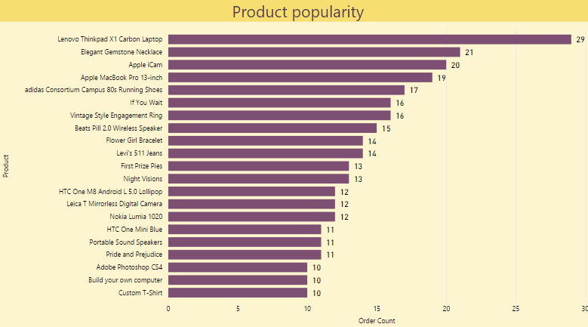
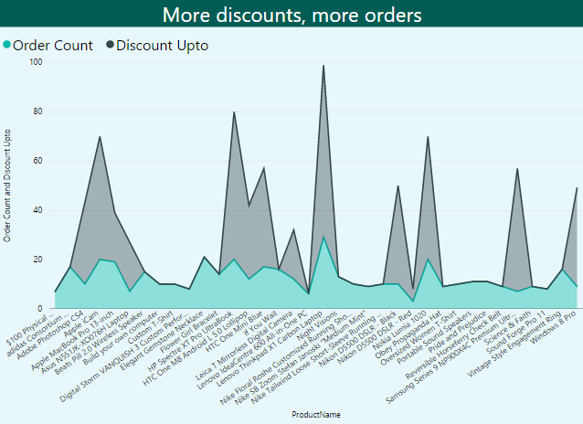


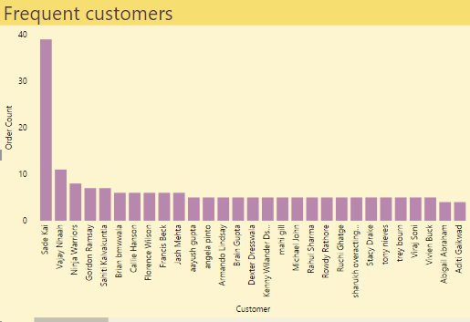
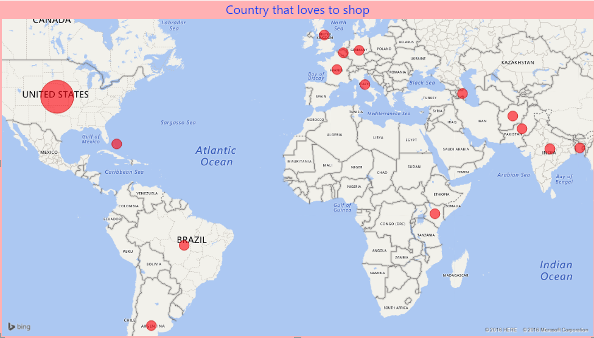

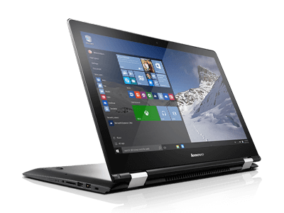
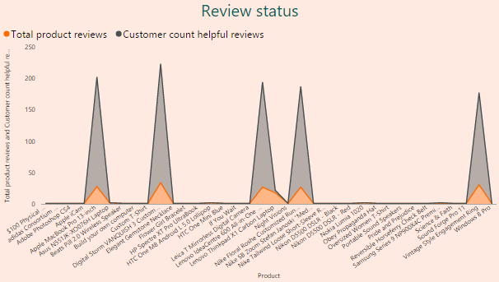
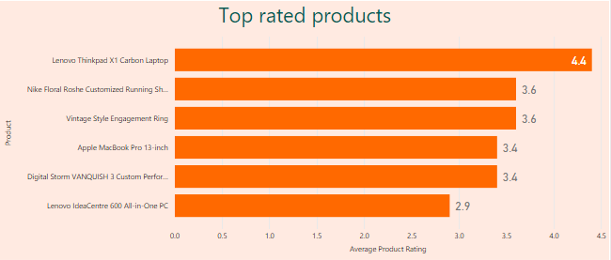
Data Warehouse
External sources
Order Placement
Date
nopCommerce
Staging
Date
Product
Product
Customer
Customer
Address
Store
Product Review
Store
Order
Order
Product review
Order item
Product review
Business Intelligence
Charts exhibit top selling products and highlights the impact of discounts on sales.
Lenovo Thinkpad X1 Carbon Laptop
Sade Kai
Charts display frequent customers and the map reveals the distribution of products sold across the globe.
Interactive charts depict product reviews and the weighted ratings for the products.
Tools used: Microsoft Excel, Microsoft Power BI, Microsoft Visual Studio (SQL Server Integration Services, SQL Server Analysis Services), Microsoft SQL Server Management Studio

