Slide 1





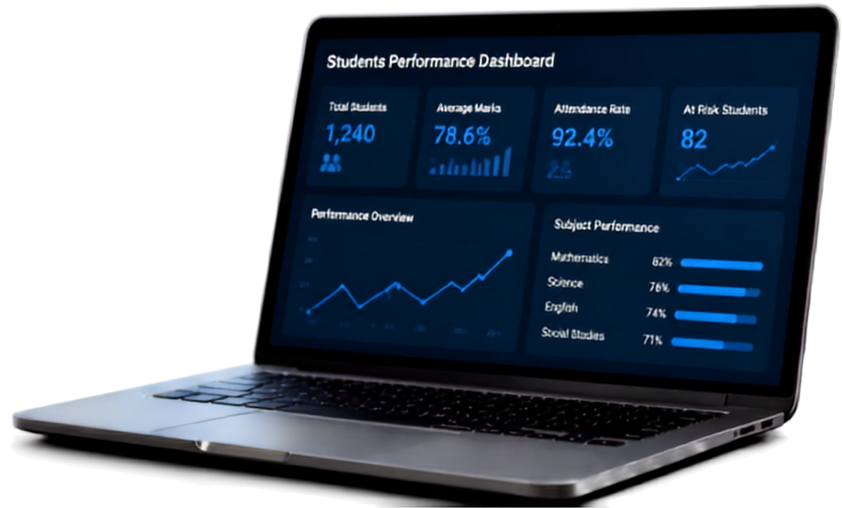



Students Performance Analysis System
Project Presentation
Presented by
Baranika, Girija Shree, Jasmitha, Kajasri
September 11, 2026

Slide 2



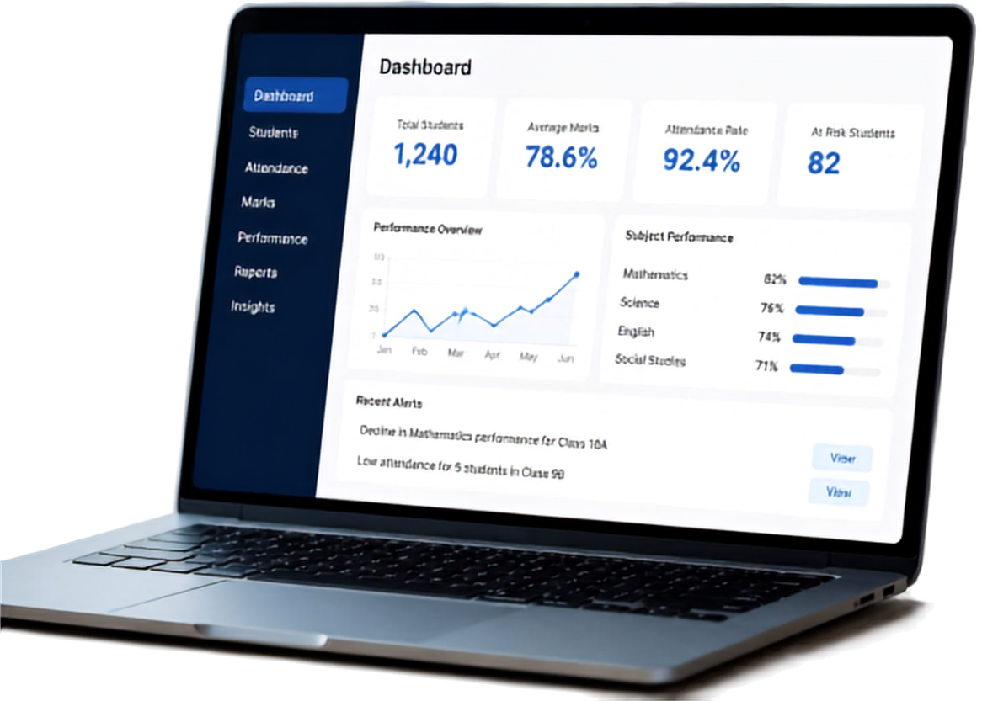


Introduction
What is the Students Performance Analysis System?
A smart platform that monitors and analyzes student performance to drive better academic outcomes.
Tracks marks, attendance, strengths, weaknesses, and overall progress
Centralizes student data for easy monitoring
Provides clear insights for timely support and informed decisions
Empowers teachers, students, and institutions to achieve more together

Slide 3


Background
multiple factors shape student performance and manual processes limit accurate insights
KEY FACTORS THAT INFLUENCE PERFORMANCE
01
Attendance
LIMITATIONS OF MANUAL ANALYSIS
02
Examination marks
time-consuming processes delay insights
03
Assignments
prone to human errors and inconsistencies
04
Participation
makes it harder to identify patterns and take timely action
05
Learning habits

Slide 4



Problem Statement
Tracking individual student progress is difficult and inconsistent
Manual analysis of marks and attendance is inefficient and error-prone
Identifying students who need academic support happens too late
Fragmented data leads to unclear insights

Slide 5










Objectives
Our goals for a smarter performance analysis system
Analyze and monitor academic performance effectively
Identify students’ strengths, weaknesses, and improvement areas
Assist teachers in making informed academic decisions
Empower data-driven actions for better learning outcomes

Slide 6









Methodology
A structured process that turns student data into meaningful performance insights.
01
02
03
Collect Data
Analyze Data
Visualize Insights
Gather marks, attendance, assignments, and academic records from multiple sources.
Process and analyze data to identify patterns, strengths, weaknesses, and performance trends.
Present results through reports, charts, and dashboards for clear and actionable insights.

Slide 7

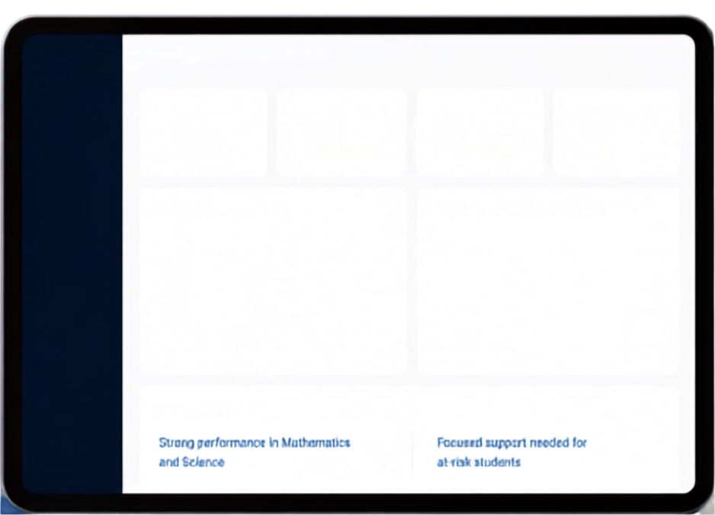





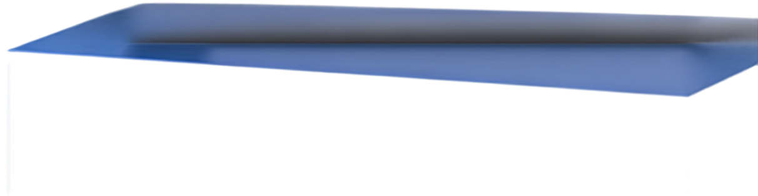
Discussion
Performance Dashboard
Total Students
Average Marks
Attendance Rate
At Risk Students
Organized data turns insights into academic impact.
Students
1,240
78.6%
92.4%
82
Attendance
Marks
Student Performance by Category
Student Performance by Category
Top Subjects by Average Marks
Top Subjects by Average Marks
Enables teachers to track academic progress comprehensively
Performance
35%
Mathematics
Reports
High Performers
82%
45%
Science
76%
Insights
Average Performers
20%
English
74%
Needs Support
Facilitates comparison of marks, attendance, and other factors
Social Studies
71%
Key Insights
Helps identify both high performers and students needing support
Strong performance in Mathematics and Science
Focused support needed for at-risk students
Data-driven insights lead to better understanding and stronger outcomes

Slide 8





Key Findings
78.6%
early detection of performance changes
The Students Performance Analysis System delivers measurable impact.
92.4%
influence from attendance and academic activities
82%
students benefiting from personalized academic support

Slide 9



Conclusion
A smarter way to understand.
A stronger path to success.
Enhances academic monitoring and decision-making efficiency
Reduces manual analysis difficulties and errors
Provides meaningful insights to support teachers and students effectively
Empowering education
through data-driven insights

