Slide 1
.NET MAUI
Roman Jašek
Riganti s.r.o. Microsoft Most Valuable Professional (MVP)
roman.jasek@riganti.cz

Slide 2
Who knows?
C#
.NET
MVVM
.NET MAUI

Slide 3

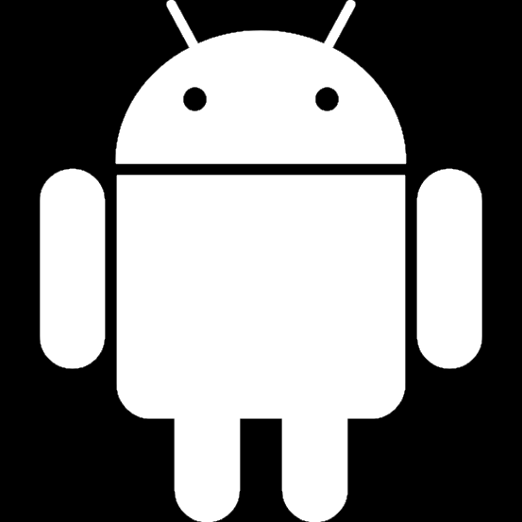


„Standard“ Application Development
iOS
Objective-C
Swift
XCode
Android
Java
Kotlin
Android Studio
Windows
C#
Visual Studio
Mac OS
Objective-C
Swift
XCode

Slide 4




.NET Multi-platform App UI
.NET
Cross-platform, native UI
Single project system, single codebase
Deploy to multiple devices, mobile & desktop
.NET MAUI
Android
iOS
macOS
Windows

Slide 5
How It Works - Structure
Platform specific frameworks
.NET for Android
.NET for iOS
.NET for MacOS
Windows UI (WinUI) library
Common BCL - .NET
.NET Runtimes
Mono – Android, iOS, MacOS
WinRT – Windows

Slide 6
How It Works - UI
Platform specific UI
Different platforms - different ways of defining UI
Can be defined separately using platform specific APIs
.NET for Android, .NET for iOS, .NET for MacOs, WinUI
Common UI
Single framework for defining UI – mobile & desktop
XAML

Slide 7
How It Works - compilation
Android
C# compiles to intermediate language (IL)
JIT compilation to native assembly on app launch
iOS
Fully ahead-of-time (AOT) compiled to native ARM assembly code
MacOS
Using Mac Catalyst
Apple’s solution to bring iOS Apps to desktop
Provides access to Mac OS APIs
Windows
WinUI 3 library
Native apps and UWP

Slide 8
How It Works – Application Startup
.NET Generic Host – DI, logging, configuration…
Static MauiProgram class
Create builder, register dependencies..
Create a MauiApp instance
App class
Derives from Application
Initializes application, sets initial page
Separate startup points for each platform (Platforms folder)
MainApplication.cs (Android), Program.cs (iOS)
App.xaml.cs (Windows), Program.cs (Mac Os)

Slide 9





How .NET MAUI Works

Slide 10
.NET MAUI
Collection of Controls
Layout engine for pages
Navigation – pages, drawers
Customizable handlers – enable platform specific controls
APIs for native device features – GPS, accelerometer…
Graphics library for 2D drawing code
Single project, multi-targeting system
.NET hot reload

Slide 11




Platforms
Official support
*
Community
* Tizen .NET supported by Samsung

Slide 12
XAML
Format for serialization of hierarchy of objects
Mostly used for UI
Possible connection to a code-behind class

Slide 13
Where is XAML used?
Windows Presentation Foundation (WPF)
Silverlight
Windows Phone
Universal Windows Platform (UWP)
Windows Workflow Foundation (WF)
Not used for UI
Xamarin.Forms
WinUI3
.NET MAUI

Slide 14
XAML
x:Class … name of generated class
UserControl … inheritance
xmlns:x … special namespace for XAMLu (mandatory)
xmlns … namespace with built-in framework controls
<?xml version="1.0" encoding="utf-8" ?>
<ContentPage xmlns="http://xamarin.com/schemas/2014/forms"
xmlns:x="http://schemas.microsoft.com/winfx/2009/xaml"
x:Class="CookBook.Mobile.Views.Page1">
</ContentPage>

Slide 15
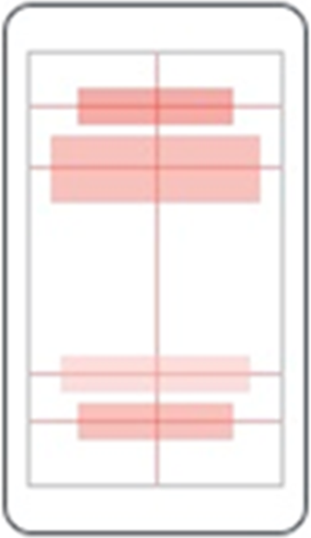

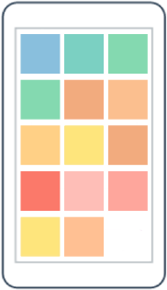
Layouts
AbsoluteLayout
RelativeLayout
FlexLayout

Slide 16
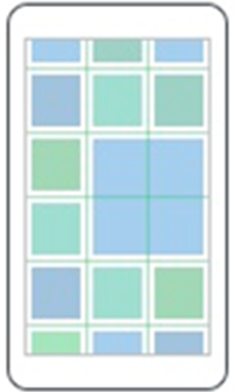

Layouts
Grid
StackLayout

Slide 17
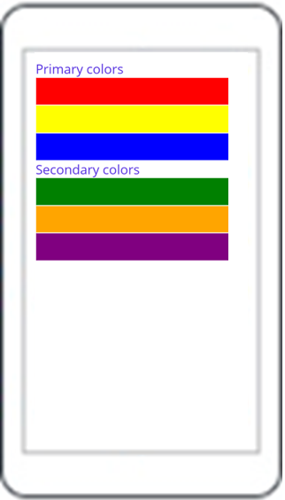
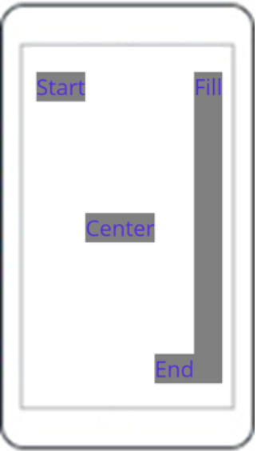
Layouts – StackLayout
StackLayout
VerticalStackLayout
HorizontalStackLayout

Slide 18
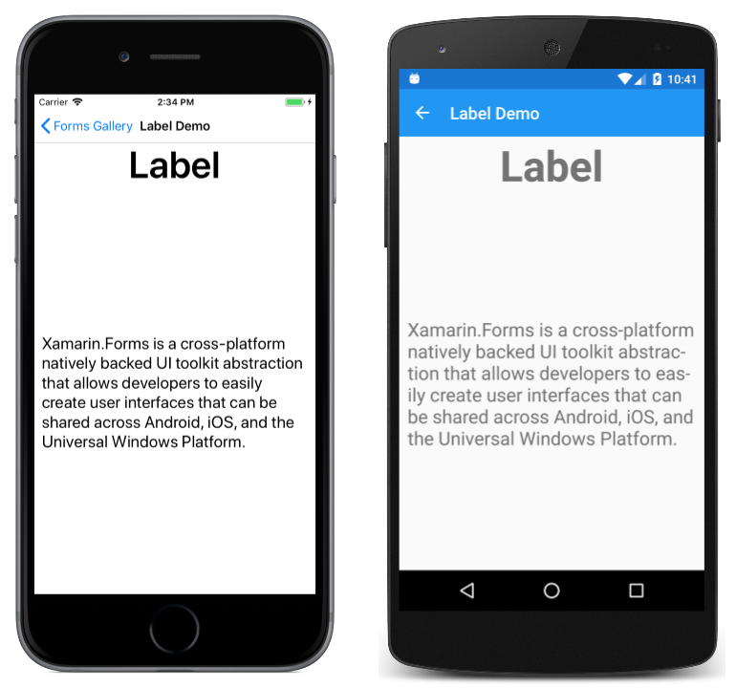
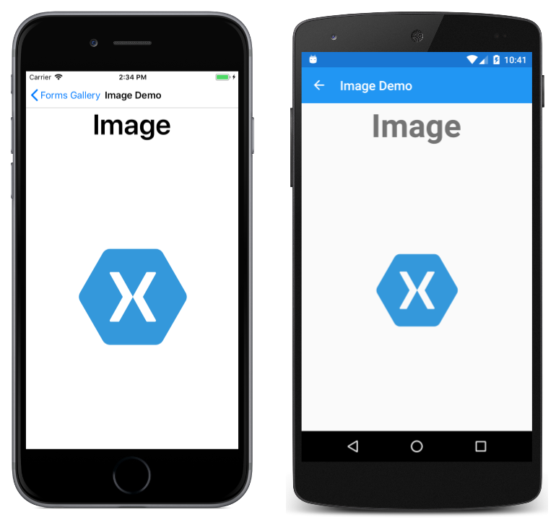
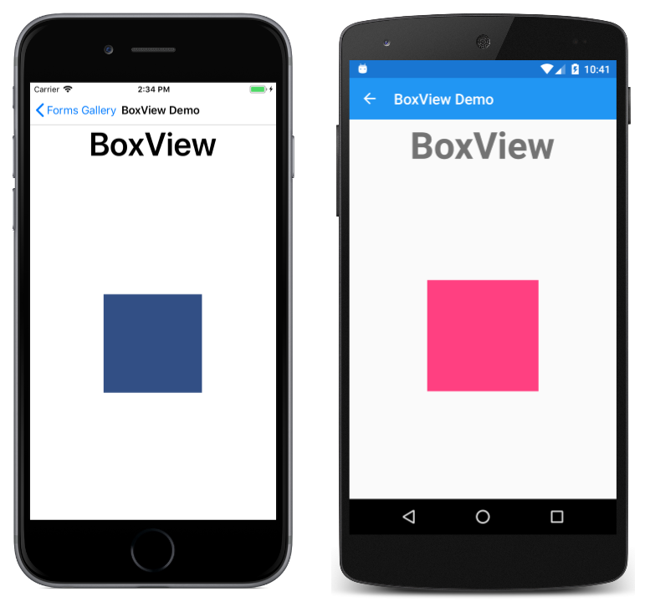
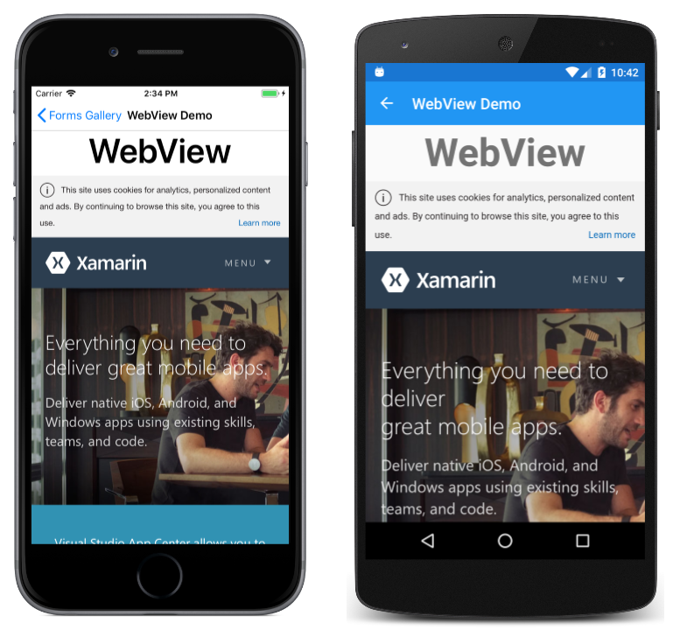
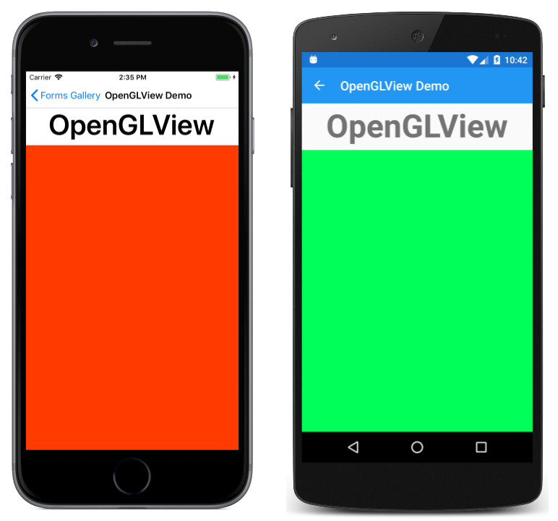
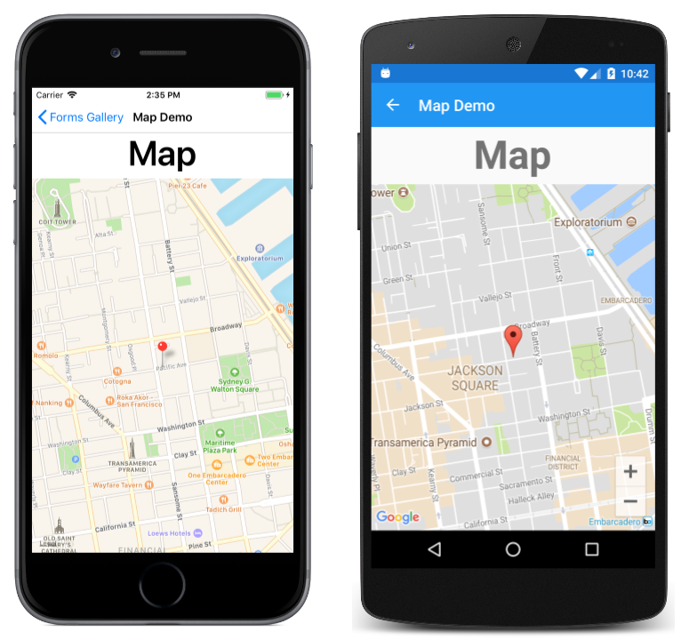
Content Presentation

Slide 19
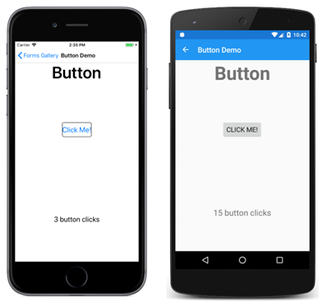
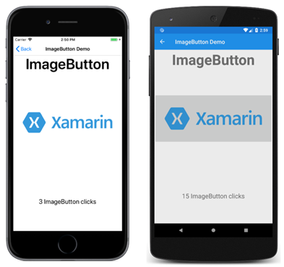
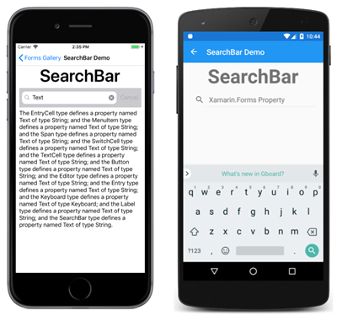
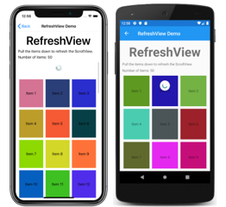
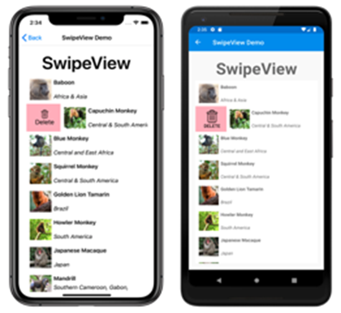
Actionable Controls

Slide 20
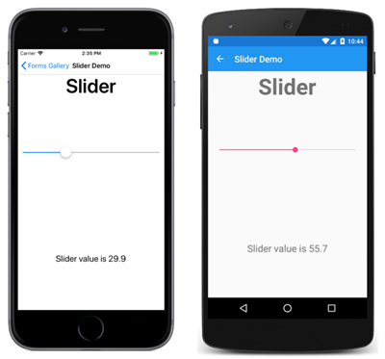
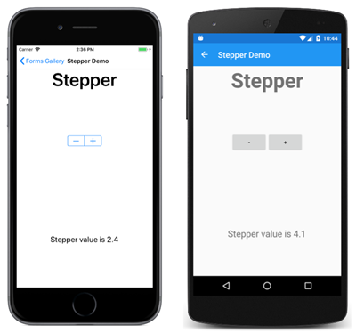

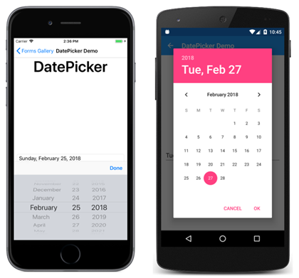
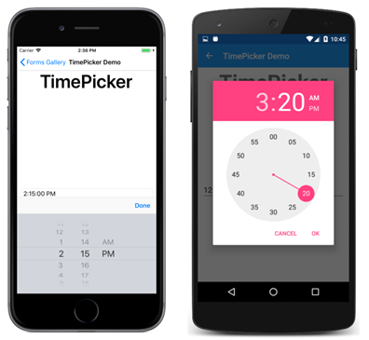
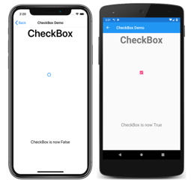
Setting Values

Slide 21
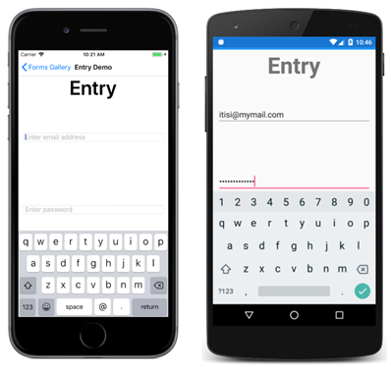
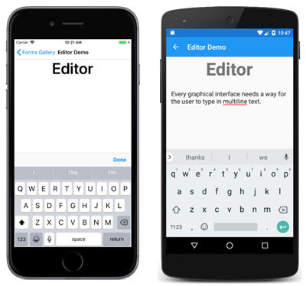
Editing Text

Slide 22
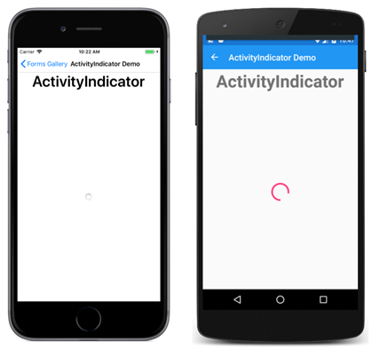
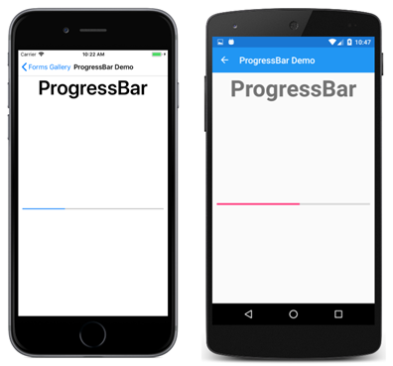
Activity Indication

Slide 23
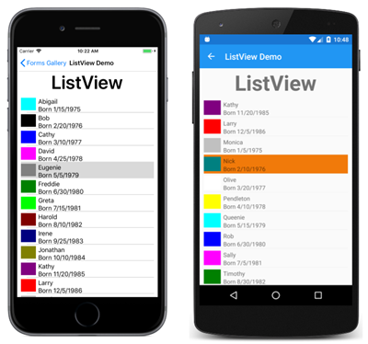
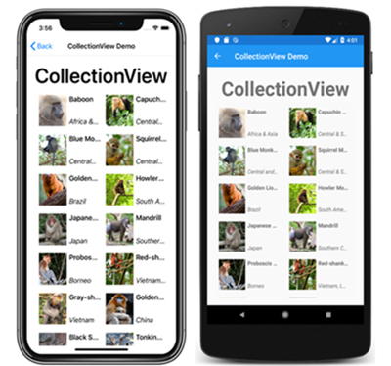
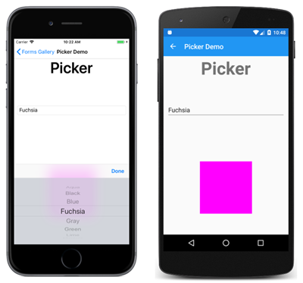
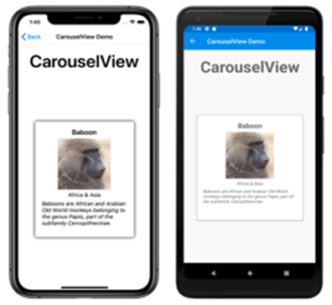
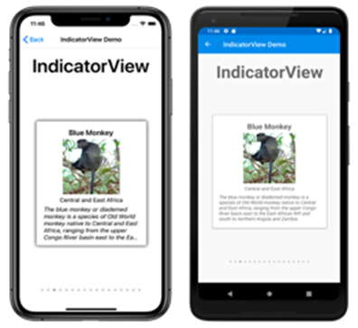
Collections

Slide 24
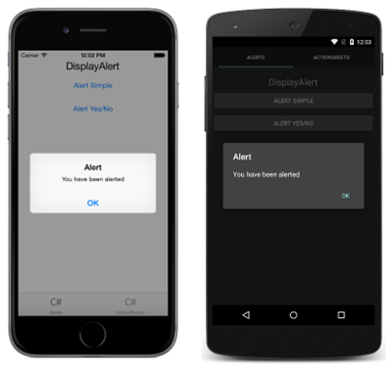
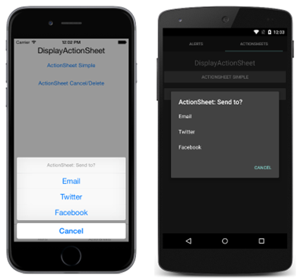
Pop-ups

Slide 25
Demo

Slide 26
Model View ViewModel
View
View
Displays data and deals with user interaction
Model
Represents data structure
ViewModel
Keeps context of current view
Nofies View when changes happen
Model
ViewModel
Business Layer

Slide 27
Data binding
Connection of code and XAML
Between ViewModel and View
Text="{Binding Path=Operand1}"
Between controls in View
Text="{Binding Source={x:Reference Name=DisplayAlertButton}, Path=Text}"

Slide 28
MVVM Frameworks
MVVM Cross
Simple MVVM
MVVM Light
Catel
Prism
ReactiveUI

Slide 29
.NET MAUI Blazor
Use Blazor in applications
Razor, standard Blazor code
Hosted in WebView
Runs natively
No SignalR, no WebAssembly
Access to system APIs (file access, network access…)
But why?
Blazor/web developer using razor – develop mobile applications
Use Blazor components in any .NET applications (MAUI, WPF, UWP…)
The cross-platform UI stuff is already solved – it’s in a browser!

Slide 30
Advantages of .NET MAUI
XAML
.NET
Good documentation
Sharing code – 90%+

Slide 31
Materials
Lecture materials: https://github.com/jasho/pv239-maui
Sample project: https://github.com/jasho/cookbook-maui

Slide 32

Free for Students
Code: MEEETUPDATEBRNO
https://brno.meetupdate.cz

