Slide 1
.NET MAUI
Roman Jašek
Software Architect, Riganti s.r.o. Microsoft Most Valuable Professional (MVP)
roman.jasek@riganti.cz

Slide 2
Who knows?
C#
.NET
MVVM
Xamarin

Slide 3




„Standard“ Application Development
iOS
Objective-C
Swift
XCode
Android
Java
Kotlin
Android Studio
Windows
C#
Visual Studio
Mac OS
Objective-C
Swift
XCode

Slide 4
Xamarin
Common logic for all platforms
UI written in C#
Use development practices analogous to the specific target platforms
iOS C# UI
Android C# UI
Windows C# UI
Shared C# Backend
Xamarin

Slide 5
Xamarin + Xamarin.Forms
iOS C# UI
Android C# UI
Windows C# UI
Shared UI Code
Shared C# Backend
Shared C# Backend
Xamarin
Xamarin.Forms
5

Slide 6
How It Works - Structure
Platform specific frameworks
.NET for Android
.NET for iOS
.NET for MacOS
Windows UI (WinUI) library
Common BCL - .NET 6
.NET Runtimes
Mono – Android, iOS, MacOS
WinRT – Windows

Slide 7
How It Works - UI
Platform specific UI
Different platforms - different ways of defining UI
Can be defined separately using platform specific APIs
.NET for Android, .NET for iOS, .NET for MacOs, WinUI
Common UI
Single framework for defining UI – mobile & desktop
XAML

Slide 8
How It Works - compilation
Android
C# compiles to intermediate language (IL)
JIT compilation to native assembly on app launch
iOS
Fully ahead-of-time (AOT) compiled to native ARM assembly code
MacOS
Using Mac Catalyst
Apple’s solution to bring iOS Apps to desktop
Provides access to Mac OS APIs
Windows
WinUI 3 library
Native apps and UWP

Slide 9
How It Works – Application Startup
.NET Generic Host – DI, logging, configuration…
Static MauiProgram class
Create builder, register dependencies..
Create a MauiApp instance
App class
Derives from Application
Initializes application, sets initial page
Separate startup points for each platform (Platforms folder)
MainApplication.cs (Android), Program.cs (iOS)
App.xaml.cs (Windows), Program.cs (Mac Os)

Slide 10





How .NET MAUI Works

Slide 11
.NET MAUI
Collection of Controls
Layout engine for pages
Navigation – pages, drawers
Customizable handlers – enable platform specific controls
APIs for native device features – GPS, accelerometer…
Graphics library for 2D drawing code
Single project, multi-targeting system
.NET hot reload

Slide 12
.NET MAUI Essentials
Extension library, continuation of Xamarin Essentials
Cross-platform APIs for native device features
Included directly in MAUI, no need for extra Nuget packages

Slide 13
.NET MAUI Essentials
Accelerometer | App Actions | App Information
App Theme | Barometer | Battery
Clipboard | Color Converters | Compass
Connectivity | Contacts | Detect Shake
Display Info | Device Info | Email
File Picker | File System Helpers | Flashlight
Geocoding | Geolocation | Gyroscope
Haptic Feedback | Launcher | Magnetometer
MainThread | Maps | Media Picker
Open Browser | Orientation Sensor | Permissions
Phone Dialer | Platform Extensions | Preferences
Screenshot | Secure Storage | Share
SMS | Text-to-Speech | Unit Converters
Version Tracking | Vibrate | Web Authenticator

Slide 14




Platforms
Official support
*
Community
* Tizen .NET supported by Samsung

Slide 15
XAML
Format for serialization of hierarchy of objects
Mostly used for UI
Possible connection to a code-behind class

Slide 16
Where is XAML used?
Windows Presentation Foundation (WPF)
Silverlight
Windows Phone
Universal Windows Platform (UWP)
Windows Workflow Foundation (WF)
Not used for UI
Xamarin.Forms
.NET MAUI

Slide 17
XAML
x:Class … name of generated class
UserControl … inheritance
xmlns:x … special namespace for XAMLu (mandatory)
xmlns … namespace with built-in framework controls
<?xml version="1.0" encoding="utf-8" ?>
<ContentPage xmlns="http://xamarin.com/schemas/2014/forms"
xmlns:x="http://schemas.microsoft.com/winfx/2009/xaml"
x:Class="CookBook.Mobile.Views.Page1">
</ContentPage>

Slide 18
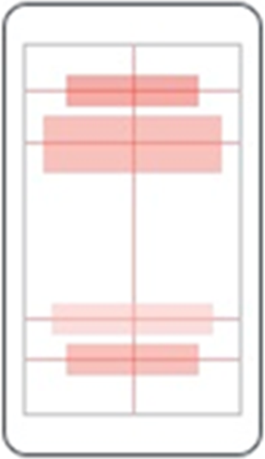

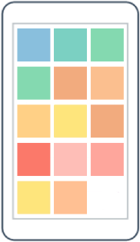
Layouts – multiple components
AbsoluteLayout
RelativeLayout
FlexLayout

Slide 19
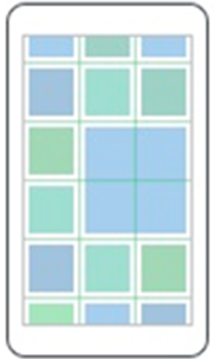

Layouts – multiple components
Grid
StackLayout

Slide 20
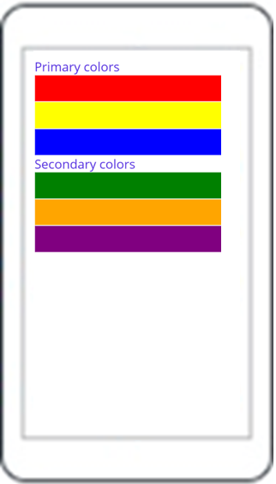
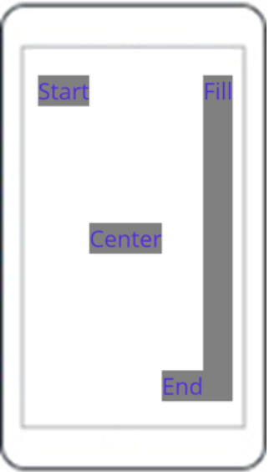
Layouts – StackLayout
StackLayout
VerticalStackLayout
HorizontalStackLayout

Slide 21
StackLayout…
HorizontalLayout, VerticalLayout
Individual layouts for single direction
Separate LayoutManagers with Measure methods
Recommended
StackLayout
Wraps HorizontalStackLayout and VerticalStackLayout
Has Orientation
Useful for adaptive layouts

Slide 22
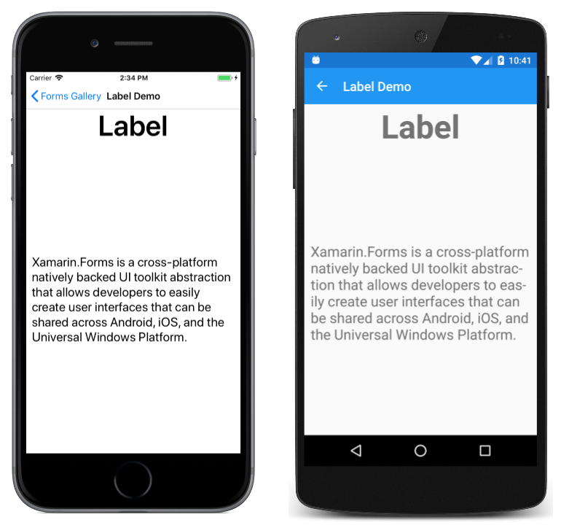
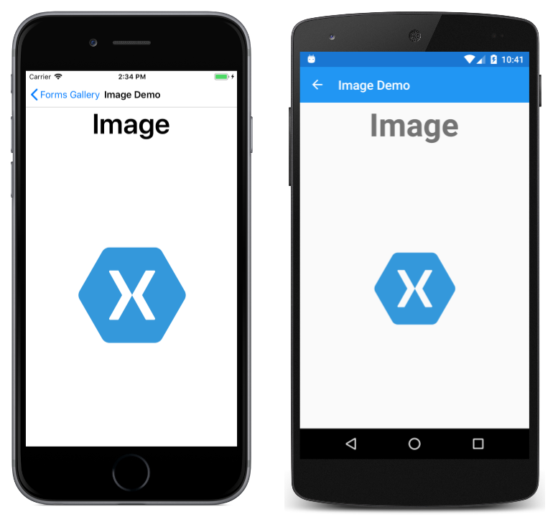
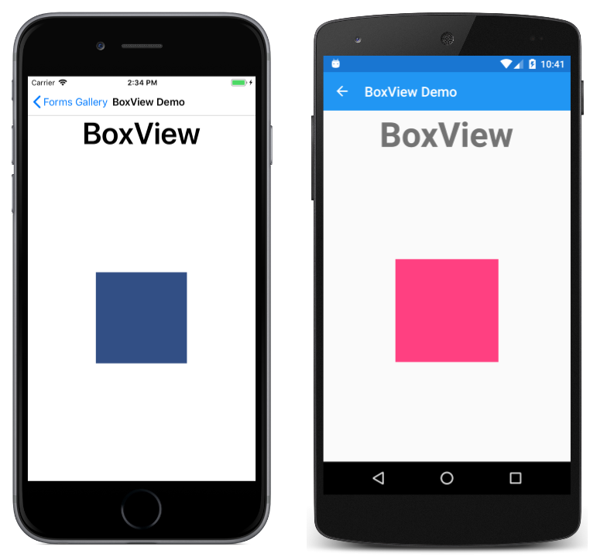
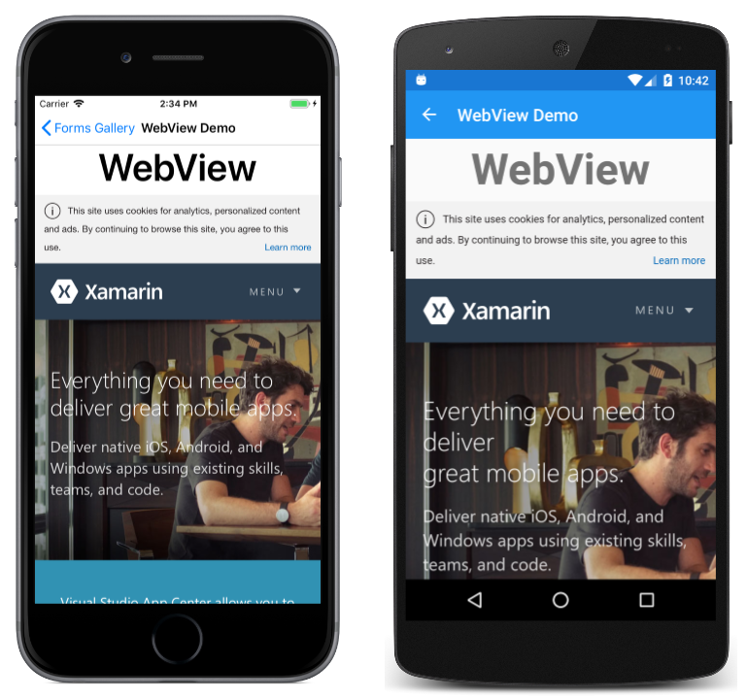
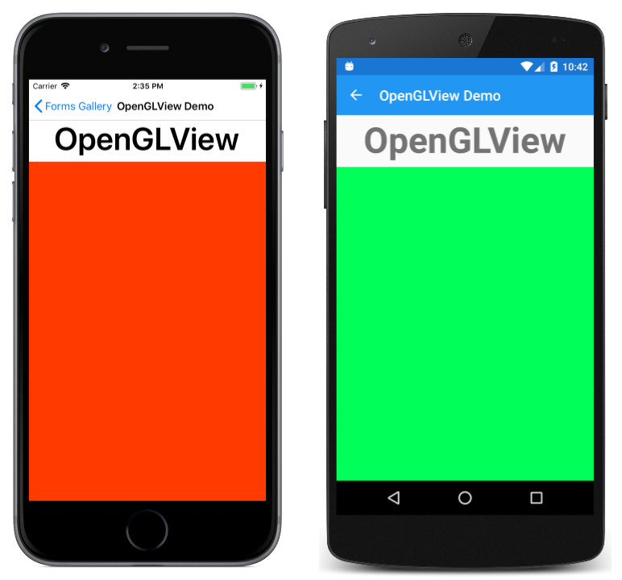
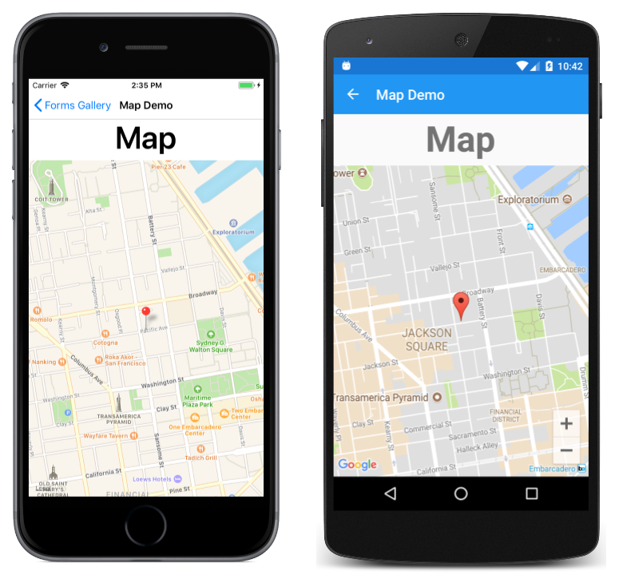
Content Presentation

Slide 23
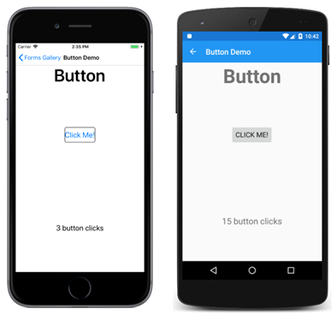
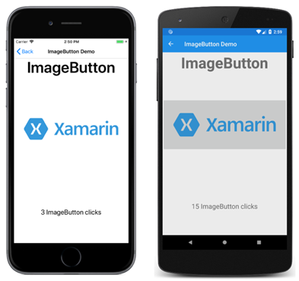
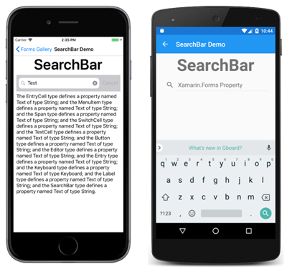
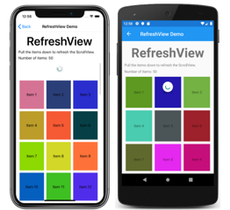
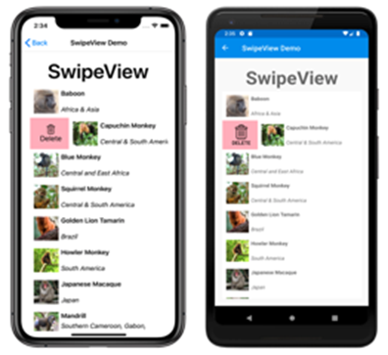
Actionable Controls

Slide 24
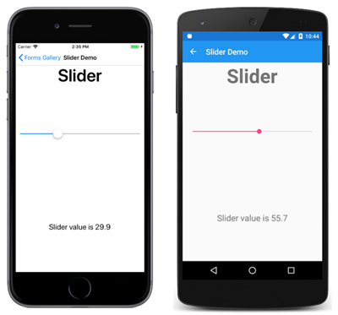
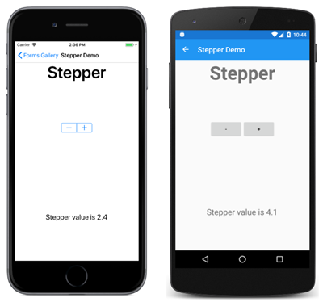

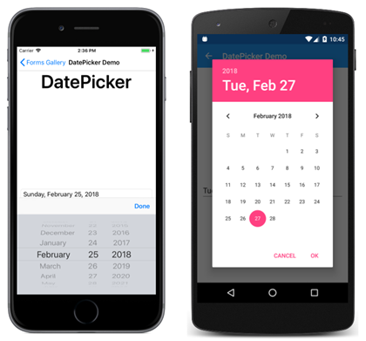
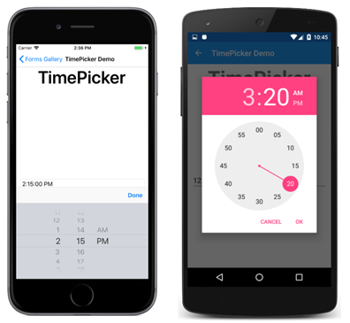
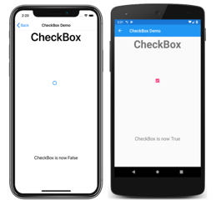
Setting Values

Slide 25
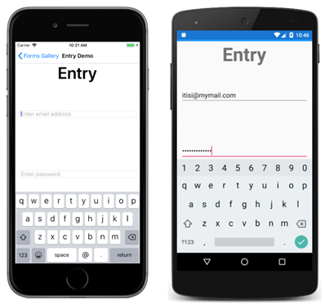
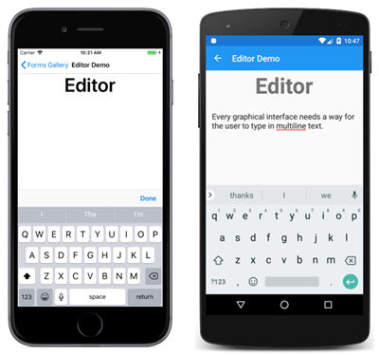
Editing Text

Slide 26
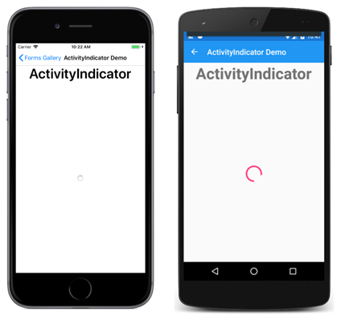
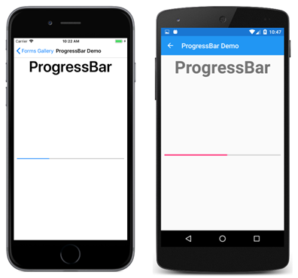
Activity Indication

Slide 27
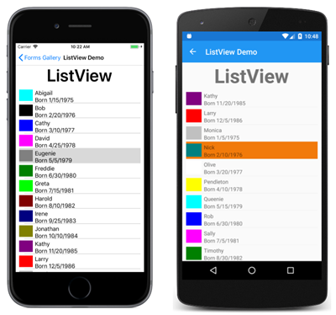
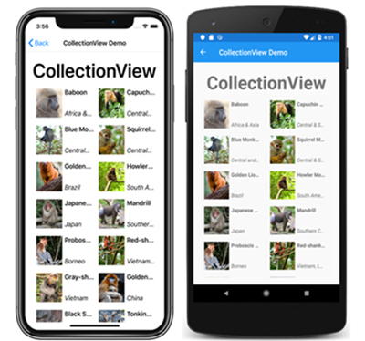
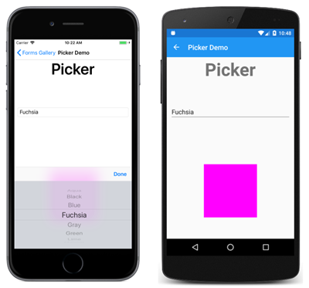
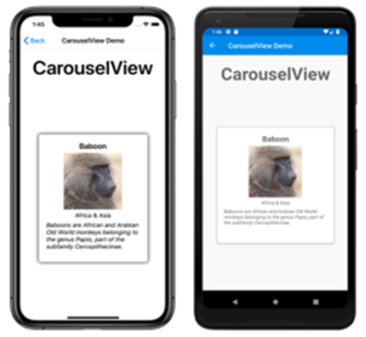
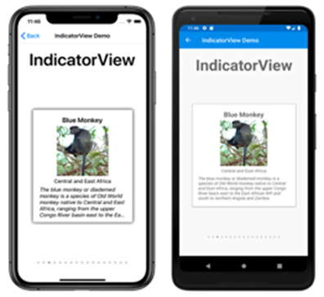
Collections

Slide 28
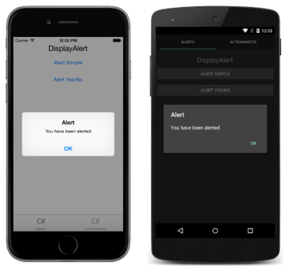
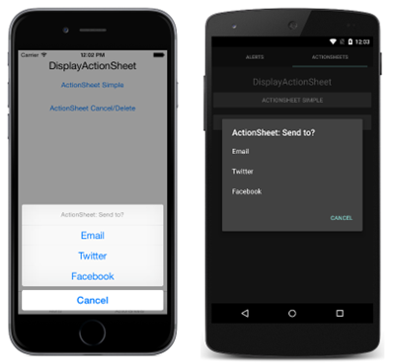
Pop-ups

Slide 29
Demo time!

Slide 30
Model View ViewModel
View
Model – Reprezentuje data.
View – Zobrazuje data uživateli
a dává mu možnost ovládání programu a zadávání nových
dat.
ViewModel– drží si kontext aktuální (části) obrazovky.
Model
ViewModel
Business Layer

Slide 31
Data binding
Connection of code and XAML
Between ViewModel and View
Text="{Binding Path=Operand1}"
Between controls in View
Text="{Binding Source={x:Reference Name=DisplayAlertButton}, Path=Text}"

Slide 32
MVVM Frameworks
MVVM Cross
Simple MVVM
MVVM Light
Catel
ReactiveUI

Slide 33
.NET MAUI Blazor
Use Blazor in applications
Razor, standard Blazor code
Hosted in WebView
Runs natively
No SignalR, no WebAssembly
Access to system APIs (file access, network access…)
But why?
Blazor/web developer using razor – develop mobile applications
Use Blazor components in any .NET applications (MAUI, WPF, UWP…)
The cross-platform UI stuff is already solved – it’s in a browser!

Slide 34
MAUI vs. Xamarin
.NET 6, C# 10
Single project
Unified working with images, fonts, splash screen and other resources
Custom Renderers -> Handlers
IoC/DI
Unified working with WinRT
Official support for Mac OS

Slide 35
Xamarin Migration
Current solution - manual process
Create new project
Copy code files
Bulk rename Xamarin namespaces to MAUI namespaces
Update dependencies to target .NET 6 and MAUI
Expected solution - .NET upgrade assistant ()
Automatically migrate to single project and swap namespaces
Update dependencies (manual)
Register compatibility services or renderers (manual)

Slide 36
Current state
Implementation
All platforms supported as single project
Most controls are available, still working on some attributes
VS integration
Project templates available
Compilation, errors, warnings, syntax highlighting, IntelliSense
Documentation
Installation, Getting started, Sample application, Basics...
Release notes for Preview versions
Areas specific to MAUI (control handlers…)
New controls documentation added every month
Deeper knowledge - linking to Xamarin documentation

Slide 37
Current state
Current release: Preview 14 (03/2022)
Planned GA release: Q2/2022
Next GA release – synced with .NET 7 release

Slide 38
Advantages of .NET MAUI
XAML
.Net
Good documentation (some for Xamarin)
Sharing code – 90%+

Slide 39
Materials
Slides – IS
Current state of code – IS
GitHub: https://github.com/jasho/cookbook-maui

