Slide 1
PV239 - 03 MVVM
Roman Jašek, Michal Hazdra
Riganti s.r.o.
roman.jasek@riganti.cz
michal.hazdra@riganti.cz

Slide 2
Project
Kdo má nápad?
Kdo má zadání?

Slide 3
What do you already know?
MVVM
Data Binding
Command
Inversion of Control/Dependency Injection

Slide 4
goals
Get to know available navigation options
Get to know the MVVM design pattern
Look at the concepts for Data Binding

Slide 5
Shell
Controls
Layouts
Navigation
Styles
Localization
Application layout
Navigation using URIs
Hierarchical navigation
Easy passing of parameters between pages
String parameters or strongly typed objects
Works even in backwards navigation “..?success=true”

Slide 6
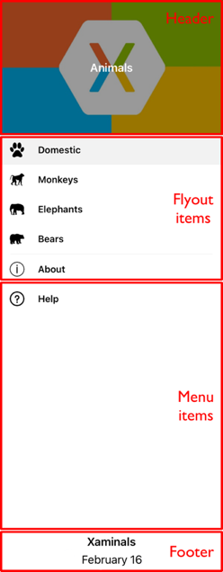
Shell - Flyout
Controls
Layouts
Navigation
Styles
Localization
Header
Items
Footer
Support for text, icons or custom templates

Slide 7
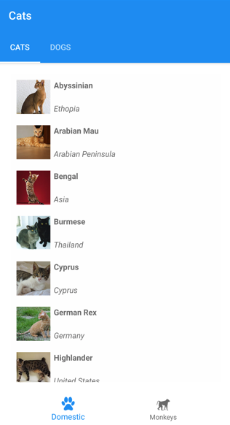
Shell - tabs
Controls
Layouts
Navigation
Styles
Localization
2 levels of hierarchy
Bottom tabs
Top tabs
Support for text, icons, custom templates

Slide 8
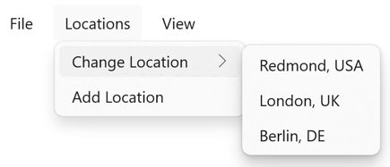
Shell - MenuBar
Controls
Layouts
Navigation
Styles
Localization
MenuBarItem
MenuFlyoutItem
MenuFlyoutSubItem
Support for text, icons

Slide 9
Navigationpage
Controls
Layouts
Navigation
Styles
Localization
NavigationPage
PushAsync
PopAsync

Slide 10



Pages
Controls
Layouts
Navigation
Styles
Localization
ContentPage
Single content
TabbedPage
Tabs
FlyoutPage
Items + detail

Slide 11
Navigation
Controls
Layouts
Navigation
Styles
Localization
Demo

Slide 12
Model View ViewModel
MVVM
Binding
INotify...
Command
View
Model – Represents data
View – Displays data to user and provides interactivity options.
ViewModel – keeps the current context of the View
Model
ViewModel
Business Layer

Slide 13
Binding
MVVM
Binding
INotify...
Command
Binding the value from the backend to it’s display in the frontend

Slide 14
Binding types
MVVM
Binding
INotify...
Command
Using current BindingContextu
{Binding}
Referencing current BindingContext
{Binding Name}
Referencing property Name in current BindingContext
{Binding Name.Length}
Referencing property Name.Length

Slide 15
Binding types
MVVM
Binding
INotify...
Command
Using a named element
attribute x:Name
{Binding Path=Text, Source={x:Reference TextBox1}}
Referencing property Text of object TextBox1
x:DataType
Specifies data type of the object that is used in current BindingContext
If it is unclear what data type is used in current BindingContext
Used for Intellisense and build-time control

Slide 16

Layouts
Ovládací prvky
Layouty
Navigace
Styly
Lokalizace
MVVM
Binding
INotify...
Command
MVVM, Binding
Demo

Slide 17
Binding directions
MVVM
Binding
INotify...
Command
Attribute Mode
OneTime
Value is set only one time when the control is created
OneWay
Value updates in one way – from backend to frontend (for example Label)
TwoWay
Value updates in both ways (for example Entry)
OneWayToSource
Value updates in one way – from frontend to backend

Slide 18
Binding – notify about changes
MVVM
Binding
INotify...
Command
OneWay & TwoWay
Reacts on value changes in the backend
The frontend needs to be notified that something changed
Backend object implements INotifyPropertyChanged
public event PropertyChangedEventHandler PropertyChanged
It’s advised to add an OnPropertyChanged method with a parameter with attribute [CallerMemberName]

Slide 19
INotifyCollectionChanged
MVVM
Binding
INotify...
Command
If something changes inside an existing collection (item gets added or removed)
ObservableCollection<T>
Already implements interface INotifyCollectionChanged
Existing collections
Create a wrapper that implements INotifyCollectionChanged
Custom collections
Implement INotifyCollectionChanged and add support for notitfying the frontend on changes

Slide 20
Fody
MVVM
Binding
INotify...
Command
Solves calling of PropertyChanged for you
Inserts code into IL after build time
Nuget packages
Fody
PropertyChanged.Fody

Slide 21
Layouts
Ovládací prvky
Layouty
Navigace
Styly
Lokalizace
MVVM
Binding
INotify...
Command
INotifyPropertyChanged
FODY
Demo

Slide 22
ICommand
MVVM
Binding
INotify...
Command
Interface for making actions while using Bindings
public void Execute(object parameter)
public bool CanExecute(object parameter)
public event EventHandler CanExecuteChanged
Usage in XAML
Command="{Binding SaveCommand}"

Slide 23
Command Parameter
MVVM
Binding
INotify...
Command
Passing value to Command
Value gets passed as type Object – needs to be casted
CommandParameter="{Binding Detail}"

Slide 24
Layouts
Ovládací prvky
Layouty
Navigace
Styly
Lokalizace
MVVM
Binding
INotify...
Command
command
Demo

Slide 25
MVVM Community toolkit
Framework independent – can be used with .NET MAUI, WPF, WinForms, Xamarin...
Uses source generators
Helps with
Property changed events
Commands
Messaging

Slide 26
MVVM Community Toolkit - RelayCommand
Implementation of ICommand interface
Add attribute to a method and get the command property generated
Supports CanExecuteChanged and passing of values
Also for asynchronous methods with CancellationToken support
[RelayCommand], [RelayCommand<T>]
[AsyncRelayCommand], [AsyncRelayCommand<T>]

Slide 27
MVVM Community Toolkit - observableobject
Base class that implements INotifyPropertyChanged & INotifyPropertyChanging
Provides SetProperty() method that handles setting value and notifying
Alternatively can be added by using [INotifyPropertyChanged] attribute
If the class already inherits from a base class and cannot inherit from ObservableObject

Slide 28
Mvvm community toolkit - ObservableProperty
Attribute [ObservableProperty]
Add to a field and get the corresponding property generated
Can be used in classes that implement INotifyPropertyChanged

Slide 29
Layouts
Ovládací prvky
Layouty
Navigace
Styly
Lokalizace
MVVM
Binding
INotify...
Command
MVVM Community Toolkit
Demo

Slide 30
goals
Get to know the MVVM design pattern
Look at the concepts for Data Binding

