Slide 1
PV239 – 02- Design

Slide 2
Goals
Get to know available layouts
Try to create a layout with some controls
Get to know available navigation options
Bonus:
- Styles
- Localization

Slide 3
Controls
Controls
Layouts
Navigation
Styles
Localization
ActivityIndicator
BoxView
Button
DatePicker
Editor
Entry
Image
Label
TimePicker
Slider
OpenGLView
Picker
ProgressBar
SearchBar
Stepper
WebView
TableView
ListView
TextCell
EntryCell
ImageCell
SwitchCell
ViewCell
Map
…

Slide 4
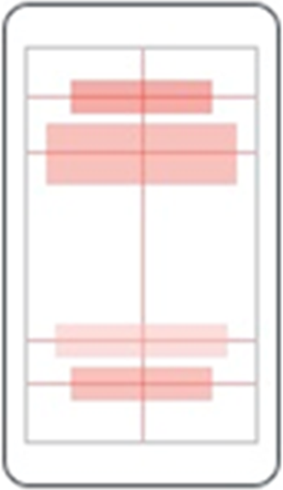
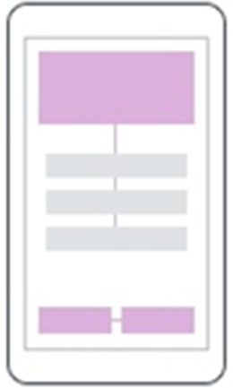
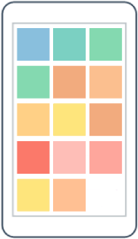
Layouts
Controls
Layouts
Navigation
Styles
Localization
AbsoluteLayout
RelativeLayout
FlexLayout

Slide 5
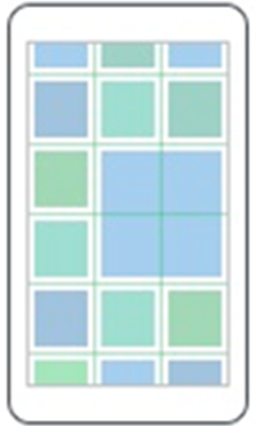

Layouts
Controls
Layouts
Navigation
Styles
Localization
Grid
StackLayout

Slide 6
Grid
Controls
Layouts
Navigation
Styles
Localization
Table-style layout
RowDefinitions, ColumnDefinitions
Width / Height = 150 | * | Auto
Grid.Row, Grid.Column – placement of control in the Grid
Grid.RowSpan, Grid.ColumnSpan – control can span over multiple “cells”
HorizontalSpacing, VerticalSpacing – empty space between “cells”

Slide 7
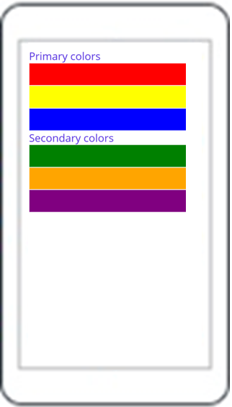
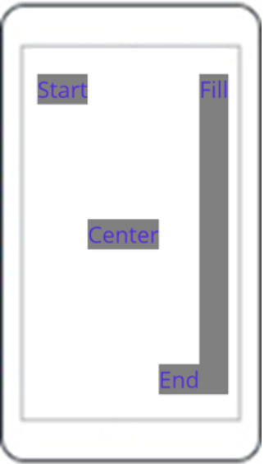
StackLayout
Controls
Layouts
Navigation
Styles
Localization
StackLayout
VerticalStackLayout
HorizontalStackLayout

Slide 8
StackLayout…
Controls
Layouts
Navigation
Styles
Localization
HorizontalStackLayout, VerticalStackLayout
Individual layouts for single direction
Separate LayoutManagers with Measure methods
Recommended (Performance)
StackLayout
Wraps HorizontalStackLayout and VerticalStackLayout
Has Orientation
Useful for adaptive layouts

Slide 9
Layouts
Controls
Layouts
Navigation
Styles
Localization
Demo

Slide 10

Layouts
Controls
Layouts
Navigation
Styles
Localization
Exercise

Slide 11
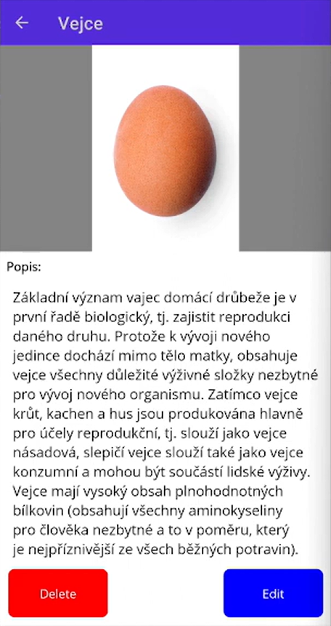
exercise - Layouts
Controls
Layouts
Navigation
Styles
Localization
Grid, Horizontal/VerticalStackLayout
Image, Label, Button

Slide 12
Shell
Controls
Layouts
Navigation
Styles
Localization
Application layout
Navigation using URIs
Hierarchical navigation
Easy passing of parameters between pages
String parameters or strongly typed objects
Works even in backwards navigation “..?success=true”

Slide 13
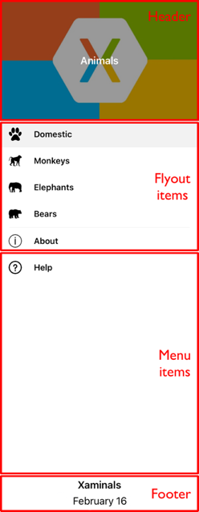
Shell - Flyout
Controls
Layouts
Navigation
Styles
Localization
Header
Items
Footer
Support for text, icons or custom templates

Slide 14
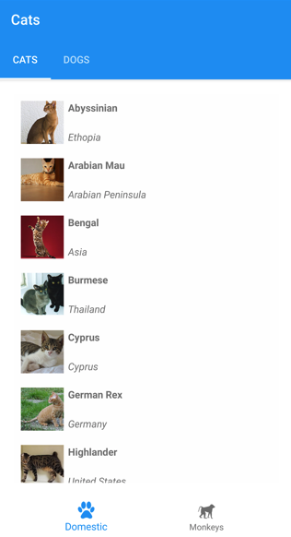
Shell - tabs
Controls
Layouts
Navigation
Styles
Localization
2 levels of hierarchy
Bottom tabs
Top tabs
Support for text, icons, custom templates

Slide 15
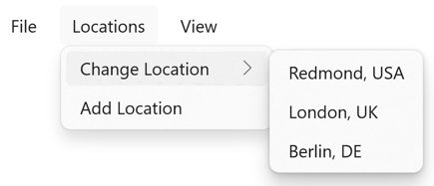
Shell - MenuBar
Controls
Layouts
Navigation
Styles
Localization
MenuBarItem
MenuFlyoutItem
MenuFlyoutSubItem
Support for text, icons

Slide 16
Navigationpage
Controls
Layouts
Navigation
Styles
Localization
NavigationPage
PushAsync
PopAsync

Slide 17
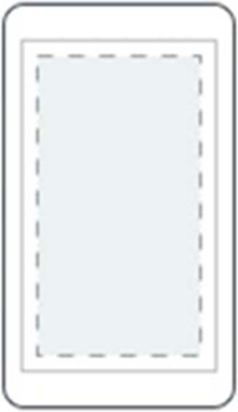
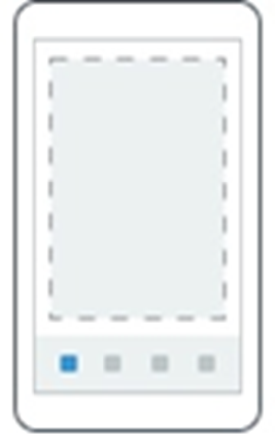
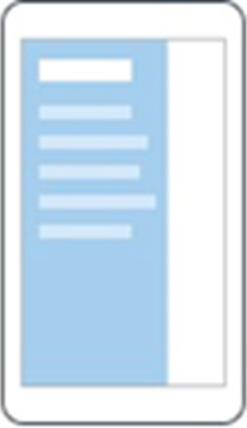
Pages
Controls
Layouts
Navigation
Styles
Localization
ContentPage
Single content
TabbedPage
Tabs
FlyoutPage
Items + detail

Slide 18
Navigation
Controls
Layouts
Navigation
Styles
Localization
Demo

Slide 19
Resources
Controls
Layouts
Navigation
Styles
Localization
Each element contains a collection of Resources
Resources can define any content
Referencing using x:Key
Access with {StaticResource Key}
Can be defined in separate files - merged dictionaries
Hierarchical application
Can be overridden on any level

Slide 20
Styles
Controls
Layouts
Navigation
Styles
Localization
Settign style for a control
TargetType – specifies which element type it should be applied to
x:Key – key of style, can be omitted – in that case it will be automatically applied to all controls of the type
Collection of Setter objects
Property
Value
BasedOn – base style that this style extends – optional

Slide 21
Styles
Controls
Layouts
Navigation
Styles
Localization
Demo

Slide 22
Goals
Get to know available layouts and controls
Try to create a layout with some controls
Get to know available navigation options
Bonus:
- Styles
- Localization

