Slide 1
PV239 - 06 API
Roman Jašek, Michal Hazdra
Riganti s.r.o.
roman.jasek@riganti.cz
michal.hazdra@riganti.cz

Slide 2
questions
What types of storage did we talk about in the previous exercise?
What can we use Preferences for?
What can we use Secure Storage for?
What can we use SQLite for?
How does SQLite database work on a phone?

Slide 3
Bonus Exercise
Creating custom controls
Loading animations
Application configuration for different environments (dev, test, production)
Tips for useful tools and libraries

Slide 4
goals
Web API concepts
Client-server communication
Generating API client and it’s usage to communicate with API

Slide 5
OpenAPI
Generating client
Using client
OpenAPI
Open specification
Standard for describing REST API
Language and framework independent
YAML/JSON
OpenAPI map: https://openapi-map.apihandyman.io/

Slide 6
Swagger
Generating client
Using client
OpenAPI
Tools for creating and working with OpenAPI specification
Swagger Editor
YAML/JSON
Swagger CodeGen
Generating client/server part
Swagger UI
Interactive documentation

Slide 7
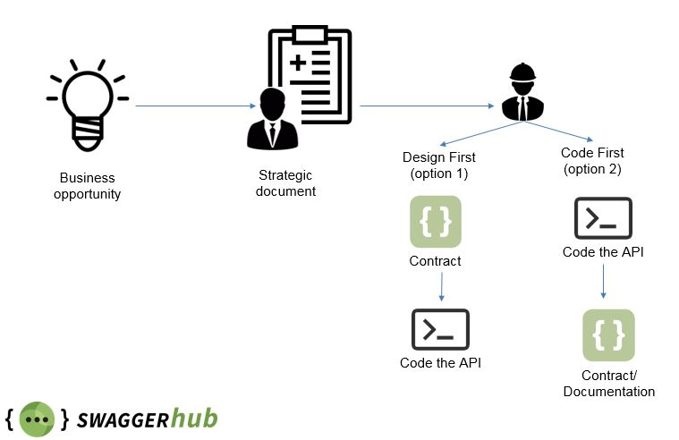
approaches for creating API specification
Generating client
Using client
OpenAPI

Slide 8
Design first approach
Generating client
Using client
OpenAPI
SwaggerHub
https://app.swaggerhub.com/
Portal for design first approach
Supports hosting on own server

Slide 9
Code First approach
Generating client
Using client
OpenAPI
ASP .NET Core
Library NSwag.AspNetCore

Slide 10

Layouts
Generating client
Using client
OpenAPI
Ovládací prvky
Layouty
Navigace
Styly
Lokalizace
OPEN API
Code First
Demo

Slide 11
Setup
Generating client
Using client
OpenAPI
Nuget package NSwag.AspNetCore
Add configuration:
services.AddOpenApiDocument(document =>
{
document.Title = "CookBook API";
document.DocumentName = "cookbook-api";
});

Slide 12
Setup
Generating client
Using client
OpenAPI
Přidat middleware:
Přidat middleware pro Swagger UI:
app.UseOpenApi();
app.UseSwaggerUi3(settings =>
{
settings.SwaggerRoutes.Add(
new SwaggerUi3Route("CookBook API", "/swagger/cookbook-api/swagger.json"));
});

Slide 13
Swagger editor
Generating client
Using client
OpenAPI
Online version https://editor.swagger.io
Support for running locally
Docker image

Slide 14
generating – online
Generating client
Using client
OpenAPI
Generator from Swaggeru
Enables generating directly from browser
https://generator.swagger.io/
Settings:
{
"options": { "packageName": „LibraryName" },
"swaggerUrl": „URL of OpenAPI specification"
}

Slide 15
generating – Swagger CodeGen CLI
Generating client
Using client
OpenAPI
CLI tool
Java app
Download .jar file from Maven

Slide 16
generating - AutoRest
Generating client
Using client
OpenAPI
CLI tool https://github.com/Azure/autorest
Installed using NPM
AutoRest.Csharp – generator for C#

Slide 17
generating - NSwagStudio
Generating client
Using client
OpenAPI
NSwag - CLI tool
NSwagStudio - Desktop app
https://github.com/RSuter/NSwag
Settings:
Namespace
Set Operation Generation Mode
Path to output file

Slide 18
Layouts
Generating client
Using client
OpenAPI
Ovládací prvky
Layouty
Navigace
Styly
Lokalizace
NSWAGSTUDIO
Demo

Slide 19
Layouts
Generating client
Using client
OpenAPI
Ovládací prvky
Layouty
Navigace
Styly
Lokalizace
Using generated client
Demo

Slide 20
Adding client to mobile app
Generating client
Using client
OpenAPI
Add client registration to DI container:
serviceCollection.AddHttpClient<IIngredientsClient, IngredientsClient>(client =>
{
client.BaseAddress = apiBaseUri;
});
For usage in emulators
URL for „Localhost“: 10.0.2.2

Slide 21
Processors
Used for modifying the OpenAPI specification
Can be used on multiple levels:
IOperationProcessor – modifies individual operations
ISchemaProcessor – modifies the schema
IDocumentProcessor – modifies the entire document

