Slide 1
Jak na offline aplikaci v Blazoru
Roman Jašek
MVP: Developer Technologies
roman.jasek@wug.cz

Slide 2
Progressive Web Apps
Existing web site
No hybrid applications
Easy installation
Faster service
Native device features
Updates without Store
Discoverability

Slide 3
Web App Manifest
Metadata of your application
<link rel="manifest" href="/manifest.json">
Properties
short_name and/or name
icons
start_url
background_color
theme_color
display
orientation
scope
lang

Slide 4
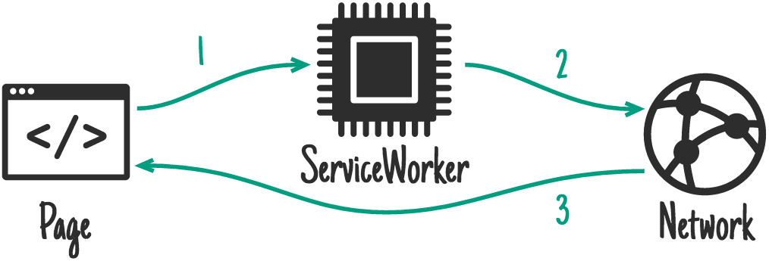
Service Worker
Separate script from web
Runs in background
Interferes requests

Slide 5
Service Worker
Caching
Background sync
Push notifications
Cannot access DOM
Reacts to events
You need HTTPS

Slide 6
Service Worker registration
Check if service worker is supported
if ('serviceWorker' in navigator)
Register
navigator.serviceWorker.register('service-worker.js');

Slide 7
Why Apps in Blazor?
Blazor Cons:
Bigger size on first page load
Uses client’s computing power
It is on the client – no direct database connection
Usually communicates with an API
Blazor Pros:
Runs on client
Doesn’t need server after first load
Runs alongside JavaScript
Can communicate with JavaScript

Slide 8
Local storage
No expiration date
Key-value storage for strings
About 5MB limit
Not accessible from service worker

Slide 9
Sync When Online
Detect when the web goes online/offline
JavaScript - navigator.online
Sync local data with server
Logic depends on application

Slide 10
JavaScript Interoperability
[JSInvokable] attribute – enable calling of method from JavaScript
In JavaScript - interop.invokeMethodAsync()
1st parameter – name of method
Other parameters – method parameters
IJSRuntime – run JavaScript from C# code
InvokeVoidAsync() – no return value expected
InvokeAsync<>() – return value expected

Slide 11
IndexedDB
Size limit – depends on browser – but is in 10s or 100s of MBs
There is already a 3rd party implementation for Blazor
Also accessible from service worker
More complex than LocalStorage
Need to take care of updating schema of database on client
But enables more advanced scenarios

Slide 12
SQLite
We are still on the client
Where do we store the .db file?
Native File System to the rescue?
Safari and Firefox – no support yet

Slide 13
Background Sync
Initiate sync from service worker
Not yet supported in Firefox and Safari

Slide 14




Caching strategies
Network Only
1
2
3
Cache Only
1
2
3

Slide 15


Caching strategies
Network First
4
3
1
2
Cache First
4
3
1
2

Slide 16
Caching Strategies
Stale-While-Revalidate
3
5
1
2
4

Slide 17
Chrome Developer Tools
Application
Manifest
Service Workers
Storage
Audits
Progressive Web App
Remote Target

Slide 18

Dotazy
Roman Jašek
MVP: Developer Technologies
roman.jasek@wug.cz

