Slide 1
Jak na offline aplikaci v Blazoru
Roman Jašek
MVP: Developer Technologies
roman.jasek@wug.cz

Slide 2
Progressive Web Apps
Existing web site
No hybrid applications
Easy installation
Faster service
Native device features
Updates without Store
Discoverability

Slide 3
You only need 3 things
HTTPS
Web App Manifest
Service Worker

Slide 4
Web App Manifest
Metadata of your application
<link rel="manifest" href="/manifest.json">
Properties
short_name and/or name
icons
start_url
background_color
theme_color
display
orientation
scope
lang

Slide 5
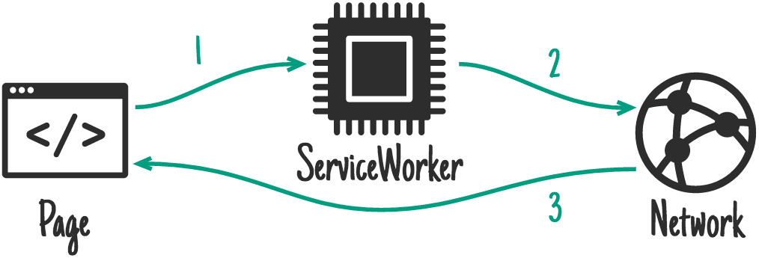
Service Worker
Separate script from web
Runs in background
Interferes requests

Slide 6
Service Worker
Caching
Background sync
Push notifications
Cannot access DOM
Reacts to events
You need HTTPS

Slide 7
Service Worker registration
Check if service worker is supported
if ('serviceWorker' in navigator)
Register
navigator.serviceWorker.register('service-worker.js');

Slide 8
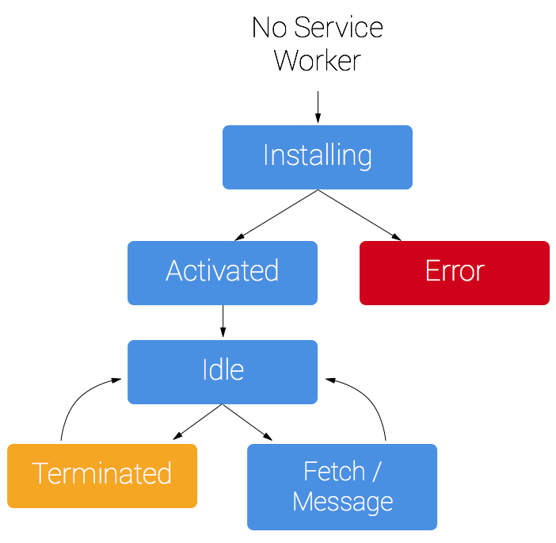
Service Worker Lifecycle
Installing
Cache static assets
Activated
Manage old caches
Idle
Fetch/Message
Process request

Slide 9




Caching strategies
Network Only
2
1
3
Cache Only
1
2
3

Slide 10


Caching strategies
Network First
4
3
1
2
Cache First
4
3
1
2

Slide 11
Caching Strategies
Stale-While-Revalidate
3
5
1
2
4

Slide 12
Why Apps in Blazor?
Blazor Cons:
Bigger size on first page load
Uses client’s computing power
It is on the client – no direct database connection
Usually communicates with an API
Blazor Pros:
Runs on client
Doesn’t need server after first load
Runs alongside JavaScript
Can communicate with JavaScript

Slide 13
Demo
CookBook

Slide 14
Local storage
No expiration date
Key-value storage for strings
About 5MB limit
Not accessible from service worker

Slide 15
SQLite
We are still on the client
Where do we store the .db file?
Native File System to the rescue?
Safari and Firefox – no support yet

Slide 16
IndexedDB
Size limit – depends on browser – but is in 10s or 100s of MBs
Also accessible from service worker
More complex than LocalStorage
Need to take care of updating schema of database on client
But enables more advanced scenarios
Dexie.js – nice library for working with IndexedDb

Slide 17
Sync When Online
Detect when the web goes online/offline
JavaScript - navigator.online
Sync local data with server
Logic depends on application

Slide 18
JavaScript Interoperability
[JSInvokable] attribute – enable calling of method from JavaScript
In JavaScript - interop.invokeMethodAsync()
1st parameter – name of method
Other parameters – method parameters
IJSRuntime – run JavaScript from C# code
InvokeVoidAsync() – no return value expected
InvokeAsync<>() – return value expected

Slide 19
Demo
Checking online status
Storing data locally

Slide 20
Blazor – Service Worker & Assets
Differentiate local and published service worker
<ItemGroup>
<ServiceWorker Include="wwwroot\service-worker.js"
PublishedContent="wwwroot\service-worker.published.js" />
</ItemGroup>
Generate service worker assets
<PropertyGroup>
<ServiceWorkerAssetsManifest>service-worker-assets.js</ServiceWorkerAssetsManifest>
</PropertyGroup>
Import generated assets
self.importScripts('./service-worker-assets.js');

Slide 21
Chrome Developer Tools
Application
Manifest
Service Workers
Storage
Audits
Progressive Web App
Remote Target

Slide 22
PWA builder
Check your PWA capabilities
Add a prepared service worker
Add features
Generate
Android application package
Windows 10 application
Samsung package
https://www.pwabuilder.com/

Slide 23
Android App
Option 1: Download a pre-built package from PWA builder
Option 2: Create a project in Android Studio
Option 3: Download a ready-made TWA Android Studio project and modify URLs and images: https://github.com/AJONPLLC/com-ajonp-app (how to use: https://www.youtube.com/watch?v=db9Y5jyparA)

Slide 24
Trusted Web Activities – TWA
Android only
The app and web are from the same developer
Digital Asset Links file
Rendered in user’s browser
Fullscreen
https://developers.google.com/web/updates/2019/02/using-twa

Slide 25
iOS App
From browser
Add custom install prompt
Supported
App Store:
Cordova

Slide 26
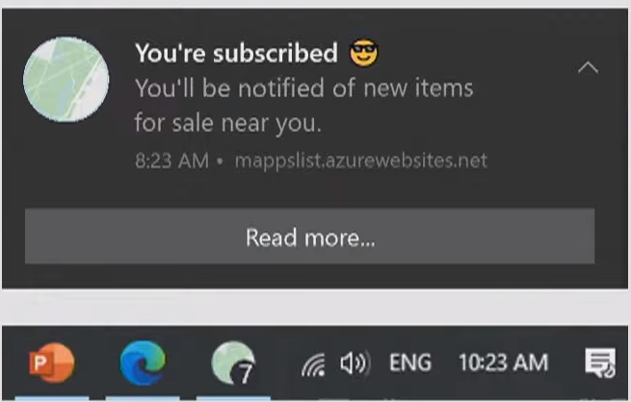
PWAs on Windows
Native notifications + Badging

Slide 27
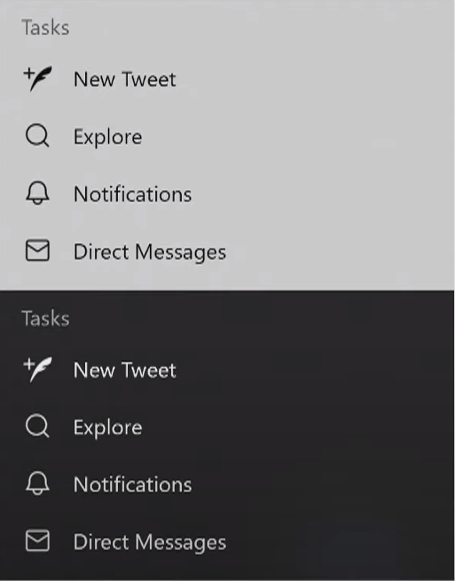
PWAs on Windows
Native notifications + Badging
Theming for app icons

Slide 28
Project Fugu
“Web Apps should be able to do anything iOS/Android/desktop apps can.”
File, Url and protocol handling
Native file system access – save file to its original location
Run on OS login
Title bar customization - override default window titlebar
Share target
App shortcuts (jump lists)
https://web.dev/fugu-status/

Slide 29

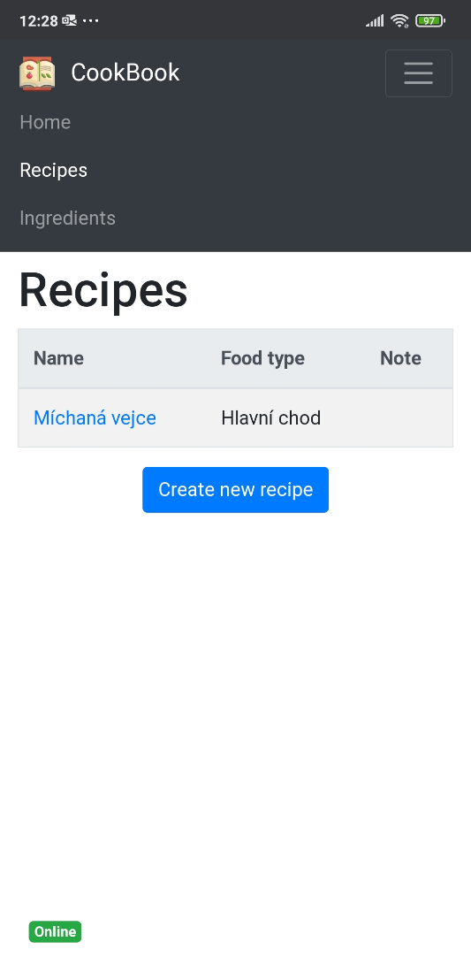
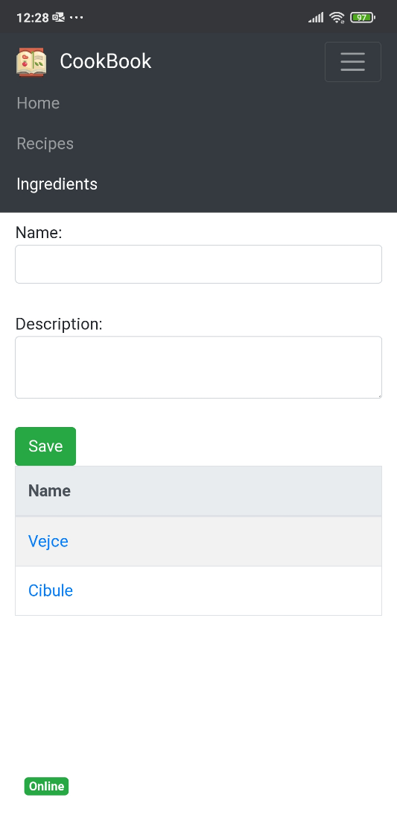
Dotazy

