Slide 1
IBM University Engagement Project Submission
“KrishiMitra: AI Agent for Smart Farming Advice with IBM Granite and watsonx.ai”

Slide 2
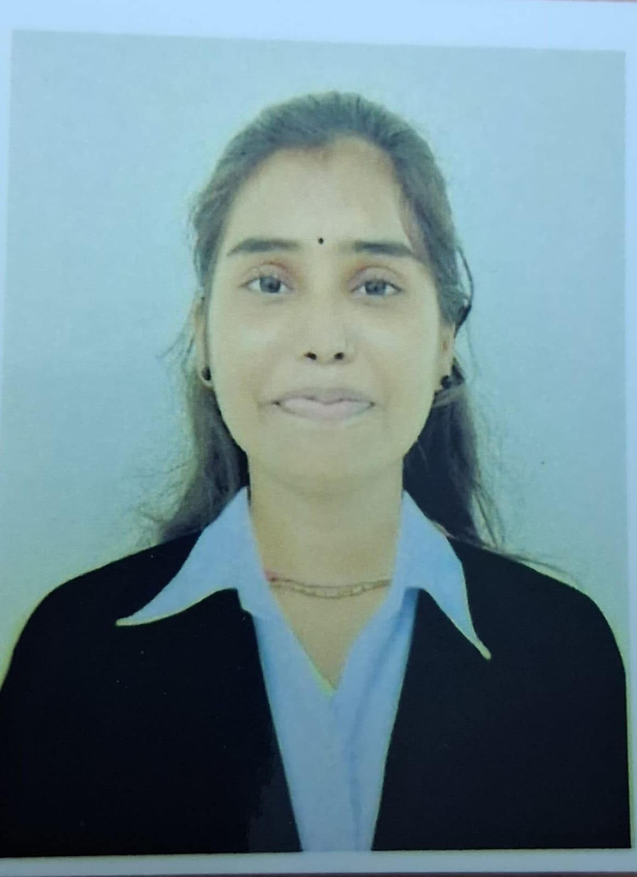
Project Title – KrishiMitra: AI Agent for Smart Farming Advice
Domain of Project – Artificial Intelligence (AI), AgricultureTech & Agentic AI
Student Name | Recent Passport Photo | Email ID | Mobile number [WhatsApp]
Jashodha Borana |  | okaymanu00@gmail.com | 9951900970

Slide 3
Problem Statement –
Problem Statement : KrishiMitra Smart Farming Agent
The Challenge
Small-scale Indian farmers often struggle to get timely, localised and trustworthy farming advice. Generic search results do not consider soil type, season, weather, mandi prices, pest issues, government schemes or the farmer’s preferred language.
The Objective
Develop an AI-powered Farming Agent using IBM watsonx.ai Granite Models that:
Provides personalised crop and farming guidance.
Supports farmer queries in 10 Indian languages.
Uses RAG to answer from a curated agriculture knowledge base.
Integrates live weather, mandi price and crop recommendation tools.
Helps farmers make better decisions through a simple web interface.

Slide 4
Proposed Solution -
Proposed Solution: KrishiMitra AI Farming Agent
KrishiMitra is a RAG-powered AI agent built with FastAPI, IBM watsonx.ai and IBM Granite models to provide smart farming assistance for Indian farmers. Farmers can ask questions in natural language and receive practical, context-aware advice.
The system combines an AI chat agent, language detection and translation, crop recommendation engine, live weather service, mandi price service, pest-control guidance and a curated farming knowledge base.
Powered by IBM Granite generation and embeddings, the solution retrieves relevant farming context, reasons over the farmer’s query and returns useful guidance in the user’s preferred language. It is designed to improve accessibility, decision-making and productivity for small and marginal farmers.

Slide 5
Technology Used
Python FastAPI | Backend framework for APIs, WebSocket chat and farming-agent orchestration.
IBM Granite Model | Provides AI-powered reasoning, answer generation and farming guidance.
IBM watsonx.ai | Enables access to Granite LLM and embedding models through IBM Cloud.
RAG + ChromaDB | Retrieves relevant agriculture knowledge using vector search and embeddings.
Open-Meteo API | Provides live 7-day weather forecast for farm-specific advisories.
Agmarknet / MSP Data | Supports mandi price information and fallback crop price insights.
HTML, CSS & JavaScript | Builds a simple responsive farmer-facing web chat interface.

Slide 6
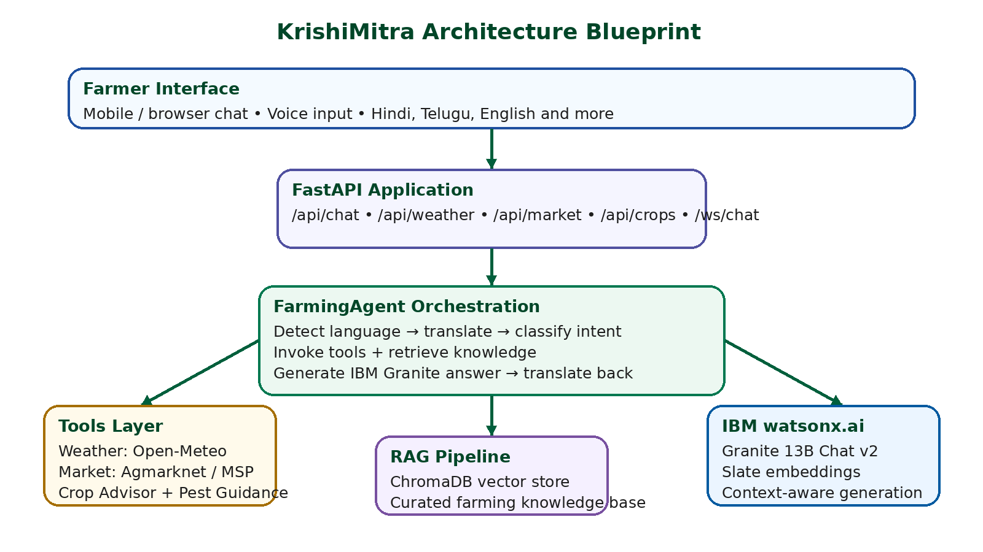
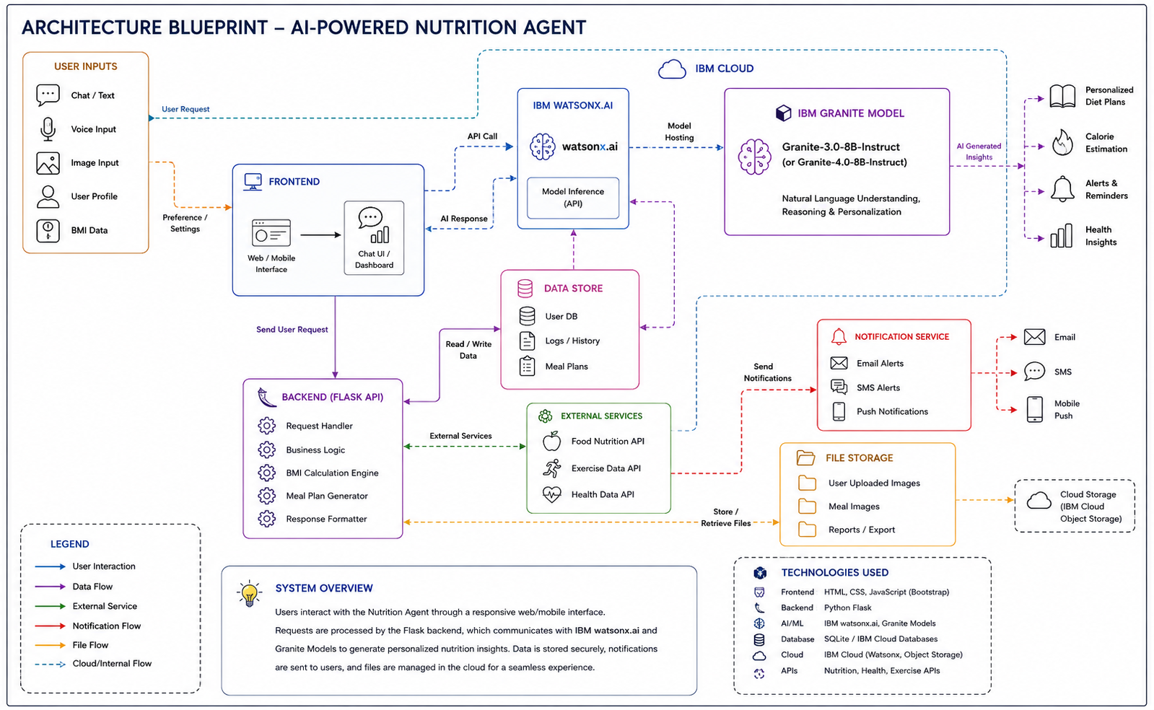
Architecture blueprint -

Slide 7

Role of Agentic AI in the solution
Role of Agentic AI in KrishiMitra
Agentic AI enables KrishiMitra to understand farmer queries, identify the intent and decide which tool or knowledge source is needed. Powered by IBM watsonx.ai and IBM Granite Models, the agent can reason over farming questions and provide localised, useful advice.
The agent detects language, translates the query, classifies it as weather, market, crop advice, pest control or general farming, fetches real-time data where required, retrieves relevant farming knowledge through RAG and generates a grounded response.
This makes the solution more than a chatbot: it works like a digital farm assistant that actively chooses the right steps to support farmers with decision-making.

Slide 8
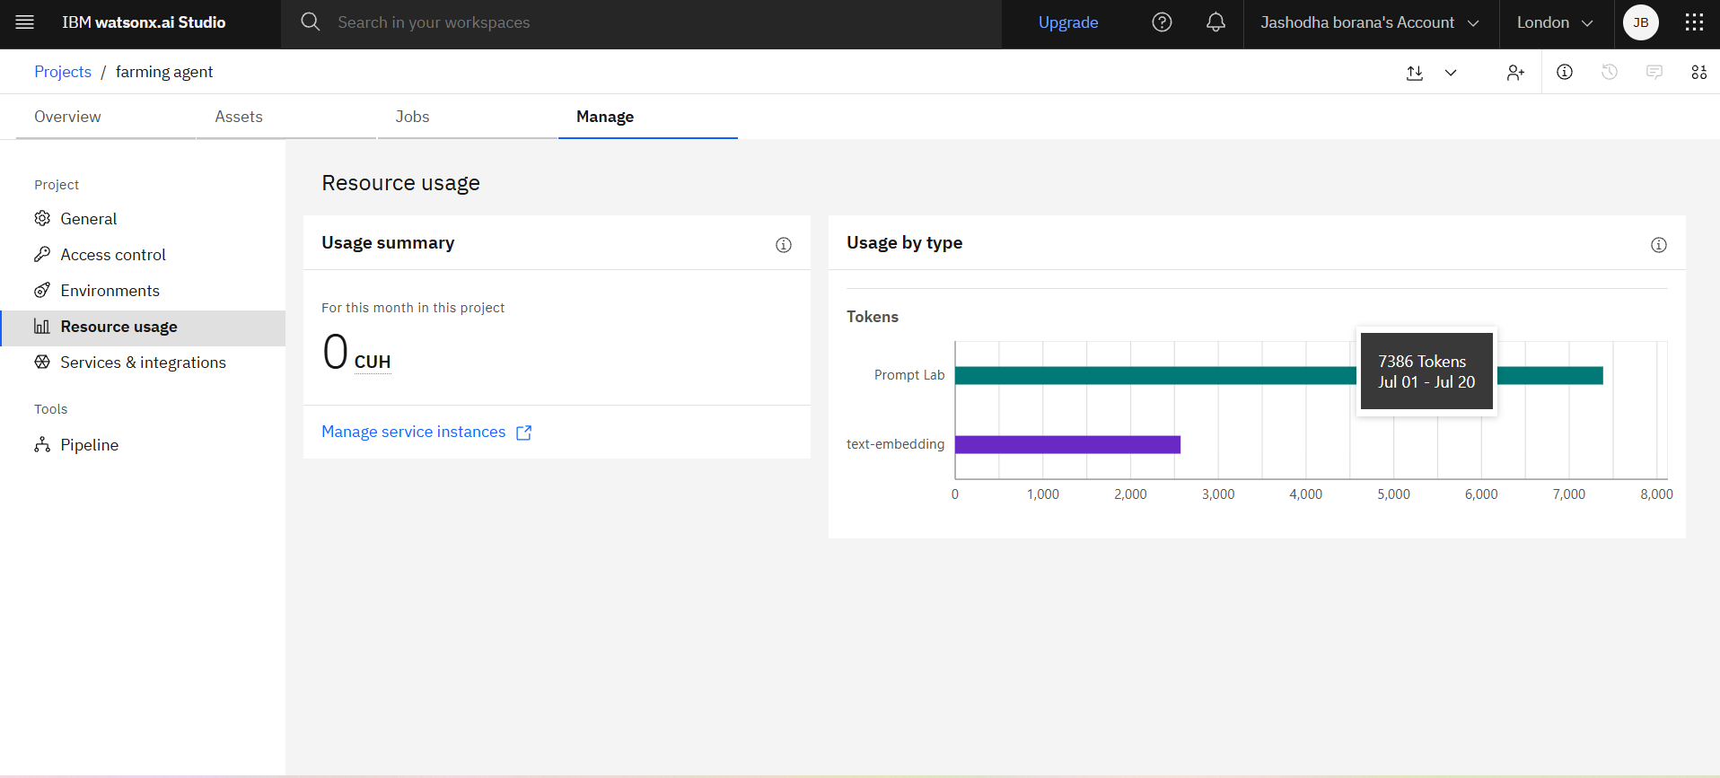
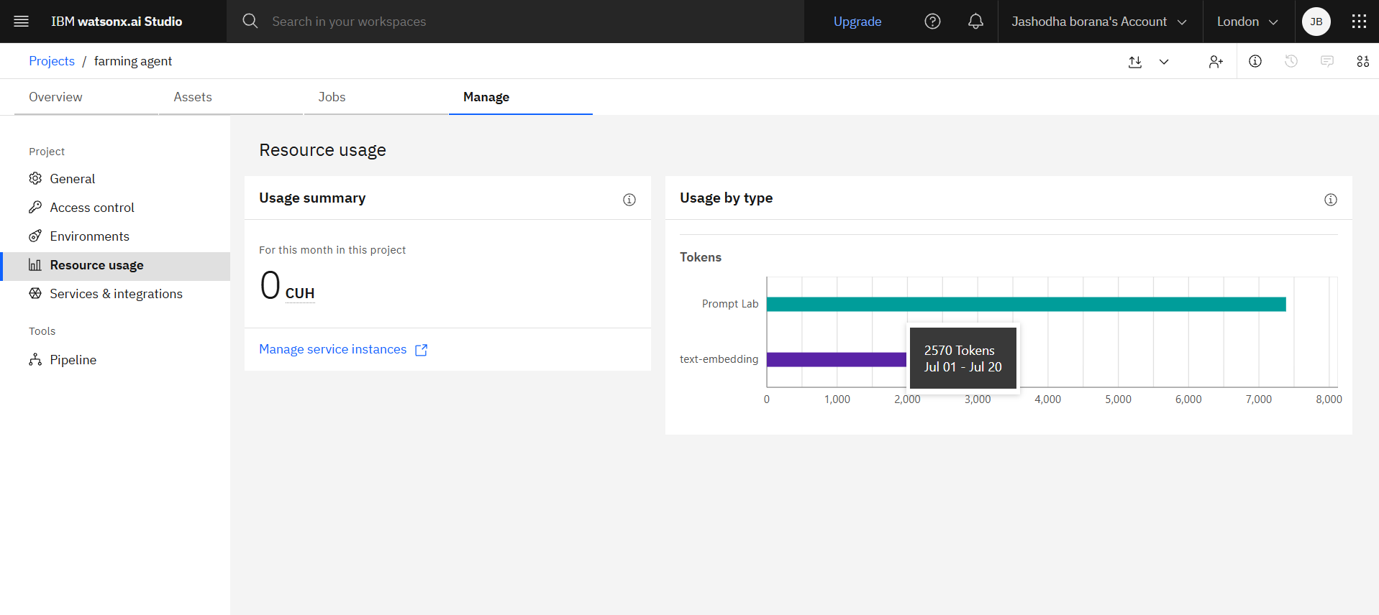
Token Usage

Slide 9
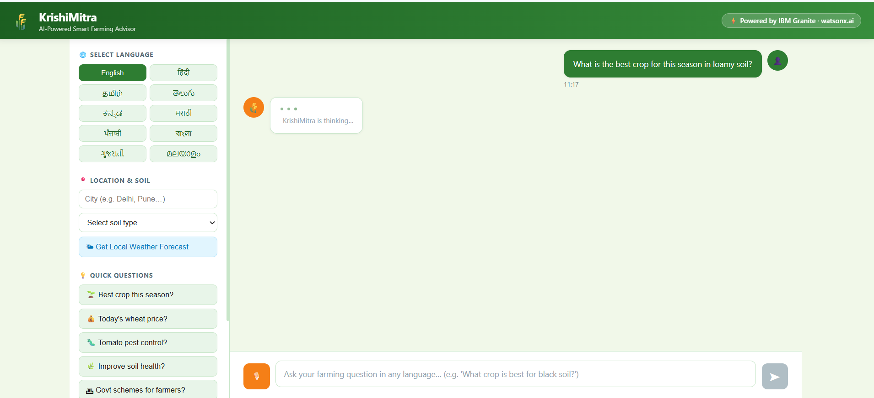
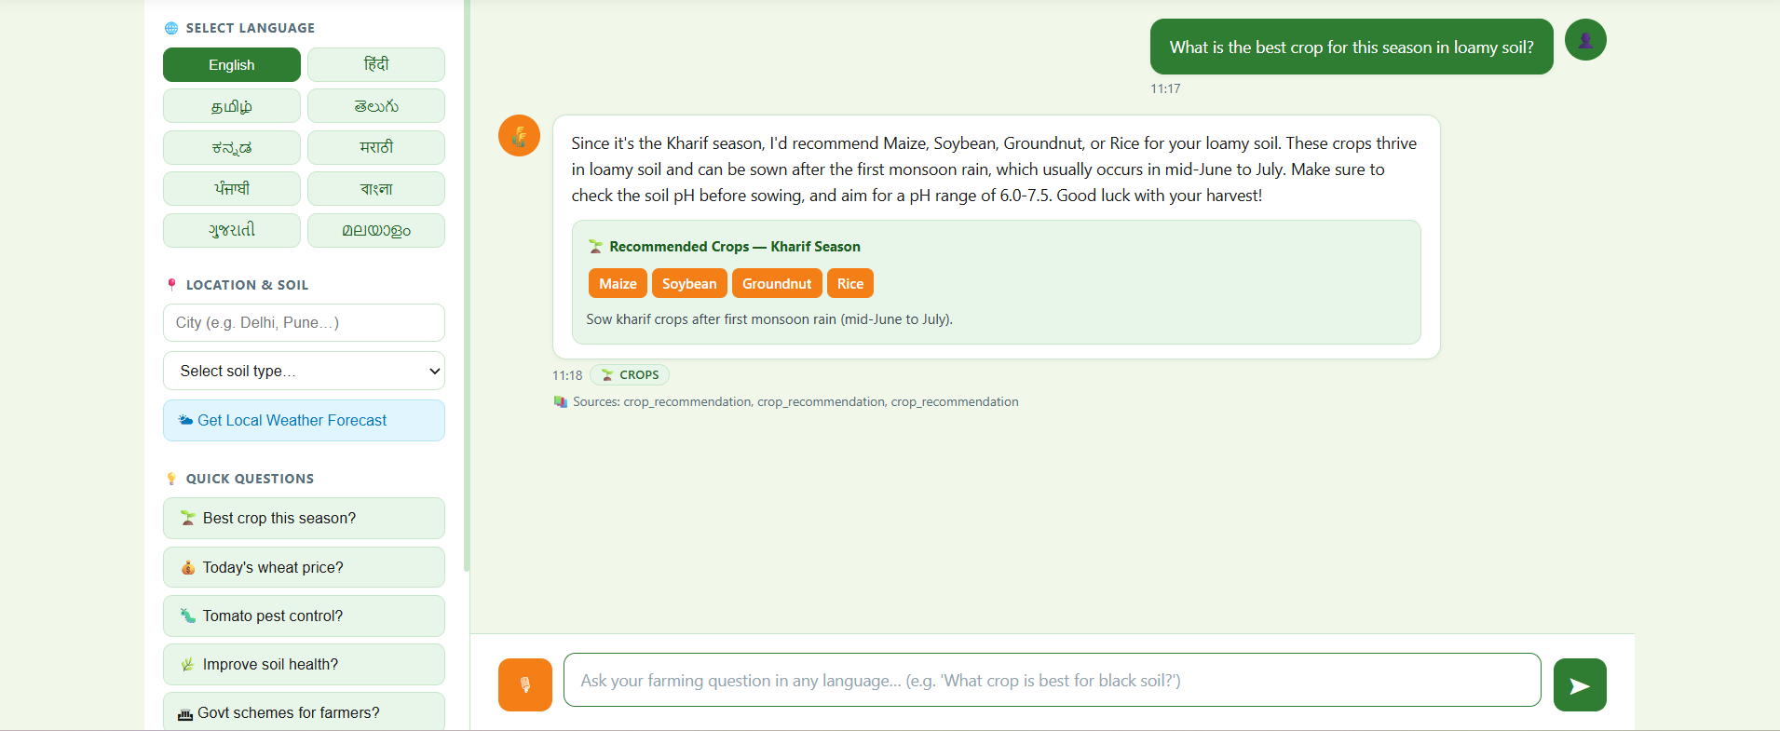
Before prompt
After prompt

Slide 10
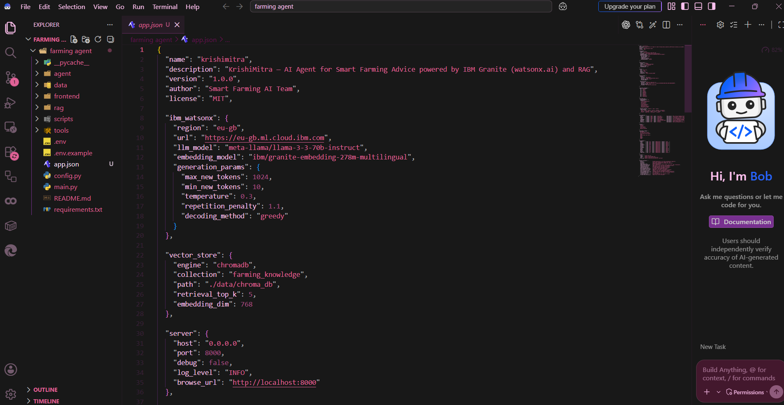

Slide 11
Novelty and Uniqueness
The proposed KrishiMitra AI Farming Agent combines IBM watsonx.ai Granite Models with a real-time, multilingual agriculture advisory system for Indian farmers.
AI-Powered Farm Assistant – Provides context-aware farming advice using IBM Granite models.
RAG-Based Knowledge Support – Retrieves grounded answers from a curated agriculture knowledge base.
Multilingual Farmer Access – Supports 10 Indian languages with translation and localised responses.
Real-Time Weather & Mandi Insights – Uses live weather and market data to improve decisions.
Crop & Pest Advisory – Suggests crops based on soil and season and supports pest-control guidance.
Voice and Web Chat Support – Makes the solution easy to use for farmers on any device.
Cloud-Ready Deployment – Built with FastAPI and prepared for hosting through Render.
Overall, KrishiMitra acts as an intelligent digital farm friend that helps farmers make timely, data-driven and practical agricultural decisions.

Slide 12
Git Hub Link:
https://github.com/jashodhaborana09/Farming-Agent-AICTE

Slide 13
Future Scope
1. Image-Based Crop Disease Detection Enable farmers to upload crop leaf images for automatic disease identification and treatment suggestions using computer vision.
2. GPS-Based Local Advisory Use location data to provide more accurate weather, soil, scheme and mandi recommendations based on the farmer’s region.
3. Voice Assistant & Offline Support Add voice conversation and low-bandwidth/offline support so farmers can access guidance even with limited internet.
4. Advanced Farm Dashboard Track crop health, weather risk, market prices, income estimates and advisory history through a farmer-friendly dashboard.
5. IoT & Sensor Integration Connect soil moisture, temperature and humidity sensors for precision farming recommendations and alerts.

Slide 14
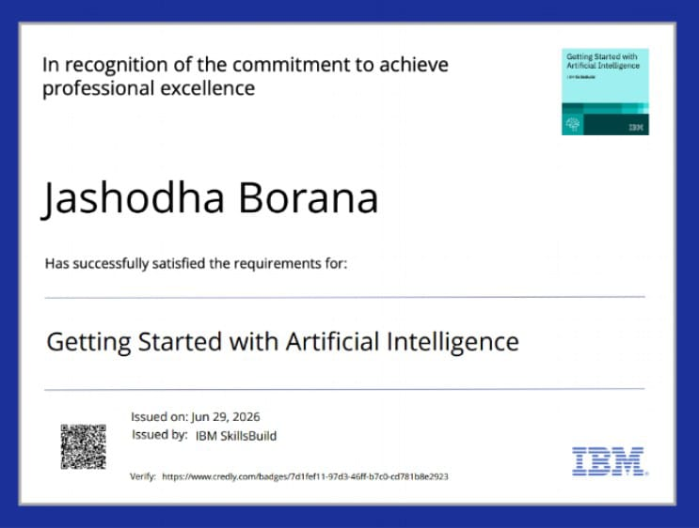
Certificates Earned:

Slide 15
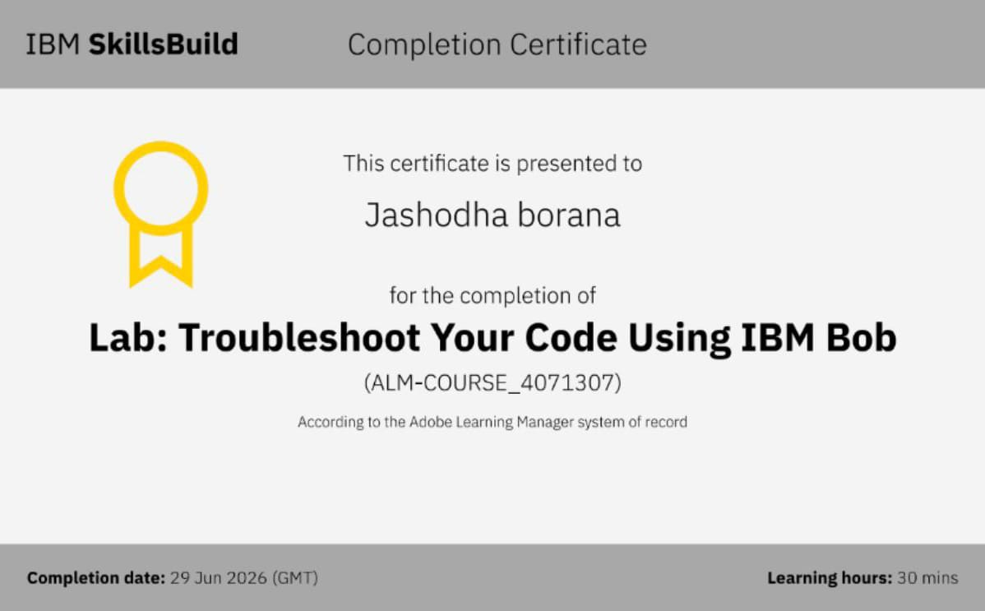
Certificates Earned:​

Slide 16


