Slide 1
KDD '26 · AI4SCIENCE TRACK
Condition-Gated Reasoning for Context-Dependent Biomedical Question Answering
Jash Parekh¹, Wonbin Kweon¹, Joey Chan¹, Rezarta Islamaj², Robert Leaman², Pengcheng Jiang¹ , Chih-Hsuan Wei ², Zhizheng Wang², Zhiyong Lu², Jiawei Han¹
1 UNIVERSITY OF ILLINOIS URBANA-CHAMPAIGN · 2 NATIONAL INSTITUTES OF HEALTH
Notes:
20s — Good afternoon. I'm Jash Parekh from University of Illinois Urbana-Champaign, presenting joint work with the National Institutes of Health titled Condition-Gated Reasoning for Context-Dependent Biomedical QA. Our paper asks a narrow question: what happens to biomedical QA when the correct answer depends heavily on the patient in front of you.

Slide 2
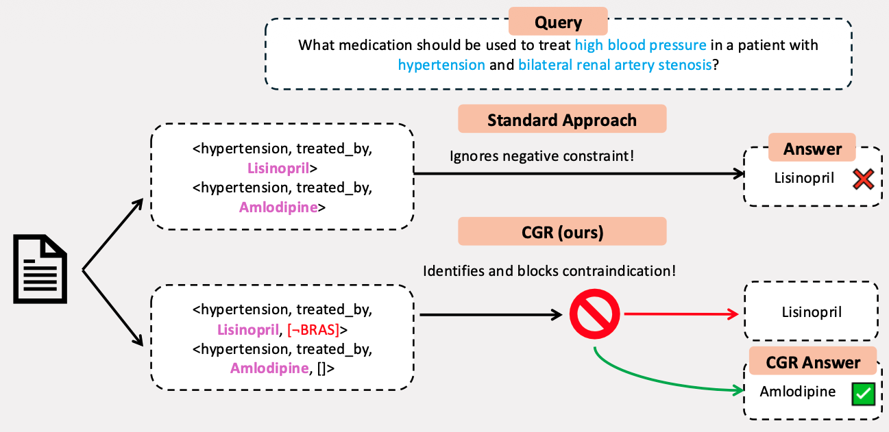
Motivating Example
Biomedical QA is not a fact-lookup task.
01 The answer depends on patient-specific factors — allergies, comorbidities, concurrent medications.
02 One question can have several correct answers, one per patient context.
03 A default treatment may be contraindicated: the best answer shifts with the constraint.
⟨lisinopril, treats, hypertension⟩ is true and useless without knowing the exact conditions about when it applies.
02 / 16
Notes:
80s — Start with a case. A 68-year-old with hypertension and bilateral renal artery stenosis. Both pipelines read the same source document and extract the same two treatment relations. The standard approach has nowhere to put the stenosis constraint, so it ignores it and returns lisinopril — an ACE inhibitor, which is contraindicated here and can precipitate acute renal failure. CGR carries the condition on the tuple: lisinopril's relation holds only in the absence of BRAS. The query asserts BRAS, so that path is blocked before ranking, and amlodipine — a calcium channel blocker with no blocking condition — is returned instead. Same question, same knowledge, two different correct answers, and what separates them is one clause about the patient.

Slide 3
Two Gaps in Current Approaches
GAP 01 · REPRESENTATION
GAP 02 · EVALUATION
Triples have no slot for a condition
No benchmark tests answer revision
A graph of ⟨entity, relation, entity⟩ cannot state the circumstances under which the relation holds. Contraindications, patient-population restrictions and stage-specific guidelines are discarded at extraction time.
MedHopQA, BioASQ and PubMedQA measure factual recall and multi-hop composition. None of them measures whether an answer moves when a patient-specific constraint is added.
01 CondMedQA — a benchmark that isolates the behaviour.
02 Condition-Gated Reasoning — a method that produces it.
03 / 16
Notes:
60s — That case points at two gaps. First, representation. Every KG-RAG system in this space stores triples. Contraindications, population restrictions, stage-specific guidance — none of it has a home in a triple, so it is dropped at extraction time. Second, evaluation. MedHopQA, BioASQ and PubMedQA all test recall and multi-hop composition. None tests whether a model changes its answer when the patient changes. So we contribute one of each: a benchmark that isolates the behaviour, and a method that produces it.

Slide 4
Talk Overview
01
02
03
The Benchmark
The Method
The Evidence
What makes a question conditional, and how we built 100 of them.
Conditions on edges, resolved once per query, enforced during traversal.
Four benchmarks, three foundation models, and what the gate is worth.
04 / 16
Notes:
20s — Three parts. The benchmark, so we can measure the behaviour. The method, which is where most of the time goes. Then the evidence across four datasets and three model families.

Slide 5
Defining Conditionality
01
Modifier presence
The question names a specific patient condition.
WORKED EXAMPLE
Which antidepressant for major depressive disorder is contraindicated in patients with bulimia?
02
General answer exists
A standard answer applies if the modifier were absent.
03
Answer divergence
The conditional answer differs from the general one.
MODIFIER
Bulimia nervosa
04
Dual validity
Both answers are correct — each in its own context.
GENERAL ANSWER
05
Causal dependence
Strike the modifier and the general answer returns.
Sertraline
CONDITIONAL ANSWER
Bupropion lowers the seizure threshold
05 / 16
Notes:
65s — Conditional is a fuzzy word, so we made it a test with five clauses. A modifier has to be present. A default answer has to exist without it. The two answers have to differ. Both have to be genuinely correct in their own context — this rules out cases where the general answer was simply wrong. And the dependence has to be causal: strike the modifier and the general answer returns. The example on the right: MDD, contraindicated antidepressant. Without the bulimia clause you'd say sertraline. With it, bupropion is the answer, because bupropion lowers the seizure threshold and bulimia raises seizure risk.

Slide 6
Benchmark Composition
57%
23%
16%
4%
Comorbidity & organ-based
Diagnostic modality
Special populations
Drug–drug interactions
Disease contraindications and organ dysfunction that force a drug substitution.
Imaging choice under radiation exposure and contrast contraindications.
Pregnancy safety, pediatric dosing, geriatric precautions.
CYP enzyme interactions and pharmacogenomic variation.
BUILT IN THREE STAGES
01 LLM candidate generation
02 Automated filtering
03 Manual expert verification
06 / 16
Notes:
60s — 100 questions passing all five criteria. The distribution is deliberately skewed toward what shows up in practice: over half are comorbidity and organ-function cases, where a disease or an organ forces a substitution. A quarter are imaging-modality choices — radiation, contrast. Then special populations, and a small tail of drug-drug interactions. Construction was three stages: Gemini proposed candidates, rule-based filters removed anything failing criteria one through three, and every surviving question was checked by hand.

Slide 7
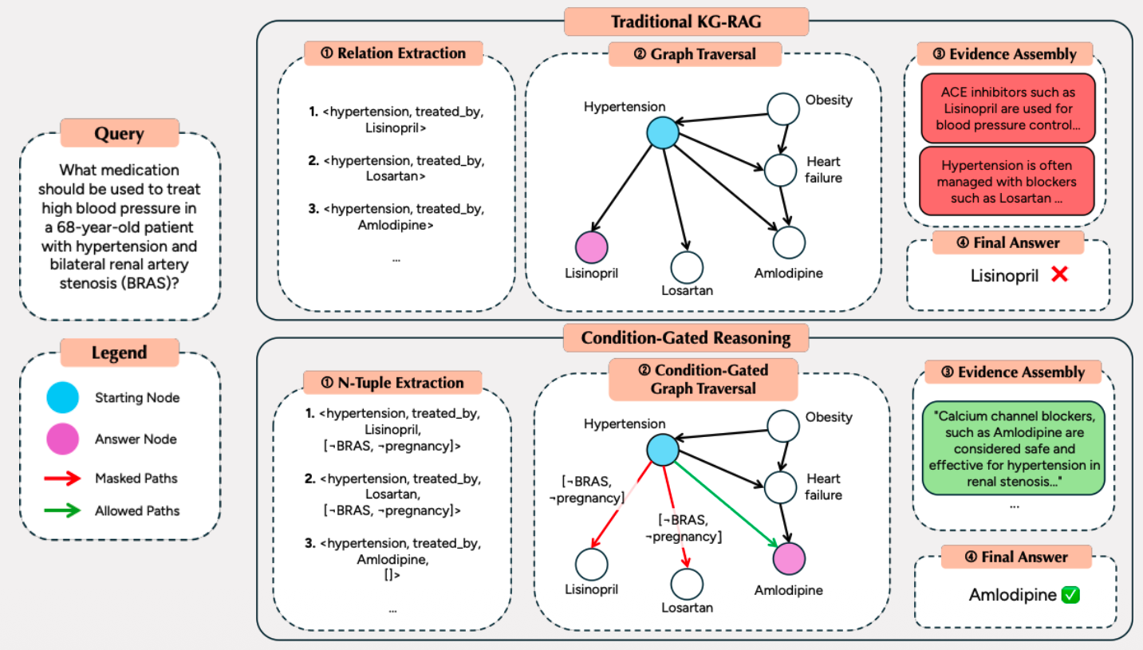
CGR vs. Traditional KG-RAG
TOP BAND
Every treatment edge is followed. A triple has no field for the BRAS, so lisinopril reaches the generator and becomes the answer.
BOTTOM BAND
The same edges now carry conditions. Two are masked, one survives — and only the surviving path's evidence reaches the generator.
07 / 16
Notes:
75s — Here is the full comparison. Top band, a conventional KG-RAG pipeline on our query. Relation extraction gives treatment triples. Traversal has no reason to prefer one over another, so every treatment edge from hypertension is followed. Evidence assembly retrieves passages about ACE inhibitors, and the final answer is lisinopril. Wrong, and confidently so. Bottom band, same corpus, same query. N-tuple extraction keeps the condition list attached to each edge. Traversal evaluates the query against those lists: the lisinopril and losartan edges carry not-BRAS, the query asserts BRAS, so those paths are masked — the dashed arrows. Amlodipine has no blocking condition, so it is the one path that survives, and the evidence that reaches the generator is about calcium channel blockers in renal stenosis. The difference is not a bigger model or better retrieval. It is that the condition rode along on the edge.

Slide 8
Condition-Aware Knowledge Graph
N-TUPLE EXTRACTION
ENTITY NORMALIZATION
GRAPH CONSTRUCTION
⟨u, r, v, C⟩
UMLS Metathesaurus
G = (V, E)
C is the list of conditions under which the relation holds or fails. In practice these are demographics, physiological status, comorbidities, disease stage and contraindication contexts.
Surface forms collapse onto canonical concepts — heart attack and myocardial infarction become one node, so conditions accumulate on the same edge.
Every edge carries its conditions C and its source snippets S. Parallel edges between the same pair are allowed, so one drug can treat one disease under several distinct conditions.
EXTRACTED TUPLES
⟨metformin, treats, type_2_diabetes, [¬severe_renal_impairment] ⟩ ⟨misoprostol, contraindicated_in, wanted_pregnancies, [pregnant_women]⟩
08 / 16
Notes:
65s — Step one, build the graph. We extract 4-tuples: subject, relation, object, and a list of conditions under which the relation holds or fails. The conditions cover demographics, physiological status, comorbidities, disease stage and explicit contraindication contexts. Entities are normalised through UMLS so heart attack and myocardial infarction land on one node. And we allow multiple edges between the same pair, because the same drug can treat the same disease under different conditions. Bottom row shows two real extractions — note the negation in the metformin tuple: that edge holds provided there is no severe renal impairment.

Slide 9
Query Processing
QUERY PARSING
CONDITION EVALUATION
parse(q) = {K, C, N}
eval: C_{G} × q → {T, F, ∅}
K entity keywords that seed traversal — drug, hypertension
true the query satisfies the condition
C required and excluded conditions — in pregnancy
false the query violates it — the only blocking verdict
N negated entities to exclude — ACE inhibitors
null unknown, and therefore not blocking
Parser: Qwen2.5-14B-Instruct.
A single batched pass builds the lookup table L; every later edge test is O(1).
WORKED EXAMPLE — “WHAT ANTIBIOTIC FOR A 5-YEAR-OLD BOY WITH PNEUMONIA?”
“in children” → true · “in adults” → false · “renal impairment” → null
09 / 16
Notes:
60s — Step two happens once per query. We parse the question into three things: the entity keywords to start traversal from, the conditions the patient satisfies or violates, and any entities the question explicitly excludes. Then — and this is what keeps the method cheap — we evaluate every condition appearing anywhere in the graph against this query, in a single batched LLM call, and cache the verdicts in a lookup table. Three-valued: true, false, and null for unknown. Null matters: an unknown condition does not block. Absence of evidence is not a contraindication. After this call, every edge test during traversal is an O(1) dictionary lookup.

Slide 10
Condition-Gated Graph Traversal
EDGE GATING FUNCTION
TRAVERSAL TERMINATES WHEN
G(e, L) = ∏_{c ∈ C(e)} 1[L(c) ≠ false]
Max depth d_{max} is reached · no outgoing edge passes the gate · the node is a leaf.
WALKTHROUGH — “MEDICATION FOR HYPERTENSION WITH BILATERAL RENAL ARTERY STENOSIS”
⟨hypertension, treated_by, lisinopril, [¬BRAS, ¬pregnancy]⟩
L(¬BRAS) = false
BLOCKED
⟨hypertension, treated_by, losartan, [¬BRAS]⟩
L(¬BRAS) = false
BLOCKED
⟨hypertension, treated_by, amlodipine, [ ]⟩
no conditions to violate
TRAVERSED
Blocked edges are removed from the search space, not ranked down — the answer generator never sees the contraindicated path.
10 / 16
Notes:
85s — Step three is the mechanism the paper is named for. Breadth-first traversal from the seed entities, but each edge passes through a gate. The gate is a product over the edge's conditions of the indicator that the condition is not false. One false condition and the product is zero: the edge is not traversable. Everything else — true, null — passes. Walk the motivating query. Lisinopril's edge carries not-BRAS; the query asserts BRAS, so that condition evaluates false and the edge closes. Losartan carries not-BRAS too, and closes for the same reason. Amlodipine's condition list is empty; there is nothing to violate, so it is traversed. Note we are not ranking these edges down. We remove them from the search space before ranking ever sees them. Traversal stops at max depth, when no outgoing edge passes the gate, or at a leaf.

Slide 11
Path Ranking and Answer Generation
PATH RANKING
EVIDENCE ASSEMBLY
ANSWER GENERATION
score(q, p) = ∑_{k ∈ K} cos(φ(chain(p)), φ(k))
E_{q} = {(V_{p}, E_{p}, S_{p}, C_{p})}
A = LLM(q ⊕ P_{q} ⊕ E_{q})
Each retained path keeps its entity sequence, its source text snippets, and the conditions on every edge it traversed — so the generator can see why the path was admissible.
A single generation call over the query, the ranked paths and their evidence. The backbone model is swappable — nothing in the gate is model-specific.
Aggregate cosine similarity between the path's relation chain and each query keyword. Embeddings from MedEmbed-large-v0.1; the top N paths are kept.
Cost. One batched LLM call for condition evaluation regardless of graph size, then O(|V| + |E|) traversal with constant-time gate checks per edge.
11 / 16
Notes:
55s — Step four. Surviving paths are scored by aggregate cosine similarity between the path's relation chain and the query keywords, embedded with MedEmbed-large. Top-N paths become the evidence set, and each path keeps its entity sequence, its source snippets, and the conditions on the edges it traversed — so the generator can see why a path was admissible. The answer is one LLM call over query plus paths plus evidence. Overall: one call for condition evaluation regardless of graph size, then linear traversal with constant-time gate checks.

Slide 12
Main Results
CONDMEDQA
MEDHOPQA
MEDHOP (C)
BIOASQ-B
METHOD
EM
F1
EM
F1
EM
F1
EM
F1
Zero-Shot
22.0
41.3
20.5
47.9
28.3
53.5
13.0
40.2
CoT
40.0
52.8
49.5
57.6
50.0
59.4
25.6
47.8
HippoRAG2
46.0
67.6
45.0
60.8
48.6
72.8
22.6
43.6
MKRAG
60.0
71.1
51.3
65.6
62.9
79.3
28.8
55.4
RAG
44.0
52.4
51.3
62.6
45.7
55.0
31.8
54.8
StructRAG
62.0
71.2
71.8
79.6
65.7
78.6
31.8
55.1
MedRAG
57.0
70.5
75.8
84.4
74.3
89.3
35.4
55.5
CGR (ours)
82.0
86.7
86.8
89.9
80.0
85.4
40.6
58.0
+20.0 EM on CondMedQA · +11.0 EM on MedHopQA · leads on BioASQ, where nothing is conditional Exact match and token-level F1 · post-retrieval setting over gold documents
12 / 16
Notes:
80s — GPT-5.2 backbone, exact match and F1 on all four datasets. Read the last row against the rest. On CondMedQA, 82.0 EM against 62.0 for the strongest baseline — a 20-point gap. On MedHopQA, 86.8 against 75.8, eleven points. On the conditional slice of MedHopQA, 80.0. And on BioASQ, where no question is conditional at all, we still lead at 40.6 — because when there are no conditions the gate is a no-op and you are left with a well-structured graph traversal. Two things worth flagging: the graph baselines, HippoRAG2 and StructRAG, build graphs but without condition modelling, and they plateau. And RAG with a strong retriever is genuinely competitive on the factoid set — our margin there is smaller and we say so in the paper.

Slide 13
Ablation: Condition Gating
+25.0
+17.1
+14.3
CondMedQA
MedHopQA (Cond)
MedHopQA
EM, 57.0 → 82.0 — every question is conditional
EM, 62.9 → 80.0 — the conditional slice
EM, 72.5 → 86.8 — mostly non-conditional
CONFIGURATION
CondMedQA EM
F1
MedHopQA EM
F1
MedHop (C) EM
F1
CGR without gating
57.0
60.2
72.5
76.8
62.9
73.5
CGR (full)
82.0
86.7
86.8
89.9
80.0
85.4
Extracting conditions is not sufficient. The gain comes from enforcing them during search, and it concentrates where conditions actually bind.
13 / 16
Notes:
60s — This is the ablation that matters. Keep everything — the 4-tuple extraction, the normalisation, the path ranking — and remove only the gate, so conditions are extracted but never enforced. CondMedQA drops 25 points. MedHopQA's conditional slice drops 17. Standard MedHopQA drops 14, which is smaller and exactly what you'd expect, because fewer of those questions turn on a condition. Two conclusions. Extracting conditions is not sufficient; you have to act on them during search. And the gate is not doing generic retrieval work — its benefit is concentrated where conditions actually bind.

Slide 14
Error Analysis
11
of 18 · 61%
5
of 18 · 28%
2
of 18 · 11%
Retrieval
Extraction
Reasoning
The gold entity is in the graph and admissible, but a high-degree generic edge outranks the condition-appropriate path, so it misses the top-k.
The entity never entered the graph, or UMLS resolved it wrongly — SSRI → SsrI endonuclease .
The evidence was right and the model answered the wrong question — naming the drug to replace instead of the replacement.
Ranking is purely semantic today — it does not know a path survived the gate. Both dominant categories are addressable without changing the gate.
14 / 16
Notes:
45s — We read all 18 remaining CondMedQA errors. Only two are reasoning failures. Eleven are retrieval: the gold entity is in the graph and admissible, but a high-degree generic edge outranks the condition-appropriate path, so it never makes the top-k. That is a ranking problem, and our ranking is purely semantic — it does not know a path survived the gate. Five are extraction: either the entity never made it into the graph, or UMLS normalisation went wrong. Our favourite failure is SSRI resolving to SsrI, a restriction endonuclease. Both dominant categories are fixable without touching the gate.

Slide 15
Limitations and Future Work
Benchmark scope
Knowledge-source dependence
100 questions makes CondMedQA a diagnostic instrument, not a training set. Broader coverage across condition types and clinical specialties is the next step.
CGR inherits the errors, omissions and biases of its source documents. Extraction quality bounds everything downstream of it.
Ranking is condition-blind
Entity normalization
Path ranking uses semantic similarity alone. Folding a condition-match signal into the score would address the dominant error category.
UMLS CUI resolution can compound errors — SSRI → SsrI endonuclease . Auditing that pipeline is necessary work.
Future directions. Condition-aware path ranking, multi-modal knowledge graphs, privacy-preserving deployment, demographic bias auditing, and extension to other high-stakes domains.
B7 / 7
Notes:
Backup — limitations. CondMedQA is 100 questions: a diagnostic instrument, not a training set, and expanding coverage across specialties is the obvious next step. CGR inherits whatever the source documents get wrong. Path ranking is condition-blind, which our error analysis identified as the dominant failure mode. And UMLS resolution can compound errors — SSRI to SsrI is the example we keep quoting. Future work: condition-aware ranking, multi-modal graphs, privacy-preserving deployment, demographic bias auditing, and other high-stakes domains.

Slide 16
Knowing when knowledge applies is a requirement.
BENCHMARK
METHOD
RESULT
NEXT
100 questions where a patient-specific constraint changes the correct answer.
Conditions ride on the edge; the gate enforces them during traversal.
82.0 EM on CondMedQA (+20), 86.8 on MedHopQA (+11), stable across models.
Condition-aware path ranking, broader condition coverage, bias auditing.
15 / 16
Notes:
40s — To close. CondMedQA is a diagnostic benchmark for a behaviour nothing else measured. CGR puts conditions on edges and enforces them during traversal. That is worth 20 points on conditional questions and holds across three model families. And the broader point: in a domain where the wrong answer is a contraindication, structure that can represent when knowledge does not apply is not an optimisation — it is a requirement. Happy to take questions.

Slide 17


Questions?
PAPER
BENCHMARK
CONTACT
jashrp2@illinois.edu
16 / 16
Notes:
Q&A holds here for five minutes. The paper QR is on the left, the benchmark and code on the right. Happy to take questions.

