Slide 1
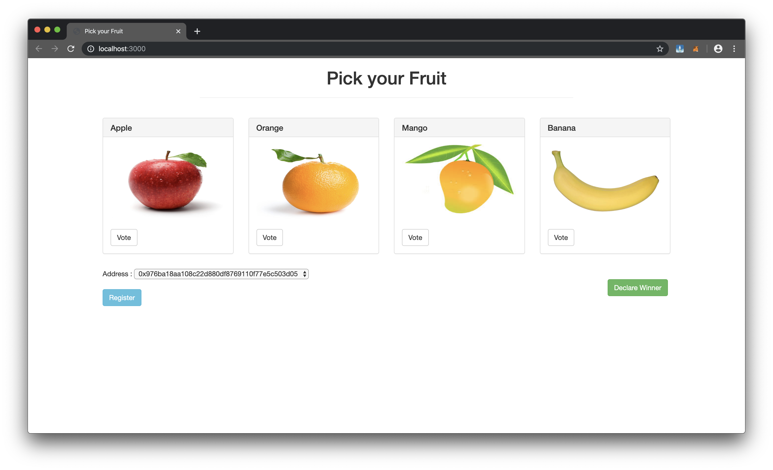
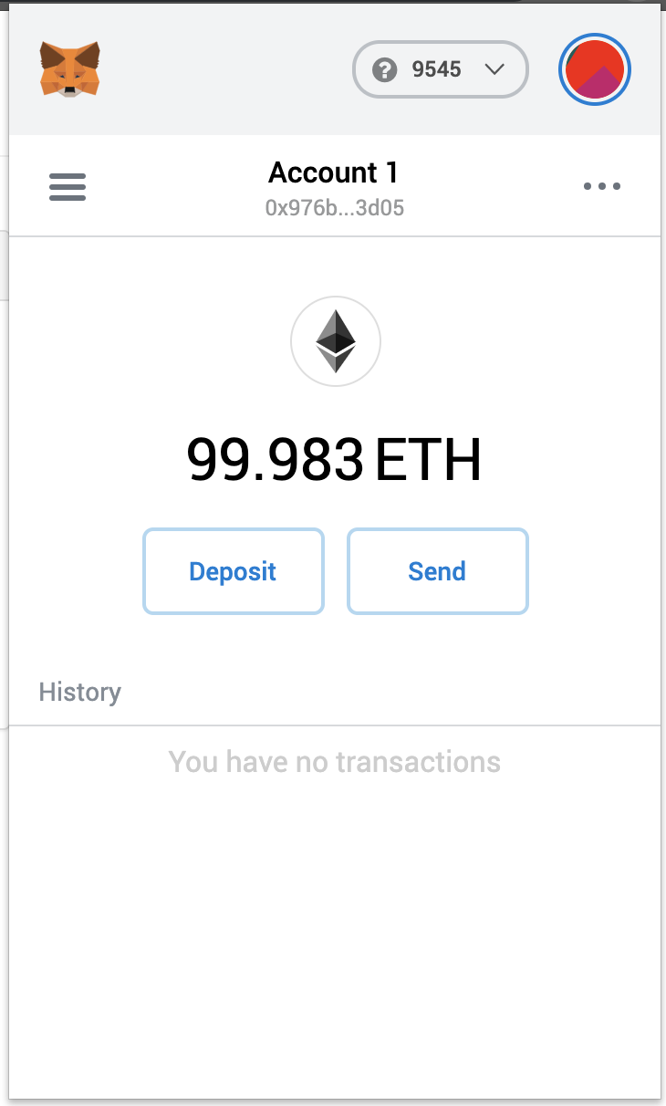
Voting Ballot Decentralised App
Logic for Ballot Contract:
Only Chairperson can register other voters.
A voter can be registered only once.
Only registered voters can vote.
Voters can vote only once.
Voters can vote only for items present.

