Slide 1
VMEbus: A tutorial
B.Satyanarayana
Department of High Energy Physics
TIFR, Mumbai, INDIA
bsn@tifr.res.in

Slide 2
Introduction to the VMEbus
Acronym for Versa Module Europa
High performance Eurocard standard TTL based backplane bus
Suitable for Single or multiple microprocessors
A completely memory mapped scheme
Introduced by Motorola, Phillips, Thompson and Mostek in 1981
Released by VMEbus International Trade Association(VITA) in 1982
Approved by IEEE and ANSI in 1987

Slide 3
Interface standard
An interfacing system used to interconnect data processing, data storage and peripheral control devices in a tightly coupled hardware configuration
Objectives:
  To allow communication between devices on the bus without disturbing the internal activities of other devices interfaced to the bus
  To specify the electrical and mechanical system characteristics required to design devices
  To specify protocols that precisely define interaction between the bus and the devices interfaced to it
  To provide terminology and definitions that describe system protocols
  To allow a broad range of design latitude so that the designer can optimise cost and performance without affecting the system compatibility
  To provide a system where performance is primarily device limited, rather than system interface limited

Slide 4
Interface system elements
Mechanical specification describes the physical dimensions of subracks, backplanes, front panels, plug-in boards etc.
  Backplane
  Board
  Slot
  Subrack
Functional specification describes the manner in which the bus operates, the functional modules that are involved in each transaction and the rules that govern their behaviour
  Requester, arbiter and arbitration bus
  Backplane interface bus
  Bus timer, serial clock driver and system clock driver
  Daisy chain and IACK daisy chain driver
  Data transfer bus and data transfer cycle
  Functional module
  Interrupter, interrupt handler and priority interrupt bus
  Location monitor, power monitor & system controller
  Master, slave and utility bus

Slide 5

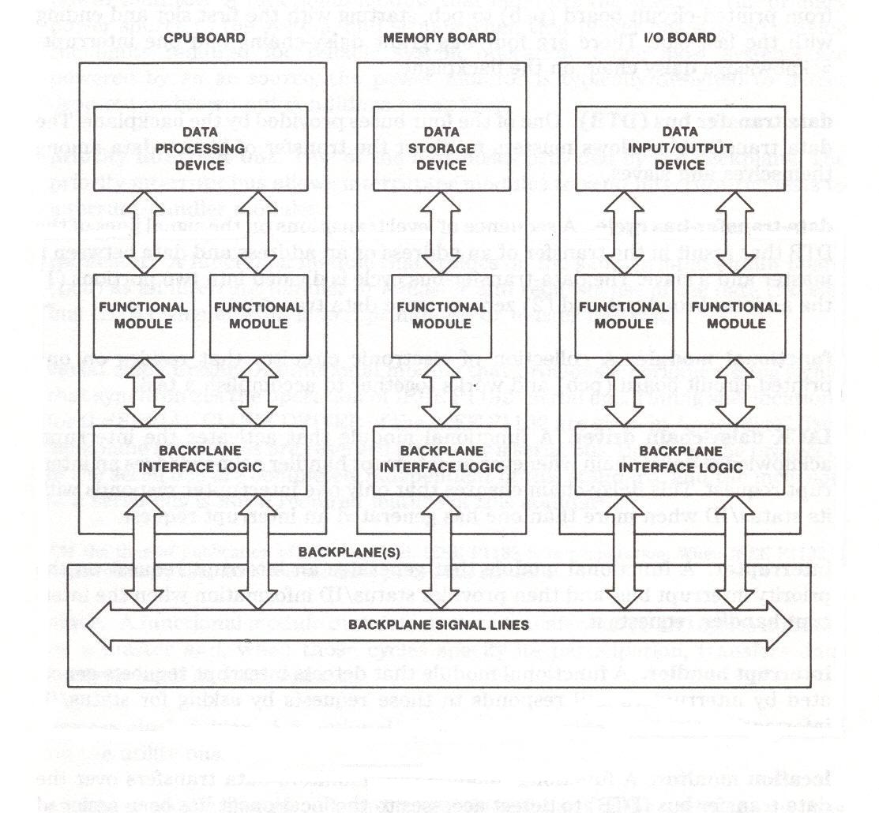
System elements of a standard

Slide 6
Types of bus cycles
Read cycle
Write cycle
Block read cycle
Block write cycle
Read-modify-write cycle
Address-only cycle
Interrupt acknowledge cycle

Slide 7
Basic structure
Data transfer bus
  Supports 8/16/32-bit transfers over a non-multiplexed 32-bit data and address highway
  Transfer protocols are synchronous and fully handshaken (Data transfer rate about 20MBytes/sec)
Priority interrupts bus
  Provides real-time interrupt services
Arbitration bus
  Allocation of bus mastership
  Allows round robin and prioritized arbitration algorithms
Utility bus
  Provides with power-up and power-down synchronisation

Slide 8
Other bus specifications
Specification diagrams
  Timing diagrams
  Sequence diagrams
  Flow diagrams
Terminology
  Rule
  Recommendation
  Suggestion
  Permission
  Observation
Protocol
  Interlocked bus signal
  Broadcast bus signal
System examples and explanations

