Slide 1
Diabetes Prediction using Machine Learning
By Jash Tailor

Slide 2
Dataset
This dataset is originally from the National Institute of Diabetes and Digestive and Kidney Diseases. The objective of the dataset is to diagnostically predict whether or not a patient has diabetes, based on certain diagnostic measurements included in the dataset. Several constraints were placed on the selection of these instances from a larger database. In particular, all patients here are females at least 21 years old of Pima Indian heritage.

Slide 3
Implementation
The following 11 Machine Learning algorithms were trained on the dataset mentioned above:
Logistic Regression
Random Forest Classifier
Stochastic Gradient Descent Classifier
Support Vector Machine
Linear Support Vector Machine
Gaussian Naive Nayes
Binomial Naive Bayes
Multinomial Naive Bayes
AdaBoost Classifier
Light Gradient Boosting Machine
Gradient Boosting Machine

Slide 4
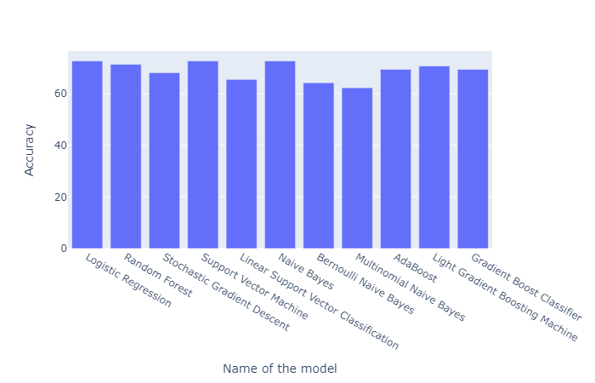
Initial Accuracies

Slide 5
Initial Accuracies
Model | Accuracy
Logistic Regression | 72.727
Random Forest Classifier | 71.429
Stochastic Gradient Descent Classifier | 68.182
Support Vector Machine | 72.727
Linear Support Vector Machine | 65.584
Gaussian Naive Bayes | 72.727
Bernoulli Naive Bayes | 64.286
Multinomial Naive Bayes | 62.338
AdaBoost Classifier | 69.481
Light Gradient Boosting Machine | 70.779
Gradient Boosting Classifier | 69.481

Slide 6
Closely looking at the models and their accuracy levels, I decided to tune the hyperparameters using GridSearchCV hoping to get higher levels of accuracy. GridSearchCV takes a dictionary of parameters as an input and then forms various combinations of the various parameters and trains the model using each of those parameter sets and outputs the parameter set which gives the highest accuracy.
Not all models could be hyperparameter tuned either because of computational constraints or because they didn’t have enough parameter options, so the following 7 models were chosen:
Logistic Regression
Random Forest Classifier
Stochastic Gradient Descent Classifier
Linear Support Vector Machine
Multinomial Naive Bayes
AdaBoost Classifier
Gradient Boosting Machine

Slide 7
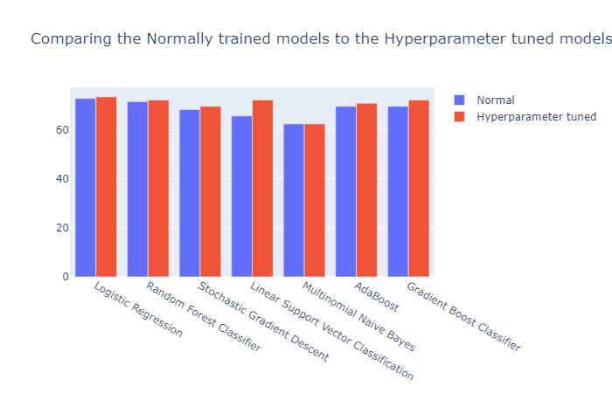
Accuracies after Hyperparameter tuning

Slide 8
Accuracies after Hyperparameter tuning
Model | Accuracy | Change in Accuracy
Logistic Regression | 73.377 | 0.65
Random Forest Classifier | 72.078 | 0.649
Stochastic Gradient Descent Classifier | 69.481 | 1.299
Linear Support Vector Machine | 72.078 | 6.494
Multinomial Naive Bayes | 62.338 | 0
AdaBoost Classifier | 70.779 | 1.298
Gradient Boosting Machine | 72.078 | 2.597

Slide 9
A neural network was also trained on the data. The summary of the network is given below
Model: "sequential"
_________________________________________________________________
Layer (type) Output Shape Param #
=================================================================
flatten (Flatten) (None, 8) 0
_________________________________________________________________
dense (Dense) (None, 128) 1152
_________________________________________________________________
dense_1 (Dense) (None, 64) 8256
_________________________________________________________________
dense_2 (Dense) (None, 2) 130
=================================================================
Total params: 9,538
Trainable params: 9,538
Non-trainable params: 0
_________________________________________________________________

Slide 10
The front end was deployed using Streamlit. The user has to input eight values in their respective fields and press submit, those values are then fed to the ten Machine Learning algorithms, and the neural network. The outputs from all these are stored in a list and compared. The value that occurs the most number of times will be displayed to the user.
Frontend Link: https://share.streamlit.io/jashtailor/exposys/main/mk2.py

Slide 11
Thank You

