Slide 1
CBDRH Health Data Science Datathon 2023
Oscar Perez-Concha

Slide 2
Acknowledgement of Country

Slide 3
Acknowledgement of Country
I would like to acknowledge the Bedegal people that are the Traditional Custodians of this land. I would also like to pay my respects to the Elders both past and present, and extend that respect to other Aboriginal and Torres Strait Islanders who are present here today.

Slide 4
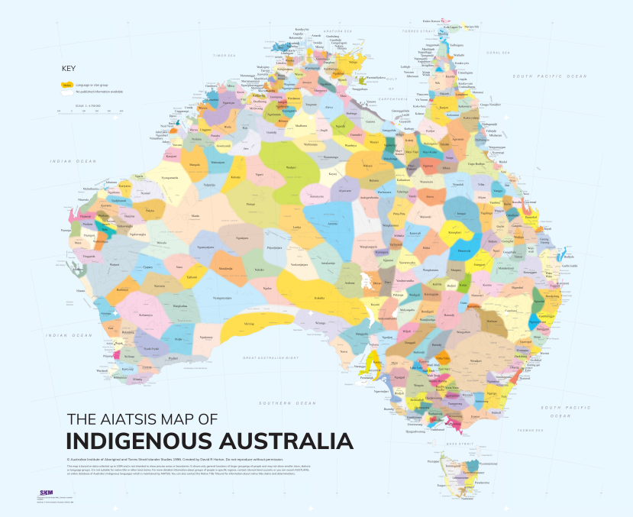
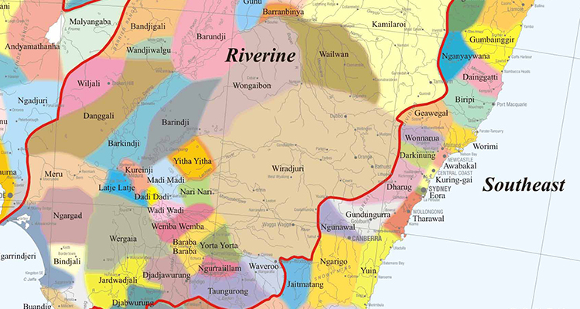
The maps of Indigenous Australia
https://aiatsis.gov.au/explore/map-indigenous-australia
https://www.inside.unsw.edu.au/campus-life/acknowledgement-country-in-virtual-meetings-and-events

Slide 5
Agenda
Welcome and introductions
HIV Medications research in practice (Dr Juliana de Oliveira Costa, School of Population Health)
The Health Gym and the HIV Medications dataset (Dr Nic Kuo, CBDRH)
Datathon rules and plan for the day (Dr Oscar Perez Concha, CBDRH)
Questions

Slide 6
Datathon
A full-day datathon where teams will work together to analyse a HIV medications dataset. Participants will develop a full data science pipeline—from research question to analytic output—with prizes awarded for the best submission.

Slide 7
Datathon
A full-day datathon where teams will work together to analyse a HIV medications dataset. Participants will develop a full data science pipeline—from research question to analytic output—with prizes awarded for the best submission.
To facilitate an activity where our Health Data Science students, Clinical AI students, and alumni can meet each other.
To apply what we learn in our courses.
To solve a real-world problem.
To have fun.

Slide 8
The organization team
Mark Hanly
Glenda Bishop
Juliana de Oliveira Costa
Nic Kuo
Sebastiano Barbieri
Michele Partridge
Louise Francis
Sanja Lujic

Slide 9
Presentations

Slide 10
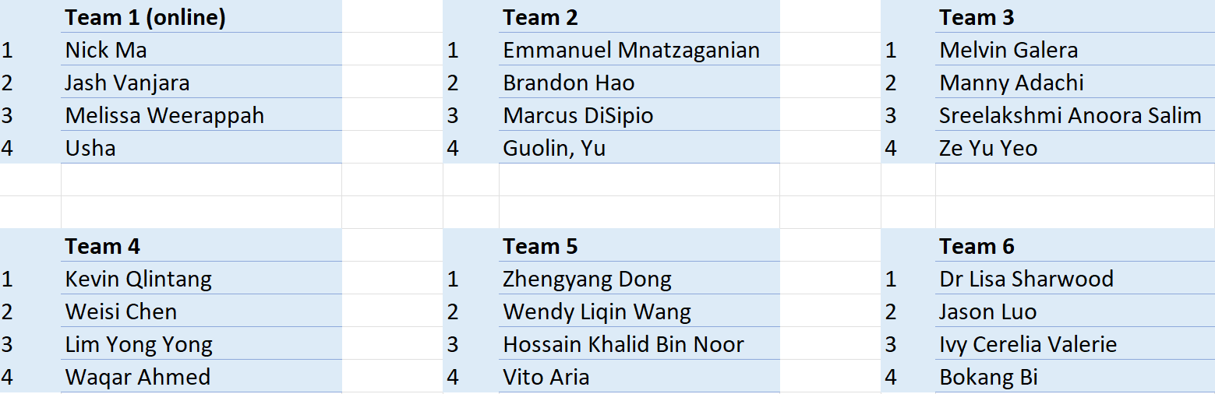
Our teams:

Slide 11
Schedule – Datathon (Hybrid event)
Friday, May 26, 2023: 08:00 - 17:00 AEST
08:00 - 08:30 Registration
08:30 - 09:00 Welcome and introduction to domain experts
09:00 - 12:00 Teams work on project
12:00 - 12:30 Lunch
12:30 - 15:00 Teams work on project
15:00 - 16:15 Presentations (7 mins presentation + 3 mins questions per team)
16:15 - 16:45 Jury deliberation and drinks reception
16:45 - 17:00 Awards and closing
https://cbdrh-hds-datathon-2023.github.io/schedule.html

Slide 12
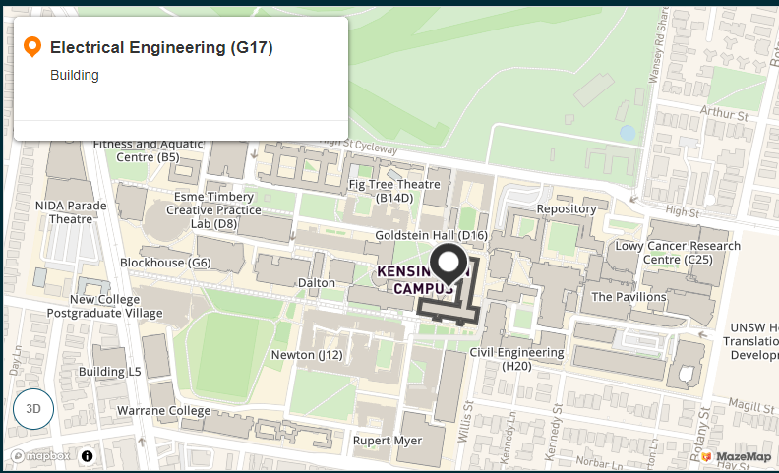
Where is it?
Online team
In-person teams
Teams
Glenda Bishop

Slide 13
Judging criteria:
Research Question
Analysis
Communicating results
Jury: 4 people
Two EMR experts from Sydney Local Health District – NSW Health.
Dr Sanja Lujic – Program Director of Health Data Science
Dr Sebastiano Barbieri – Health Gym leader investigator

Slide 14
Judging criteria:

Slide 15
Code of conduct
The organisers of the CBDRH Datathon are committed to providing an event that is welcoming and safe for all participants, is free from discrimination and harassment, and where all participants are treated with dignity and respect. Adherence to this Code of Conduct is a requirement for all event participants, and covers all aspects of the datathon, including online and in-person spaces, the pre-event online information session, the datathon event, any social events and all communication, including that via email or social media associated with the event.
https://cbdrh-hds-datathon-2023.github.io/code-of-conduct.html

Slide 16

Photos: Please inform us if you would prefer not to appear in our photos.

Slide 17

Questions

